Slide 1

Smart Farming: From Sensor to Artificial Intelligence
Basic integration of artificial intelligence of a plant experimentation chamber with LEDs and sensors through connection to the IoT with node-RED and securing access to data
The 1st International Online Conference on Agriculture:
ADVANCES IN AGRICULTURAL SCIENCE AND TECHNOLOGY
Authors :
Dr. Cristóbal Javier Solano Navarro (UPCT)
Dr. Gregorio Barba-Espín (CEBAS-CSIC)
Dr. Juan Suardíaz Muro (UPCT)
Dr. José Antonio Hernández Cortes (CEBAS-CSIC)

Slide 2
Basic integration of artificial intelligence of a
plant experimentation chamber ….
INTRODUCTION

Slide 3
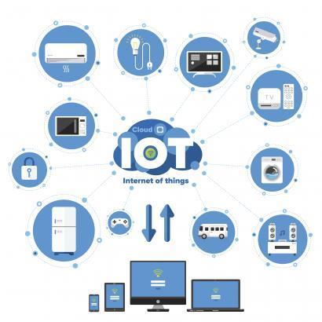


Basic integration of artificial intelligence of a
plant experimentation chamber ….
IoT : Internet of Things

Slide 4
Basic integration of artificial intelligence of a
plant experimentation chamber ….
RESULTS

Slide 5


Basic integration of artificial intelligence of a
plant experimentation chamber ….
Node-RED
a)
b)
Data Classification
Function
Data out of range
Google Spreedsheet Gsheet
Datalogger
Sensor Data Input
No
Yes
Warning
High temperature
Low temperature
Low level of illumination
Watchdog_bot

Slide 6





FOG COMPUTING
Mobile
CONTRIBUCIÓN AL DESARROLLO DE
SISTEMAS INTELIGENTES DE MONITORIZACIÓN Y CONTROL …
Cloud-Layer
Telegram-Bot
Fog-Layer
Gateway
HMI
http://127.0.0.1:1880/ui
Raspberry Pi
WI-FI
ETHERNET
HDMI
http://127.0.0.1:1880
USB
Edge-Layer
USB
Arduino Uno
Edge-Devices
Sensor DHT22
Sensor TSL2591
Sensor PAR
Sensor UV

Slide 7
Basic integration of artificial intelligence of a
plant experimentation chamber ….
System flow diagram
Temperature Data Input
Temp>25ºC
Temp<15ºC
No
No
Yes
Yes
Warning High Temperature
Warning Low Temperature
Send Warning Watchdog_bot
Send Warning Watchdog_bot
Cool down chamber
Heat the chamber

Slide 8
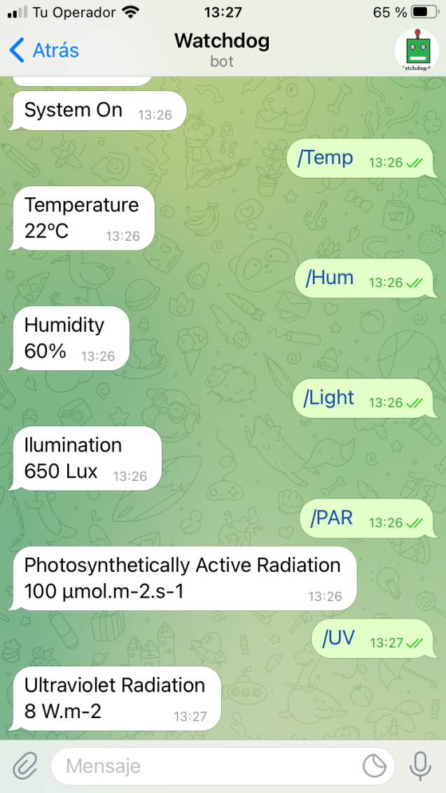
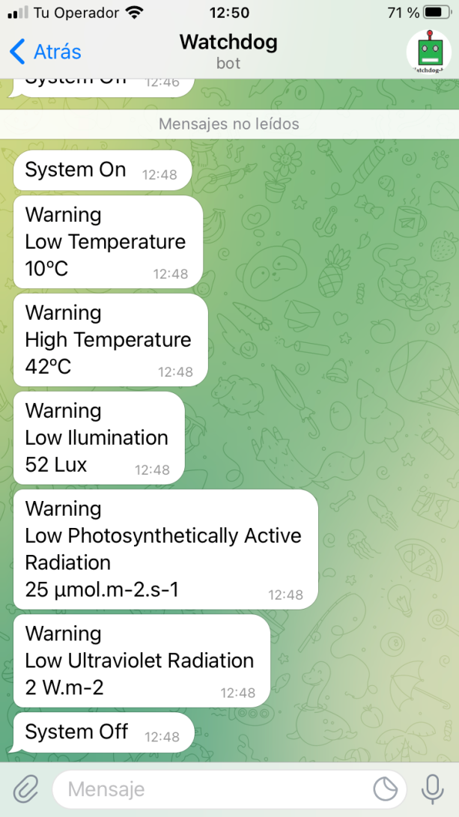
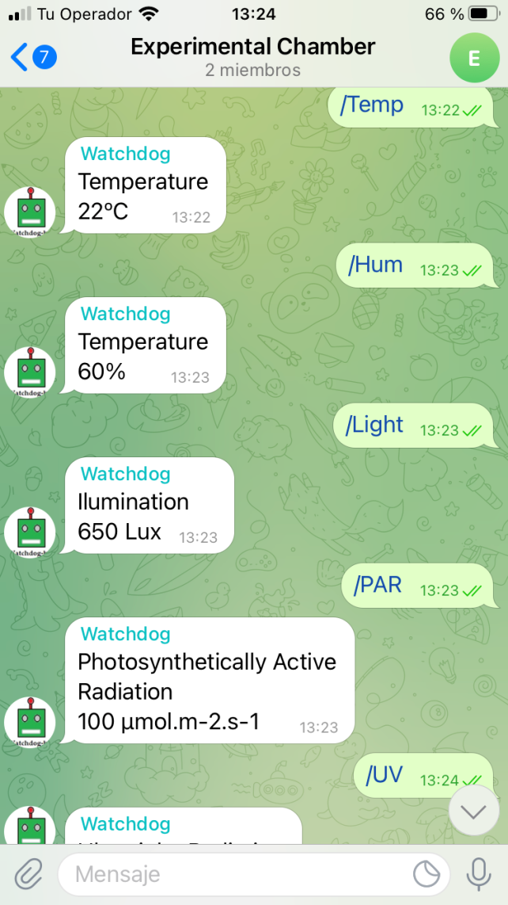
Basic integration of artificial intelligence of a
plant experimentation chamber ….
Telegram
a)
b)
c)

Slide 9
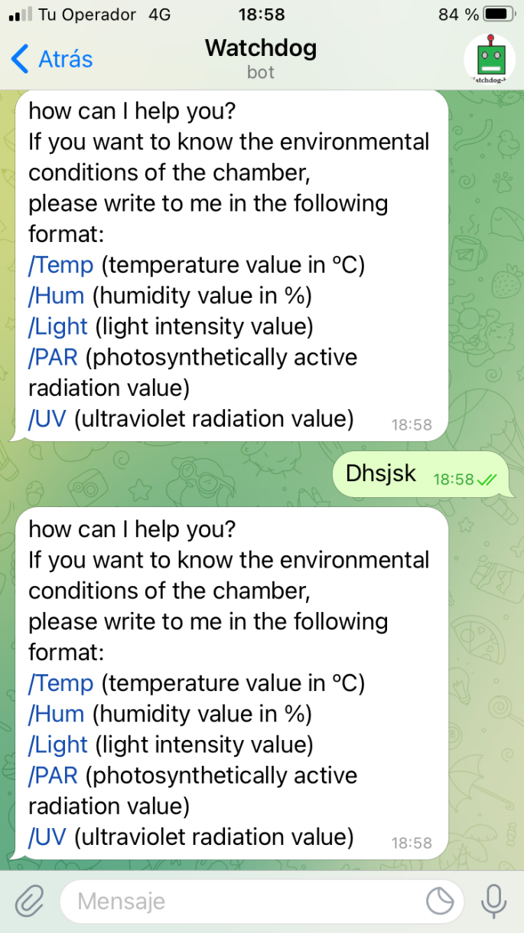
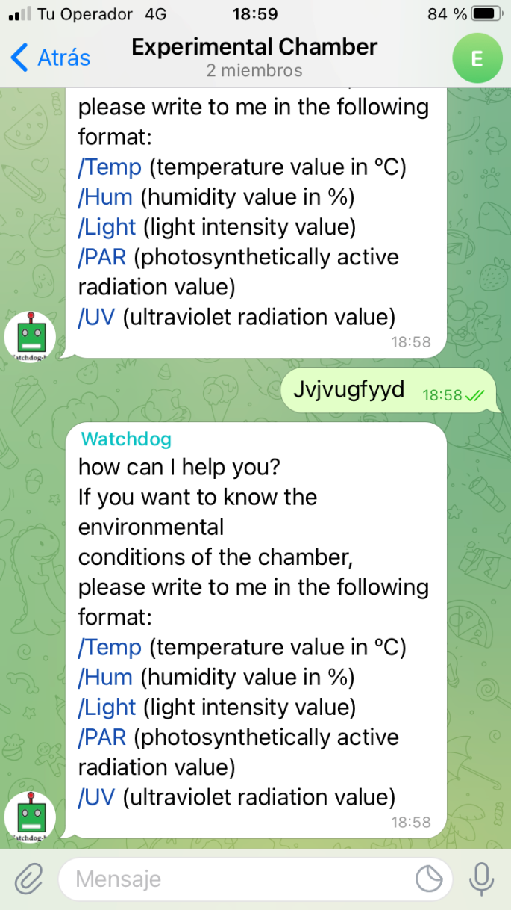
Basic integration of artificial intelligence of a
plant experimentation chamber ….

Slide 10
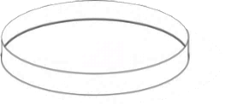

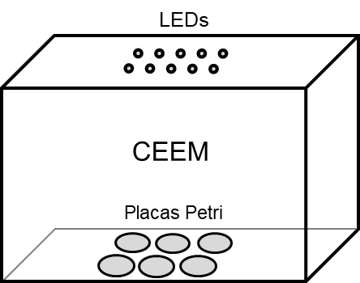
Biological validation : pea seed treatment
Preparation of plant material
Pea seeds(after 12h imbibition)
Treatment in the chamber
LEDs - Red
13, 50 y 100 µmol s⁻¹ m⁻²
Fresh weight (mg/seedling)
Treatment times :
0’, 5’, 10’, 15’, 30’, 60’
Incubation
25 °C, darkness
Length (cm/seedling)
2 a 5 days
Sampling and analysis
Photo shooting
Fresh weight
Seedling length
Measure enzymatic activities
Red light treatment time (minutes)

Slide 11
Basic integration of artificial intelligence of a
plant experimentation chamber ….
CONCLUSIONS

Slide 12
Basic integration of artificial intelligence of a
plant experimentation chamber ….
Conclusions
The proposed system has a low cost, low energy consumption, is compact and highly accurate to monitor the environment with the dedicated sensors remotely from anywhere in the world.
A perfect balance between accuracy and cost is achieved through the use of free, cost-effective, and open source resources.
Researchers are in an excellent position to take advantage of these tools to revolutionize plant science and improve reproducibility in experimentation with little impact on their budgets.

Slide 13

Smart Farming: From Sensor to Artificial Intelligence
Basic integration of artificial intelligence of a plant experimentation chamber with LEDs and sensors through connection to the IoT with node-RED and securing access to data
The 1st International Online Conference on Agriculture:
ADVANCES IN AGRICULTURAL SCIENCE AND TECHNOLOGY
Acknowledgments:
Funded by Fundación Séneca (Project 21632/PDC/21)
Authors :
Dr. Cristóbal Javier Solano Navarro (UPCT)
Dr. Gregorio Barba-Espín (CEBAS-CSIC)
Dr. Juan Suardíaz Muro (UPCT)
Dr. José Antonio Hernández Cortes (CEBAS-CSIC)

