Slide 1
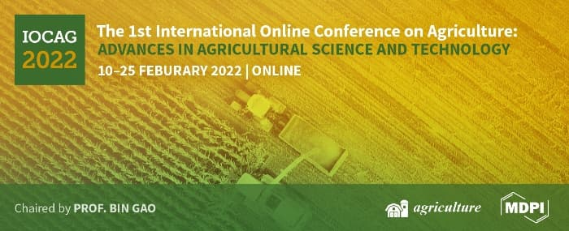
ASSESSMENT OF TOTAL PHENOLIC AND TOTAL FLAVONOID CONTENTS AND THEIR CORRELATION WITH SOME PHYSICOCHEMICAL PARAMETERS OF MONOFLORAL ROMANIAN HONEY
Aida Albu, Razvan-Mihail Radu-Rusu*, Daniel Simeanu*, Cristina-Gabriela Radu-Rusu and Ioan Mircea Pop
”Ion Ionescu de la Brad” Iasi University of Life Sciences, 700489, 8 Mihail Sadoveanu Alley, Iasi, Romania
Email : albu.aida@uaiasi.ro

Slide 2
ABSTRACT
Since ancient times, honey has been considered not only a sweet food but also known as a remedy against diseases, due to its antioxidant properties.
The purpose of this study was to assess the total phenolic and flavonoid contents from Romanian raw monofloral honey and to establish their correlations with several qualitative parameters. In 2019, 28 samples were harvested: 8 acacia; 7 linden; 5 rapeseed, 5 sunflower and 3 mint, then analyzed in accordance with standardized methods, to measure: color intensity, water insoluble solids content, refractive index, moisture content, solid substances content, total soluble substances content, specific gravity, pH, free acidity, ash content, electrical conductivity, total phenols content and total flavonoids content.
Pearson test shown several correlation levels of total phenols content with other compounds: strong positive with total flavonoids (r=0.76) and color intensity (r=0.72); moderate positive with free acidity (r=0.57), ash content (r=0.51) and electrical conductivity (r=0.53); weak negative with pH (r=-0.23).
For total flavonoids content, correlations were: strong positive with color intensity (r=0.81), ash content (r=0.76) and electrical conductivity (r=0.73); fairly strong positive with free acidity (r=0.65); low positive between total flavonoids content and moisture (r= 0.35).
The relevant levels of polyphenols and flavonoids identified in the analyzed honey demonstrate its antioxidant potential, as essential nutritional and sanogenic features in human nutrition.
Keywords: honey, quality, phenolic content, flavonoid content, Pearsonʹs correlation

Slide 3
Introduction
Honey bee has been used as food and also as medicine since ancient times. Properties of this beehive product like antimicrobial, anti-inflamatory, antioxidative activities have been recognized as having beneficial effects on the human body. Many studies have shown that the composition and antioxidant activity of honey depends on several factors that can directly or indirectly affect its quality such as: bee species, geographic area, plants, weather, harvesting technique and storage condition. Antioxidant capacity of this complete food has been correlated with the amount of some substances that are present in honey composition: enzymes, polyphenolic compounds (phenolic acids, phenolic acid derivates, flavonoids), proteins, amino acids and other compounds.
Aim
The aim of this research was to assesed total phenolic and total flavonoids contents from monofloral raw honey and to establish their correlations with several qualitative parameters.

Slide 4
Materials and Methods

Slide 5
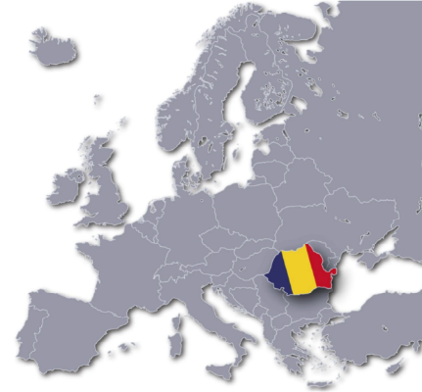
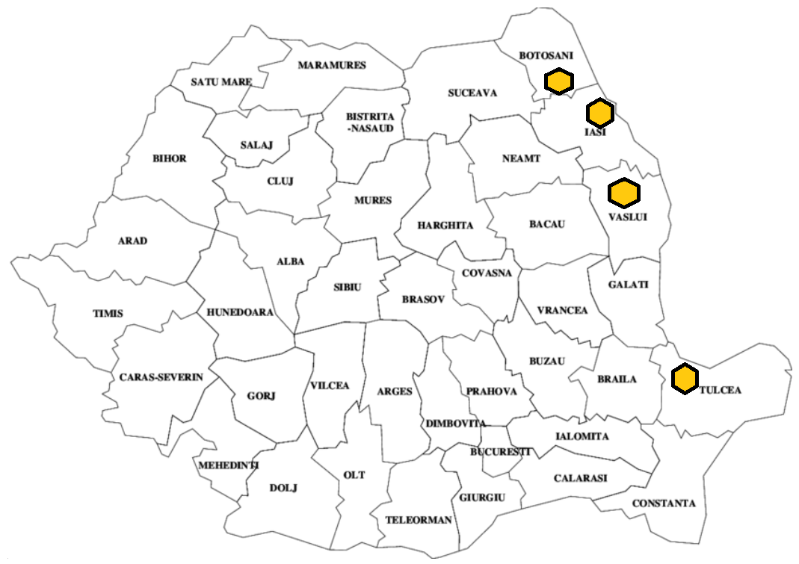
ACACIA
8 SAMPLES
(A)
RAPESEED
5 SAMPLES
(R)
LINDEN
7 SAMPLES
(L)
SUNFLOWER
5 SAMPLES
(SF)
ROMANIA
MINT
3 SAMPLES
(M)
28 raw honey samples
4 counties: Botosani: A7, A8, L6, L7, R5, SF4, SF5
Iasi: A1, A2, A3, A4, L1, L2, R1, R2, SF1, SF2
Vaslui: A5, A6, L3, L4, L5, R3, R4, SF3
Tulcea: M1, M2, M3

Slide 6
Parameter | Method | Reference
Color | 50% honey aqueous solutions were spectrophotometrically analyzed at 635 nm (Shimadzu UV-1700 Pharma Spec); the absorbance units were converted in mm Pfund | Ratiu I.A. et al., 2020
Water insoluble solids (WIS) | determined by the gravimetric method; the results were expressed in g/100 g honey | SR(Romanian Standard) 784-3:2009: Honey bee. Part 3: Analytical methods
Refractive index (RI) | read on the ABBÉ Kruss AR 2008 refractometer
Moisture (M) | refractometric method (ABBÉ Kruss AR 2008 refractometer, with temperature correction); the results were expressed in g/100 g honey
Solid substances (SS) | 100- M (moisture); the results were expressed in g/100 g honey
Total soluble substances (TSS) | refractometric method with ABBÉ Kruss AR 2008 refractometer; the results were expressed in ºBrix | USDA, Extracted honey grading manual, United States Department of Agriculture. Standards for Honey Grading. USDA, Washington DC, 1985
Specific gravity (SG) | determined by the gravimetric method with pycnometer; the results were expressed in g/cm³ | Popescu N. and Meica S.,1997

Slide 7
Parameter | Method | Reference
pH | 10% (w/v) honey solution measured at WTW MULTI 3320 multiparameter | Bogdanov S., 2009; Sereia M.J. et al., 2017; SR(Romanian Standard) 784-3:2009: Honey bee. Part 3: Analytical methods
Free acidity (FA) | titration method (10% (w/v) honey solution with 0.1 N NaOH), expressed in meq kg⁻¹
Ash | calcination method (550 ºC); the results were expressed in g/100 g | Bogdanov S., 2009; Sereia M.J. et al., 2017; SR(Romanian Standard) 784-3:2009: Honey bee. Part 3: Analytical methods
Electrical conductivity (EC) | 20% (w/w) honey solution (dry matter basis) in mili-Q water, measured at WTW MULTI 3320 multiparameter; the results were expressed in mS cm⁻¹
Total phenols content (TPC) | Folin-Ciocalteu method modified from Bobiș et al. (2008) and Sereia et al. (2017). The absorbance was measured at 742 nm against a blank (UV-1400 Shimadzu spectrophotometer). Standard calibration (gallic acid; 5 calibration points and 3 replicates; concentration ranging in 2-12 mg L⁻¹ interval; y=0.089x+0.1147; R²=0.9972). The results were expressed in mg of quercetin equivalents (QE)/100g | Bobiș et al. (2008) and Sereia et al. (2017)
Total phenols content (TPC) | method with minor changes developed by Bobiș et al. (2008) and Pontis et al. (2014). The absorbance was measured at 430 nm against a blank (UV-1400 Shimadzu spectrophotometer). Standard calibration (quercetin; 6 calibration points and 3 replicates; concentration ranging in 0.5-5 mg L⁻¹ interval; y=0.1331x+0.0112; R²=0.9997). The results were expressed in mg of quercetin equivalents (QE)/100g | Bobiș et al. (2008) and Pontis et al. (2014)

Slide 8
Results and Discussions

Slide 9
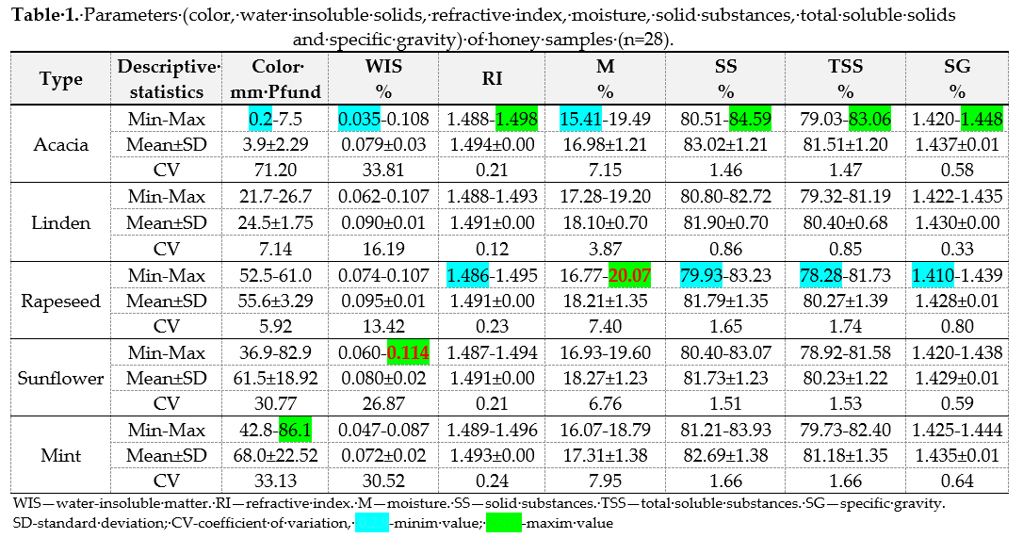
(Council Directive 2001/110/CE concerning honey)
In present research
Samples: 2 samples acacia, 2 samples linden, 2 samples rapeseed, 1 sample sunflower WIS˃0.1%
Sample: 1 sample rapeseed M˃20%
Moisture
Limit:
˂ 20% moisture
WIS
Impurity content for commercial honeys:
˂ 0.1% for filtered honey
˂ 0.5% for pressed honey

Slide 10
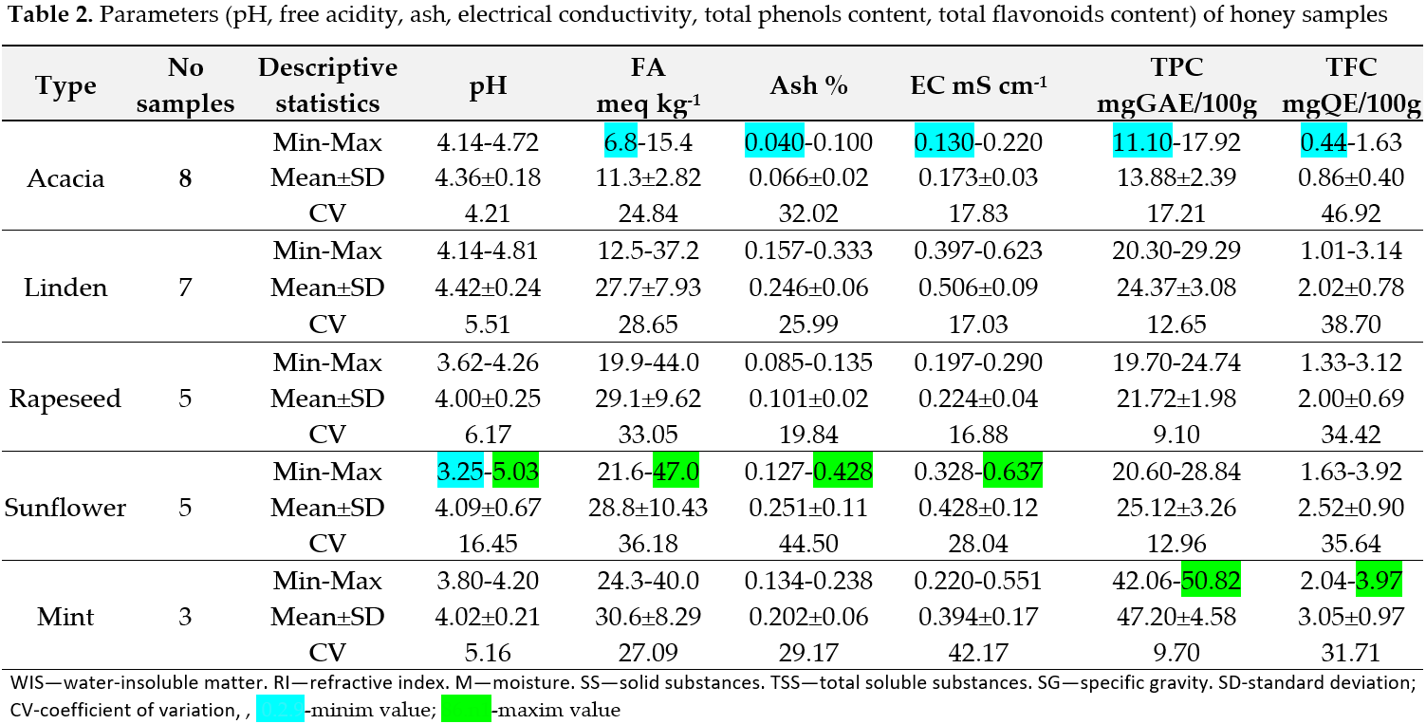
(Council Directive 2001/110/CE concerning honey)
Free acidity
Limit:
˂ 50 meq kg⁻¹
Electrical conductivity
Limit:
˂ 0.8 mS cm⁻¹

Slide 11
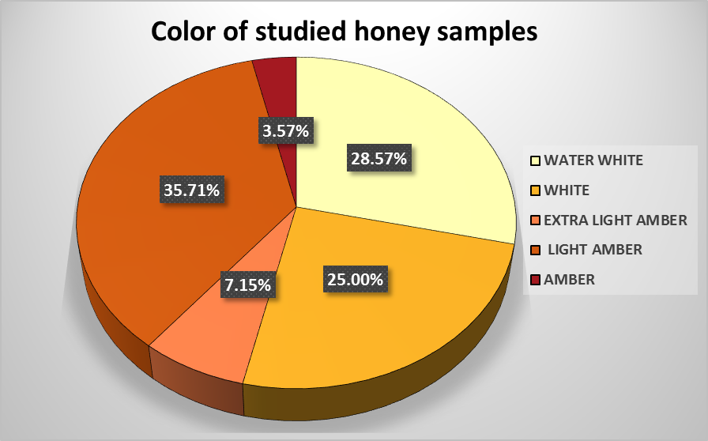
Correlations between some honey parameters
Figure 2. Correlation between ash and electrical conductivity (r=0.95)
Figure 1. Correlation between color and total flavonoids content fi honey samples (r=0.81)

Slide 12
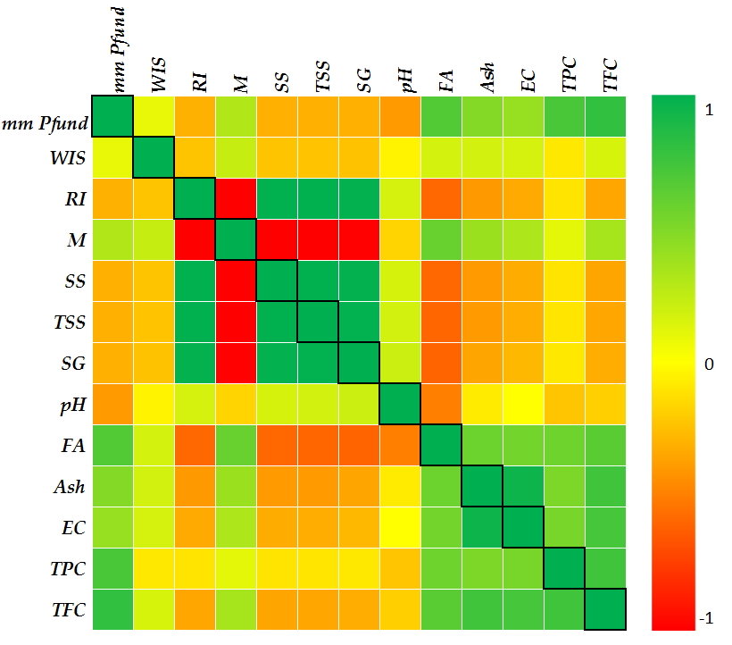
Pearson's correlation
Correlations of honey parameters
Strong positive linear correlation between:
- RI and : SS (r=+1); TSS (r=+1); SG (r=+0.99);
- Color and: TPC (r=+0.72); TFC (r=+0.81);
- TFC and: Ash (r=+0.76); EC (r=+0.73); TPC (r=+0.76);
- Ash and EC (r=+0.81);
- SS and: TSS (r=+1); SG (r=+0.99);
Moderate positive linear correlation between:
- Color and : FA (r=0.68); Ash (r=0.49);
- FA and: Ash (r=0.58); EC (r=0.55); TPC (r=0.57);
TFC (r=0.65);
- TPC and: Ash (r=0.51); EC (r=0.53);
Figure 3. Head map of Pearson's correlation between honey parameters

Slide 13
Conclusions
Romanian honey is appreciated for its quality, this fact is proved by the large amount of honey exported.
The relevant levels of polyphenols and flavonoids identified in the analyzed honey demonstrate its antioxidant potential, as essential nutritional and sanogenic features in human nutrition.

Slide 14
Selective References
1.Geana, E.I.; Ciucure, C.T. Establishing authenticity of honey via comprehensive Romanian honey. Food Chemistry 2020, 306. doi.org/10.1016/j.foodchem.2019.125595.
2.Ciulu M., Spano N., Pilo M.I., Sanna G. Recent Advances in the Analysis of Phenolic Compounds in Unifloral Honeys. Molecules 2016, 21, 451. doi: 10.3390/molecules21040451.
3.da Silva, P.M.; Gauche, C.; Gonzaga, L.V.; Costa, A.C.O.; Fett, R. Honey: Chemical composition, stability and authenticity. Food Chem. 2016, 196, 309–323.
4.de-Melo, A.A.M.; de Almeida-Muradian, L.B.; Sancho, M.T.; Pascual-Maté, A. Composition and properties of Apis mellifera honey: A review.A. J. Apic. Res. 2017, 57, 5–37. dx.doi.org/10.1080/00218839.2017.1338444.
5.Pontis, J.A.; Costa, L.A.M.A.D.; Silva, S.J.R.D.; Flach, A. Color, phenolic and flavonoid content, and antioxidant activity of honey from Roraima, Brazil. Food Sci. Technol. 2014, 34, 69–73.
6.Al-Farsi, Mohamed; Al Amri, Abeer; Al-Hadhrami, Ahlam; Al-Belushi, Sharifa. Color, flavonoids, phenolics and antioxidants of Omani honey. Heliyon 2018, 4. 10.1016/j.heliyon.2018.e00874. doi.org/10.1016/j.heliyon.2018.e00874.
7.Ahmida, N.H.; Elagori, M.; Agha, A.; Elwerfali, S.; Ahmida, M.H. Physicochemical, heavy metals and phenolic compounds analysis of Libyan honey samples collected from Benghazi during 2009–2010. Food Nutr. Sci. 2013, 4, 33–40.
8.Cimpoiu, C.; Hosu, A.; Miclaus, V.; Puscas, A. Determination of the floral origin of some Romanian honeys on the basis of physical and biochemical properties. Spectrochim. Acta Part A 2013, 100, 149–154.
9.Ratiu, I.A.; Al-Suod, H.; Bukowska, M.; Ligor, M.; Buszewski, B. Correlation study of honey regarding their physicochemical properties and sugars and cyclitols content. Molecules 2020, 25(1), 34. doi.org/10.3390/molecules2501003.
10.Romanian Standards Association. SR(Romanian Standard) 784-3:2009: Honey bee. Part 3: Analytical methods. Available online: https://e-standard.eu/en/standard/174480 (accessed on 16 April 2018).
11.USDA. Extracted Honey Grading Manual, United States Department of Agriculture. Standards for Honey Grading; USDA:Washington DC, USA, 1985. Available online: https://www.ams.usda.gov/sites/default/files/media/Extracted_Honey_Inspection_ Instructions%5B1%5D.pdf (accessed on 10 December 2018).
12.Popescu, N.; Meica, S. Bee products and their chemical analysis. In Produsele Apicole si Analiza lor Chimica; Diacon Coresi: Bucuresti, RO, USA, 1997.
13.Bogdanov, S. 2009: Harmonized Methods of the International Honey Commission. Available online: https://www.ihc-platform. net/ihcmethods2009.pdf (accessed on 30 May 2018).
14.Sereia, M.J.; Março, P.H.; Perdoncini, M.R.G.; Parpinelli, R.S.; de Lima, E.G.; Anjo, F.A. Chapter 9: Techniques for the Evaluationof Physicochemical Quality and Bioactive Compounds in Honey. In Honey Analysis; INTECH: London, UK, 2017; pp. 194–214.
15.Bobis, O.; Marghitas, L.; Rindt, I. K.; Niculae, M. & Dezmirean, D. Honeydew honey: correlations between chemical composition, antioxidant capacity and antibacterial effect. Scientific Papers Animal Science and Biotechnologies, 2008, 41(2), 271-277.
16.European Commission. Council Directive 2001/110/CE concerning honey. Off. J. Eur.Comm. 2002, L10, 47–52.

Slide 15
THANK YOU

