Slide 1
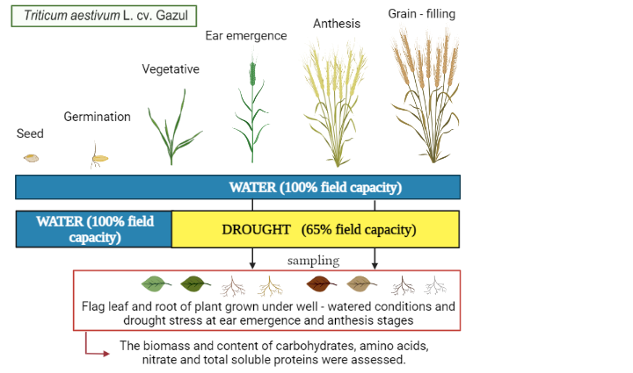
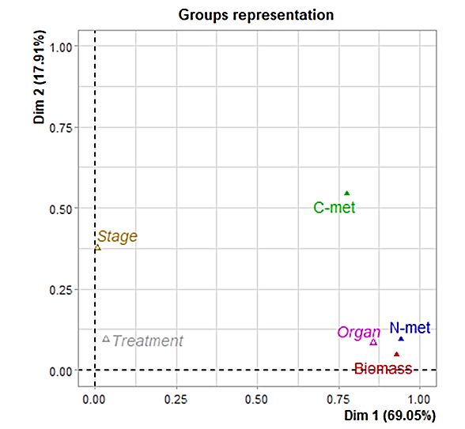
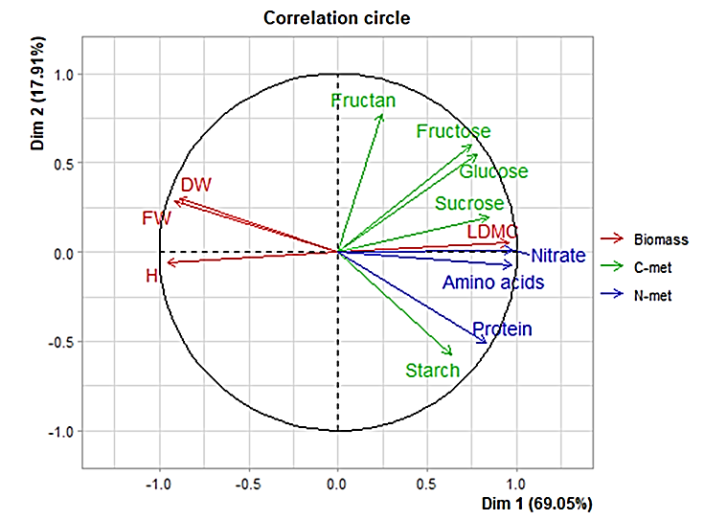
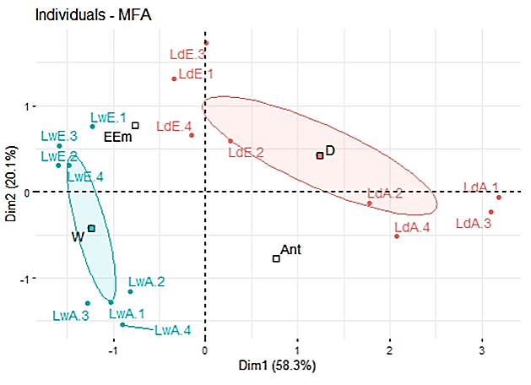
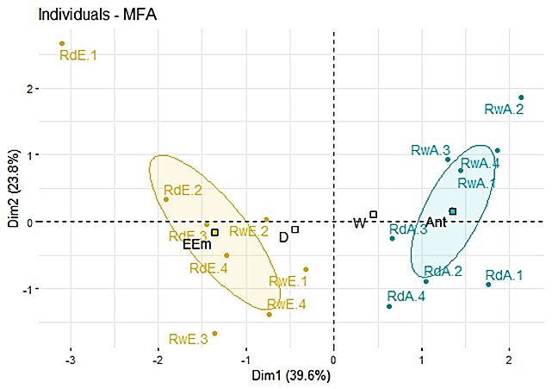
IMPACT OF WATER DEFICIT ON PRIMARY METABOLISM AT THE WHOLE PLANT LEVEL IN BREAD WHEAT GROWN UNDER ELEVATED CO2 AND HIGH TEMPERATURE AT DIFFERENT DEVELOPMENTAL STAGES
Bueno-Ramos N.*, González-Hernández A.I.*, Marcos-Barbero E.L., Miranda-Apodaca J., Bendou O., Gutiérrez-Fernández I., Arellano J.B., Morcuende R.
*These authors contributed equally to this work. Corresponding author: Rosa Morcuende (rosa.morcuende@irnasa.csic.es)
Institute of Natural Resources and Agrobiology of Salamanca (IRNASA), Consejo Superior de Investigaciones Científicas (CSIC), 37008 Salamanca, Spain
INTRODUCTION
OBJECTIVE
EXPERIMENTAL DESIGN
Predicted increases in the atmospheric CO2 concentration and the earth's mean surface temperature will be accompanied by a higher incidence of drought events.
These environmental changes are likely to adversely affect crop productivity and quality, including wheat, an essential food in the human diet.
We investigated the primary C-N metabolism response to drought stress at the whole-plant level and its dependence on plant development in bread wheat grown under combined elevated CO2 and temperature.
Chamber conditions:
[CO₂]:
900 ppm.
Temperature:
26 / 16ºC.
Photoperiod:
16h / 8h.
Light intensity:
450 μmol${\text{/} \text{m}}^{\text{2}}$s.
RESULTS
FLAG LEAVES
Multifactorial analysis revealed that the organ was the main factor explaining data variation. The physiological and biochemical traits in the flag leaves were more affected by drought than growth stage, leading to an accumulation of soluble carbohydrates, nitrate and amino acids.
By contrast, roots were affected by the developmental stages but not by the treatment. The root content of fructose, glucose, starch and amino acids was higher at ear emergence than anthesis, whereas the accumulation of sucrose, fructans, proteins and nitrate increased at the latest growth stage.
CONCLUSION
ROOTS
This study provides new insights into the reprograming of primary metabolism at whole plant level throughout the development in response to the future climate scenario, which could help to select traits ensuring sustainable food production systems that strengthen capacity for adaptation to climate change following the Sustainable Development Goals of 2030 Agenda.
ACKNOWLEDGEMENTS
The technical cooperation of M.A. Boyero and A. Verdejo is acknowledged. This research was supported by the Spanish National R&D&I Plan (Project PID2019-107154RB-100) and the Regional Government (CSI260P20). A.I.G-H had a JCyL postdoctoral contract; N.B-R and E.L. M-B had JCyL fellowships; O.B. an Algerian Government fellowship. Project “CLU-2019-05—IRNASA/CSIC Unit of Excellence” (funded by the JCyL and EU).

