Slide 1
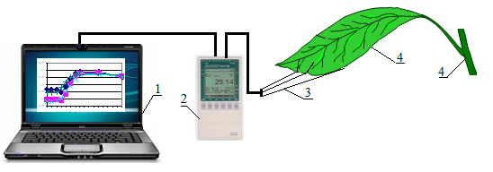
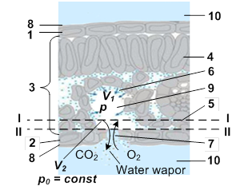
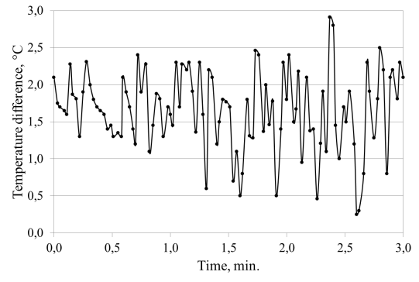
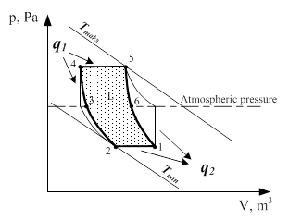
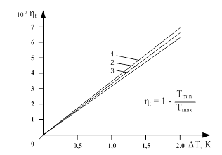
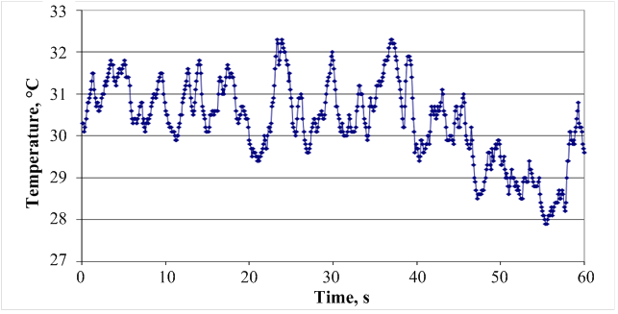
Energy transformation in a plant leaf during a sunny day
Tomas Ūksas
INTRODUCTION
METHODOLOGY
The Sun provides energy to the Earth in the form of rays which is used by plants for biomass development. Biomass developed by plants can only release such amount of energy which matches the amount of solar radiation energy absorbed by plants in the biomass production process. The process of CO₂ assimilation involves complex biological and physical processes of energy exchange.
In a plant leaf the share of the absorbed solar energy, 98–96 %, is converted into heat energy [1,2]. Due to a small mass and biologically limited maximum temperature (58 ºC) [3,4] of their tissues thin plant leaves are not able to accumulate released heat. Therefore, the solar energy transformed into heat in plant leaves has to be released as a metabolite, in the form of heat and water vapour, to the environment [1,5-7].
Thermodynamic processes taking place in the leaf, in the cavities of gas exchange with the environment, transform low-potential (low-temperature) heat energy into mechanical energy which is used for creating the driving force, friction forces in the leaf system of gas exchange with the environment [1,8-9]. Thermodynamic heat transformation processes in plant leaf stomata occur in daylight when plant leaf temperature changes [1,8-12].
In terms of bionics, the analysis of processes occurring in the system of gas exchange between the plant leaf and the environment shows that the anatomical structure of a plant leaf and the use in engineering of processes occurring in the plant leaf makes it possible to develop an essentially different mini engine (biological prototype of an engine) running in the range of low temperatures.
The temperature of a plant growing in natural environmental conditions was measured by thermocouple temperature sensors made of Cu-CuNi (copper-constantan) wires, 0.05 mm in diameter. To maintain the same resistance of the sensors, only wires of equal length were used. The measurements were recorded with an instrument ALMEMO 2590-9 having a microprocessor data processing and accumulation system (Figure 1). Temperatures were recorded by necessity taking a maximum of 100 measurements per second. This enabled us to observe short-term dynamic processes of temperature changes. Temperature sensors for all temperature measurements were used in observance of the requirements to be met by temperature measurements (in respect of the plant and its environment) [13].
Fig. 1. Schematic diagram of temperature measurement. 1 – computer, 2 – measurement data logger ALMEMO, 3 – temperature measurement sensors, 4 – test object
RESULTS
In the technical field, heat is transformed into mechanical work by heat engines when respective thermodynamic processes take place cyclically. In plant leaf channels made of the system of plant leaf stomata and gas exchange cavities heat energy is also transformed into kinetic mechanical energy cyclically and the thermodynamic cycle is similar to the thermodynamic cycle of a jet engine. The anatomical structure of a plant leaf, the leaf gas exchange model and the processes inside it must be discussed in order to evaluate the heat transformation processes in the system of plant gas exchange with the environment for the purpose of bionics. It is clear that the physical processes taking place in a plant leaf have been insufficiently examined and quite different information is presented about the process of gas (CO₂, O₂, H₂O vapor) and energy exchange between the plant leaf and the environment.
Plant leaves have fully adapted their anatomical structure to biological and physical processes occurring inside them, which enables them to use all possible driving forces for the process of CO₂ assimilation in satisfying the leaf gas exchange needs. Gas exchange takes place in the plant leaf's mesophyll. The system of gas exchange in the mesophyll consists of channels having nano, micro and mini openings. Gas exchange with the environment takes place through plant leaf stomata.
The experimental study shows (Fig. 2) that the temperature of the air around the plants is variable during the sunny day.
Figures 3 and 4 show the temperature variations at different wind speeds.
Fig. 5. Fluctuations in air temperature around a plant in natural environmental conditions in sunshine. Wind speed
v_{vid} = 5 m/s.
During one cycle gas in the plant leaf heat engine, cavities and stomata system performed mechanical work (L) which corresponds to the amount of heat used in the cycle. Based on the laws of engineering thermodynamics we can state that the mechanical work (L) generated by thermodynamic processes in plant leaf gas exchange cavities in the p-v (p – peressure, V – volume) coordinate system is represented by the cycle’s area 1-2-3-4-5-6-1 (Fig. 6).
After idealising the thermodynamic processes in a plant leaf by using the mathematical expression of the ideal Carnot cycle thermal efficiency η_{t} adapted for the biological prototype of a leaf heat engine we present the relationship between the thermal efficiency of this engine and the temperature of plant leaf tissues as well as its change in a plant leaf (Fig. 7).
As we can see (Fig.7), the thermal efficiency coefficient of a plant leaf heat engine η_{t} is very small since the engine operates only when changes in temperature are minor. There is a little dependence of ambient temperature (up to 2 %) on η_{t}. There is a great dependence of η_{t} on the change of temperatures in a plant leaf.
During daylight hours the mechanical force created in the system of gas exchange in a plant leaf activates the process of gas and energy exchange between the plant leaf and the surrounding environment.
Fig. 2. Anatomical structure of a plant leaf and the model of the plant leaf cavity and stoma gas exchange system. 1 – upper epidermis, 2 – lower epidermis, 3 – mesophyll, 4 – palisade tissue), 5 – spongy tissue), 6 – internal gas exchange surface of a leaf , 7 – stoma, 8 – cuticle, 9 – cavity with the system of channels in the mesophyll, 10 – ambient air around the leaf.
p, Pa
T_{max}
10⁻³ η_{t}
q₁
7
6
5
4
3
2
1
0
Atmospheric pressure
T_{min}
T_{max}
Fig. 3. Temperature change between the environment and the plant under natural conditions
q₂
η_{t} = 1 –
T_{maks}
V, m³
0 0.5 1.0 1.5 2.0 ΔT, K
Fig. 6. The thermodynamic cycle of the plant leaf heat engine in the pv (pressure p, volume v) coordinate system. L – area of the cycle (mechanical work created during the cycle); 1, 2, 3, 4, 5, 6 – characteristic points of thermodynamic states describing the parameters of plant leaf cavities.
Fig.7. Relationship between the thermal efficiency η_{t} of the plant leaf heat engine (biological prototype) working in the ideal Carnot cycle and temperature change in a plant leaf. 1 – plant leaf tissue temperature 20ºC; 2 – 30ºC, 3 – 40ºC
CONCLUSIONS
1. The bionic analysis of a plant leaf enabled us to determine that the thermodynamic processes of heat transformation into mechanical work take place in the leaf gas exchange system during daylight hours when plant leaf temperature changes.
2. When transformed into kinetic energy of the flow in plant leaf stomata the potential energy of gas pressure created during the change of leaf temperature creates mechanical work which stimulates the processes of gas and energy exchange between the leaf and the environment.
3. Thermal efficiency coefficient ηt of the plant leaf heat engine is very low. Assuming that η_{t} = 0.003, depending on the density of solar energy provided to a plant leaf in natural environmental conditions, transformation into mechanical energy represents 0.06–0.6 W/m². Energy conversion accounts for 0.3 % of the heat participating in convective heat transfer between a leaf and the environment.
Fig. 4. Fluctuations in the difference between plant leaf and ambient temperature during the sunny period of the day under natural environmental conditions. Wind speed v_{vid} = 1 m/s
1. Zhi Yuan, Hong Ye, Shimin Li. Bionic Leaf Simulating the Thermal Effect of Natural Leaf Transpiration. Journal of Bionic Engineering. 2014, 11, 1, 90-97.
2. Lambers H. Plant physiological ekology. New York. Springer, 2006, 540.
3. Levitt J. Response of plants to environmental stresses. Academic Press. New York. 1980, 2, 607.
4. Ellwagner T, Bingham Jr, Chapell S. We and Tolin SA. Cytological effects of ultra-high temperatures on Corn. Weed Science, 1973, 21, 4, 299-303.
5. Sirvydas A, Kerpauskas P, Kučinskas V. Augalų energinė apykaita. [Plant energy exchange]. Lietuvos žemės ūkio universitetas. Akademija. Kaunas, 2011, 224.
6. Šlapakauskas V. Augalų ekofiziologija. Kaunas. 2006, 413.
7. Fitte, A, Hay R. Environmental physiology of Plants. S.D., S.F., N.Y., B., L., S., T. Academic press, 2002, 367.
.
8. Sirvydas A, Kučinskas V, Kerpauskas P, Nadzeikienė J, Kusta A. Solar radiation energy pulsations in a plant leaf. Journal of Environmental Engineering and landscape management. 2010, 18, 3, 188-195
9. Sirvydas A, Kučinskas V, Kerpauskas P, Nadzeikienė J, Kusta A. Solar radiation energy pulsations in a plant leaf. Journal of Environmental Engineering and landscape management. 2010, 18, 3, 188-195.
10. Sirvydas A, Nadzeikienė J, Kerpauskas P, Ūksas T. The principle of heat conversion into mechanical work. Mechanika. 2013 19, 3, 358 – 362.
11. Yi Peng, Wangyu Liu, Wei Chen, Ningling Wang. A conceptual structure for heat transfer imitating the transporting principle of plant leaf. International Journal of Heat and Mass Transfer 2014, 71, 79–90.
12. Wang S J, Ren L Q, Liu Y, Han Z W, Yang Y. Mechanical characteristics of typical plant leaves. Journal of Bionic Engineering, 2010, 7, 294–300.
13. Sirvydas, A. - Kerpauskas, P. - Nadzeikienė, J. - Stepanas, A. - Тereščiuk, V.S.: Temperature measurements in research of thermal weed extermination. Proceedings of the international conference Development of agricultural technologies and technical means in ecological and energetic aspects. Lithuania. Raudondvaris. 2006. No.11, pp. 321-331.
Vytautas Magnus University, Lithuania
* Corresponding author: tomas.uksas@vdu.lt

