Slide 1
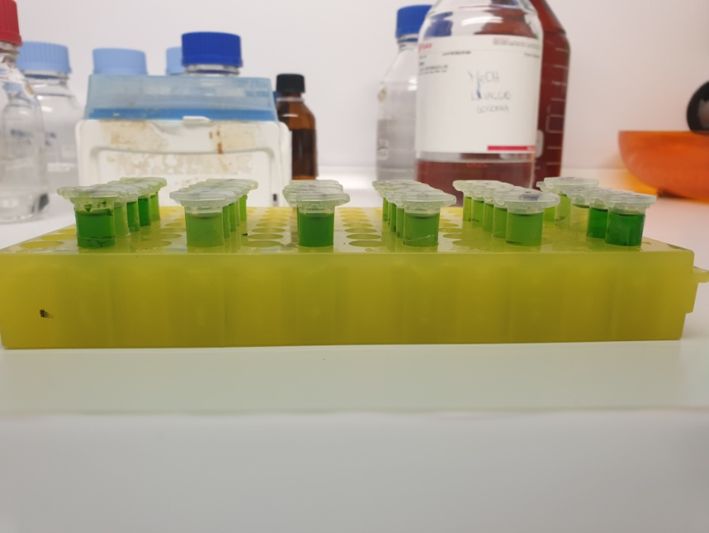
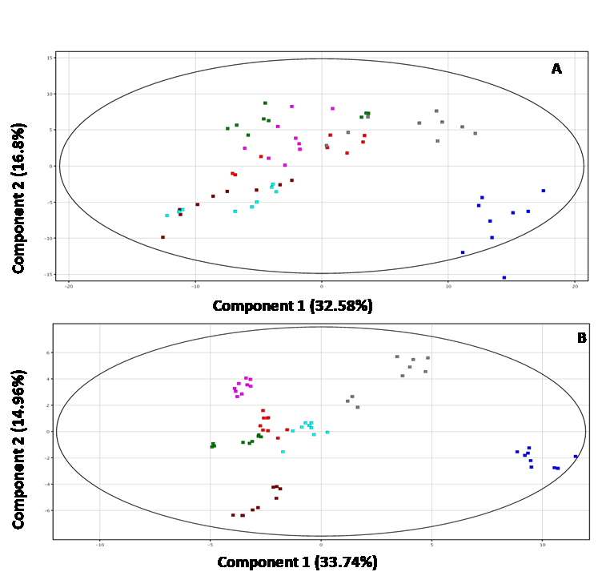
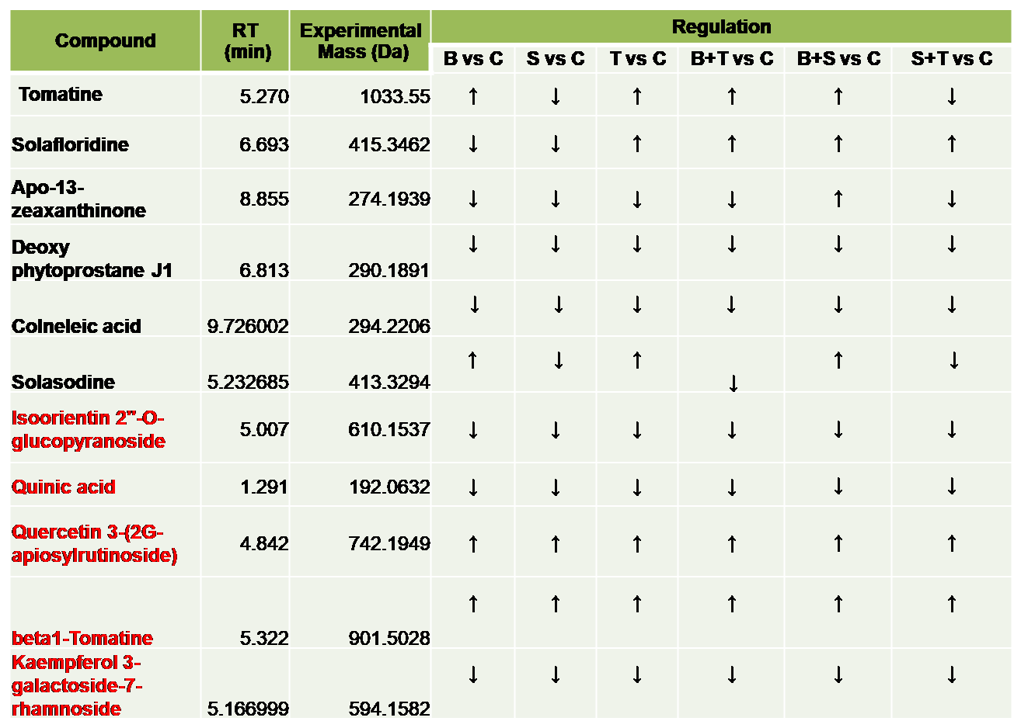
Spagro
Beneficial microbes application on tomato significantly improves accumulation
of metabolites with nutraceutical value
G. Iacomino^{1*}, A. Staropoli^{1,2}, M.I. Prigigallo³, G. Bubici ³, M. Scagliola⁴, P. Salerno⁴, S. Bolletti Censi⁵, G. Murolo⁵,
F. Vinale^{2,6}
¹Department of Agricultural Sciences, University of Naples Federico II; ²Institute for Sustainable Plant Protection, National Research Council, SS Portici and ³ SS Bari; ⁴Spagro srl; ⁵Cosvitec scarl; ⁶Department of Veterinary Medicine and Animal Productions, University of Naples Federico II;
*e-mail presenting author: giuseppina.iacomino@unina.it
Tomato (Solanum lycopersicum) is an important crop and is consumed worldwide. This vegetable is an excellent source of natural compounds (i.e antioxidants including vitamins C and E, lycopene, b-carotene, lutein and flavonoids) and minerals useful for human health.
AIM OF THE WORK:
Investigate the impact of beneficial microorganisms application on tomato metabolome.
MATERIALS AND METHODS:
Streptomyces fulvissimus, Bacillus subtilis and Trichoderma afroharzianum were applied on tomato plants in a field trial either as single inoculants or as microbial consortia. After the treatments, plants were harvested and subjected to organic extraction (Figure 1) followed by metabolomic analysis (LC-MS qTOF).
IDENTIFICATION OF PLANT METABOLITES:
Spectrometric analysis led to the identification of several secondary metabolites (i.e. tomatine, solasodine, etc.) belonging to different classes of natural compounds (Table 1).
Figure 1. Extraction of metabolites from tomato leaves.
METABOLOMIC ANALYSIS:
Metabolomic analysis highlighted several differentially accumulated compounds, whose abundance is dependent on the treatment (PCA on Figure 2).
Figure 2. Principal components analysis (PCA) score plots of the LC–MS data acquired in positive (B) and negative (A) mode. Each group of replicates subjected to different treatments is depicted with a different color: control group (C) in blu; Streptomyces fulvissimus group (S) in brown; Trichoderma afroharzianum group (T) in pink; microbial consortium Streptomyces fulvissimus and Bacillus subtilis group (S+B) in grey; Bacillus subtilis group (B) in red; microbial consortium Streptomyces fulvissimus and Trichoderma afroharzianum group (S+T) in green; microbial consortium Trichoderma afroharzianum and Bacillus subtilis group (T+B) in light blue.
Conclusion:
Field applications of Streptomyces fulvissimus, Bacillus subtilis and Trichoderma afroharzianum induced changes in the metabolic profile of tomato. In particular, a certain accumulation of molecules has been observed, such as tomatin, with demonstrated antioxidant, antitumoral and fungicidal properties. The accumulation of these metabolites with nutraceutical value represents a starting point for further future studies to investigate the efficacy of these beneficial strains.
Table 1. Putatively identified metabolites differentially accumulated in plants treated with Streptomyces fulvissimus (S), Trichoderma afroharzianum (T) and Bacillus subtilis (B) or as mix (B+S, B+T, S+T) compared to control (group C, untreated plants).
In black = putatively identified molecule from LC-MS analysis performed in positive mode
In red = putatively identified molecule from LC-MS analysis performed in negative mode
↑ Up-regulated vs control (C). ↓ Down-regulated vs control (C).
Acknowledgments: This work was supported by PROTECTION Project
(MISE CRESO grant number Protection no. F/050421/01-03/X32 ).

