Slide 1
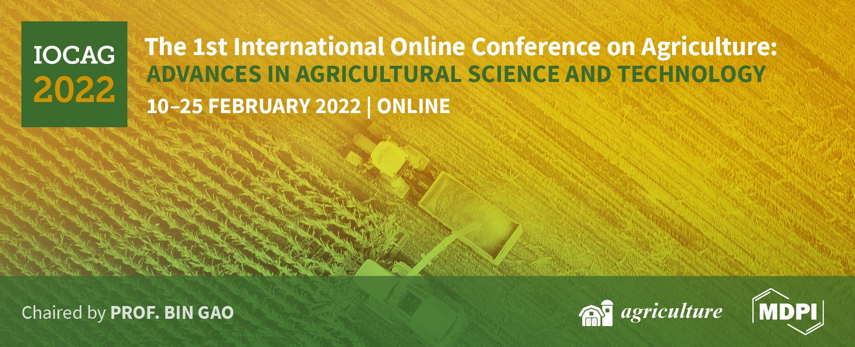
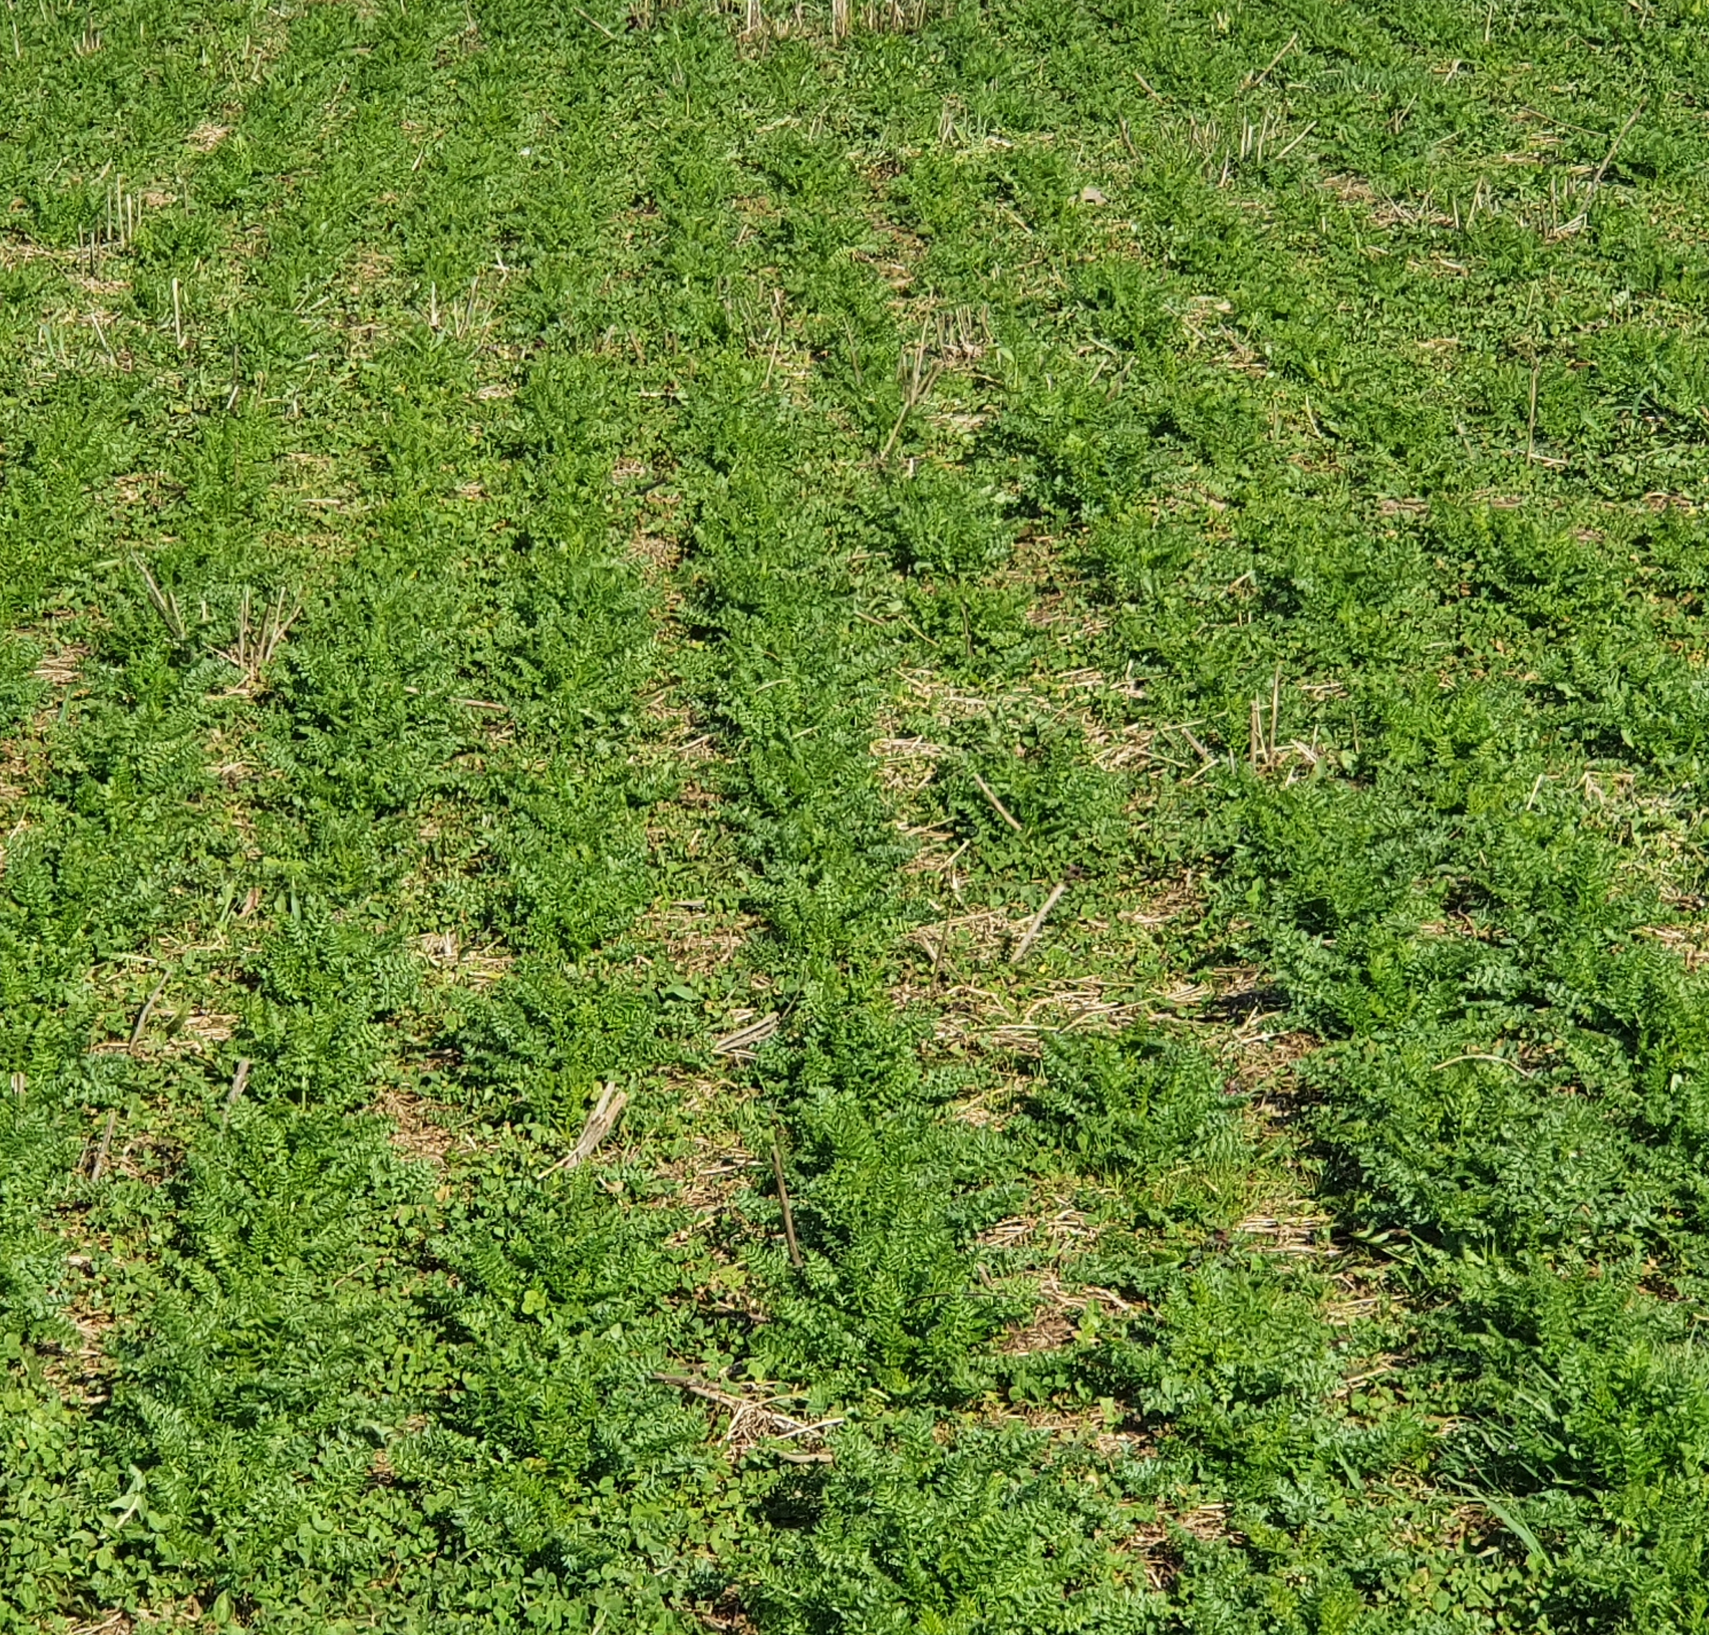
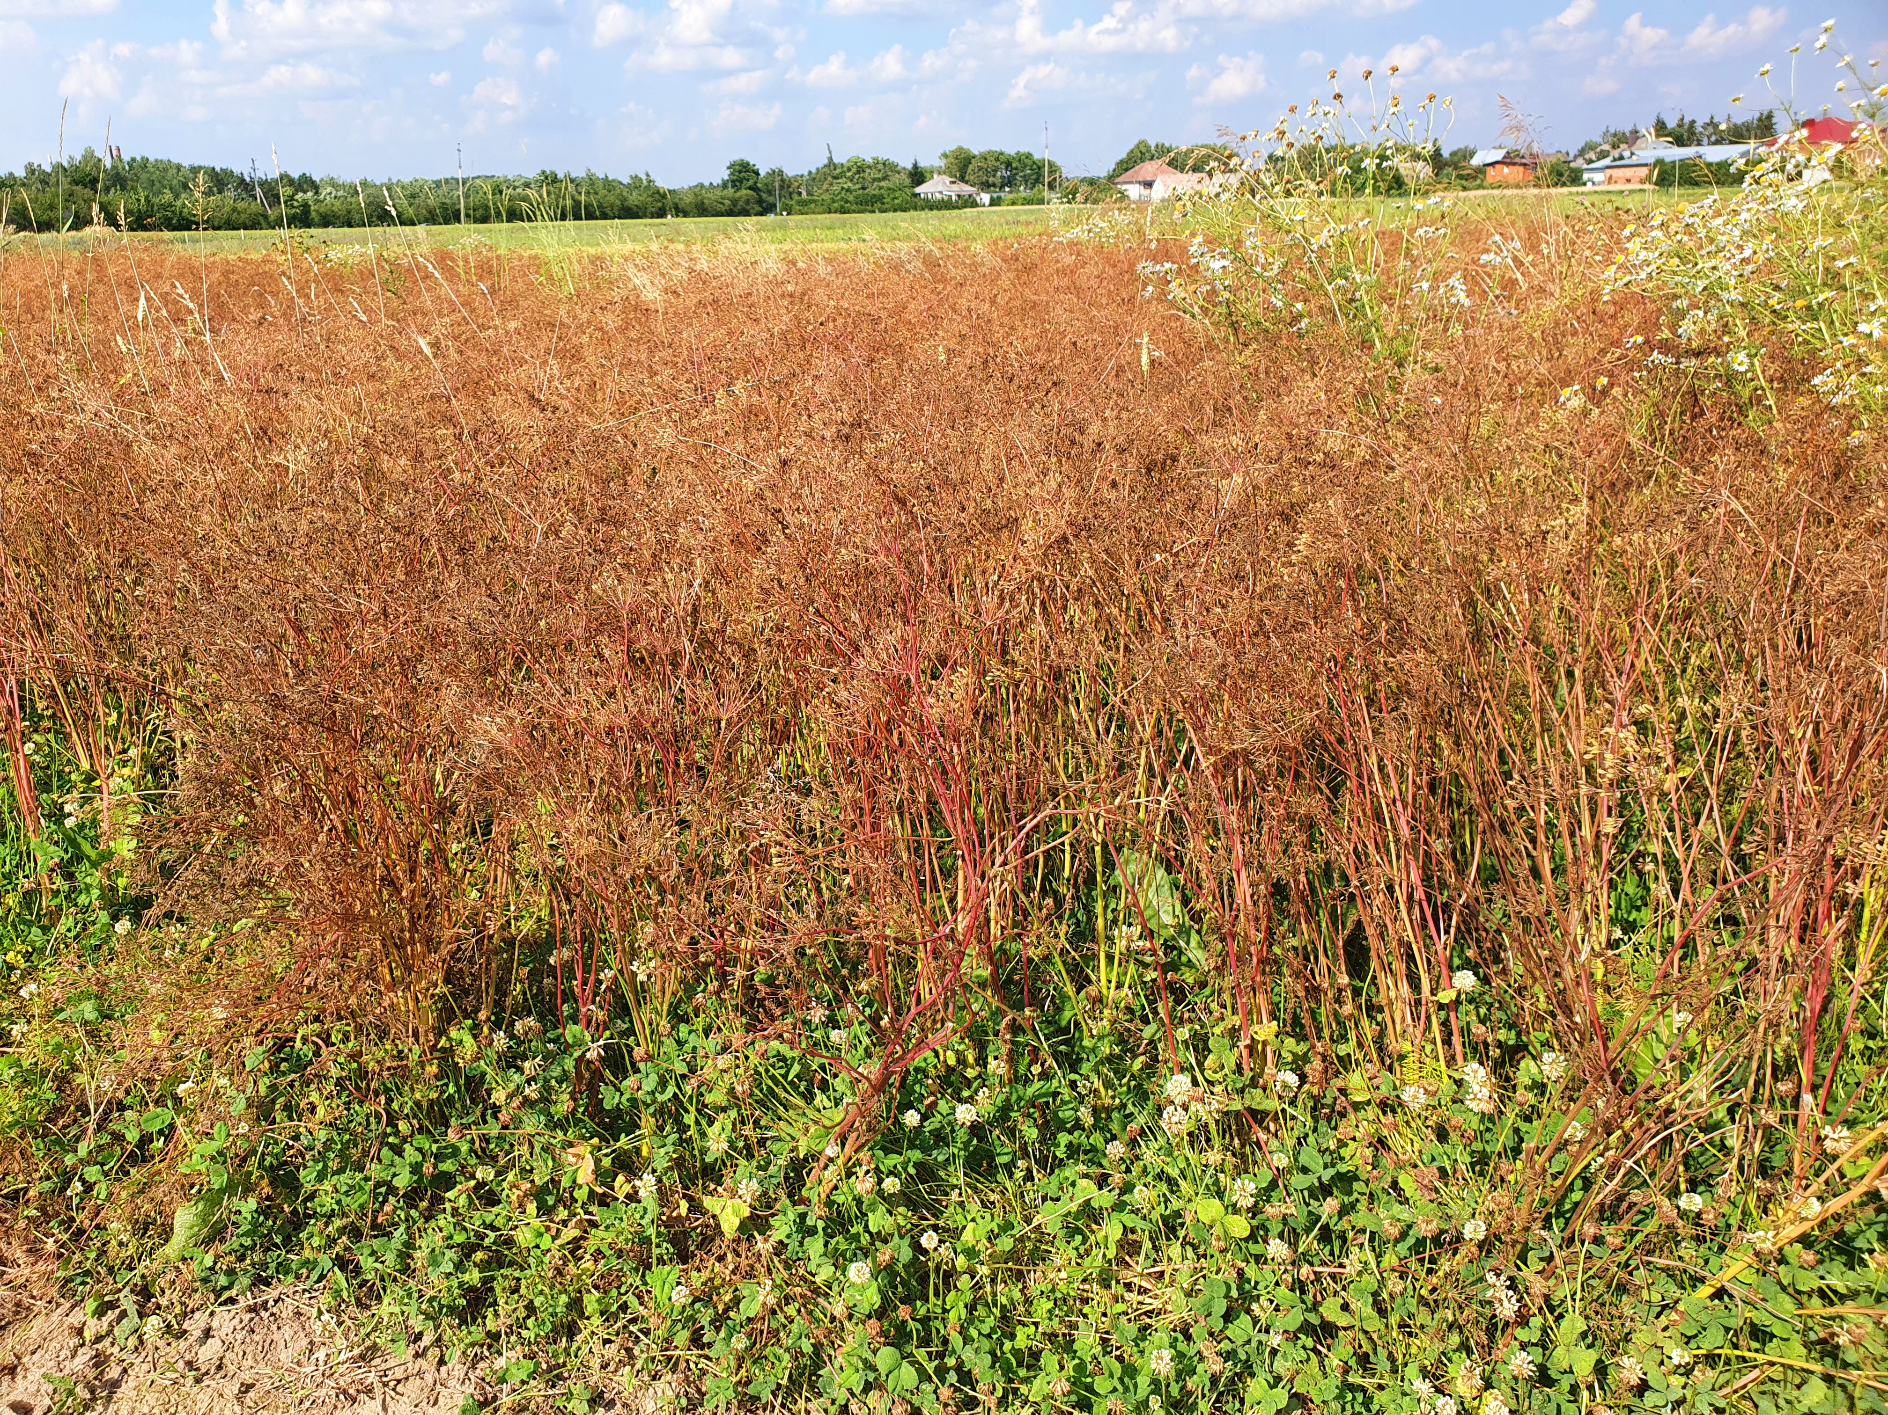
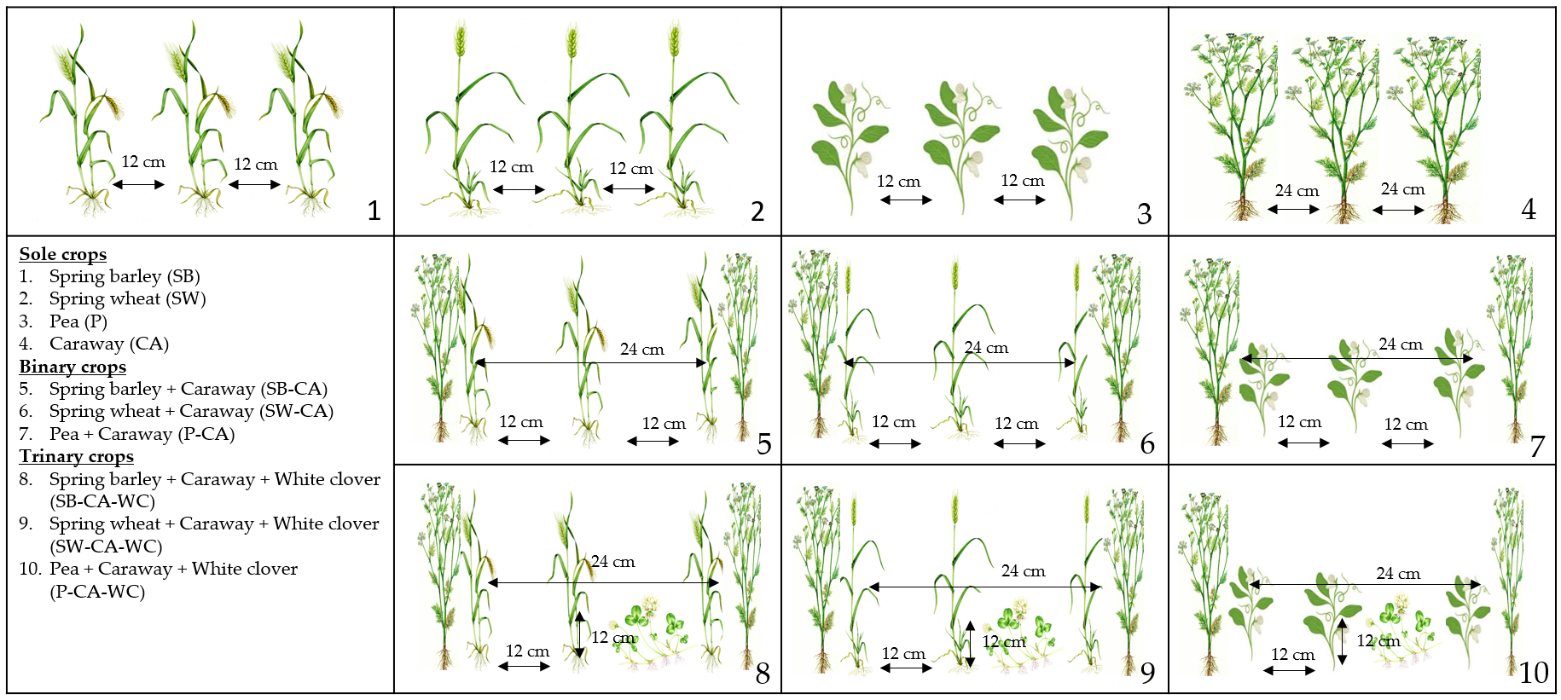
DISTRIBUTION OF WEEDS AND CARAWAY PRODUCTIVITY IN THE MULTI-CROPPING SYSTEM
Aušra Rudinskienė ¹, Aušra Marcinkevičienė ^{1*}, Zita Kriaučiūnienė ¹, Rimantas Velička ¹, Robertas Kosteckas ²
¹ Department of Agroecosystems and Soil Sciences, Agriculture Academy, Vytautas Magnus University, K. Donelaičio Str. 58, LT-44248, Kaunas, Lithuania; rimantas.velicka@vdu.lt (R.V.); zita.kriauciuniene@vdu.lt (Z.K.); aušra.rudinskiene@vdu.lt (A.R.);
² Department of Plant biology and Food Science, Agriculture Academy, Vytautas Magnus University, K. Donelaičio Str. 58, LT-44248, Kaunas, Lithuania; robertas.kosteckas@vdu.lt (R.K.)
*Correspondence: ausra.marcinkeviciene@vdu.lt; Tel.: +370 615 33187 (A.M.)
Introduction
Results
There is increasing new knowledge about how humans manage crops, including the socio-economic themes, managing intensity, extensification, diversification, water supply, land ownership, and work organization (Petrie and Bates, 2017). When using a multi-cropping system, it is important to find synergies between different, but complementary plants which can grow together, and the result is better than growing them sole (Mahapatra, 2011). In natural ecosystems, biodiversity is a cornerstone for its resilience and stability. Growing crops in multi-cropping system is one of the ways to adapt this diversity to the agroecosystem and on the other hand, growing crops at the same time in the same field is an important strategy to increase crop yield also economic benefits (Khan et al., 2012). Moreover, multi-cropping system effectively reduces the cost of weed control. In this system, the stems and leaves of the plants are arranged differently in both the vertical and horizontal directions. Such distribution provides more flexible weed control for weeds (Yadollahi et al., 2014).
Research object: Weed spread and caraway crop productivity covered by multi-cropping farming system crops.
Research aim: To compare weed spread and caraway (Carum carvi L.) crop productivity in sole (spring barley, spring wheat, pea, caraway), binary (spring barley-caraway, spring wheat-caraway, pea-caraway) and trinary (spring barley-caraway-white clover, spring wheat-caraway-white clover, pea-caraway-white clover) crops.
Research objectives: 1) to determine the weed species composition in the multi-cropping (sole, binary, and trinary) system; 2) to determine the number and dry biomass of weed in multi-cropping system; 3) to evaluate the yield of caraway seeds grown in multi-cropping system.
We hypothesized that the application of a multi-cropping system would inhibit the spread of weeds and increase the productivity of caraway crop.
a)
a)
b)
Figure 4. Trinary crop of spring barley with caraway and white clover in the spring (a) and summer (b), 2020.
Conclusions
Most common weed species in multi-cropping system predominated: white goosefoot (Chenopodium album L.), scentless chamomile (Tripleurospermum perforatum (Merat) M. Lainz), and common dandelion (Taraxacum officinale F.H. Wigg.). In the second and third years of caraway vegetative seasons increased spread of perennial weeds in the crops.
In the first year of caraway vegetative season (2019), 23 weed species were found in multi-crops, including 19 annual weeds and 4 perennial ones. The weeds found belong to 11 families. In the second year of caraway vegetative season (2020), 22 weed species were found in multi-crops, including 18 annual weeds and 4 perennial ones. The weeds found belong to 11 families.
In the first year of caraway vegetative season the highest weed number of weed was determined in trinary spring barley crop (SB-CA-WC), in the second year – in binary spring barley crop (SB-CA).
In the first year of caraway vegetative season the highest dry biomass of weed was determined in trinary pea crop (P-CA-WC), in the second year – in binary pea crop (P-CA).
Significantly, from 1.7 to 3.7 times higher, caraway seed yield was formed when it was grown in binary crop with pea, compared to other crops.
Materials and Methods
The research was carried out at the Experimental Station of Vytautas Magnus University Agriculture Academy (Lithuania), in 2019–2020. The soil – Endocalcaric Amphistagnic Luvisol (IUSS Working Group WRB, 2015). Agrochemical properties of the soil: pH – 6.70, humus – 1.57–1.86%, mobile nutrients: P₂O₅ – 213–318 mg kg⁻¹, K₂O – 103–125 mg kg⁻¹. A one-factor field experiment was carried out in 2019–2020 using a randomized block design with ten treatments. Dry biomass of weeds was established before harvesting of the main crop (spring barley, spring wheat, and pea) (2019), and during the second year (2020) of caraway vegetative season — before harvesting caraway and spring barley in 10 randomly selected sites of 0.06 m² in each harvested plot. The number and species composition of the weeds were determined in the Soil and crop ecology laboratory, and the weeds were dried in the oven at 60 °C and weighed. The number of weeds was recalculated to pcs. m⁻² and the dry biomass to g m⁻². Caraway seed yield calculation was based on a standard 12% moisture and absolutely clean seed content (t ha⁻¹).
b)
Figure 2. Weed number (a) and dry biomass (b) in the sole, binary and trinary crops, 2019–2020.
Note: CA – caraway, SB – spring barley, SW – spring wheat, P – pea, WC – white clover. Differences between the averages of treatments marked by not the same letter (a, b, c, d) are significant (P < 0.05).
References
Petrie, C. A., & Bates, J. (2017). ‘Multi-cropping’, intercropping and adaptation to variable environments in Indus South Asia. Journal of world prehistory, 30(2), 81–130.
Mahapatra, S. C. (2011). Study of grass-legume intercropping system in terms of competition indices and monetary advantage index under acid lateritic soil of India. Journal of Experimental Agriculture International, 1(1),1–6.
Khan, M. B., Khan, M., Hussain, M., Farooq, M., Jabran, K., & Dong-Jin, L. (2012). Bio-economic assessment of different wheat-canola intercropping systems. International Journal of Agriculture and Biology, 14(5), 769–774.
Yadollahi, P., Abad, A. R. B., Khaje, M., Asgharipour, M. R., & Amiri, A. (2014). Effect of intercropping on weed control in sustainable agriculture. International Journal of Agriculture and Crop Sciences, 7(10), 683–686.
IUSS Working Group WRB, 2015. World Reference Base for soil resources 2014. International soil classification system for naming soils and creating legends for soil maps. Update 2015. World Soil Resources Report 106. FAO, Rome: 188 pp.
Figure 3. Caraway seed yield, 2020.
Note: CA – caraway, SB – spring barley, SW – spring wheat, P – pea, WC – white clover. Differences between the averages of treatments marked by not the same letter (a, b, c) are significant (P < 0.05).
Figure 1. The experimental treatments: Four treatments were formed by sole crops; three treatments were combinations of caraway with the other crops as binary crops; and three treatments were combinations of three crops with included white clover as trinary crops.
Notes:
Download more poster presentation templates from FPPT.com

