Slide 1
Spatial exploration of the relationships between agricultural land use and water quality measures
Pietro Macedoni,
Flavio Lupia,
Elisabetta Carfagna

Slide 2
Agricultural land-use and effects on water quality (surface and groundwater) is a well known issue and actions are needed to reduce the impacts of farm inputs management.
In order to monitor the presence of chemicals in the waters and study the relation with the land use detailed vector layer are needed.

Slide 3
Case Study
Implement a methodological process for the integration and use in statistical analysis of georeferenced administrative sources.
The following datasets, regarding the province of Foggia, are provided by AGEA and ISPRA:
Refresh, vector layer (AGEA 2016)
Company File, vector layer (AGEA 2018)
GIS Soil, vector layer (AGEA 2018)
Water chemicals, point data (ISPRA 2016)

Slide 4
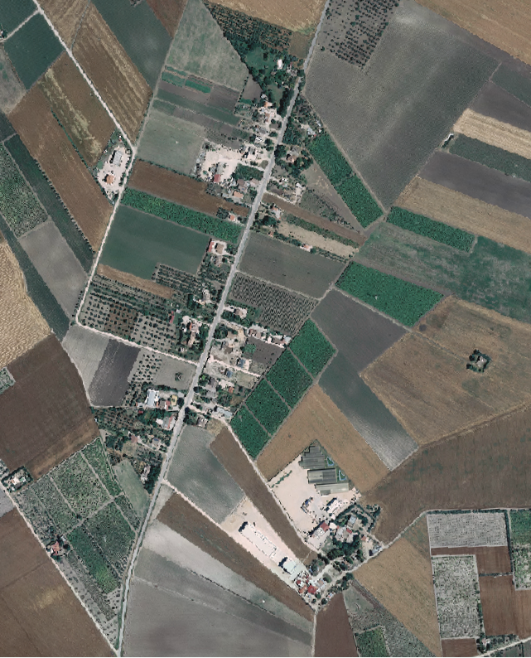
Refresh 1 of 2
The Refresh layer consists of a complete mapping of the Italian territory through the interpretation of orthophotos.
This layer is used during the procedure for assigning European funds to agriculture: it provides a certified basis on which farmers can create their own declarations.
The update of this base has a three-year term. Italy is divided into 3 macro-areas and one every year is updated.
Orthophoto, area near the city of Arpinova and SP26

Slide 5
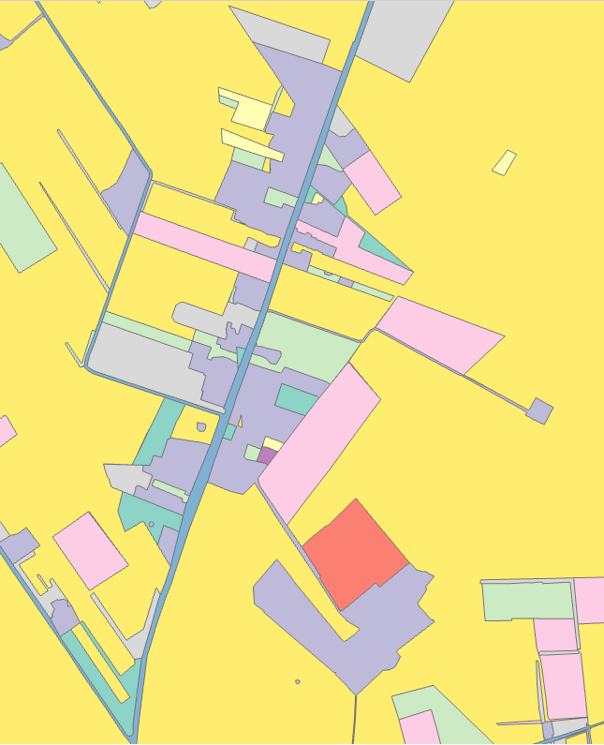
Refresh 2 of 2
PRO:
The datasets provide a complete description of the land use in Italy.
The total number of polygon is quite low making it more manageable.
CON:
It is not possible to have a detailed definition of the land use.
The update period is long.
During the preproduction process, a shift in the location of the polygon can occur.
Olive Trees
Vineyard
Arable land by photo-interpreter
Refresh for the whole Puglia region, after the topology corrections has 1,025,756 polygons.
52 Polygons every ${km}^{2}$
Refresh, area near the city of Arpinova and SP26
Color based on polygon code

Slide 6
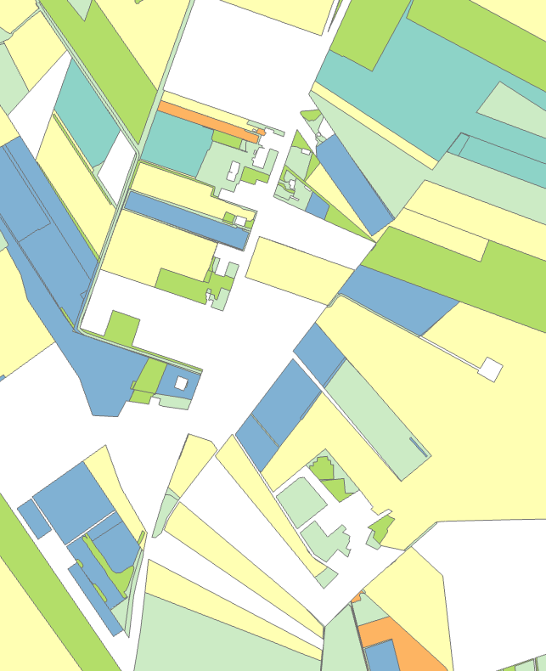
Company File
The Company File is a vector layer that refers to the data of the farmers' declarations to access European funds.
These declarations are submitted every year by farmers.
The land use is specific and not macro
This vector layer includes only the agricultural areas for which a declaration has been made, and as a result, a large part of the territory is not represented.
The polygons are drawn and updated by the farmers.
Vineyard
Durum Wheat
Company File for the whole Puglia region, after the topology corrections has 1,762,146 polygons.
90 Polygons every ${km}^{2}$
Company File, area near the city of Arpinova and SP26
Color based on polygon code
Notes:
4 level in code

Slide 7
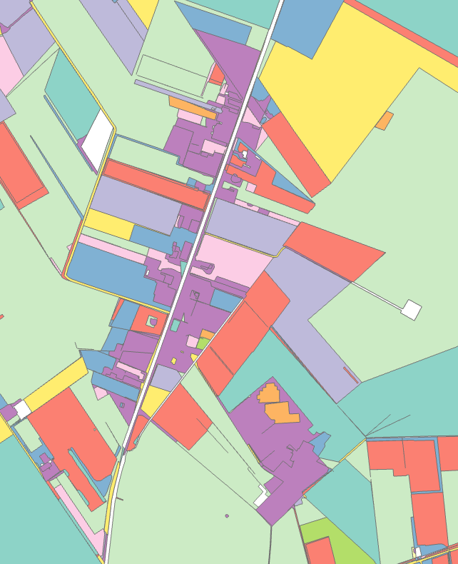
GIS Soil
This layer can be described as an “intersection” between Company File and Refresh as it uses the same reference system as the Company File but the Refresh coding system.
GIS Soil is generated annually by AGEA using its own administrative procedures, such as objective checks on land use declarations or reviews.
The correspondence between its polygons and those of Company File allows an almost perfect overlap when both are present
Drawing errors or similar can be corrected by the photo interpreter during the elaboration process.
The use of refresh codes combined with control information allows for better identification of land use
GIS Soil does not cover the entire land surface.
Arable land by photo-interpreter
Vineyard
Olive Trees
Durum Wheat
GIS Soil for the whole Puglia region, after the topology corrections has 2,501,823 polygons.
128 Polygons every ${km}^{2}$
GIS Soil, area near the city of Arpinova and SP26
Color based on polygon code

Slide 8
Creation of the “Hybrid Layer” 1 of 2
Use only Refresh layer for analysis purposes:
Quick and easy checks due to few polygons
Complete coverage
Macro land use only
3 years update period
Integrating auxiliary data sources such as Company File and GIS Soil can overcome this problems

Slide 9
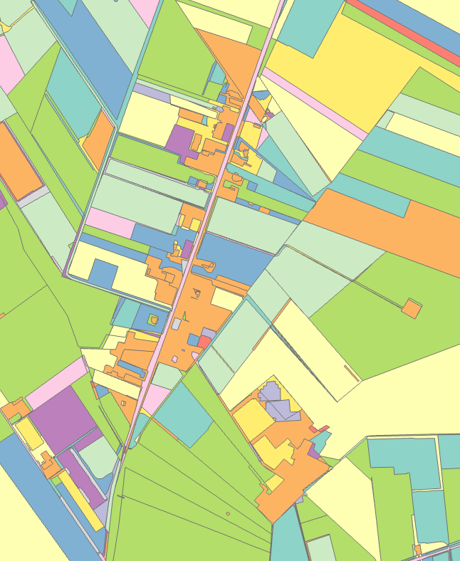
Creation of the “Hybrid Layer” 2 of 2
Step 1
Correct topology errors
Fix geometry
Step 2
Use Refresh layer to fill the gaps in GIS Soil
Step 3
Add Company File
“Hybrid Layer”:
Complete geographical coverage of land use.
The detailed crop codes of the Company File and the generic ones of GIS Soil.
Updated every year.
Olive Trees
Vineyard
Durum Wheat
“Hybrid Layer” for the whole Puglia region, after the topology corrections has 3,953,079 polygons.
202 Polygons every ${km}^{2}$
“Hybrid Layer”, area near the city of Arpinova and SP26
Color based on polygon code

Slide 10
Integration with environmental data
The following process was followed to study the relations between the chemical concentrations in surface water and the land use:
Pre-elaboration of Ispra dataset of chemicals in waters (2016).
Rasterization of the “Hybrid Layer”.
Creation of buffer zone of 5 km around the ISPRA water monitoring stations.
Correspondence Analysis.

Slide 11
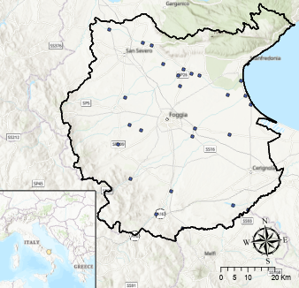
Water Chemicals
The water monitoring stations are unevenly distributed throughout the territory and 26 are located in the study area and seems to be clustered around certain area of interest.
Puglia tracks 28 substances in surface waters, Isoproturon (CAS 34123-59-6) a plant protection product, will be evaluated in the analysis
Location of survey station for the study area, ISPRA 2016

Slide 12
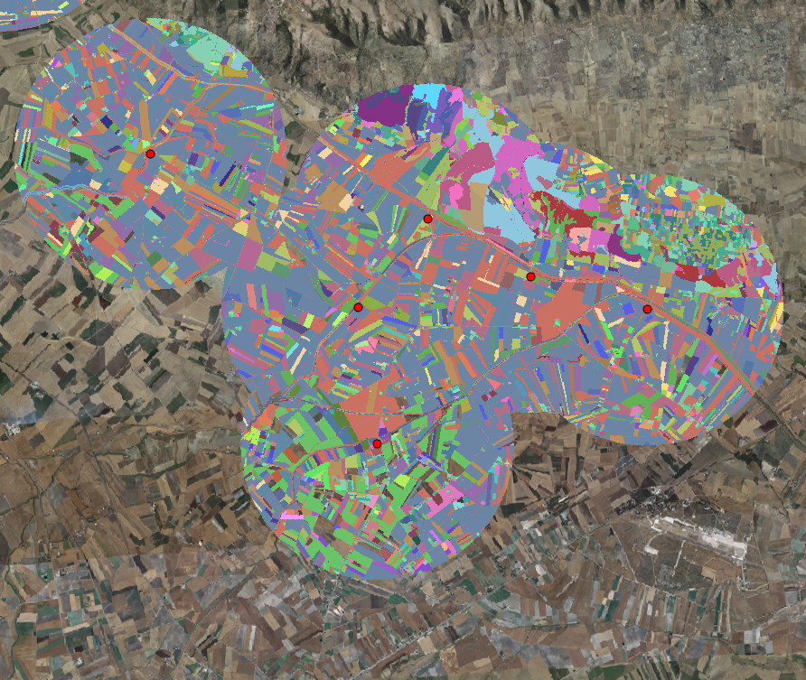
Analysis
The “Hybrid Layer” is converted in to a 10mx10m raster using the Copernicus grid as reference
Only the pixel with the 5km buffer from the station are selected.
Each pixel is associated with the level of concentration of Isoproturon within the buffer.
The total concentration can assume 6 values that are rounded at the second decimal position. These numbers will be considered as ordered categorical variable.
Example of the rasterized “Hybrid Layer” in the buffer zone of 6 clustered water monitorning stations
Notes:
In the pic there are around 3 mil points (3150847)

Slide 13
Correspondence Analysis
The relationship between the concentration of Isoproturon and Land use is studied through correspondence analysis on the frequency table obtained from the raster.
The frequency table is generated by converting each pixel containing the info of land use and concentration into a point:
Land use has been recoded in 21 levels in order to simplify the results
The total number of points within the buffers (26) is 12 960 454

Slide 14
Inertia
Dimension | Principal Inertia | % | Cumulative% | Scree Plot
1 | 0.04513 | 45.8 | 45.8 | ***********
2 | 0.025015 | 25.4 | 71.2 | ******
3 | 0.014644 | 14.9 | 86 | ****
4 | 0.007776 | 7.9 | 93.9 | **
5 | 0.005997 | 6.1 | 100 | **
Total: | 0.098562 | 100.0
The first two dimensions explain 71.2% of the total inertia and are used to represents the points in the symmetric map.

Slide 15
 |  |  |  |  | Dimension1 |  |  | Dimension 2
Code | Land Use | Mass | Quality | Inertia | Coordinates | Squared Correlation | Absolute contribution | Coordinates | Squared Correlation | Absolute contribution
134-0 | Tomato | 37 | 413 | 27 | -157 | 345 | 20 | -70 | 68 | 7
2-0 | Durum Wheat | 431 | 152 | 39 | 15 | 26 | 2 | -33 | 126 | 19
214-0 | Agricultural Area Withdrawn from Production | 24 | 63 | 11 | 53 | 60 | 1 | -11 | 3 | 0
214-14 | Agricultural Area Withdrawn from Production EFA | 26 | 450 | 14 | -154 | 450 | 13 | -3 | 0 | 0
300 | Deciduous Woods | 5 | 358 | 8 | -165 | 188 | 3 | 158 | 171 | 5
330 | Lakes and Water Basins of Significant Surface | 5 | 994 | 385 | 2577 | 961 | 809 | -476 | 33 | 50
410-0 | Vineyard | 31 | 536 | 87 | 188 | 126 | 24 | 338 | 410 | 140
420-0 | Olive Trees | 48 | 330 | 26 | 115 | 249 | 14 | 66 | 81 | 8
533-0 | Oats | 23 | 646 | 27 | -149 | 192 | 11 | -229 | 454 | 47
544-0 | Chickpea | 23 | 103 | 13 | -31 | 18 | 1 | 67 | 85 | 4
544-111 | Chickpea EFA | 10 | 10 | 4 | -16 | 6 | 0 | -14 | 4 | 0
575-0 | Beans | 12 | 335 | 6 | -42 | 33 | 0 | -125 | 301 | 7
575-111 | Beans EFA | 12 | 809 | 23 | -66 | 24 | 1 | -379 | 785 | 71
638-0 | Polifita Pasture | 34 | 886 | 19 | -197 | 705 | 29 | 100 | 181 | 14
651 | Specialized Tree Not Specified | 7 | 887 | 8 | 194 | 354 | 6 | 238 | 533 | 17
654-0 | Pascolo Arborato Tare 50% | 4 | 598 | 12 | -337 | 415 | 11 | 224 | 183 | 9
666 | Seminative Photo-interp | 158 | 565 | 117 | 10 | 1 | 0 | 202 | 564 | 259
690 | Waters | 27 | 94 | 20 | 31 | 13 | 1 | 78 | 81 | 6
800-0 | Grassland | 14 | 736 | 13 | -253 | 688 | 19 | -67 | 48 | 2
870-0 | Barley | 50 | 716 | 87 | -104 | 63 | 12 | -336 | 653 | 224
902-0 | Asparagus | 19 | 664 | 56 | -218 | 166 | 20 | -377 | 498 | 109
Durum wheat is the most common crop
Lakes and Water Areas of Significant Surface has the greater inertia and provides the largest contribution to the first axis
Land use with or without Ecological Focus Area have different sets of coordinates in the symmetrical map
Rows – Land use 1 of 2

Slide 16
Columns - Concentrations
 |  |  |  | Dimension 1 |  |  | Dimension 2
Concentration | Mass | Quality | Inertia | Coordinates | Squared Correlation | Absolute contribution | Coordinates | Squared Correlation | Absolute contribution
0,03 | 12 | 390 | 168 | 53 | 2 | 1 | 748 | 389 | 258
0,05 | 30 | 126 | 68 | -78 | 27 | 4 | -150 | 99 | 27
0,1 | 20 | 175 | 88 | 81 | 15 | 3 | 265 | 160 | 55
0,15 | 118 | 999 | 396 | 570 | 980 | 848 | -79 | 19 | 30
0,17 | 48 | 808 | 217 | -226 | 115 | 54 | -555 | 693 | 594
0,2 | 773 | 810 | 63 | -73 | 661 | 90 | 35 | 149 | 37
The level of concentration 0.2 is the one with the higher mass.
0.2, 0.17 and 0.15 are well represented in the map
0.15 accounts for most of the inertia and contribution for the first dimension

Slide 17
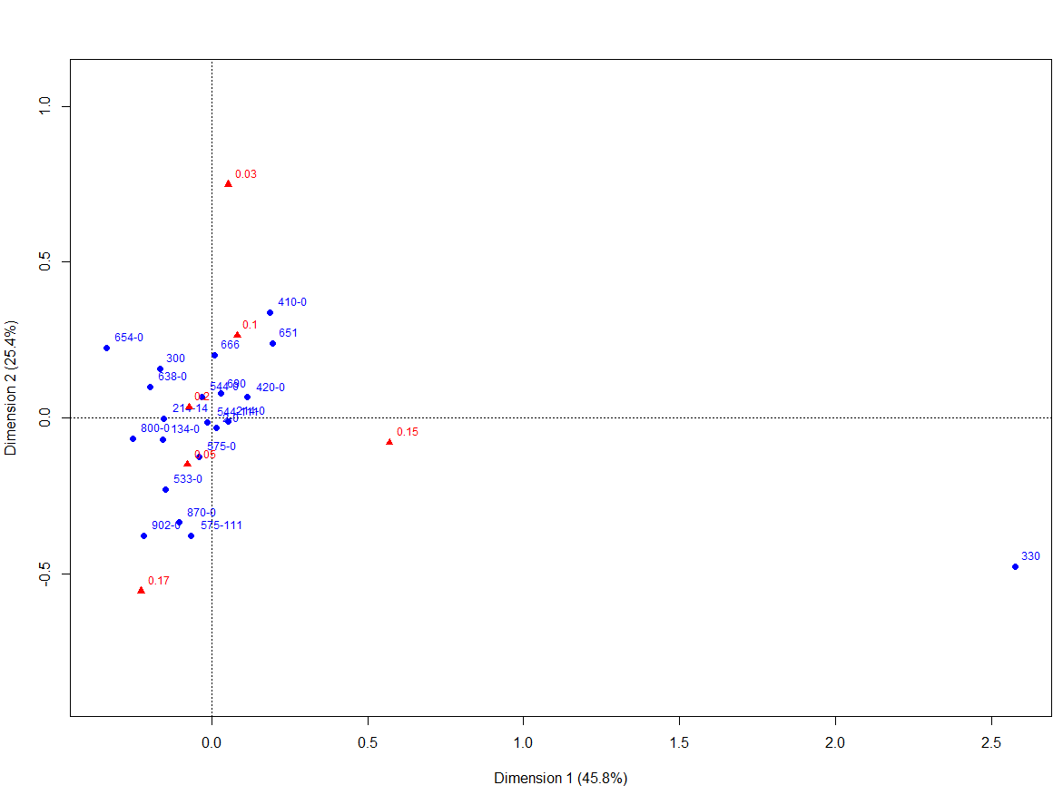
Graphical Representation

Slide 18
Conclusion
Challenges:
The complexity of managing large datasets that were not designed for this type of application.
Implementation of procedures to address the topological and geometric problems.
Opportunities:
The “Hybrid Layer” thanks to the high spatial and thematic resolution allows more detailed types of analyses.
Possibility of integration with other georeferenced data.
Overcomes the limits of a single data source.
Data Integration
Analysis
The analysis shows how land use can be associated with different level of Isoproturon:
The presence of EFA areas differs from the non EFA crops.
Large water areas behave differently than other land use.
The use of chemicals substance can be found also in non-agricultural areas due to proximity with other crops

Slide 19
Thank you for the attention

