Slide 1
A case study on minerals accumulation in grains and flours of bread wheat fertilized with ZnSO₄ and Tecnifol Zinc
Inês Carmo Luís ^{1,2,*}, Diana Daccak ^{1,2}, Ana Coelho Marques ^{1,2}, Ana Rita F. Coelho ^{1,2}, Cláudia Campos Pessoa ^{1,2}, Manuel Patanita ^{2,3}, José Dôres ³, Ana Sofia Almeida ^{2,4}, Maria Manuela Silva ^{2,5}, Maria Fernanda Pessoa ^{1,2}, Fernando H. Reboredo ^{1,2}, Manuela Simões ^{1,2}, Paulo Legoinha ^{1,2}, Ana Sofia Bagulho ^{2,4}, José Moreira ^{2,4}, Isabel P. Pais ^{2,6}, Paula Scotti Campos ^{2,6}, José C. Ramalho ^{2,7}, Roberta G. Leitão ⁸, Mauro Guerra ⁸ and Fernando C. Lidon ^{1,2}
¹Earth Sciences Department, Faculdade de Ciências e Tecnologia, Universidade Nova de Lisboa, Campus Caparica, 2829-516 Caparica, Portugal; d.daccak@campus.fct.unl.pt (D.D.); amc.marques@campus.fct.unl.pt (A.C.M.); arf.coelho@campus.fct.unl.pt (A.R.F.C.); c.pessoa@campus.fct.unl.pt (C.C.P.); jc.caleiro@campus.fct.unl.pt (J.C.); mfgp@fct.unl.pt (M.F.P.); fhr@fct.unl.pt (F.H.R.); mmsr@fct.unl.pt (M.S.); pal@fct.unl.pt (P.L.); mgb@fct.unl.pt (M.G.B.); jck@fct.unl.pt (J.C.K.); fjl@fct.unl.pt (F.C.L.)
²GeoBioTec Research Center, Faculdade de Ciências e Tecnologia, Universidade Nova de Lisboa, Campus Caparica, 2829-516 Caparica, Portugal; mpatanita@ipbeja.pt (M.P.); sofia.almeida@iniav.pt (A.S.A.); abreu-silva.manuela@gmail.com (M.M.S.); isabel.pais@iniav.pt (I.P.P.); paula.scotti@iniav.pt (P.S.C.); co-chi-chor@mail.telepac.pt (J.C.R.)
³Escola Superior Agrária, Instituto Politécnico de Beja, R. Pedro Soares S/N, 7800-295 Beja, Portugal; jdo-res@ipbeja.pt (J.D.)
⁴Instituto Nacional de Investigação Agrária e Veterinária, I.P. (INIAV), Estrada de Gil Vaz 6, 7351-901 Elvas, Portugal
⁵ESEAG-COFAC, Avenida do Campo Grande 376, 1749-024 Lisboa, Portugal
⁶Instituto Nacional de Investigação Agrária e Veterinária, I.P. (INIAV), Avenida da República, Quinta do Marquês, 2780-157 Oeiras, Portugal
⁷PlantStress & Biodiversity Lab, Centro de Estudos Florestais (CEF), Instituto Superior Agronomia (ISA), Universidade de Lisboa (ULisboa), Quinta do Marquês, Av. República, 2784-505 Oeiras, Portugal
⁸LIBPhys-UNL, Physics Department, Faculdade de Ciências e Tecnologia, Campus da Caparica, Universidade Nova de Lisboa, 2829-516 Caparica, Portugal; rg.leitao@fct.unl.pt (R.G.L.); mguerra@fct.unl.pt (M.G.)
*Correspondence: idc.rodrigues@campus.fct.unl.pt; Tel.: +351 212948573.
†Presented at the 1st International Online Conference on Agriculture, 10–25 February 2022.

Slide 2
A case study on minerals accumulation in grains and flours of bread wheat fertilized with ZnSO₄ and Tecnifol Zinc
Tecnifol Zinc
Bread wheatGrains
ZnSO₄
Mineral Quantification
Refined bread wheat fllours
K
S
Zn
Whole bread wheat fllours
Ca
Triticum aestivum L.
(cv. Paiva)

Slide 3
Abstract: Nowadays there is an increasing demand for foods capable of fulfilling the nutritional needs of consumers, leading to a search for food products with a nutrient content able to promote a healthier lifestyle. In this study an agronomic biofortification itinerary of Triticum aestivum L. (cv. Paiva) was conducted in an experimental field, located in Beja, Portugal, comprising a foliar fertilization with ZnSO₄ and with Tecnifol Zinc, in three different concentrations for each fertilizer, along the plant cycle. A mineral quantification (S, K, Ca and Zn) of whole bread wheat flours and refined bread wheat flours was measured by using an X-Ray Fluorescence analyzer (XRF analyzer), whereas the micro-Energy Dispersive X-Ray Fluorescence system (µ-EDXRF) was used to quantify the minerals within the different regions of the wheat grain (embryo, endosperm and vascular bundle). All the minerals presented lower values in the refined flour relatively to the whole bread wheat flour, in which K had higher values followed by S and finally Ca with the lower values in both types of flours. The different minerals were spread around the various regions of the grain however, they were more concentrated in the embryo and vascular bundle. The values are similar for both fertilizers, with a slight difference regarding Zn values, namely in-creasing with ZnSO₄. To sum up, as the different minerals tend to accumulate in the embryo and vascular bundle, the whole bread wheat flour presents a richest option, promoting a healthier diet for the consumers.
Keywords: bread wheat grains; foliar fertilization; mineral quantification; refined bread wheat flour; whole bread wheat flour.

Slide 4
Introduction
The global population, in 2030, is expected to grow between 8.5 – 8.6 billion; in 2050 it will reach from 9.4 to 10.1 and, at last, the population is expected to number between 9.4 and 12.7 billion people in 2100, accentuating the cleavage between developing and developed countries [1,2]. Between 2019 and 2050 such a demographic increase will find more than half of this exponential growth in the world population in sub-Saharan African countries. Conversely, other regions such as Eastern and South-Eastern Asia, Central and Southern Asia, Latin America and the Caribbean, and Europe and Northern America are projected to peak before the end of the existing century, but these values will start declining [1]. This entails an increase in food production, especially staple crops like bread wheat. Despite the predominance of such a staple crop in 2019/2020 it reached a production of about 760 million tons, in 2020/2021 increased to 776.5 and in 2021/2022 is being estimated, approximately, 769.6 million tons [3]. Currently, there is an increasing demand for foods likely to meet the nutritional needs of consumers, fostering the search for food products with a nutrient content that may contribute to a healthier lifestyle. Human health will benefit from a whole myriad of benefits through the consumption of whole wheat as it contains phytochemicals (flavonoids, carotenoids, polyphenols, phenolic acids and others), dietary fibers, vitamins and minerals, which help reduce obesity, cancer, cardiovascular disease, and type II diabetes. What distinguishes whole wheat flour from refined wheat flour is the fact that the former keeps the outer layer of the kernel where the above mentioned components are more concentrated in [4,5]. Sulfur (S) is important for human beings as it is part of the amino acids methionine and cysteine, as also coenzymes and cofactors [6]. The microelement potassium (K) is linked with the nervous system playing an important role in the maintenance of intra-cellular osmolality [7]. Calcium (Ca) is essential to the mineral homeostasis, plays a operates in the cardiac, nervous and musculoskeletal systems and acts as a cofactor [8]. Zinc (Zn) plays a key role at regulatory, functional, and structural levels in the human body and interacts with various proteins and enzymes [9]. This study aims to compare the chemical composition (S, K, Ca and Zn) of whole and refined bread wheat flours and the accumulation of the minerals when applying the fertilizers ZnSO₄ and Tecnifol Zinc.

Slide 5
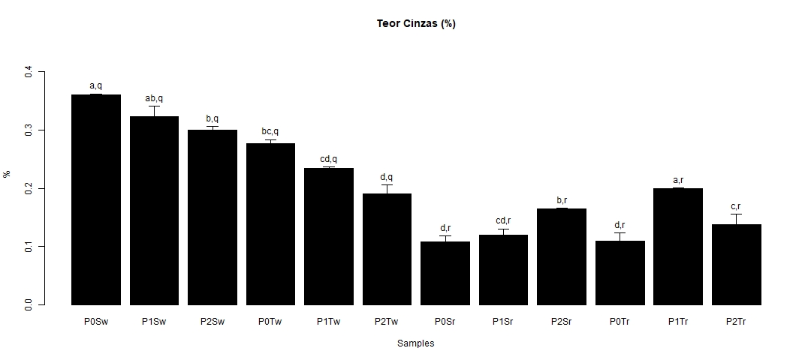
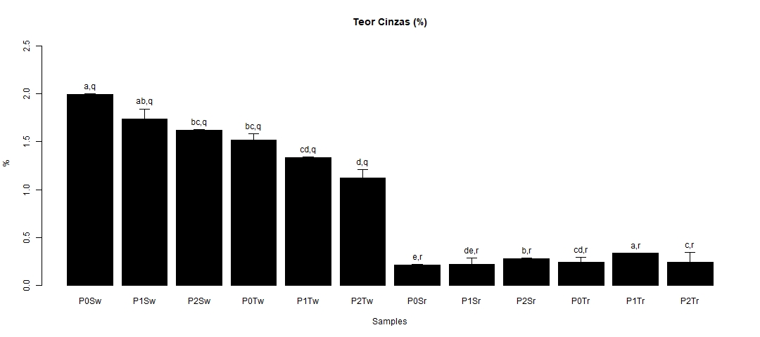
Results and Discussion
a)
b)
In a nutshell, when considering the different samples (whether from different minerals, types of flours and treatments for both fertilizers) we may say that significant differences were observed. The macro minerals present values in which K has the higher values, followed by S and, at last, Ca. For all the minerals the refined wheat flour showed lower values than whole wheat flour, irrespective of the fertilizer applied. It is verified that the P0Sw sample is about ninefold larger than the P0Sr sample for K. Relatively to the whole wheat flour, for both fertilizers, in the macro minerals the values diminish from the left to the right in the figures, revealing that the fertilizer Tecnifol Zinc presents lower values than ZnSO₄. In other words, the greater amount of fertilizer applied, the bigger the decrease concerning the macro element, for both fertilizers.

Slide 6
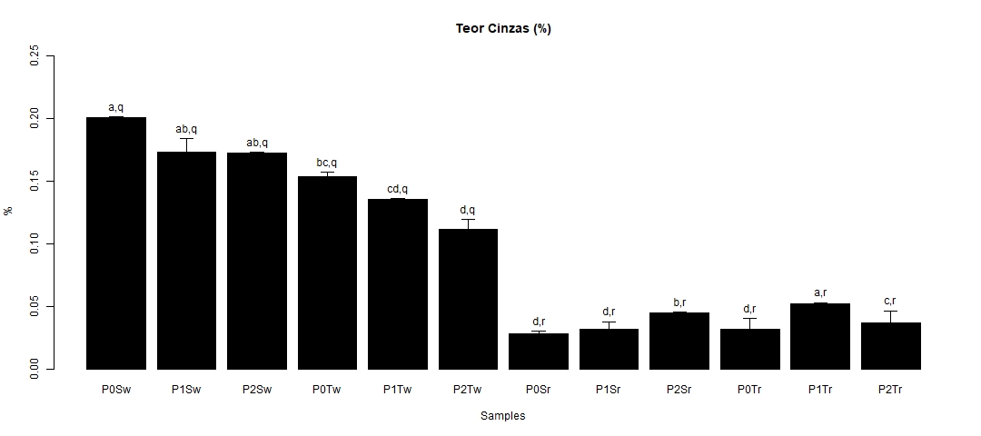
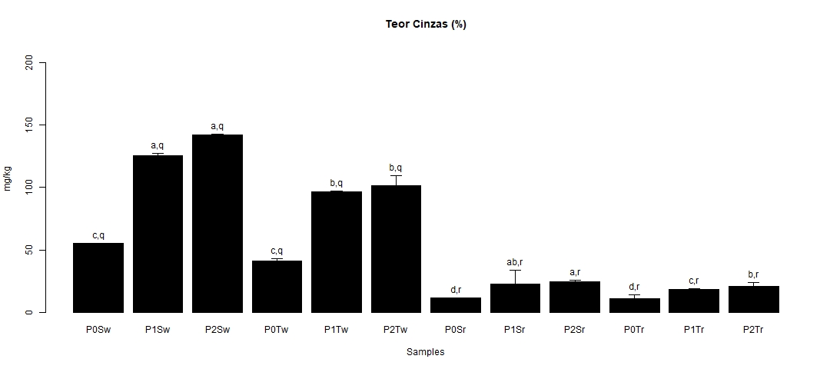
Results and Discussion
c)
d)
Considering Zn, when applying both fertilizers, it is observed that as the concentration of applied fertilizer increases, the value of Zn in whole flour (as well as in refined flour) also increases. Relatively to the refined flour, just for ZnSO₄ fertilizer, the values of the macro minerals increase when applying higher concentrations of the fertilizer. What is more, for the same type of flour, when applying Tecnifol Zinc, the value of the macro minerals shows that the values rise between the control and the intermediate concentration of fertilizer and then drops from the intermediate concentration to the highest concentration (nevertheless, the values of the upper concentration are higher than the control).

Slide 7
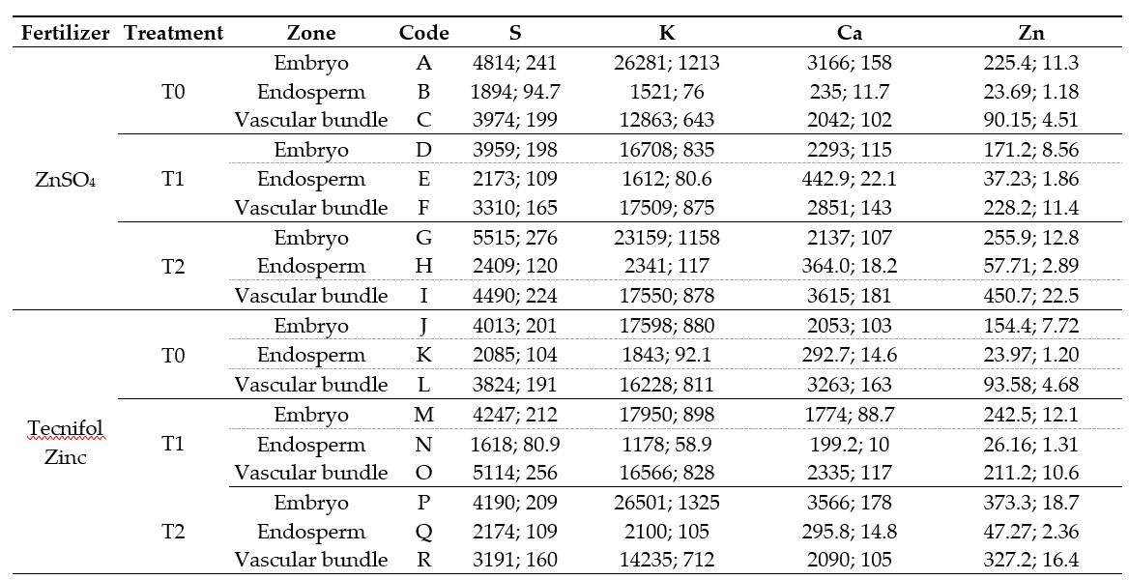
Results and Discussion

Slide 8
Results and Discussion
On the whole, when compared to the other zones of the grain, there is a greater amount of the minerals S (except for the sample O), K (but the sample F) and Zn (apart from the samples F and I) in the embryo (table 1). However, Ca is predominant in the vascular bundle, excluding the samples A and P. Regarding the predominance of each of the minerals in each of the zones, it appears that for the embryo and for the vascular bundle there is a lower prevalence of Zn, followed by Ca, S and, finally, K. When comparing the same concentration of the two different fertilizers, from the same zone of the grain, it appears that ZnSO₄ presented higher values than Tecnifol Zinc for the four minerals for T0 - embryo, T1 - endosperm, T1 - vascular bundle and T2 - vascular bundle and presented lower values than Tecnifol Zinc for the four minerals for T1 – embryo. Moreover, ZnSO₄ revealed lower values than Tecnifol Zinc for T2 – embryo (except S), T0 – vascular bundle (not including S), T0 – endosperm (only for S, K and Zn). Finally, Tecnifol Zinc showed lower values than ZnSO₄ for T2 – endosperm, for the minerals K, Ca and Zn. Regarding the comparison between the different concentrations of fertilizers (but for the same fertilizer), for the same mineral in the same grain zone, a relation was found: T0 < T1 < T2 (for ZnSO₄, for the minerals S (endosperm), K (endosperm and vascular bundle), Ca (vascular bundle) and Zn (endosperm and vascular bundle); for Tecnifol Zinc, for the minerals K (embryo) and Zn); T0 < T2 < T1 (for ZnSO₄, only the mineral Ca (endosperm); for Tecnifol Zinc, for the mineral S (embryo); T1 < T0 < T2 (for ZnSO₄, for the minerals S (embryo and vascular bundle) and Zn (embryo); for Tecnifol Zinc, for the minerals S (endosperm), K (endosperm), Ca (embryo and endosperm) and Zn); T1 < T2 < T0 (only the embryo, regarding the mineral K, when applying ZnSO₄); T2 < T0 < T1 (for Tecnifol Zinc, for the mineral S (vascular bundle)); T2 < T1 < T0 (for ZnSO₄, for the mineral Ca (embryo); for Tecnifol Zinc, for the mineral Ca (vascular bundle)).

Slide 9
Results and Discussion
The discrepancy between the amount of the same mineral for whole and refined wheat flours, regardless of the fertilizer applied, in which the whole flour presented higher values, is related to the different industrial processing of the flours. In this way, the refined flour is obtained by removing the outermost zones of the grain, where the minerals are more concentrated in, being in line with the data obtained by the quantification of the grains [12]. As a result, refined wheat flours are products less suitable to a healthier diet. According to some studies focused on bread wheat biofortified with ZnSO₄, S, K, Ca and Zn are preferably located in the embryo (S) and the vascular bundle (K, Ca, Zn) [13]. However, when comparing 11 different bread wheat varieties, in 7 of them Zn was more accumulated in the embryo, followed by the vascular bundle [14]. This finding agrees with the data obtained for S and Zn, which are preferably located in the embryo, and for Ca (predominant in the vascular bundle). Our data of the predominance of K, S, Ca and Zn in the different flours and in the grains (despite of the zone) is supported by the studies of [13]. In general, when comparing both fertilizers Tecnifol Zinc was the least effective. Foliar spraying of both fertilizers enhanced the Zn content in the flours according to [15]. The decreasing trend of S and Ca minerals with the increasing Zn concentration agrees with the literature [16].

Slide 10
Conclusions
Considering flours, macrominerals present values in which K has the highest values, followed by S and, finally, Ca. Regardless of the fertilizer applied, the refined wheat flour showed lower values than whole wheat flour, for all the minerals. Relatively to the whole wheat flour, for both fertilizers, in the macrominerals, the values diminished as the fertilizer concentrations increased. The values of whole wheat flour proved that ZnSO₄ was the fertilizer presenting higher values when compared to Tecnifol Zinc. Zinc showed that as the concentration of the applied fertilizer increases, the value of this mineral in the flours also increases, when applying both fertilizers. In general, the minerals S, K and Zn are predominant in the embryo, nevertheless, Ca is predominant in the vascular bundle. Regarding the predominance of each mineral in each zone, and, in descending order, it appears that for the three zones, there is a lower prevalence of Zn, Ca, S and, finally, K (only for embryo and vascular bundle). When comparing the same concentration of the two different fertilizers, focusing on the same section of the grain, it appears that ZnSO₄ presented higher values than Tecnifol Zinc for the four minerals, by and large. To sum up, as the different minerals tend to accumulate in the embryo and vascular bundle of the grain and the whole bread wheat flour includes these zones, this flour constitutes a healthier choice for the consumers.

Slide 11
Acknowledgments
The authors thanks to Instituto Politécnico de Beja and Associação de Agricultores do Baixo Alentejo for technical assistance and for facilities regarding the Triticum aestivum L. field. More-over, the authors thanks to the research center (GeoBioTec) UIDB/04035/2020.

