Slide 1
How to improve customer loyalty in the health industry?
Reporter: Ka Ho Kwok
Department of Sport Management, National Taiwan University of Sport

Slide 2
Outline
Abstract
Introduction
Materials and Methods
Results
Conclusion
Limitation

Slide 3
Abstract
The purpose of this research is to verify the relationship between service quality and customer loyalty in the Taichung fitness club.
The conclusions of this study indicate that although service quality has a positive correlation with customer loyalty, responsiveness and empathy are important factors to improve customer loyalty in fitness clubs.

Slide 4
Introduction
Reichheld and Sasser (1990)pointed out that keeping 5% of old customers can increase profits by 25% to 75%
The practice of excellent service quality has been proven that customer satisfaction will significantly lead to customer loyalty(Caruana, 2000).

Slide 5
Introduction
Previous studies examine customers behaviours and satisfaction in fitness services.
The relationship between service quality and customer loyalty was under-explored, especially in Taichung.

Slide 6
Materials and Methods
Respondents
18-50 years of age
At least 3 months of gym membership
Training 1-7 times a week

Slide 7
Materials and Methods
Online questionnaires
Hard-copy questionnaires
96 questionnaires were distributed
94 valid questionnaires were collected
Effective response rate was 97%

Slide 8
Results

Slide 10
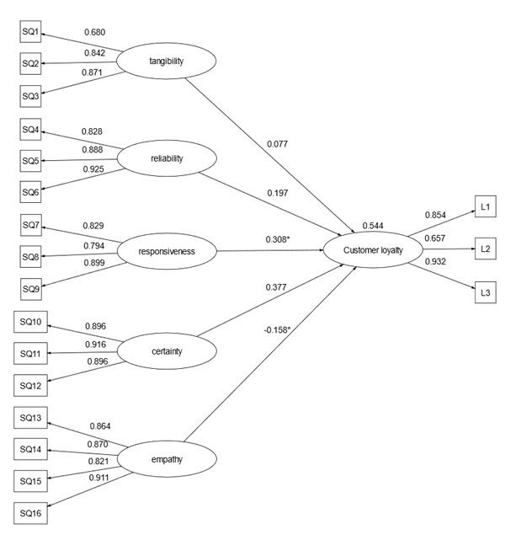

Slide 11
Conclusion
The characteristics of service quality in responsiveness would positively affect customer loyalty.
The characteristics of service quality in empathy would positively affect customer loyalty.
The managerial implication of this research is that fitness clubs need to provide effective services, pay more attention to customer needs and respond to customer enquiries quickly.

Slide 12
Limitation
This study suffers the limitation that the backgrounds of respondents are insufficient of diversity. Further research should attempt to replicate the findings in a larger sample group.

Slide 13
Thank you for your attention.

