Slide 1
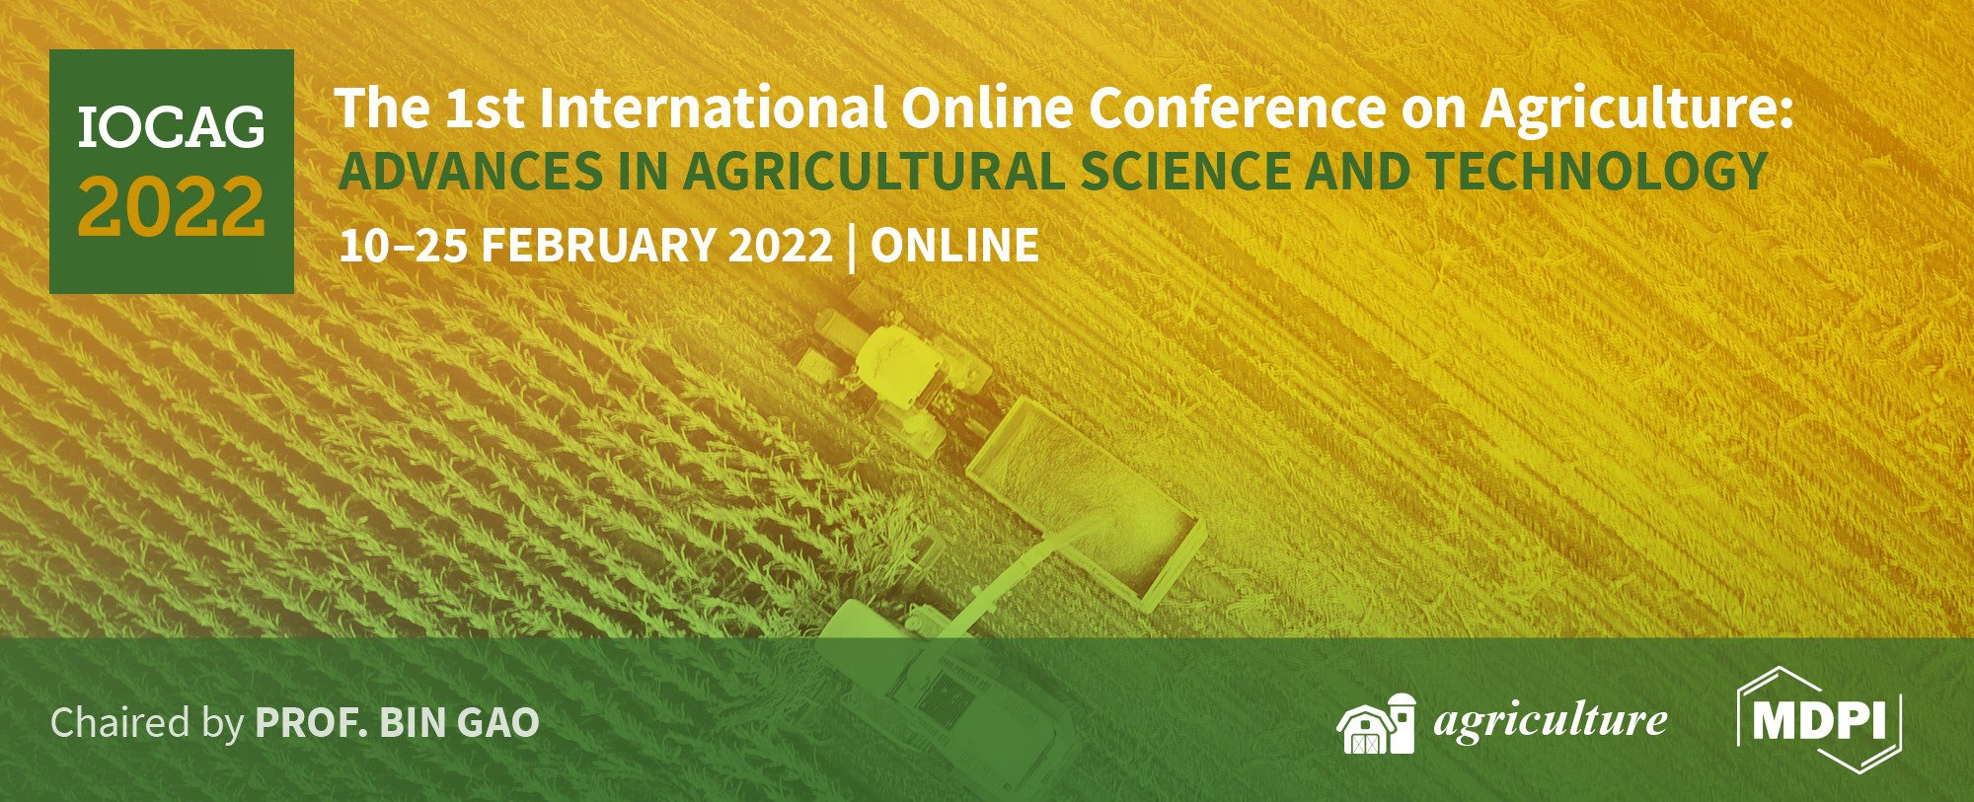
Social Network Analysis on Agricultural International Trade: A Study on Soybean, Soybean Cake and Maize Exports
Daniel Laurentino de Jesus Xavier
João Gilberto Mendes dos Reis

Slide 2
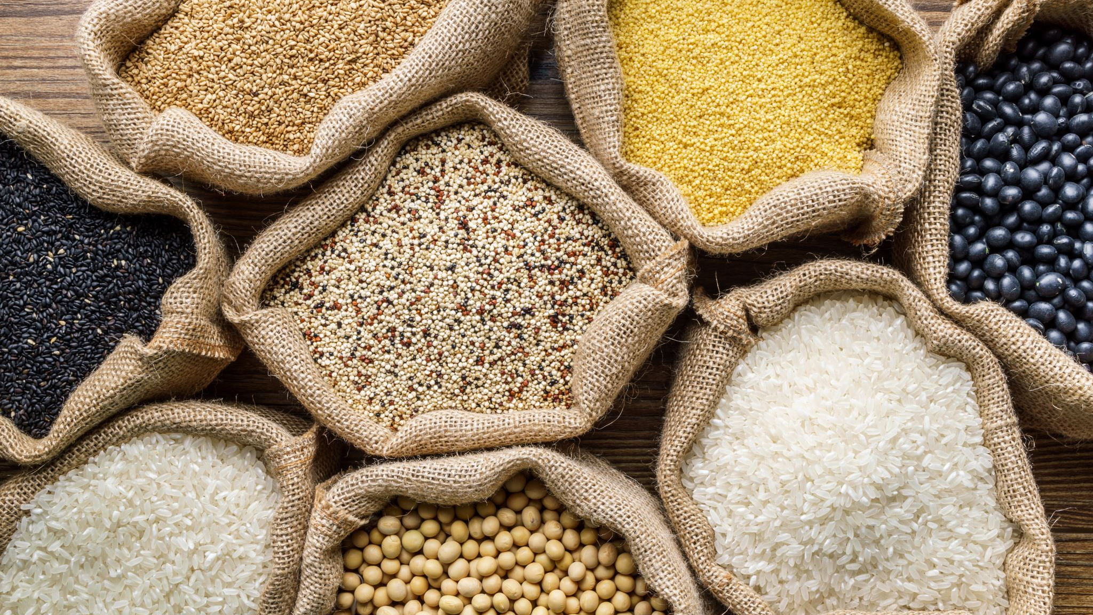
Introduction
World agribusiness trade is a important sector on global economy, reaching US$ 1.4 trillion in 2019.[1].
Main agricultural products traded in 2019 were maize, wheat, soybean, soybean cake and palm oil. (almost 40% of all agribusiness exports).[1].
Complex systems, such as agribusiness exports are difficult to fully understand, so it is important to consider different approaches and tools.
Few studies used Social Network Analysis (SNA) in the trade of agricultural products, and none related to global grain trade which reinforce the importance of this study.
1. Food and Agriculture Organization of the United Nations. Detailed trade matrix. https: //www.fao.org/faostat/en/#data/TM, accessed on 2021-11-06.

Slide 3
Methodology
Data of soybean, soybean cake, and maize exports in the last year available (2019) were extracted from Food and Agriculture Organization of the United Nations (FAO) database.
It was decided to stablish a minimum value of 1,000 metric tones of trade and autonomous regions such as Taiwan, Hong Kong, and Macau were sum with mainland China.
We set a quadratic matrix with exporters in rows and importers in columns and the amount of metric tons traded on intersections.
Data was loaded into the UCINET 6.732 software from Analytic Technologies [6] and transferred the data to NetDRAW 2.168 application [7].
On the application, we used the Node Centrality Measures, setting node size by degree. Also applied K-core measure and thickness of connections.
6. Borgatti, S.P.; Everett, M.G.; Freeman, L.C. Ucinet 6 for Windows: Software for Social Network Analysis; Analytic Technologies: Harvard, MA, 2002.
7. Borgatti, S.P.; Everett, M.G.; Freeman, L.C. Netdraw Network Visualization; Analytic Technologies: Harvard, MA, 2002.

Slide 4
Main results Soybean
The soybean market is highly concentrated. Brazil, the US, Argentina, and Paraguay represent more than 90% of exports, while only 12 countries represent 90% of imports.
Brazil and the US compete directly on all importers.
China is the biggest buyer representing 67% of the market, with a closer relationship with Brazil, being the main importer of Brazilian products.

Slide 5
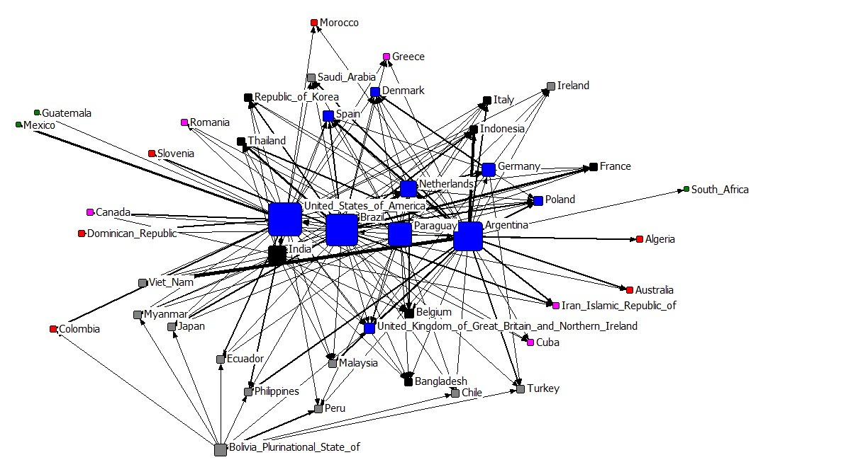
Main results Soybean Cake
Soybean cake shows the market with a larger number of importers. Argentina, Brazil, and the US are the main exporters.
Brazil and Argentina compete more in Europe and Asia countries, while the US mostly supplies its neighbours, Mexico and Canada;

Slide 6
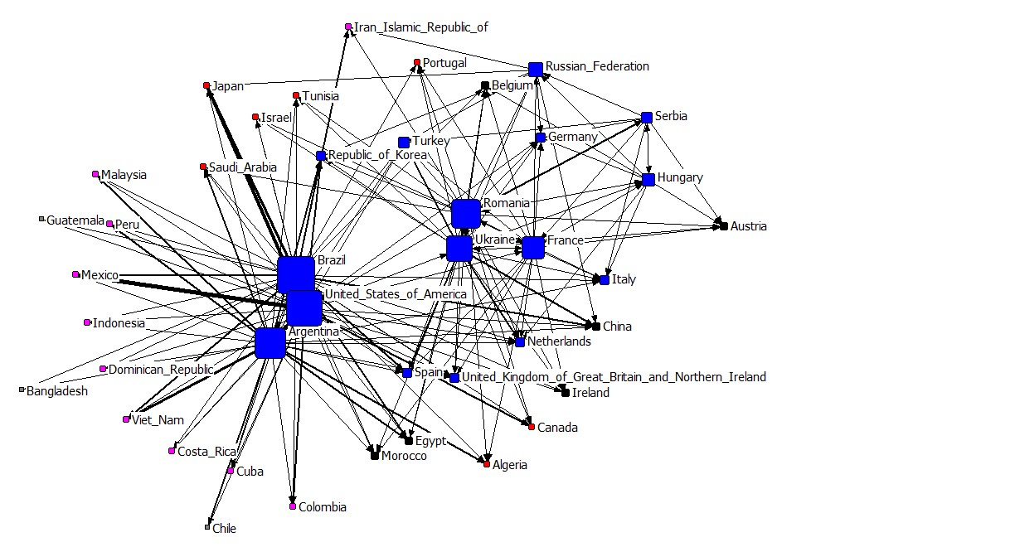
Main results Maize
Maize demonstrated the same main exporter players that soybean cake: Brazil, Argentina and the US.
Brazil and Argentina have a more diverse market over the US (33, 28, and 17 nodes, respectively).
Brazil and Argentina compete mainly in European and Asian markets, while the US mostly supplies its neighbours, except for Japan.

Slide 7
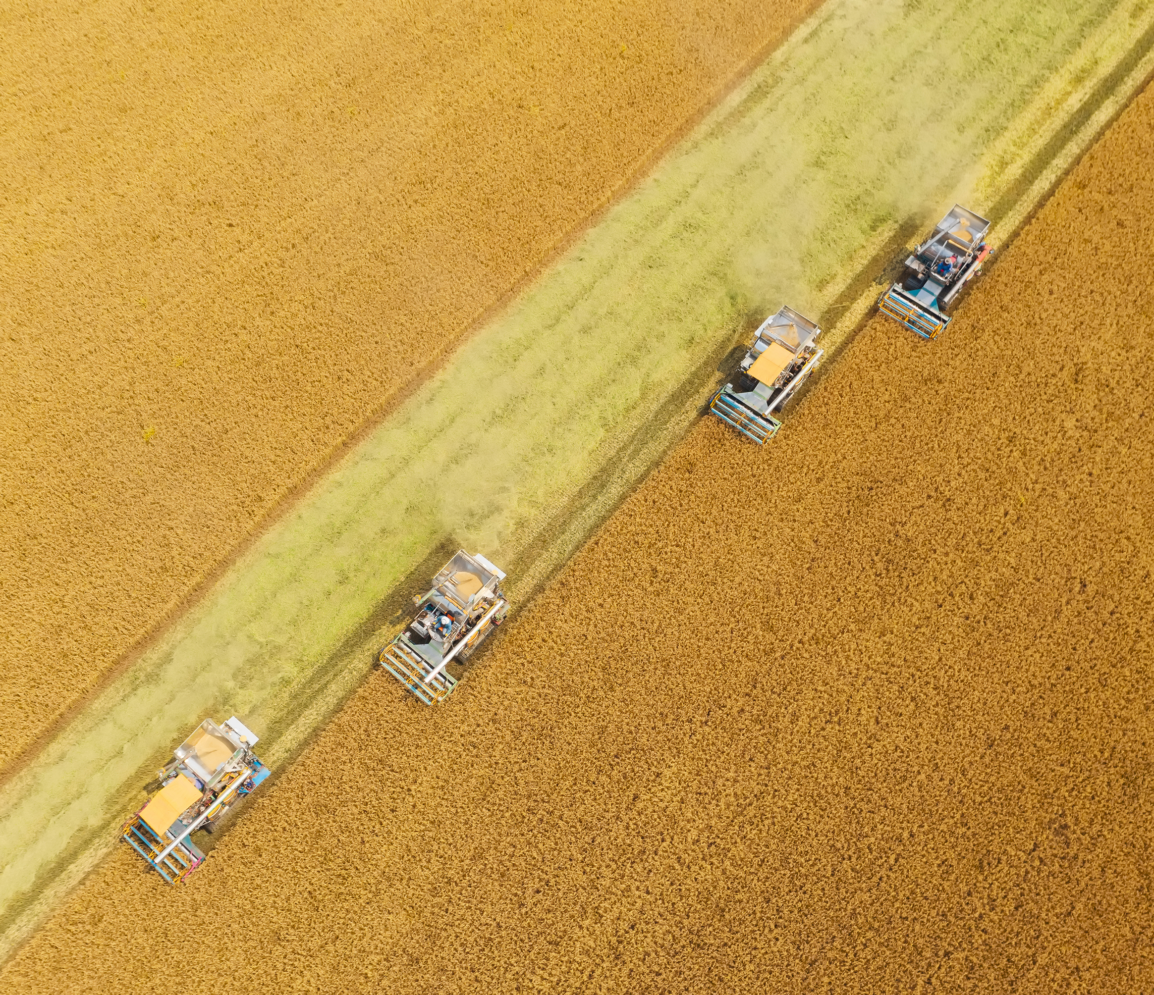
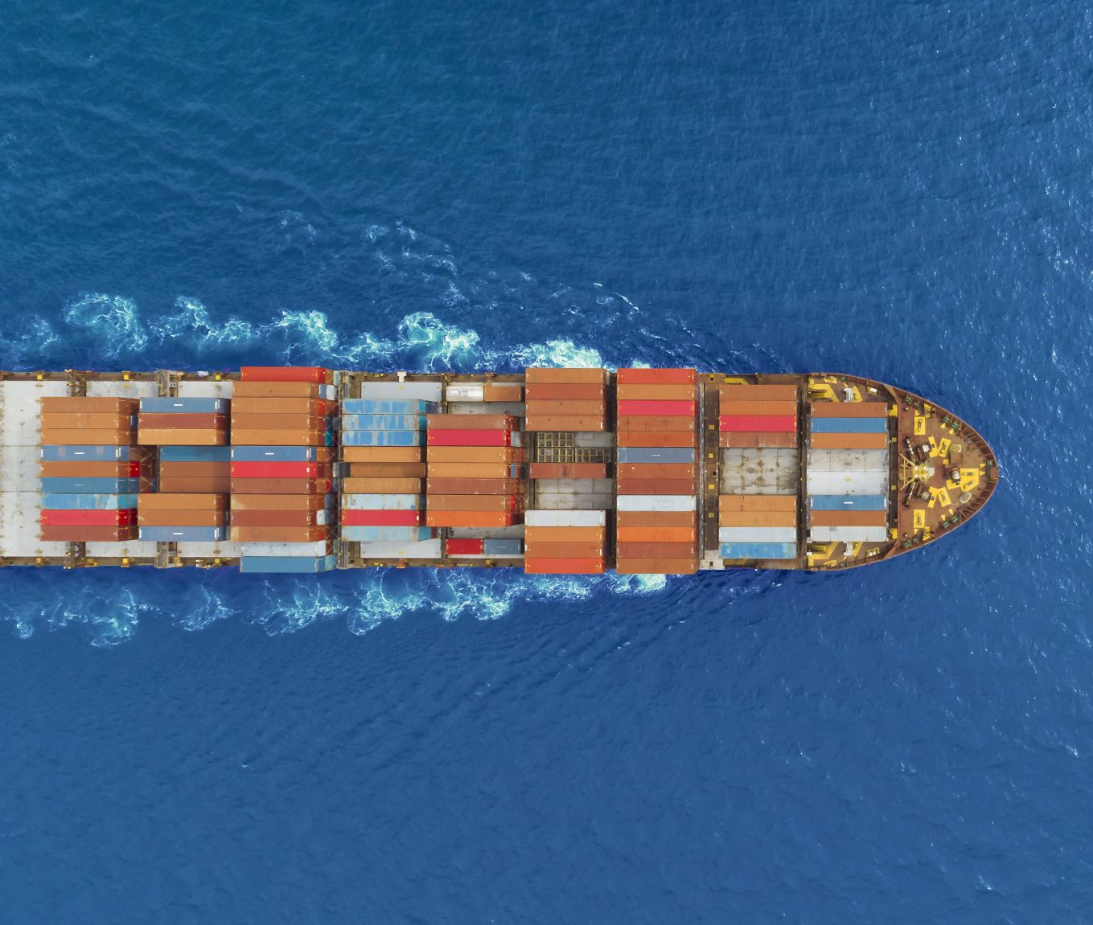
Conclusions
Social network analysis can be a relevant tool to analyze the global commerce of agricultural products, due to its capability of showing graphically a great amount of data.
The method allows observing the connections between countries that play a role on the trade, along with the importance of each player and the trade volume, among other insights.
We suggest for further studies the use of the same method on different trade markets, searching for similar insights. Another approach could be the use of different measures and tools, along with the comparison of results across time, using the same method on different years..

Slide 8
Acknowledgements
This study was financed in part by the Coordination of Improvement of Personal Higher Education - Brazil (CAPES) .
References
1. Food and Agriculture Organization of the United Nations. Detailed trade matrix. https: //www.fao.org/faostat/en/#data/TM, accessed on 2021-11-06.
6. Borgatti, S.P.; Everett, M.G.; Freeman, L.C. Ucinet 6 for Windows: Software for Social Network Analysis; Analytic Technologies: Harvard, MA, 2002.
7. Borgatti, S.P.; Everett, M.G.; Freeman, L.C. Netdraw Network Visualization; Analytic Technologies: Harvard, MA, 2002.

Slide 9
Contacts: Daniel Laurentino de Jesus Xavier
Doctorate student - RESUP Group, Postgraduate Program in Production Engineering, Universidade Paulista – UNIP
Correspondence: danielxavier78@gmail.com
Tel.: +551155864145

