Slide 1


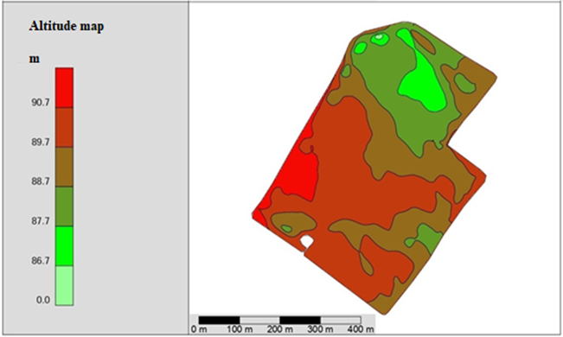
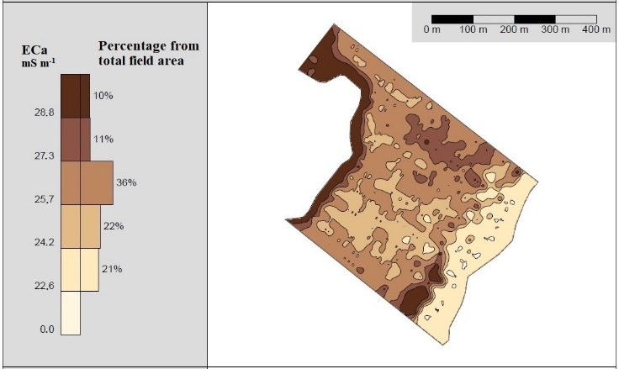
INTRODUCTION
PRECISION VARIABLE RATE SEEDING EFFECTIVENESS FOR RISKS MANAGEMENT IN CROP PRODUCTION
Egidijus Šarauskis, Vilma Naujokienė,
Marius Kazlauskas, Indrė Bručienė,
Kęstutis Romaneckas, Dainius Steponavičius,
^{Algirdas Jasinskas}
METHODS
Variable rate technologies are tools that allow farmers to apply fertilizer, water, chemicals and seeds in varying amount across a field. The main benefits of variable rate seeding (VRS) smart solutions are better use of soil productivity, cost reduction and more efficient use of resources, and reduction of environmental pollution by optimizing the amount of materials. Field position, elevation, soil structure, electrical properties and crop yield maps are used to determine the control zones for different soil productivity and seeding rates in the field [1,2,3]. One of the most important tasks for the successful application of precision agriculture technology is the assignment of optimal rates of fertilizers, limes, or seeding rates to individual field MZs [4,5].
Determining the optimal seeding rate for each field remains a challenge. The definition of specific control zones may be possible using different soil properties [6], but it may take time to establish consistent models under different crop rotations or tillage regimes [7-9].
Mapping systems are not suitable for large variations in soil conditions that are highly dependent on weather conditions. Therefore, future advanced farming requires systems that overcome the limitations of a map-based approach. The main aim of this study was to provide a synthesis of recent advances on variable rate seeding methods and critically analyse their suitability in view of challenges posed under field conditions
Scientific information was performed using scientific databases and search portals by identifying different analyses, science researches and evaluations of VRS methodologies, their impact, and economic benefits to practitioners depending on the main parameters of the soil, environment. The scientific analysis was structured first by identifying the methodology of application of different techniques and presenting methodologies of use, and in the following sections discussing and abstracting the results obtained by applying different methods, depending on the variation of the main parameters of the soil and environment. To be clear what needs to be applied to achieve certain soil, plant properties, yield improvements and financial benefits.
Using the Open Source Geographic Information System (QGIS) program, considering similar site-specific soil properties, plots were created, with an average area of 3 ha each. To determine differences of soil properties in the field and to create an accurate soil sampling plan and variable seeding rate map, soil was scanned using an EM38-MK2 electrical conductivity scanner (Geonics Ltd). Measurements of soil electrical conductivity (mS·m-1) from 0 to 1.5 m depth were performed at a speed of 10–15 km·h-1 driving on technological tracks every 24 m by towing the device EM38-MK2 mounted on plastic sleds.
The conclusions provided suggestions for practitioners, highlighting the most optimal options that had yielded the best results for the improvement of the environment and production.
RESULTS
Results identified that one of the most usage is creation a variable-rate seeding plan. At first is analysis of the apparent electrical conductivity (ECa), which, along with other soil properties, leads to changes in soil structure. VRS could adapt the appropriate seeding rate or seed rate adjustment for each field zone, based on site-specific data layers such as soil texture, ECa, pH, yield maps. As well as remotely detected images or other data that can identify yield-limiting factors. After assessing the factors of soil and environmental variability, separate field seeding zones are created, to which different seeding rates are assigned when creating prescription maps. VRS can generate higher economic returns under higher field variability. Figure 1 shows a map of the field terrain, representing the difference in altitude at different locations in the field. Soil property maps are probably the most important datasets used for the implementation of PA technologies. Soil organic matter is another very important soil property, which has a significant effect on crop productivity. Organic matter (OM) is one of the main components of soil structure and porosity, influencing soil water retention capacity, biodiversity and activity of soil organisms, and the availability of plant nutrients, especially nitrogen [10]. The amounts of OM can vary significantly in different field areas, which is perfectly demonstrated by the field study performed in Lithuania with Veris MSP 3150 and the OM map presented in Figure 2. Experimental studies were carried out in Lithuania, when the ECa map (Figure 3) was prepared after estimating the differences in soil granulometric composition, according to which the winter wheat seeding map of the study field was created. For winter wheat sowing, an average seeding rate of 180 kg ha⁻¹, typical for this region [11], was chosen. Then variable-rate seeding was applied to each of the 5 soil management zones (MZ), varying from the average rate between the zones by about 20 %, from a minimum of 146 kg ha ⁻¹ to a maximum of 214 kg ha ⁻¹. Analysing the influence of VRS on winter wheat production indicators, it was found that the unevenness of the field soil had a significant impact on the quality of seed placement, germination, and plant tillering [12]. Soil ECa maps can be made for a variety of soil depths, from 5 to 150 cm. Figure 4 shows two ECa field maps drawn at the depths of 30 and 90 cm using a Veris MSP 3150 machine. These images illustrate that the apparent electrical conductivity was higher over the entire field as the measurement depth was increased, but the differences between the zones remained similar. Chemical and physical soil properties and topographical features are highly interrelated. As one soil characteristic changes, it can influence changes in other characteristics [13]. Site-specific field data, such as digital soil maps, aerial photographs, apparent electrical conductivity maps, or previous-year yield maps, are the basis for calculating the optimal site-specific seeding rate. In this way, VRS application maps are created, showing differences in seeding rate due to different conditions related to location, cultivation system and short-term parameters (Figure 5). This means that the generated VRS maps describe the situation only at a certain point in time. Prepared VRS prescription maps are recognized by most seed drills.
Figure 1. Elevation map representing relief differences in the field (colored parameters variation internal maps were created by the authors using Veris MSP 3150).
Figure 2. Map of soil organic matter differences (colored parameter variation internal maps were created by the authors using Veris MSP 3150 and as a background layer was used ORT10LT - digital raster orthophoto map of the territory of the Republic of Lithuania M 1: 10000 (compiled 2012-2013) in the precision farming software AgLeader SMS Advanced).
Figure 3. ECa map representing differences of the soil properties in the field (colored parameter variation were created by the authors using the EM38-MK2 device) [22].
Figure 4. ECa maps of soil surface structure differences at the depth of 30 cm (left-hand-side) and 90 cm (right-hand-side) (colored parameter variation internal maps were created by the authors using Veris MSP 3150 and as a background layer was used ORT10LT - digital raster orthophoto map of the territory of the Republic of Lithuania M 1: 10000 (compiled 2012-2013) in the precision farming software AgLeader SMS Advanced).
Figure 5. Winter wheat VRS map (colored parameter variation were created by the authors using SMS software with the data received from ECa map).
Summarizing, the application of VRS pays off when the field variability is more than 10%. According to the German researchers, it is effective to apply VRS when the apparent electrical conductivity changes in the fields on average every 25 m, and in NPK, the pH changes on average every 50 m. Sowing at a variable rate is worth 10%. Variability in apparent electrical conductivity, organic matter, terrain, and therefore plant density. It is therefore useful to apply a variable rate of nitrogen. The payback of VRS is such that if you earn an average of 100 Eur per ha, then working on 400 ha will pay off in 1 year. Thus, the conclusion is that the most efficient and most profitable to apply VRS when the farm size is on average from 150 ha. However, this also depends on the crops grown (possibly smaller) as well as on the satellite maps used, for example. Due to meteorological conditions, if satellite maps are used, it is often cloudy in Lithuania that can cause problems. Therefore, it is better to apply sensory remote and proximal close to the ground, which are effective in all meteorological conditions. Increased use of non-contact apparent electrical conductivity assessment devices due to the unnecessary need for certain conditions. The key conclusion is that the higher the field variability (altitudes, terrain, sand, etc.), the higher the VRS efficiency and payback. It is in Lithuania that the variability of most fields is due to the current cultural, political, historical, and climatic situation, so VRS pays off and is effective everywhere
CONCLUSIONS
REFERENCES
Summarizing the conclusions, it can be stated that the site-specific seeding method, where a variable seeding rate is applied to each field area, allows optimizing the crop density in the hope of the best agronomic and economic effect. Various proximal and remote sensor systems, contact and contactless equipment, mapping and VRS modeling technologies are currently used to determine soil and crop variability. VRS depends on a good understanding of field characteristics, seeding equipment capabilities, planned yields, soil productivity and the interaction of machine technology with the environment. Predicting payback over a period of time, it can be concluded that VRS is effective when the farm size starts on average from 150 ha. In future studies, it is particularly important to test, evaluate and put into practice the latest methodologies on farms, then to make complex assessments of changes in sensor, soil, plant and environmental parameters and proposed methods, and to find the best solution and optimal methods. It was identified that precision agricultural technologies allow agricultural producers to improve the management of specific crop resources in crop production. Advances in seeding technology for the implementation of VRS make it possible to make better use of soil variability. VRS allows the population to be adapted to the variability of the field and helps to ensure precision production in the field in order to reduce errors in the seeding process. Another important aspect is that interest in VRS around the world is growing due to the interaction of these technologies with current seed prices. An optimal plant population can improve crop yields while maximizing farm profits. Site-specific seeding (SSS) method, where a variable seeding rate is applied to each field area separately, makes it possible to optimize crop density in anticipation of the best agronomic and economic effect. Various proximal and remote sensor systems, contact and contactless equipment, mapping and VRS modelling technologies are currently used to determine soil and crop variability. The VRS depends on a good knowledge of the field characteristics, the capabilities of the seeding equipment, the planned crop yield, soil productivity and an understanding of the interaction of machine technology with the environment. Remote and proximal sensors, mounted on tractors or off-road vehicles, help in creating field maps of variable properties. The accuracy of these maps and the good assignment of field soil management zones are the success of VRS.
The prescription map tells the user how much seed to use, depending on the location of the seeding equipment in the field. Future research needs to answer the question of which VRS method is most suitable for different regions, as there are two technological developments in seeding with VRS. First, it is better to distribute more seeds in high-productivity soils and less in low-productivity areas. Second, it is better to use VRS in reverse, i.e. distribute more seeds in poor soils and less in high-productivity soils. There is still a lack of knowledge as to which method is more suitable for the most popular plants in the Baltic region.
Erickson, B.; Widmar, D.A. Precision agricultural services dealership survey results. Purdue University Department of Agriculture Economics/Department of Agronomy, West Lafayette, 2015, pp. 37. Available online: http://agribusiness.purdue.edu/files/resources/2015-crop-lifepurdue-precision-dealer-survey.pdf (accessed 7 February 2021).
Fulton, J. Variable-rate seeding systems for precision agriculture. In Precision agriculture for sustainability. Stafford J., Ed.; Burleigh Dodds Science Publishing Limited, Silsoe Solutions, UK, 2019; pp. 28–297.
Hoeft, R.G.; Aldrich, S.R; Nafziger, E.D.; Johnson, R.R. Modern Corn and Soybean Production, 1st Ed. MCSP Publications, Savoy, IL, 2000.
Shanahan, J.F.; Doerge, T.A.; Johnson, J.J.; Vigil, M.F. Feasibility of site-specific management of corn hybrids and plant densities in the great plains. Precis. Agric. 2004, 5(3), 207–225.
Pedersen, S.M.; Lind, K.M. Precision Agriculture: Technology and Economic Perspectives. Springer International Publishing, 2017, pp. 276.
Licht, M.A.; Lenssen, A.W.; Elmore, R.W. Corn (Zea mays L.) seeding rate optimization in Iowa, USA. Precis. Agric. 2017, 18(4), 452–469.
Bunselmeyer, H.A.; Lauer J.G. Using corn and soybean yield history to predict subfield yield response. Agron. J. 2015, 107, 558–562.
Smidt, E.R.; Conley, S.P.; Zhu, J.; Arriaga, F.J. Identifying field attributes that predict soybean yield using random forest analysis. Agron. J. 2016, 108, 637–646.
Lindsey, A. J.; Thomison, P. R.; Nafziger, E. D. Modeling the Effect of Varied and Fixed Seeding Rates at a Small‐Plot Scale, Agron. J., 2018, 110(6), 2456–2461.
Butzen, S.; Gunzenhauser, B.; Shanahan, J. Putting variable-rate seeding to work on your farm., Johnston: DuPont Pioneer, 2012.
Gaile, Z.; Ruza A.; Kreita, D.; Paura, L. Yield components and quality parameters of winter wheat depending on tillering coefficient. Agron. Res. 2017, 15(1), 79–93.
Kazlauskas, M.; Šarauskis, E.; Romaneckas, K.; Steponavičius, D.; Jasinskas, A.; Naujokienė, V.; Bručienė, I.; Žiogas, T.; Vaicekauskas, D.; Anušauskas, J.; Mouazen, A.M. Effect of variable rate seeding on winter wheat seedbed and germination parameters using soil apparent electrical conductivity. In Engineering for Rural Development: 20th international scientific conference, May 26–28, 2021: proceedings. Jelgava: Latvia University of Life Sciences and Technologies. 2021, Volume 20, pp. 1108–1113.
Wilson, J.P.; Gallant, J.C. Terrain Analysis: Principles and Applications. Wilson, J.P., Gallant, J.C., Eds.; John Wiley & Sons, Inc., NewYork, 2000.
This project has received funding from European Regional Development Fund (project No 01.2.2-LMT-K-718-03-0041) under grant agreement with the Research Council of Lithuania (LMTLT).
* Corresponding author: vilma.naujokiene@vdu.lt

