Slide 1






Application of NaCl-plant extracts to decrease the costs of microfiltration for winery wastewater treatment
Nuno Jorge^{1,2} *; Ana R. Teixeira²; Leonilde Marchão²; Piebiep Goufo³; Marco S. Lucas²; José A. Peres²
¹ Escuela Internacional de Doctorado (EIDO), Campus da Auga, Campus Universitário de Ourense, Universidade de Vigo, As Lagoas, 32004, Ourense, España
² Centro de Química de Vila Real (CQVR), Departamento de Química, Universidade de Trás-os-Montes e Alto Douro (UTAD), Quinta de Prados, 5001-801, Vila Real, Portugal
³ Centre for the Research and Technology of Agro-Environmental and Biological Sciences (CITAB)/Inov4Agro (Institute for Innovation, Capacity Building, and Sustainability of Agri-Food Production), University of Trás-os-Montes and Alto Douro (UTAD), 5000-801 Vila Real, Portugal
* njorge@uvigo.es
1st International Online Conference on Agriculture - Advances in Agricultural Science and Technology
Agricultural Water Management
10 – 25 February 2022

Slide 2
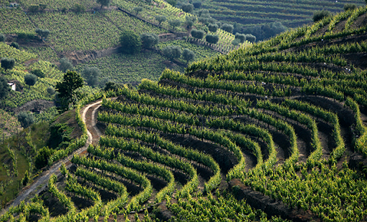
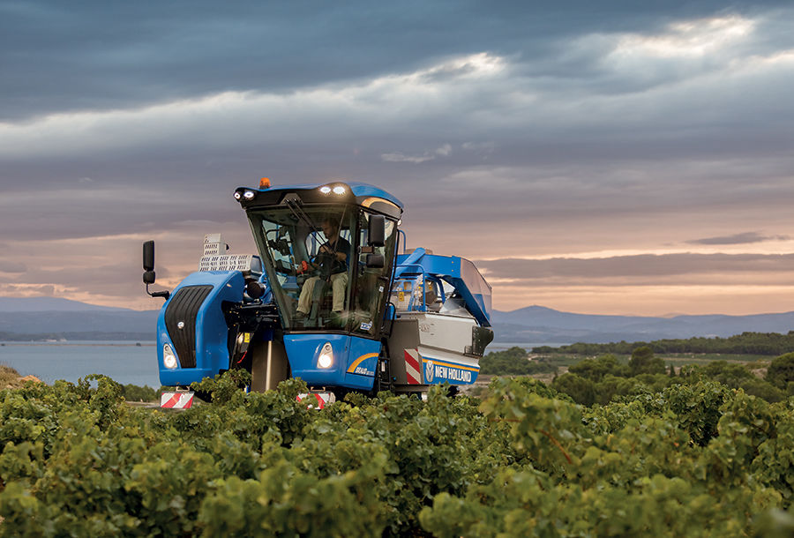
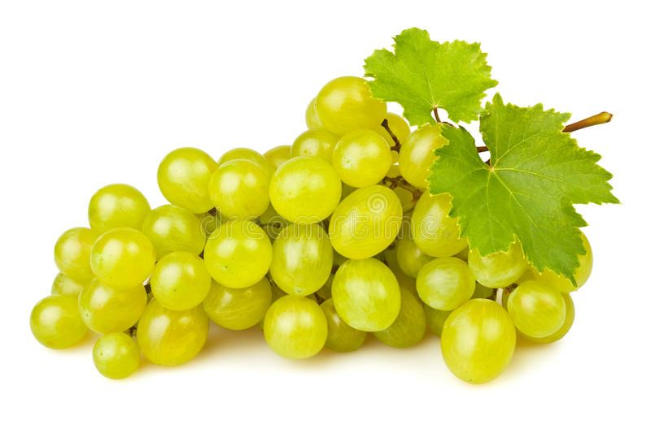
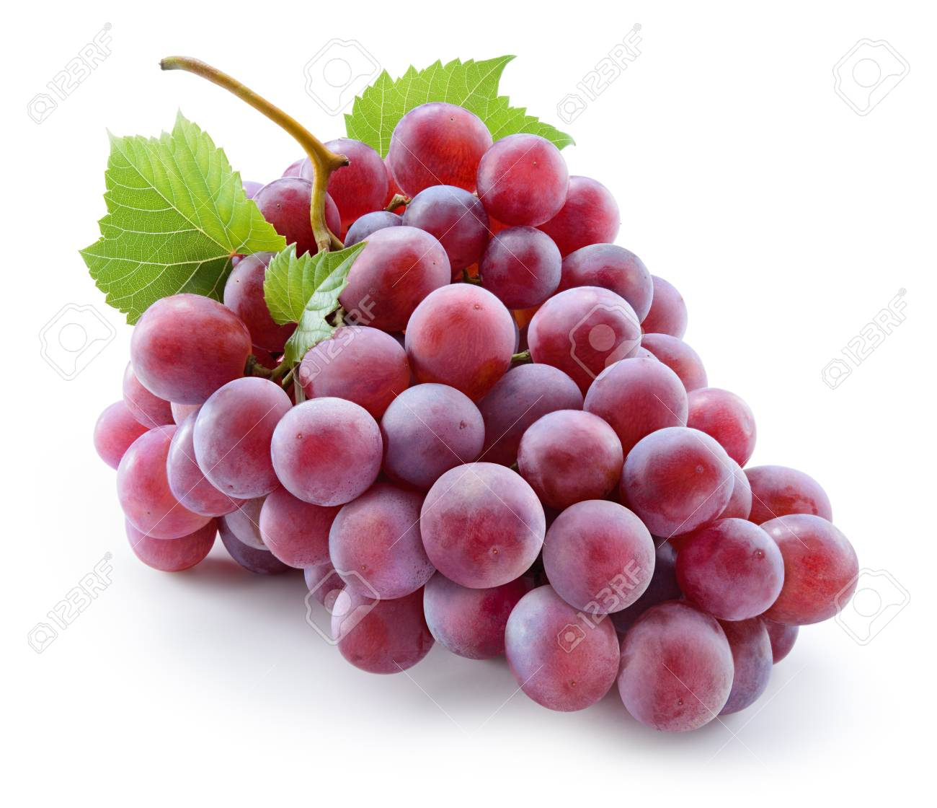
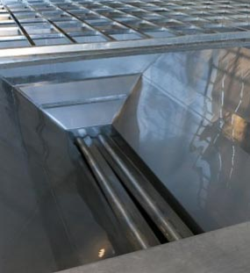
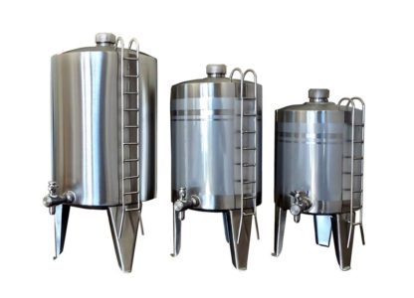
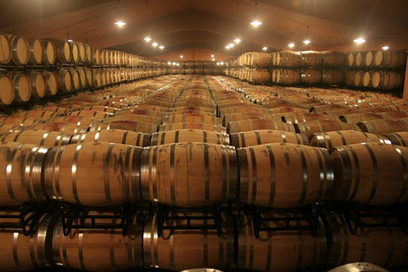
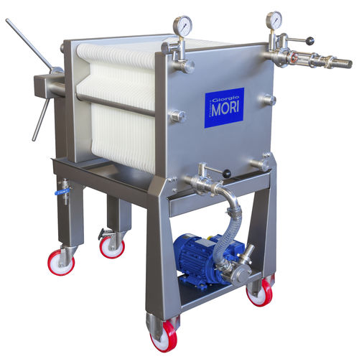
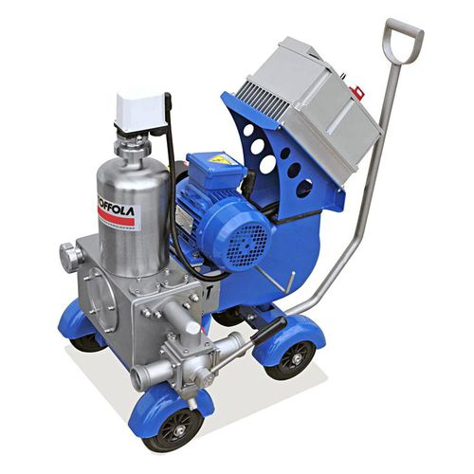
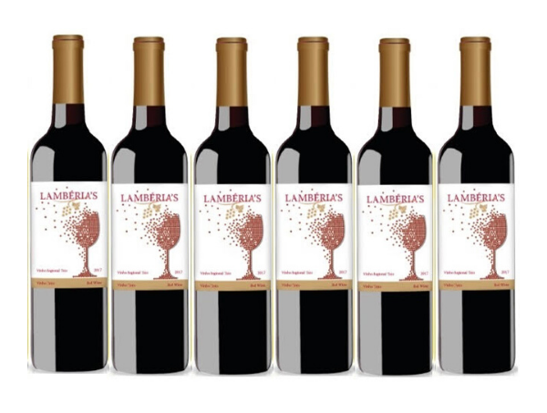
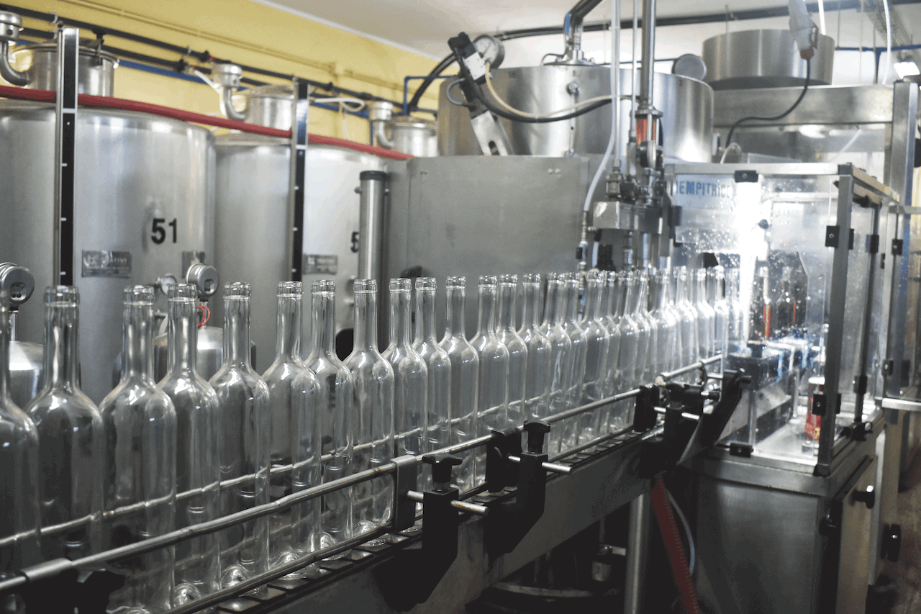
Introduction
Objectives
Material and methods
Results and discussion
Conclusions
In the vintage, the grapes are collected
In the grape reception, the grapes are selected and separated
In white wines the grapes are crushed and the must is fermented
In red wines, the grapes are marecerated and the must is fermented with the grapes
After must fermentation and wine stabilization, the wine is filtrated
Finally, the wine is bottled
Vintage
Grape reception
White grapes
Red grapes
Destemer/ Crucher
Tank Yeast add
Maceration
Must fermentation
Must fermentation
Rack
Rack
Malolactic fermentation
Rack
Finning operation
Wine stabilization
Filtration
Bottleling

Slide 3
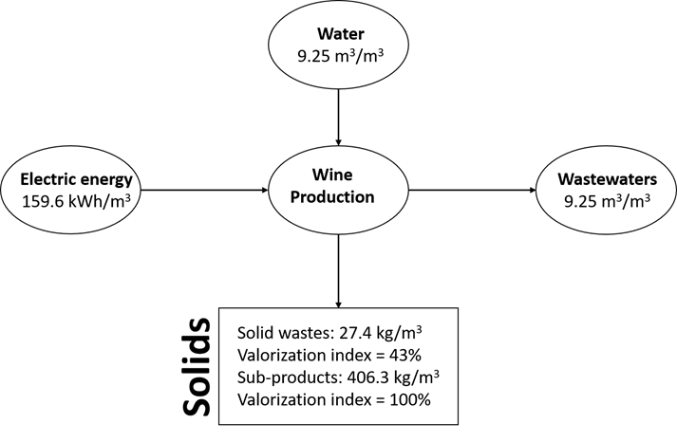
Introduction
Objectives
Material and methods
Results and discussion
Conclusions
Winery wastewater main characteristics
Fructose
Glucose
Winery wastewater
Soluble sugars
pH
Alcohols
Organic acids
BOD₅
High-molecular-weight compounds
COD
Tartaric acid
Lignin
Lactic acid
Tannins
Acetic acid
Polyphenols
Glycerol
Mass balance applied to ACPB winery representing specific values, i.e., values per cubic meter of produced wine. Losses of water by evaporation were neglected [1].
320 – 296 000 mg O₂ L⁻¹
Ethanol
[1] Brito, A. G., Peixoto, J., Oliveira, J. M., Oliveira, J. A., Costa, C., Nogueira, R., & Rodrigues, A. (2007). Brewery and winery wastewater treatment: some focal points of design and operation. In Utilization of by-products and treatment of waste in the food industry (pp. 109-131). Springer, Boston, MA.
3 - 4
125 – 130 000 mg O₂ L⁻¹

Slide 4
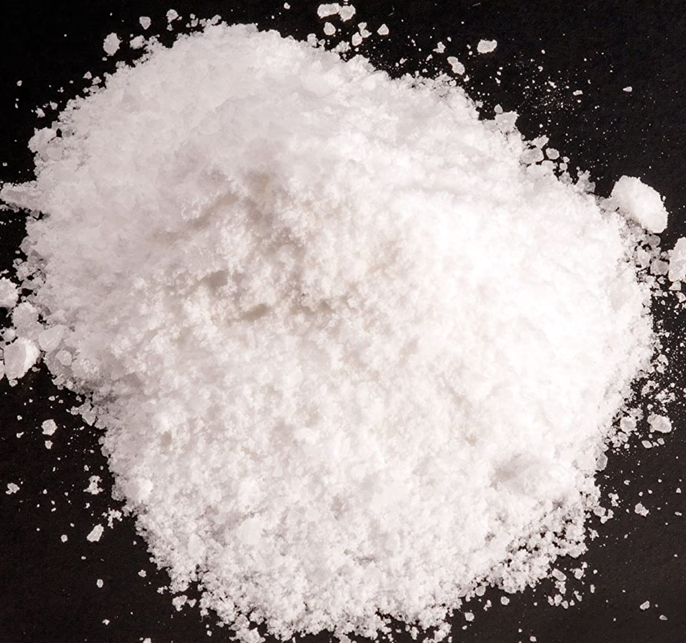
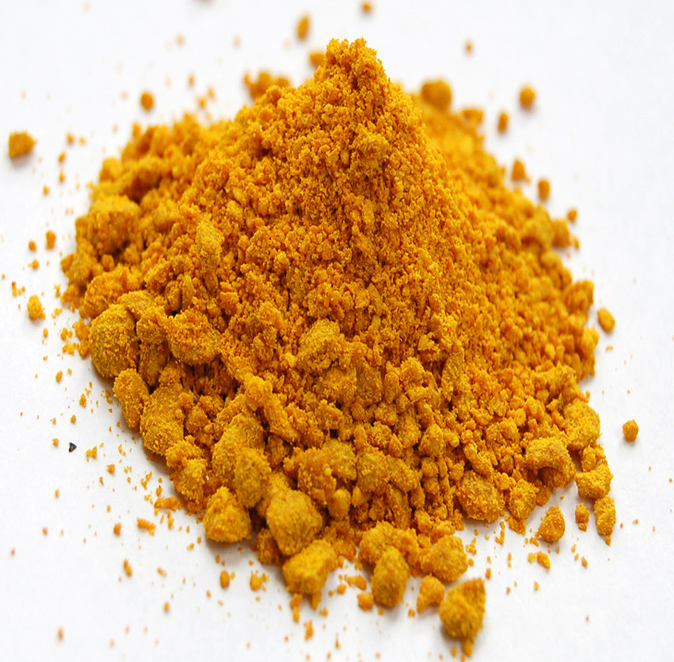

Introduction
Objectives
Material and methods
Results and discussion
Conclusions
Physical-chemical treatments of wastewater
Coagulation-flocculation-decantation (CFD)
Disadvantages
Aluminum
Dialysis encephalopathy
Alzheimer's disease
Iron
Generally corrosive
Strongly dependent on the pH
The leach cannot be recycled
Stable colloids
Destabilised colloids
Aggregated colloids
Add coagulant/flocculant
Hydrolysable metal salts (mainly, aluminum and iron)
Most used on waster treatment

Slide 5

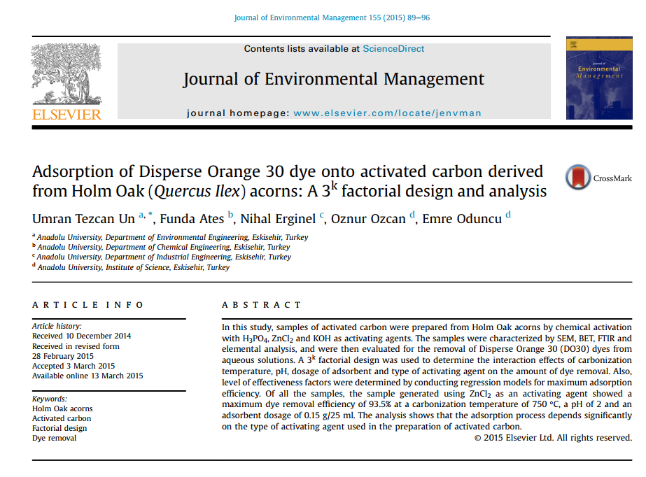
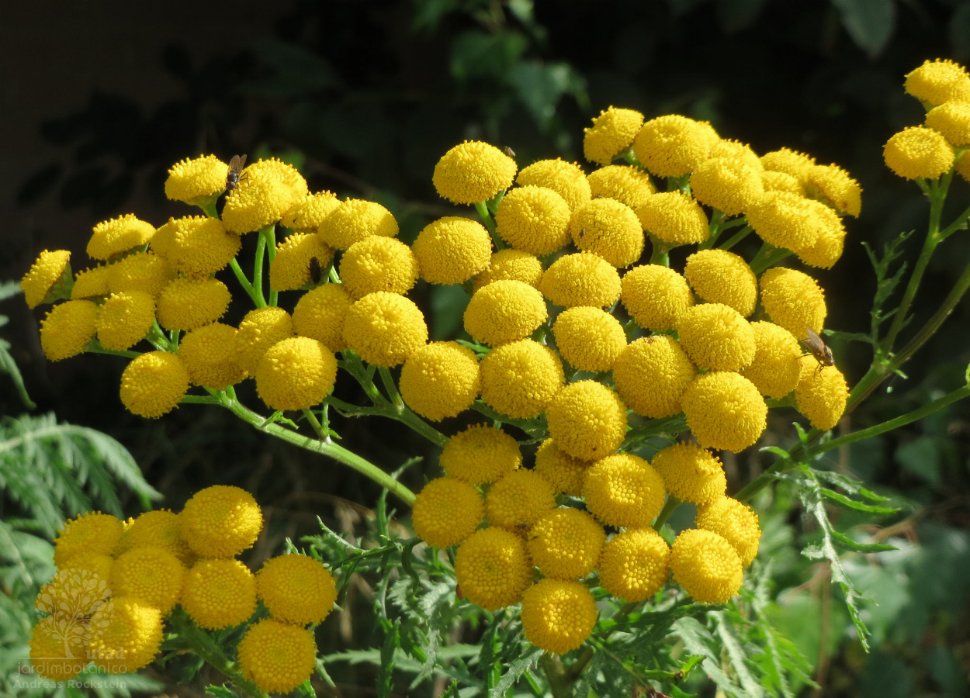
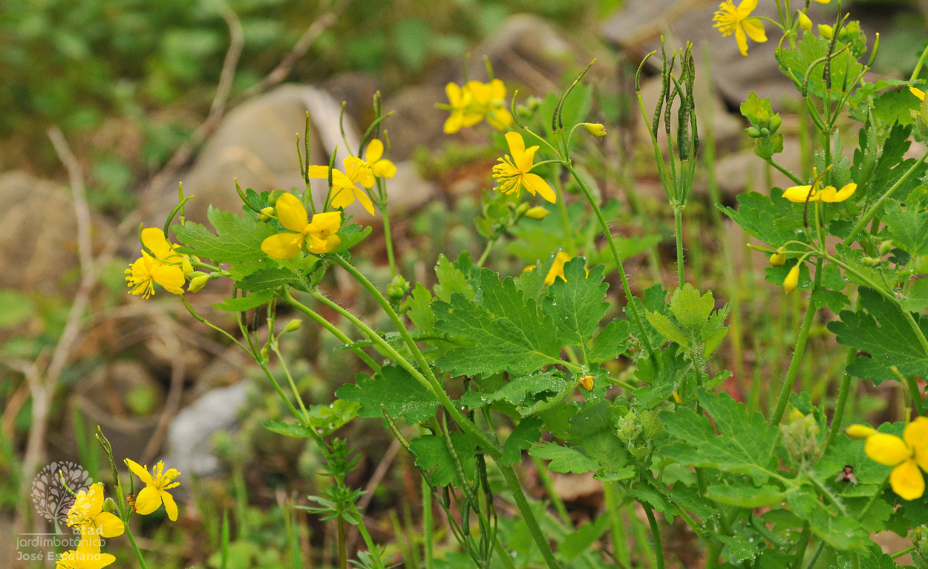
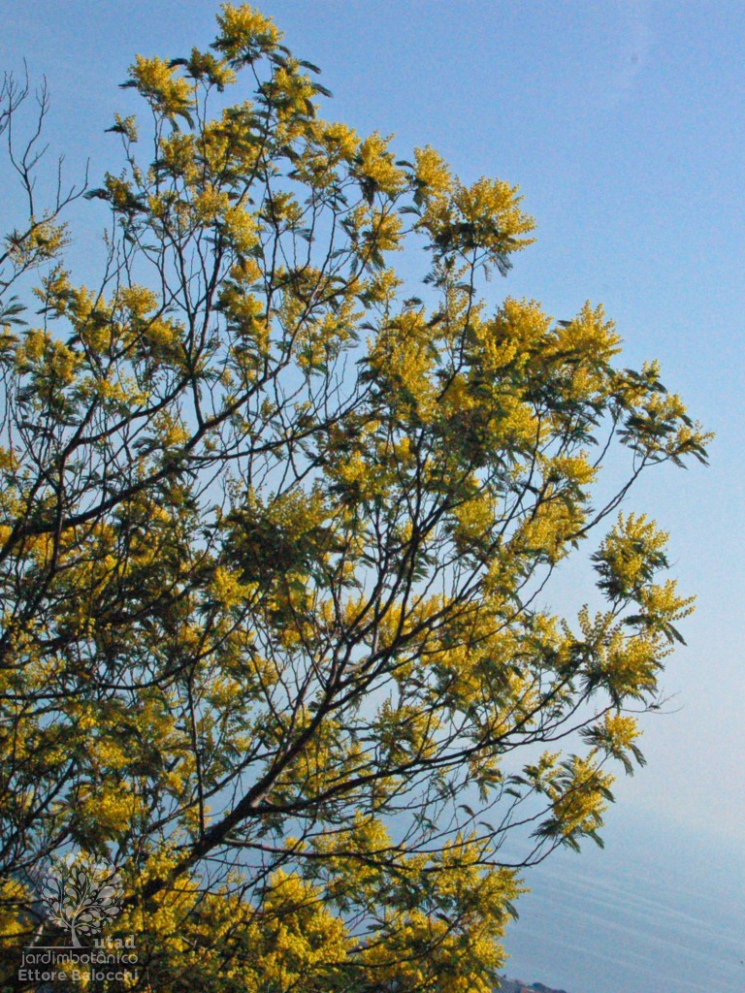
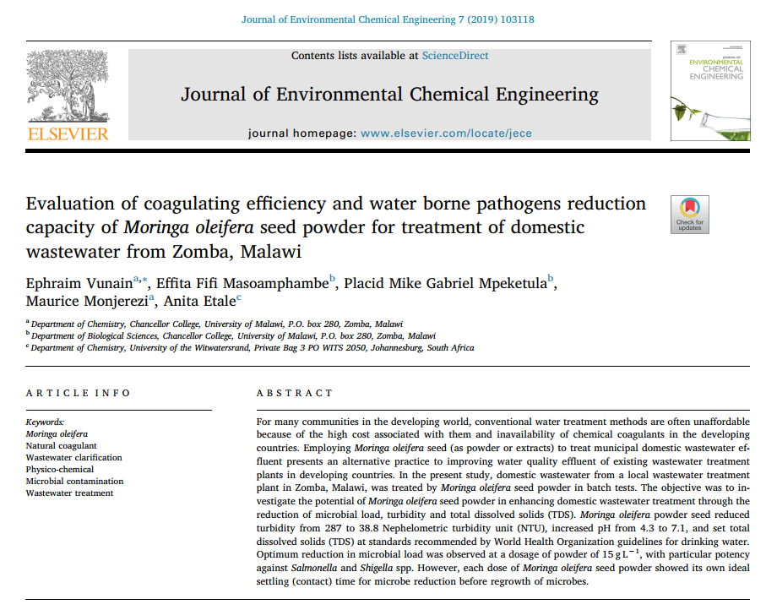
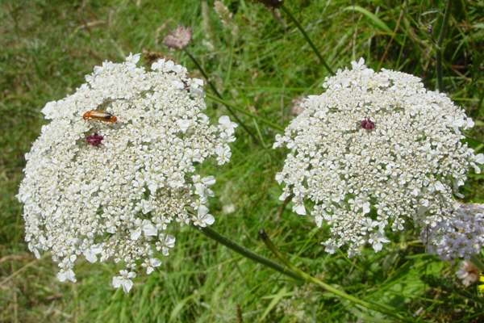
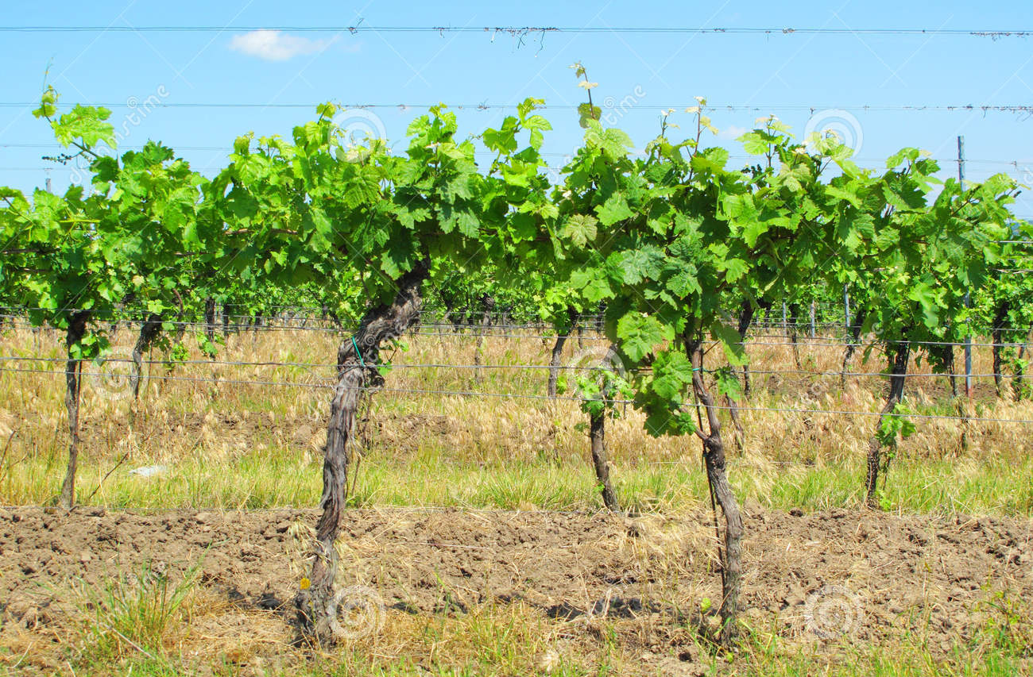
Introduction
Objectives
Material and methods
Results and discussion
Conclusions
Plant species colected during this work, for the development of Na-Cl plant extracts
Works performed with plant based coagulants
Chelidonium majus L.
(seeds)
Tanacetum vulgare L. (seeds)
Acacia dealbata Link
(pollen)
Daucus carota L. (seeds)
Vitis vinífera L. (rachis)

Slide 6
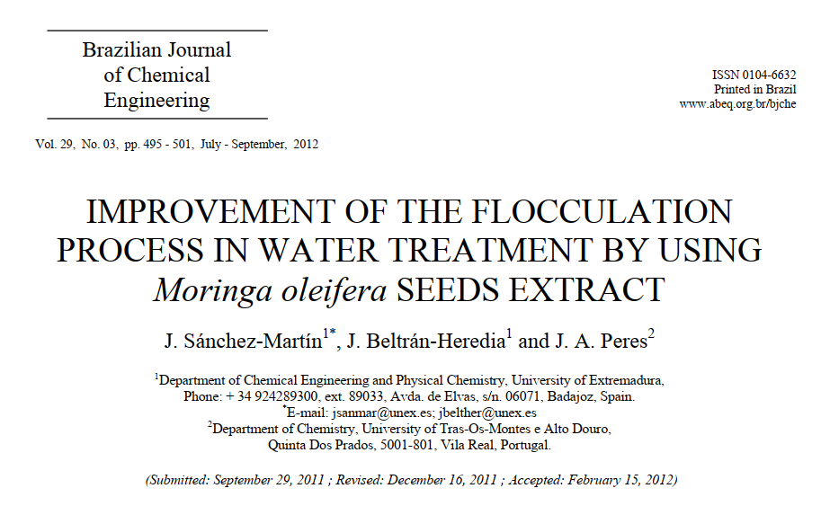
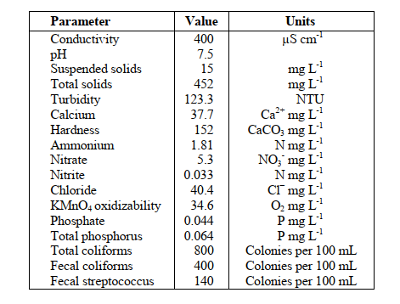
Introduction
Objectives
Material and methods
Results and discussion
Conclusions
Example of NaCl plant extract used in wastewater treatment
River water, taken from the Guadiana river at Badajoz (Spain)
(Characterization of raw wastewater)
Optimization steps
pH
Stirring Time
Coagulant dosage
Variation of pH between 3.0 – 9.0
Turbidity removal = 98 %
96 % and 94 % removal in the case of total and fecal coliforms
100 % removal in the case of fecal streptococcus
Variation of the agitation time in the slow stages between 5 and 60 minutes
Variarion of dosage: 8 and 16 mg L⁻¹

Slide 7
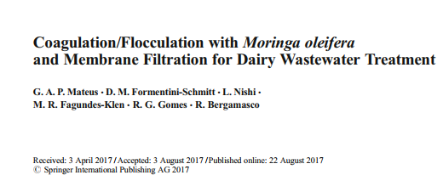
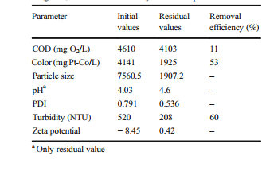
Introduction
Objectives
Material and methods
Results and discussion
Conclusions
Example of Microfiltration used in wastewater treatment
Initial characteristics of the DW, residual values of physicochemical parameters after CFS treatment with 3000 mg/L of coagulant, and removal efficiency of the CFS process
The application of CFD process enhanced the microfiltration process
A plant based coagulante was used
There was a high removal of turbidity from the dairy wastewater

Slide 8
Introduction
Objectives
Material and methods
Results and discussion
Conclusions
To our knowledge, the combined coagulation-flocculation-decantation-microfiltration processes were never applied to winery wastewater treatment and its effects in organic carbon, turbidity, total sus-pended solids and phenolic compounds reduction are unknown.
Therefore, the objectives of this work are
(1) to characterize the plants
(2) to evaluate the production and application of NaCl plant extracts in CFD process
(3) to evaluate the effect of microfiltration in WW treatment
(4) to study the effect of CFD process in microfiltration enhancement and cost reduction

Slide 9
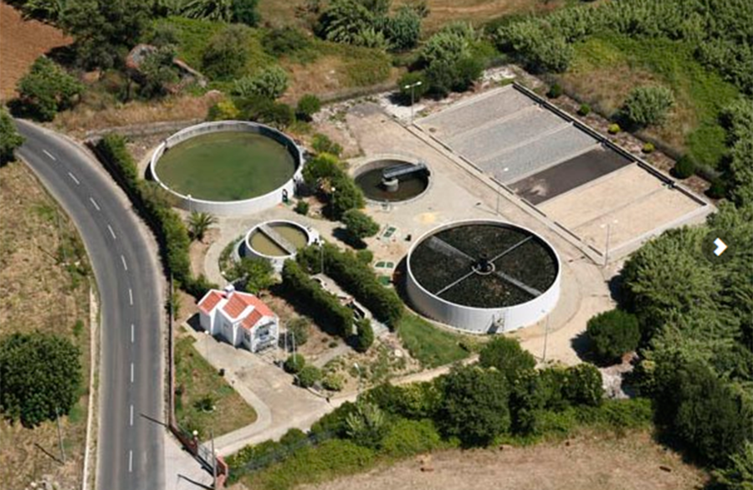
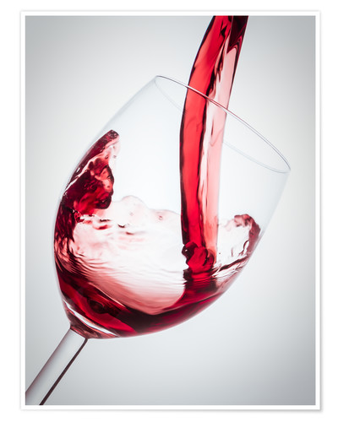
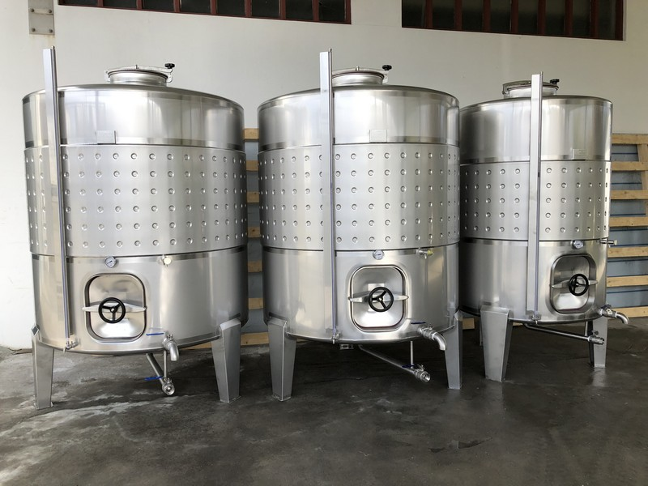
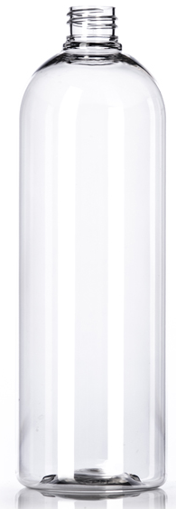
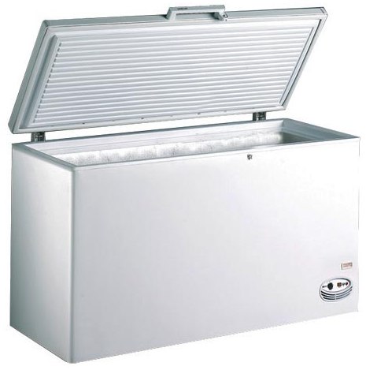
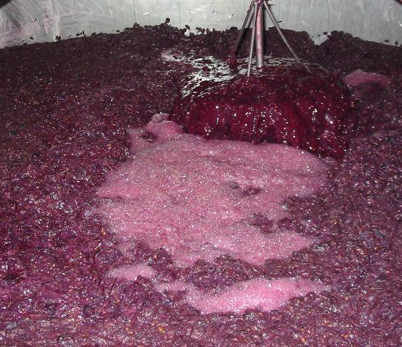
Introduction
Objectives
Material and methods
Results and discussion
Conclusions
Winery wastewater characterization
Parameters | Portuguese Law Decree nº 236/98 | WW
pH | 6.0-9.0 | 4.0±0100
Electrical conductivity (μS/cm) |  | 62.5±0.361
Turbidity (NTU) |  | 296±2.000
Total suspended solids – TSS (mg/L) | 60 | 750±1.528
Chemical Oxygen Demand - COD (mg O₂/L) | 150 | 2145±1.000
Biochemical Oxygen Demand - BOD₅ (mg O₂/L) | 40 | 550±1.155
Total Organic Carbon – TOC (mg C/L) |  | 400±4.040
Total Nitrogen – TN (mg N/L) | 15 | 9.07±0.010
Total polyphenols (mg gallic acid/L) | 0.5 | 22.6±0.100
Biodegradability – BOD₅/COD |  | 0.26±0.015
Aluminium (mg/L) | 10.0 | 0.00±0.000
Calcium (mg/L) |  | 1.07±0.010
Cobalt (mg/L) |  | 0.00±0.000
Copper (mg/L) | 1.0 | 0.014±0.001
Iron (mg/L) | 2.0 | 0.05±0.006
Magnesium (mg/L) |  | 0.51±0.006
Manganese (mg/L) | 2.0 | 0.016±0.001
Potassium (mg/L) |  | 20.5±0.015
Sodium (mg/L) |  | 0.19±0.007
Zinc (mg/L) |  | 10.53±0.006
Production of
wastewater
Production of wine
Collection
Storage at -40ºC

Slide 10
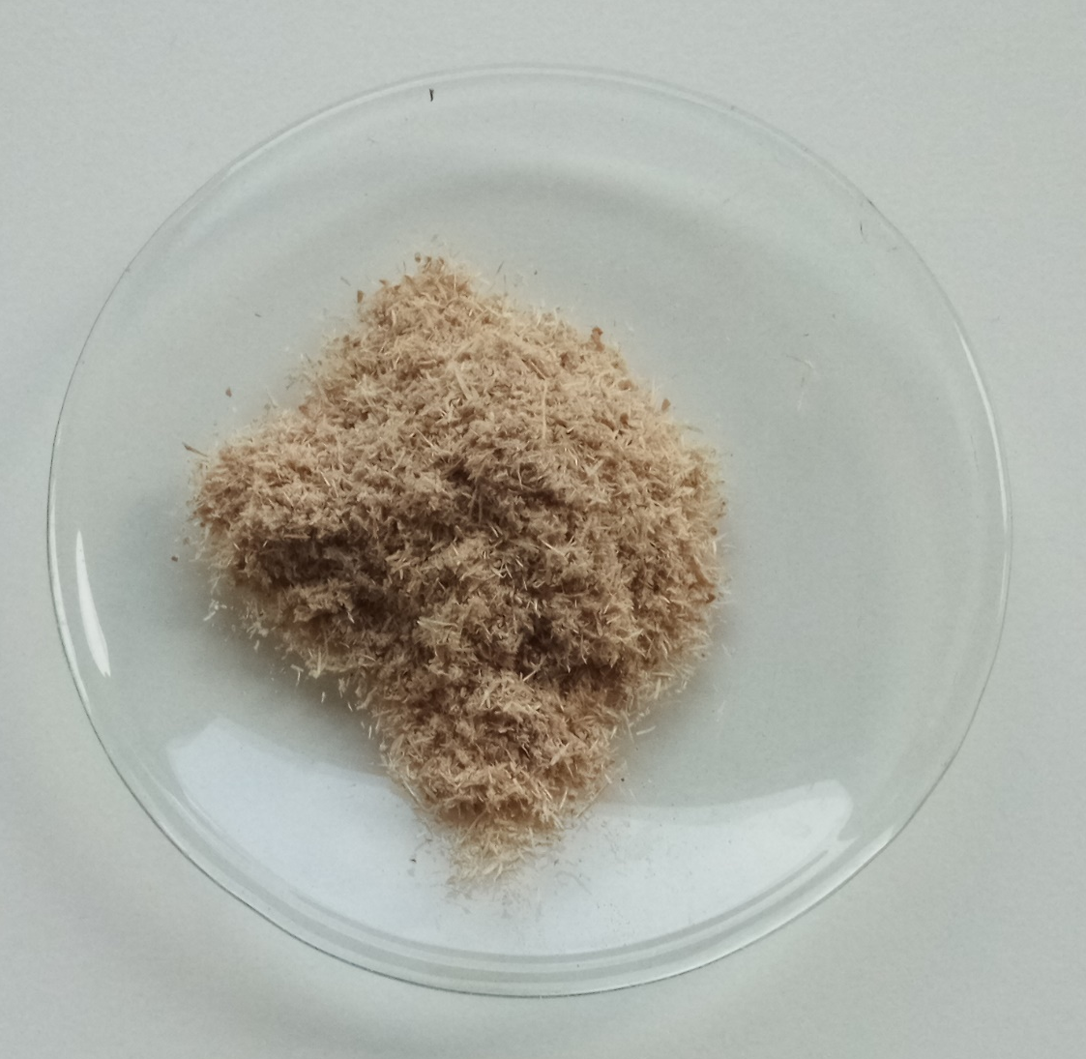
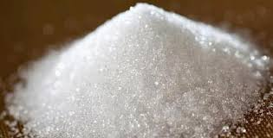
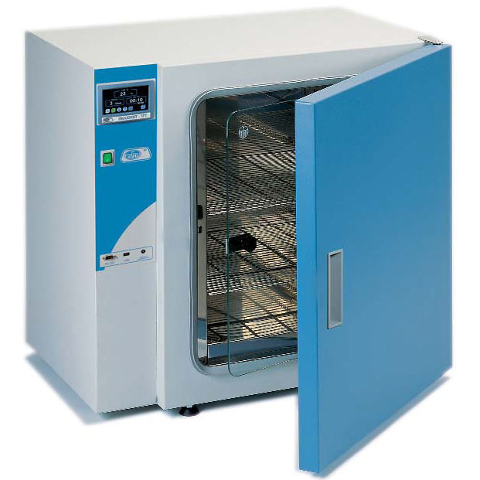
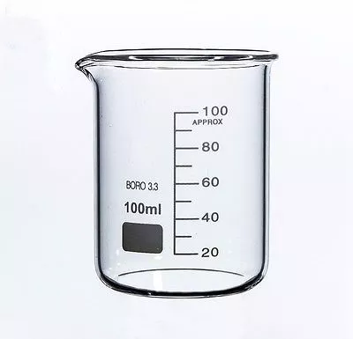
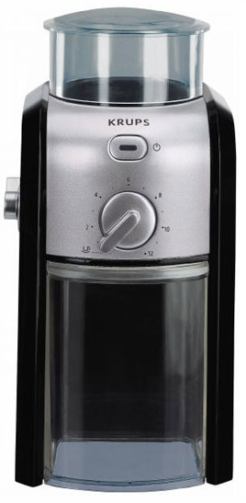
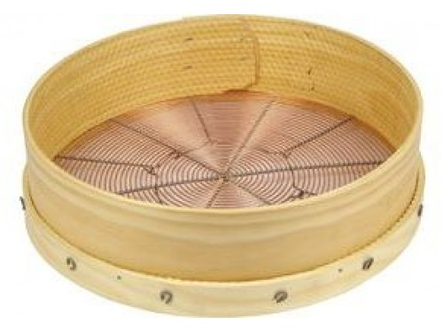
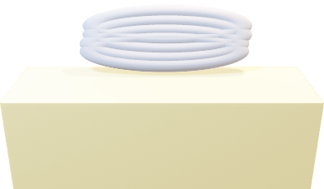
Introduction
Material and methods
Results and discussion
Conclusions
Objectives
Solid part preparation
NaCl-plant extract preparation
Separation of pollen, seeds and rachis
Crushing
Sieve
Drying at 70ºC/ 24 h
Washing and drying at 70ºC/ 24h
Plant powder
NaCl 1 M
Laboratory
incubator
Magnetic
agitator
Gobelet
Groundnut
miller
Mixture for 24 h, for extraction of compounds;
Decantation and filtration of extract
Sieve
(Mesh of 150 µm)
RPM
TºC
Magnetic agitator plate

Slide 11
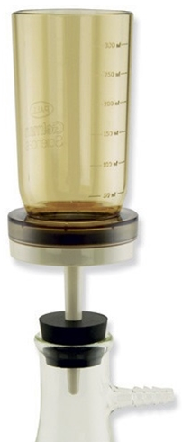
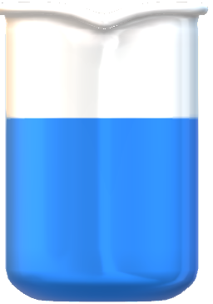
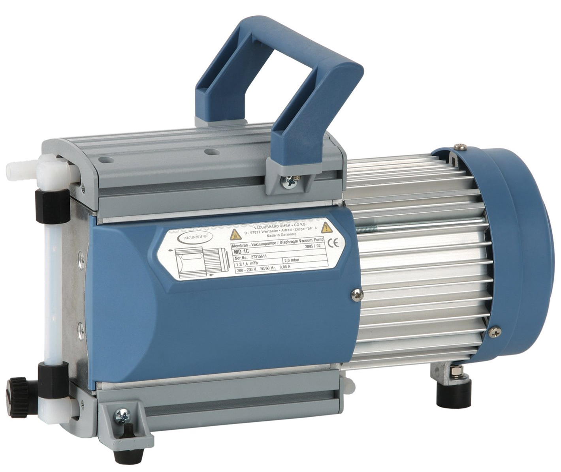

Introduction
Material and methods
Results and discussion
Conclusions
Objectives
CFD/Microfiltration Setup
Controler
Agitator blades
Decantation after sedimentation
RPM
Time
150
3
Jar-Test device
Magnetic filter funnel
Filtration process
Colloid with negative charge
Coagulants
VACUUBRAND GMBH + CO pump

Slide 12
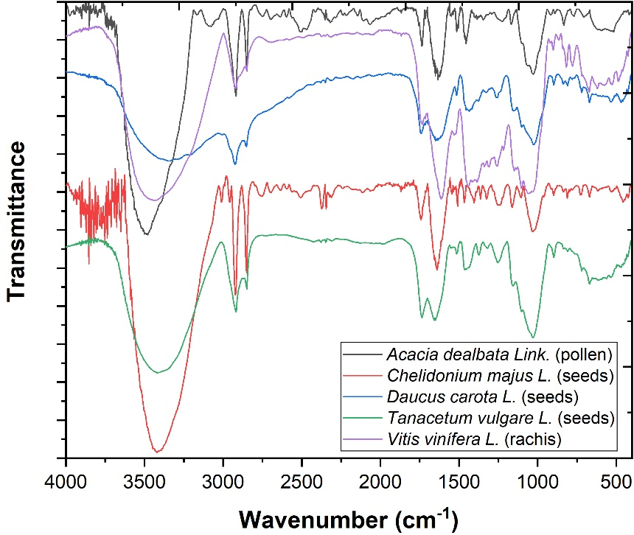
Introduction
Material and methods
Results and discussion
Conclusions
Objectives
Characterization of plants
Wavenumber (cm⁻¹) | Compound
3421.72 | stretching vibrations of OH groups (from water, alcohols, phenols, carbohydrates, per-oxides)
2920.23 and 2850.79 | C-H stretching vibrations specific to CH₃ and CH₂ from lipids, metoxy derivatives, C-H (aldehydes), including cis double bonds
1741.72 | C-O stretching vibrations of glycerides
1639.49 | bending vibrations N-H (amino acids), C=O stretchings (aldehydes and cetones, esters) and free fatty acids
1028.06 | C–O stretching vibration from the glucose ring vibration and the holocellulose and hemicellulose
1200 – 1000 | C–O–C symmetrically stretching vibration and the aromatic C–H in-plane bending vibrations
FTIR spectrum of Acacia dealbata Link. (pollen), Chelidonium majus L. (seeds), Daucus carota L. (seeds), Tanacetum vulgare L. (seeds) and Vitis vinifera L. (rachis).

Slide 13
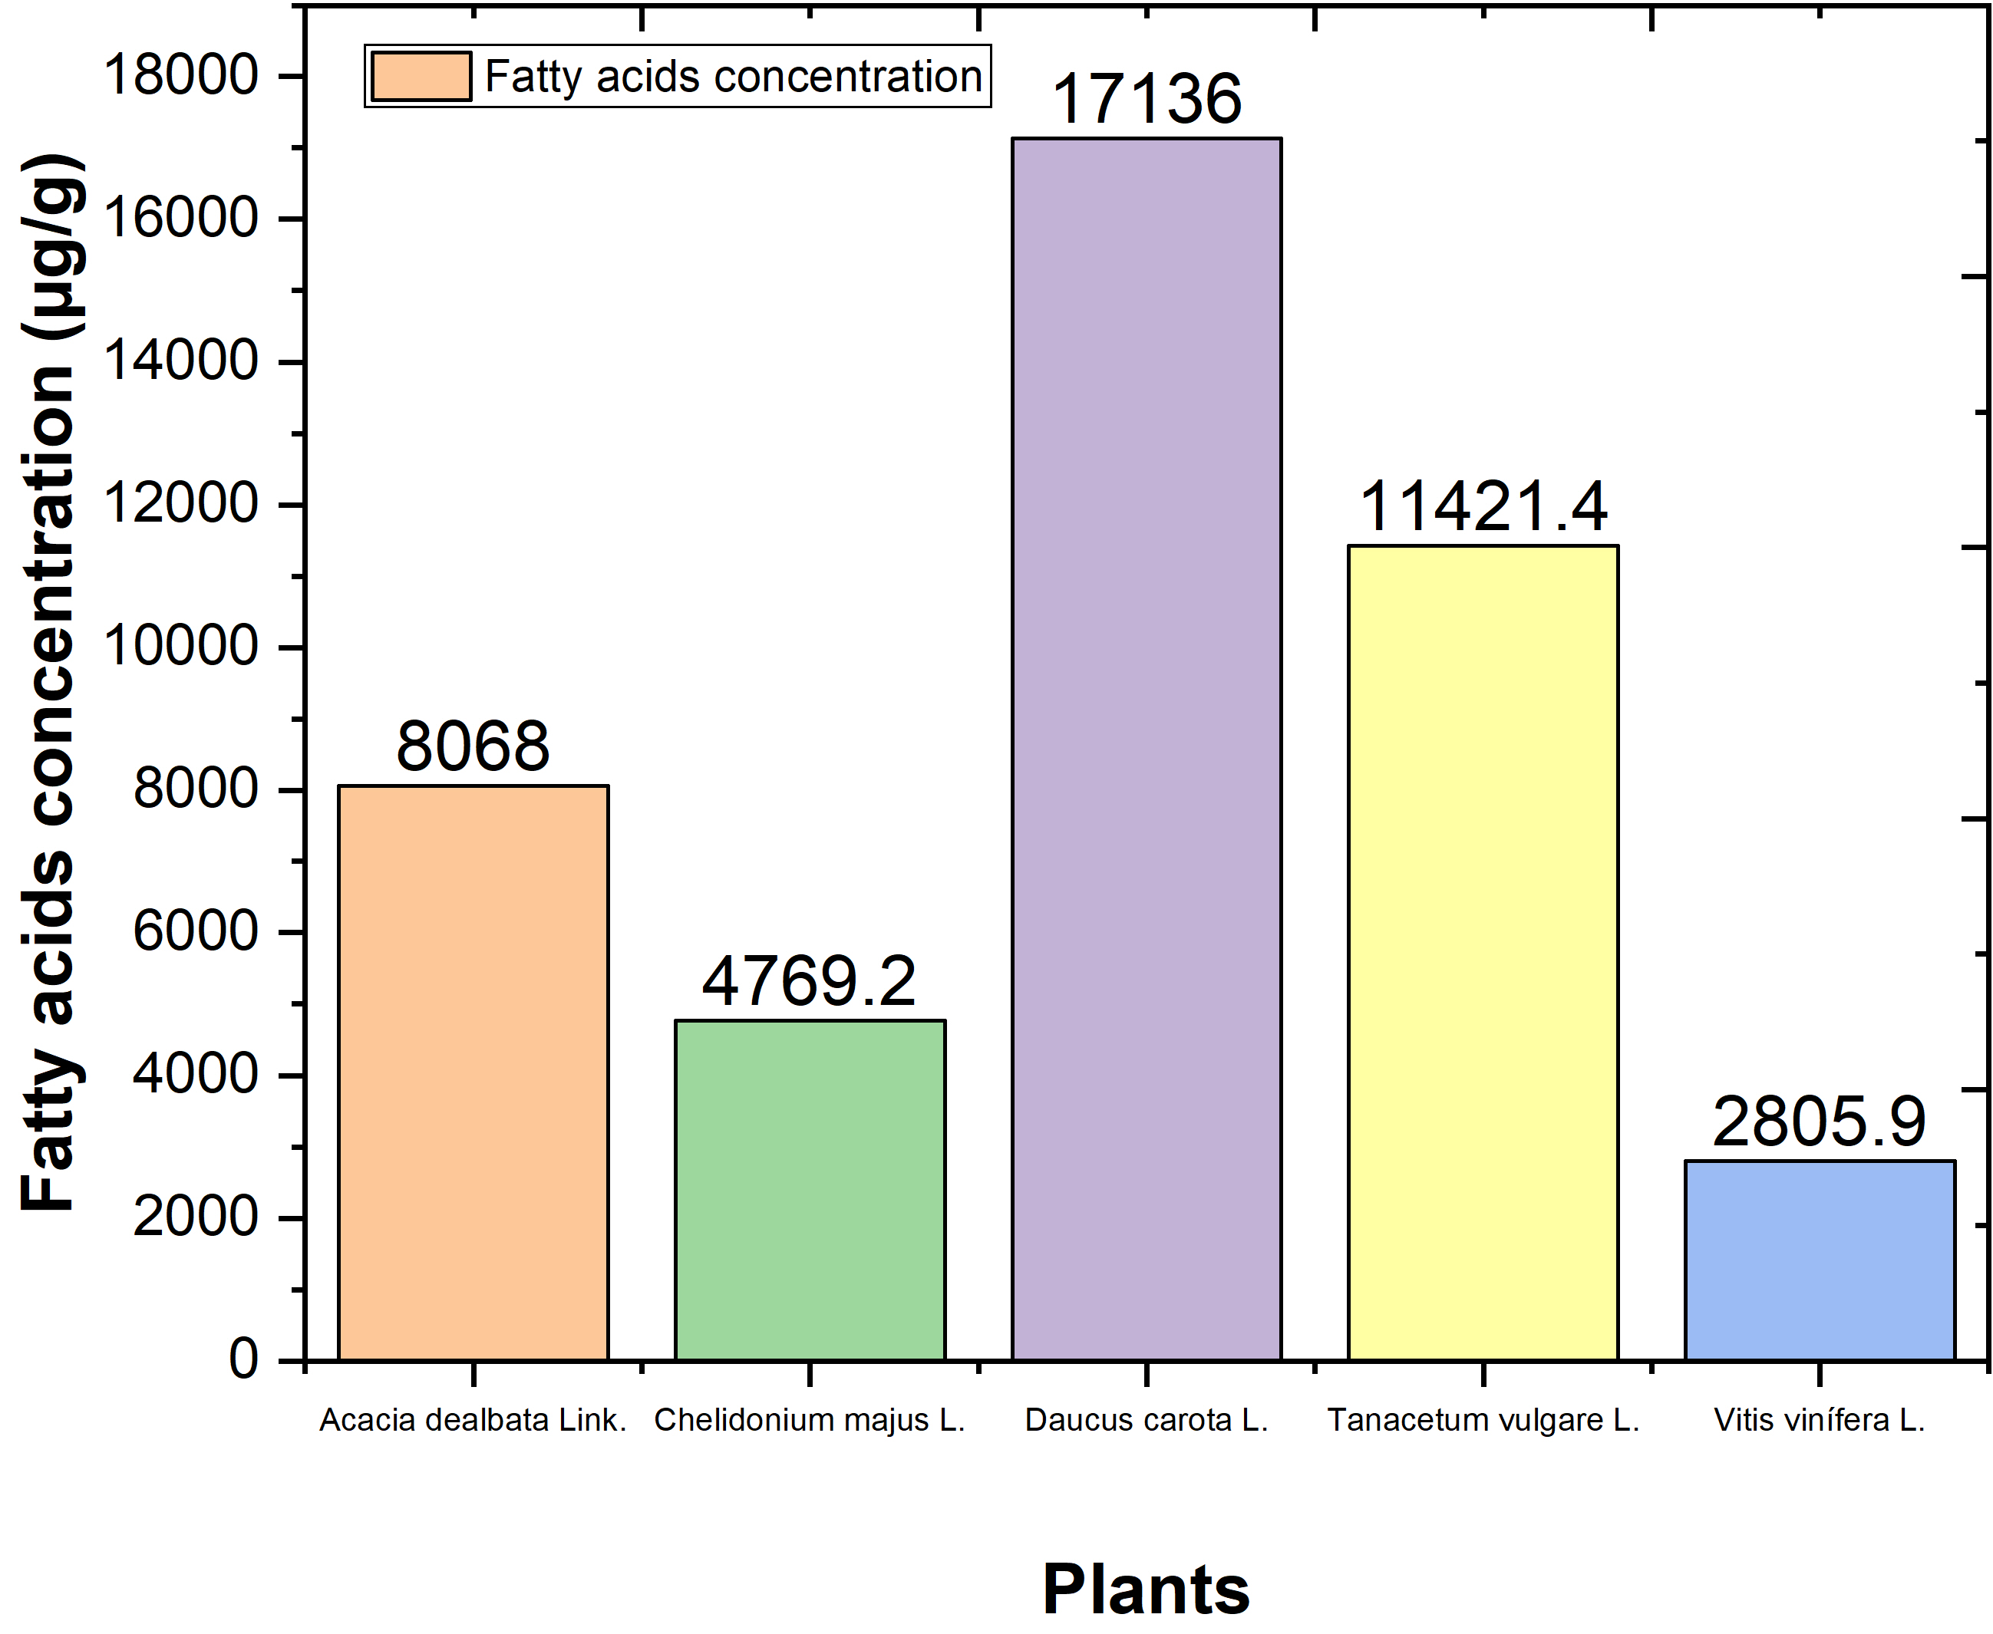
Introduction
Material and methods
Results and discussion
Conclusions
Objectives
Characterization of plants
37 FAME were initialy analysed by GC-FID and peaks were compared with plants;
Results showed diferences between fatty acid composition in each plant.
Acacia dealbata Link.
Erucic (25.69 %)
Chelidonium majus L.
Arachidic (20.65 %)
Daucus carota L.
Arachidic (38.82 %)
Tanacetum vulgare L.
Vitis vinífera L.
cis-10-Pentadecenoic (13.61 %)
cis-5,8,11,14,17-Eicosapentaenoic (20.48 %)
Fatty acid determination by GC-FID

Slide 14
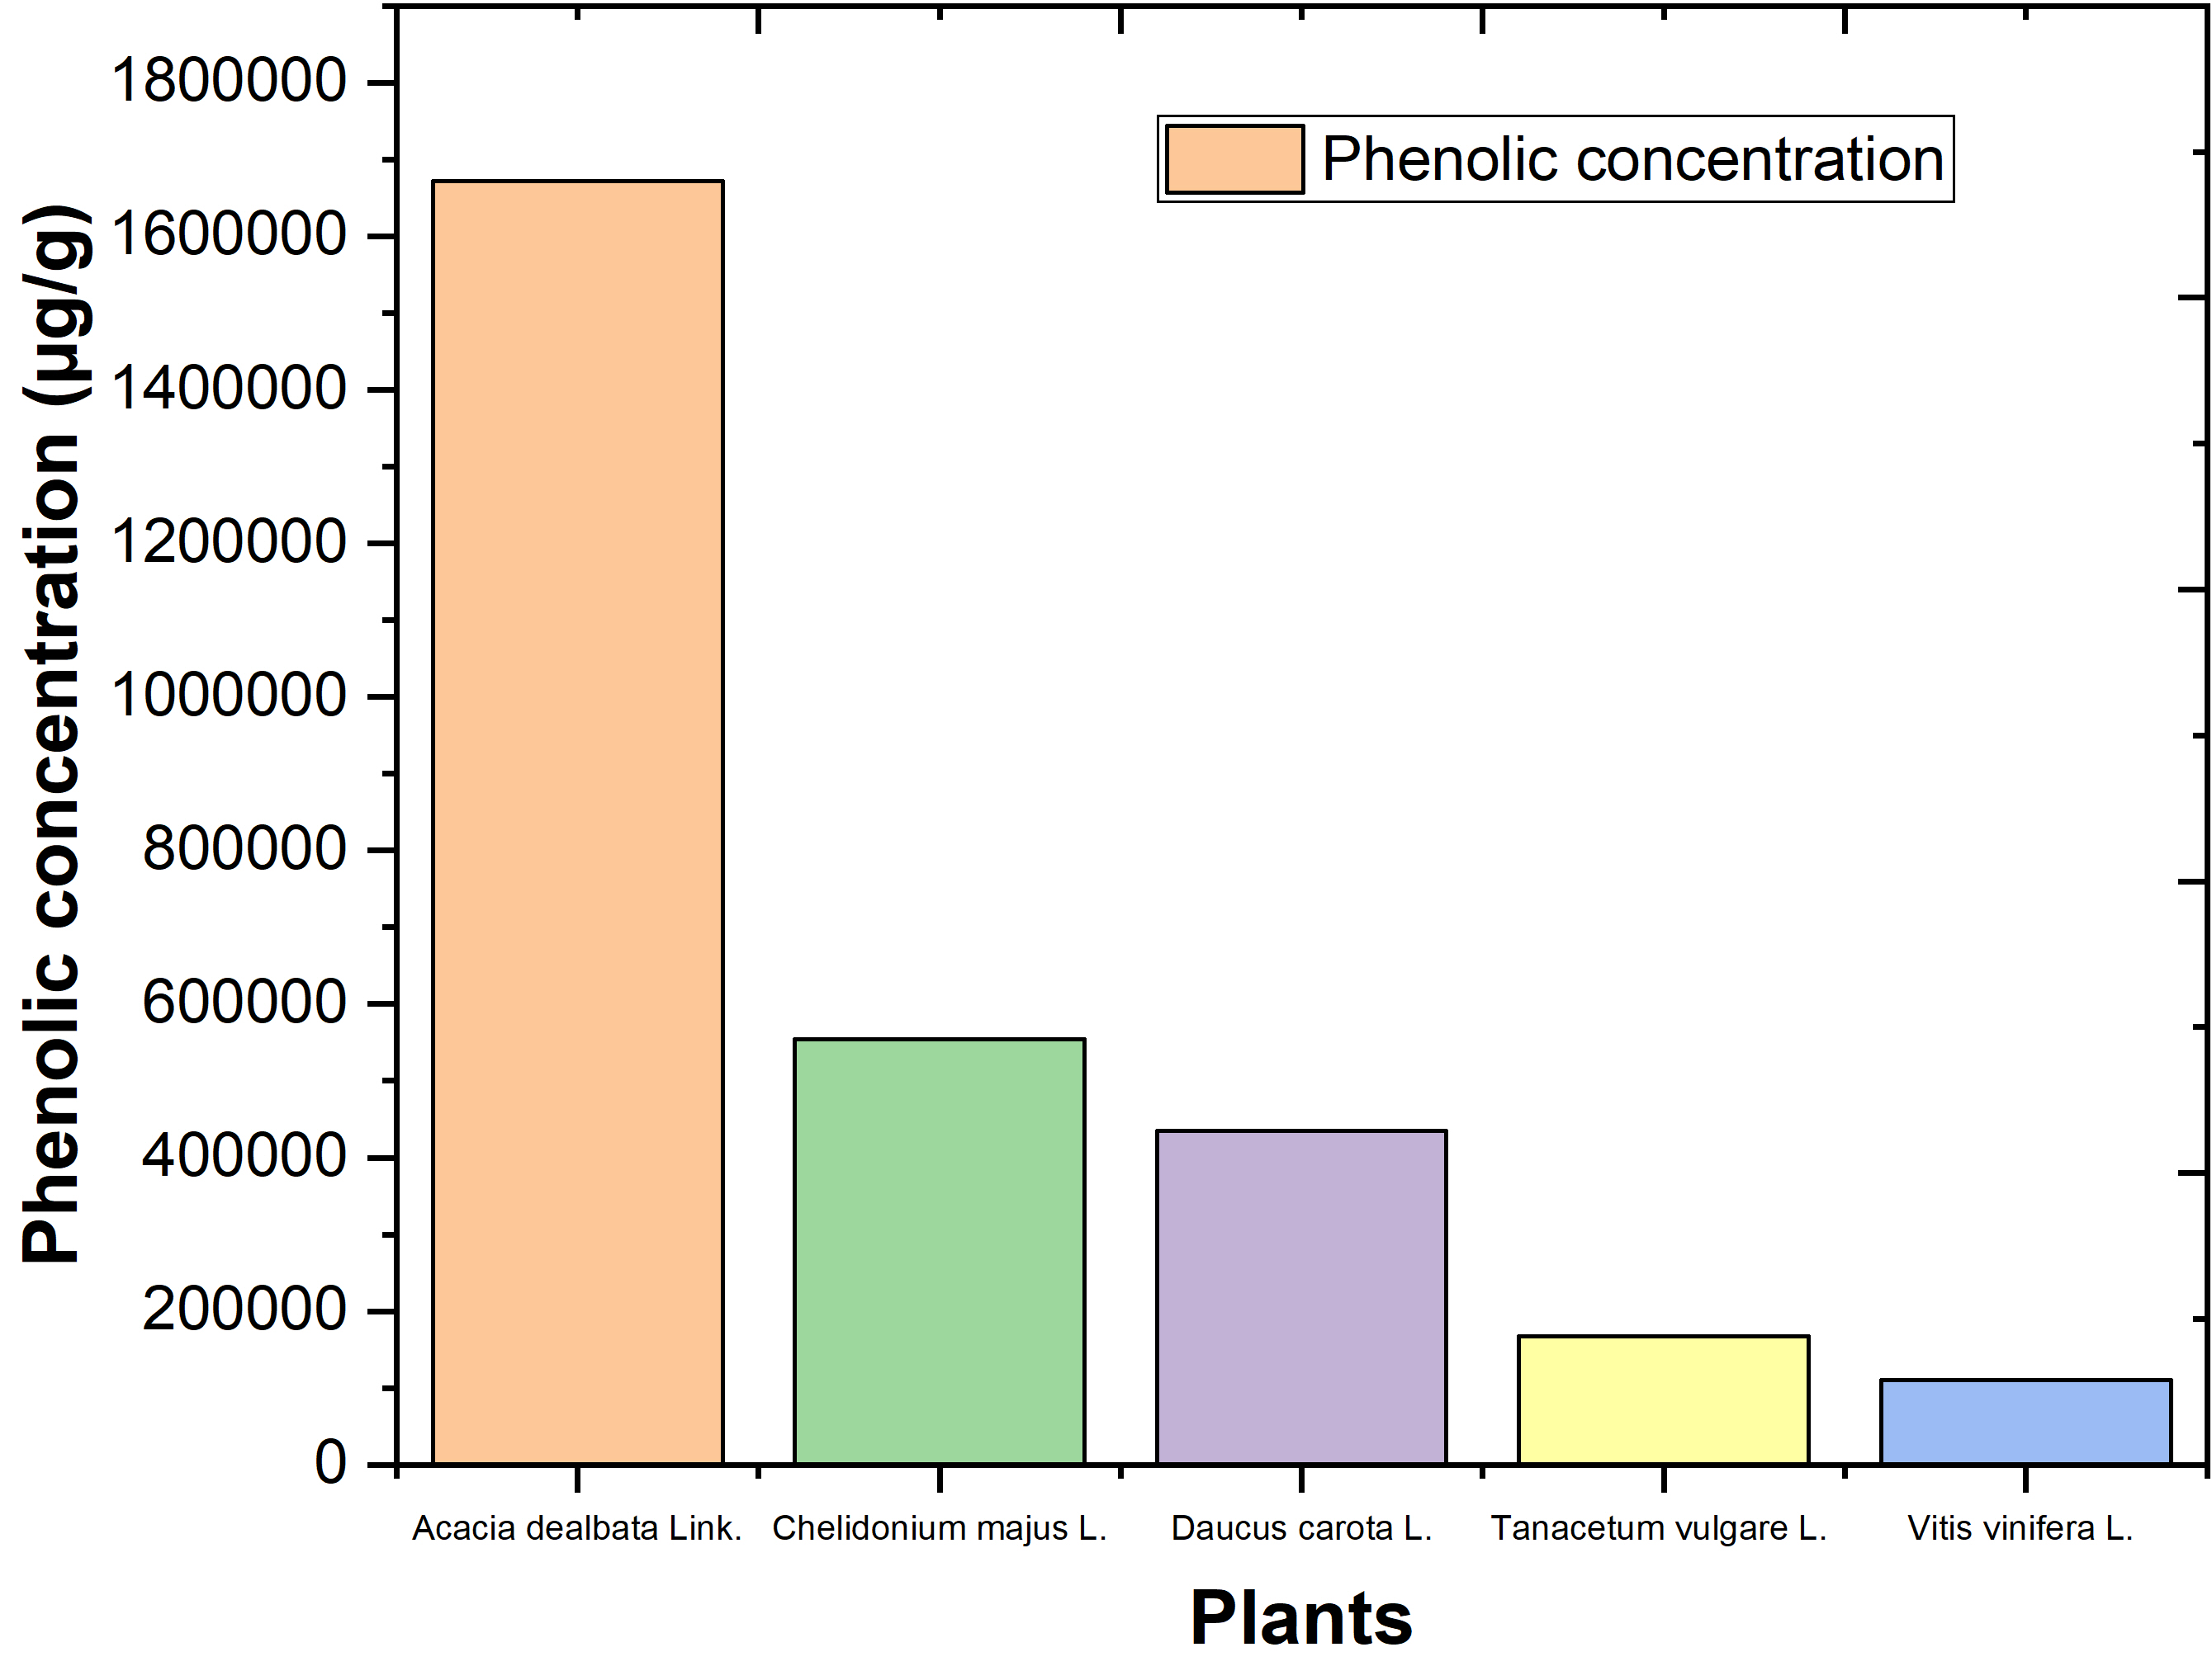
Introduction
Material and methods
Results and discussion
Conclusions
Objectives
34 phenolic compounds were initialy analysed by HPLC-DAD and peaks were compared with plants;
It were separated 4 major types of phenolic compounds (hydroxybenzoic acids (280 nm), cinnamic acids (320 nm), flavonoids (350 nm) and anthocyanins (520 nm));
Results showed diferences between the phenolic composition in each plant.
Characterization of plants
ellagic acid (55.84%)
Acacia dealbata Link.
Chelidonium majus L.
Daucus carota L.
Tanacetum vulgare L.
Vitis vinifera L.
gallic acid (9.59%)
kaempferol (33.28%)
Phenolic compounds determination by HPLC-DAD
ellagic acid (31.12%)
caffeic acid (10.37%)

Slide 15
Introduction
Material and methods
Results and discussion
Conclusions
Objectives
Coagulation-flocculation-decantation-microfiltration
Best operational conditions of NaCl plant extract Acacia dealbata Link. (pollen), Chelidonium majus L. (seeds), Daucus carota L. (seeds), Tanacetum vulgare L. (seeds) and Vitis vinífera L. (rachis) and aluminium sulfate for CFD process, as follows: [TOC]₀ = 400 mg C/L, turbidity = 296 NTU, TSS = 750 mg/L, temperature 298 K, sedimentation time 12 h, pump flow rate of 1.9 m³/h, glass microfiber filters, with micrometric retention of 1.2 µm.
 | Phase one
 | Phase two
 | Phase three
 | Phase four
Coagulant | pH | Dosage | Fast mix | Slow mix | Flocculant type | Flocculant dosage | CFD → Microfiltration
 |  | g/L | rpm/min | rpm/min |  | mg/L
Acacia dealbata Link. (5%) | 3 | 0.5 | 150/3 | 20/20 | Activated sodium bentonite | 50 | Glass microfiber filters
Chelidonium majus L. (5%) | 3 | 0.5 | 150/2 | 50/30 | Activated sodium bentonite | 5
Daucus carota L. (5%) | 3 | 0.5 | 150/3 | 20/20 | Activated charcoal | 5
Tanacetum vulgare L. (5%) | 3 | 0.1 | 150/3 | 20/20 | Potassium caseinate | 100
Vitis vinífera L. (5%) | 3 | 0.1 | 150/3 | 20/20 | Potassium caseinate | 5
Aluminium sulfate (10%) | 5 | 0.5 | 150/2 | 50/30 | Activated charcoal | 50
Phase one showed that NaCl plant extracts are more efficient at pH 3.0
The NaCl plant extracts require similar or lower dosage than aluminium sulfate
Some flocculants are more efficient when combined with the coagulants
The CFD process enhanced the microfiltration efficiency

Slide 16
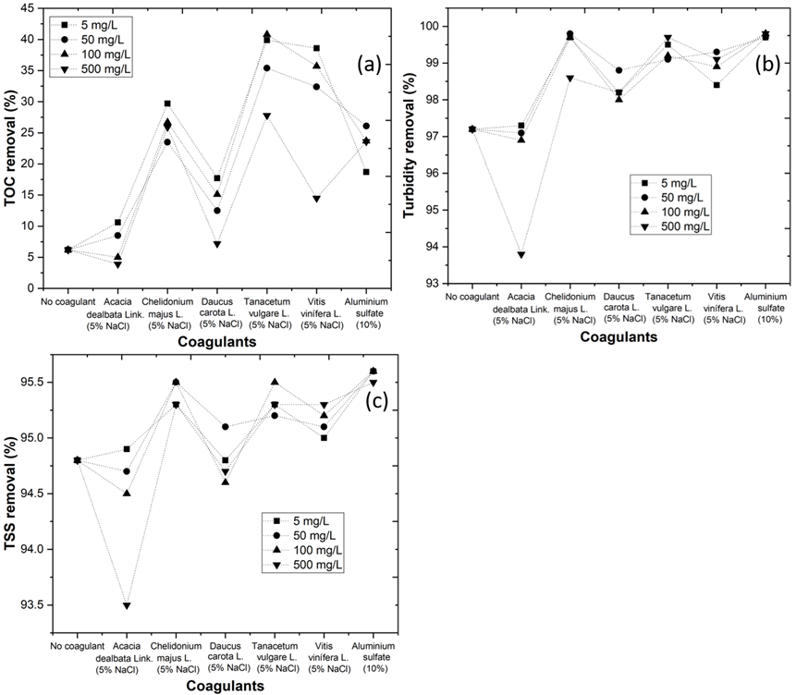
Introduction
Material and methods
Results and discussion
Conclusions
Objectives
Results showed that performance of microfiltration in raw WW and in coagulated WW with NaCl plant extract Acacia dealbata Link. (pollen), Chelidonium majus L. (seeds), Daucus carota L. (seeds), Tanacetum vulgare L. (seeds) and Vitis vinífera L. (rachis) and aluminium sulfate had a :
Coagulation-flocculation-decantation-microfiltration
TOC removal of 8.4, 8.5, 29.7, 17.7, 40.8, 38.6 and 26.1%
Turbidity removal of 97.2, 97.1, 99.7, 98.2, 99.2, 98.4 and 99.7%
TSS removal of 94.8, 94.7, 95.3, 94.8, 95.5, 95.0 and 95.6%
Evolution of (a) TOC, (b) turbidity and (c) TSS removal at different flocculant concentrations (5 – 500 mg/L) in combined coagulation-flocculation-decantation-microfiltration process. CFD/MF operational conditions, as follows: [TOC]₀ = 400 mg C/L, turbidity = 296 NTU, TSS = 750 mg/L, temperature 298 K, sedimentation time 12 h, pump flow rate of 1.9 m³/h, glass microfiber filters, with micrometric retention of 1.2 µm.

Slide 17
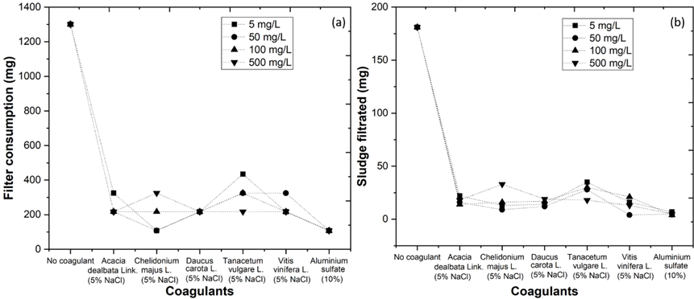
Introduction
Material and methods
Results and discussion
Conclusions
Objectives
Results showed that performance of microfiltration in raw WW and in coagulated WW with NaCl plant extract Acacia dealbata Link. (pollen), Chelidonium majus L. (seeds), Daucus carota L. (seeds), Tanacetum vulgare L. (seeds) and Vitis vinífera L. (rachis) and aluminium sulfate had a :
Coagulation-flocculation-decantation-microfiltration
Filter consumption of 1301, 217, 108, 217, 325, 217 and 108 mg
Higher costs derived mainly from the presence of sediments in the WW (181, 16, 13, 14, 30, 16 and 5 mg, respectively)
Positive correlation between sludge compaction by coagulation-flocculation-decantation process, and filter consumption by microfiltration process (y = 2.55x + 12.68, r² = 0.949), which indicated that CFD process had a direct effect in microfiltration cost reduction
CFD/MF operational conditions, as follows: [TOC]₀ = 400 mg C/L, turbidity = 296 NTU, TSS = 750 mg/L, temperature 298 K, sedimentation time 12 h, pump flow rate of 1.9 m³/h, glass microfiber filters, with micrometric retention of 1.2 µm.

Slide 18
Introduction
Material and methods
Results and discussion
Conclusions
Objectives
With the results from this work, it is concluded that
(1) It is possible to produce NaCl-plant extracts and apply them as coagulants
(2) The Na-Cl plant extracts enhance the microfiltration process and decrease the costs
(3) The application of CFD/MF process is an economic and sustainable technology for WW treatment

Slide 19
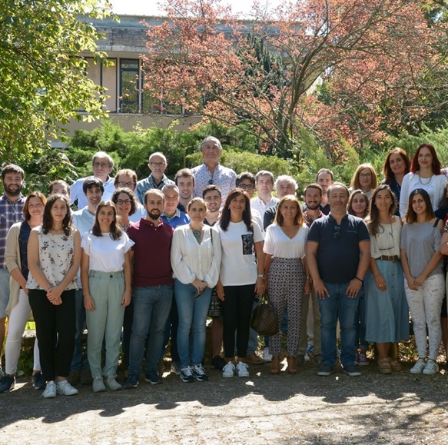

Acknowledgements
This research was funded by the North Regional Operational Program (NORTE 2020) and the European Regional Development Fund (ERDF) and authors express their appreciation for the financial support of the Project AgriFood XXI, operation nº NORTE-01-0145-FEDER-000041, and to the Fundação para a Ciência e a Tecnologia (FCT) for the financial support provided to CQVR through UIDB/00616/2020 and CITAB through UIDB/04033/2020. Marco S. Lucas also thanks the FCT for the financial support provided through the Investigator FCT-IF/00802/2015 project. Ana R. Teixeira also thanks the FCT for the financial support provided through the doctoral scholarship UI/BD/150847/2020.

Slide 20
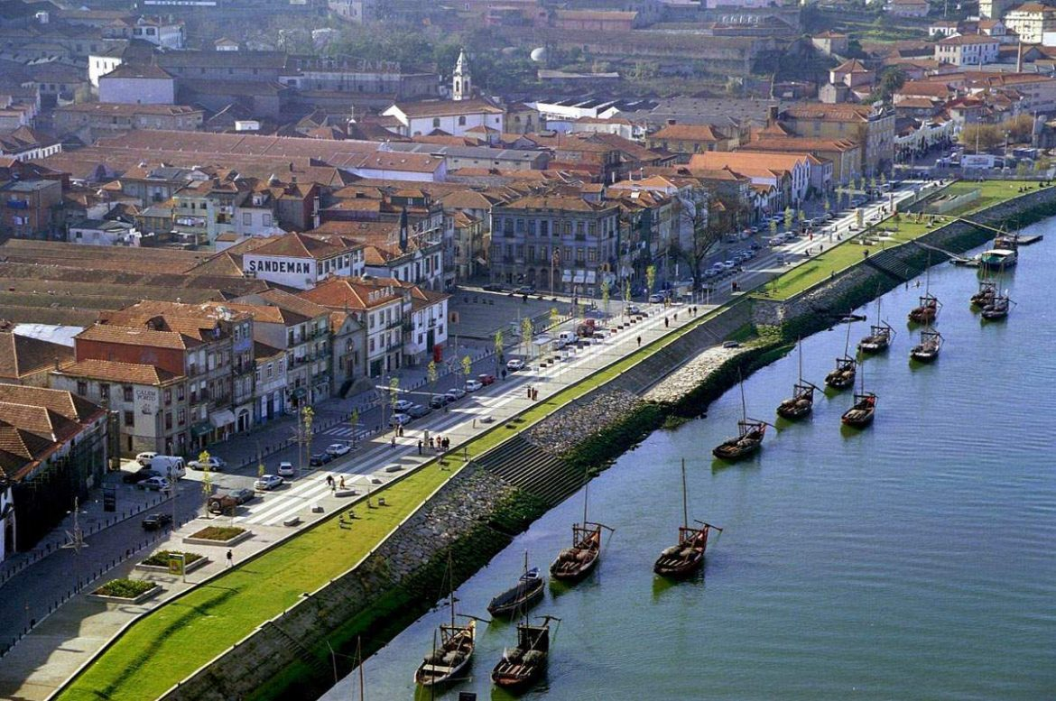
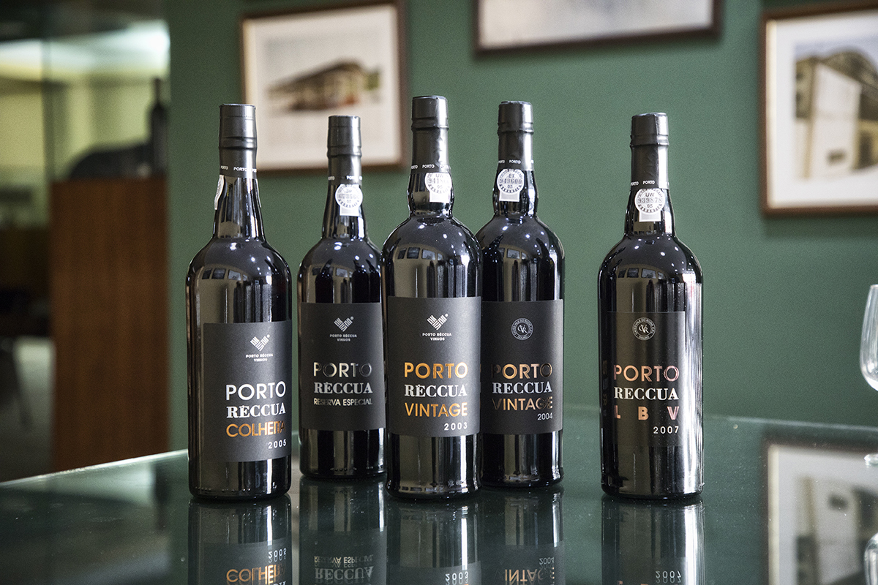

Thank you for your attention

