Slide 1
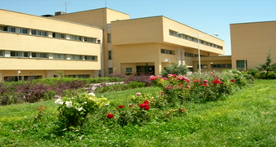
1st International Online Conference on Agriculture - Advances in Agricultural Science and Technology
The effect of chemical and biofertilizer on grain yield of two dill (Anethum graveolens L.) cultivars
Saeid Zehtab salmasi* , Abdalla Nabi Hamad and Mohammad Reza Sarikhani
*Professor of Agricultural Ecology
Department of Plant Ecophysiology
Faculty of Agriculture
University of Tabriz, Tabriz, Iran
s-zehtab@tabrizu.ac.ir
zehtabsalmasi@gmail.com

Slide 2
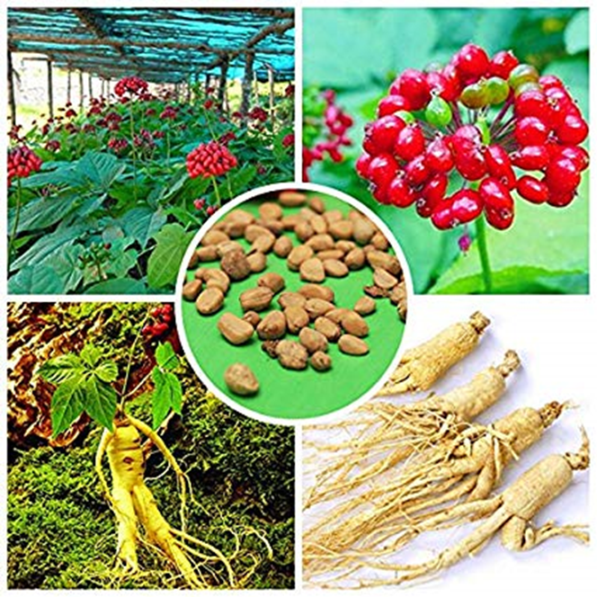
Introduction
Many of the herbs and spices used by humans to season food yield useful medicinal compounds. The demand for medicinal plants is currently increasing in both developed and developing countries for various reasons. They are used in pharmacy, cosmetology, perfumes and the food industry among others (Padulosi et al. 2002).

Slide 3
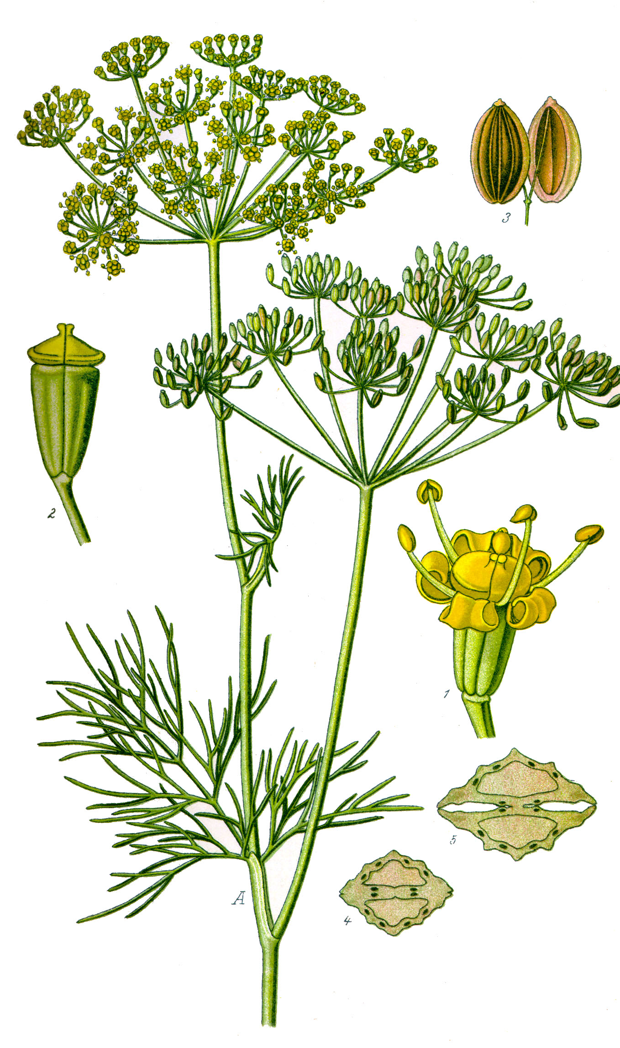
Introduction
Dill (Anethum graveolens L.) is an annual plant of Apiaceae family which is grown as an important medicinal plant among the world. Uses of dill seeds are carminative, stomachic and diuretic. It can also be used to increase milk production for mothers who breastfeed, helped prevent colic, bad breath, coughing, cold, flu and menstrual pains (Kerrouri et al. 2016). The treatment of potato tubers with carvone of the essential oil extracted from dill seeds led to the growth inhibition of the potato spouts (Sanli and Kardogan, 2019).

Slide 4
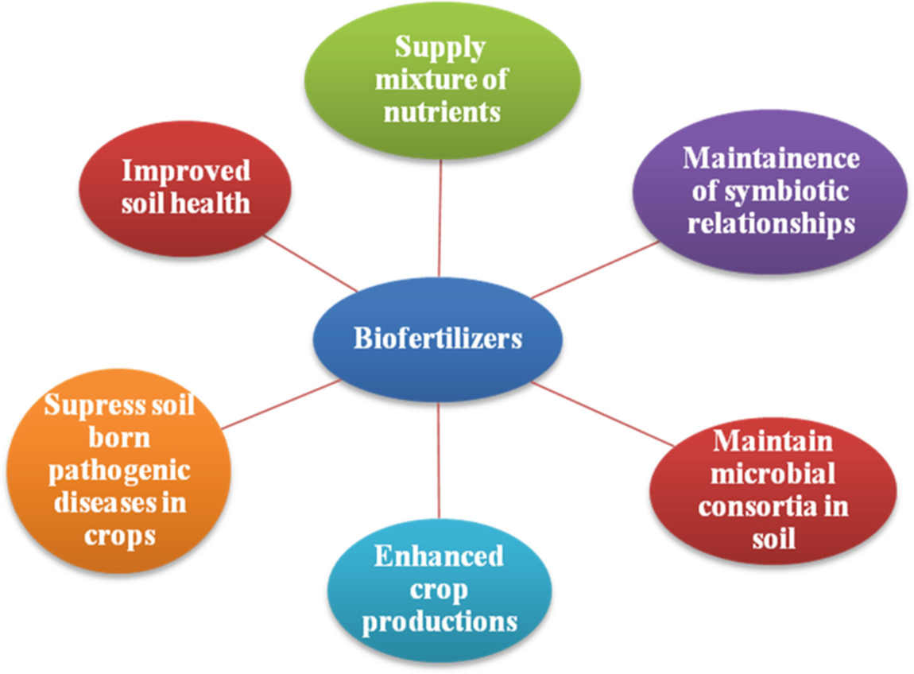
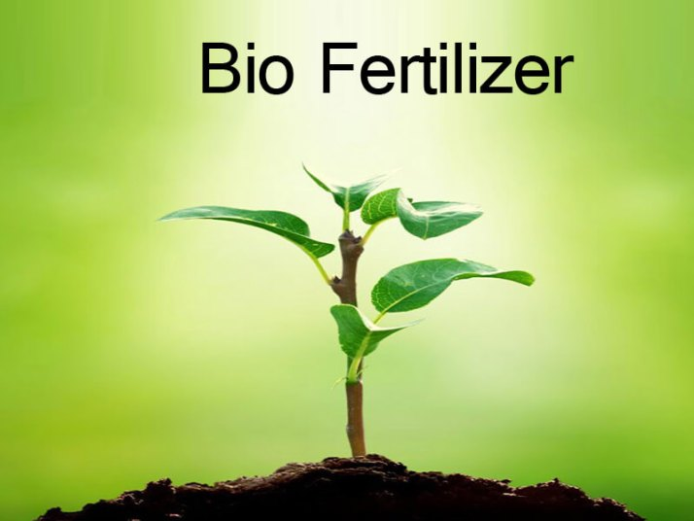
Introduction
Bioferetilizer as essential components of organic farming, play a vital role in maintaining long term fertility and sustainability of soil (Mishra et al. 2013). Integrated nutrient management strategies involving chemical fertilizer and biofertilizer have been suggested enhancing sustainability of crop production. Rhizosphere associated nitrogen fixing bacteria have been used as inoculum for non-legume crop species (Mehnaz and Lazarovits, 2006).

Slide 5
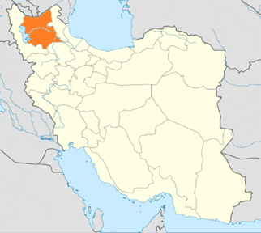
Introduction
This research was conducted out to study the effect of combined fertilizer management of biofertilizer and chemical fertilizer on grain production of two dill ecotypes at North West of Iran.

Slide 6
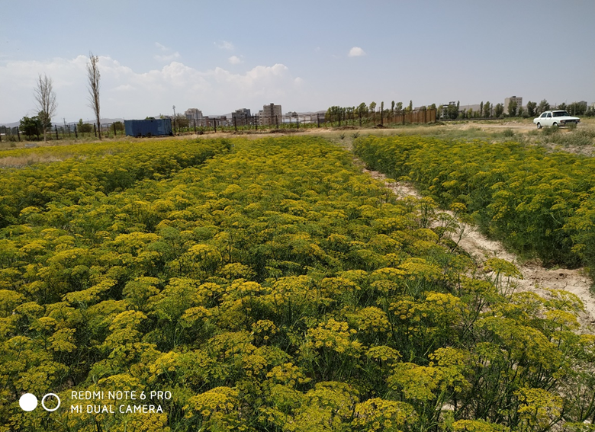
Materials and Methods
A field experiment was conducted out in a factorial layout based on randomized complete block design with three replications in 2019 in Agricultural Research Farm of the University of Tabriz which is located at North West of Iran (Longitude 46° 17ʹE, Latitude 38° 05ʹN, Altitude1360m above sea level).

Slide 7
Materials and Methods
The first factor includes two Dill ecotypes (C1: Native of Tabriz and C2: Varamin); while the second factor was composed of five fertilizers levels, namely control (N0), chemical fertilizers (N1), Enterobacter cloacae S16-3 bacteria + half a chemical fertilizer (N2), Piriformospora indica Fungi + half a chemical fertilizer (N3) and combination of bacteria + fungi +half of chemical fertilizers (N4).
Each plot consists of six rows with 25cm distance from each other and 4m length. Bacteria and fungi used in this experiment as seed inoculums was provided at Soil Biology Laboratory of the Soil Sciences Department of the University of Tabriz.

Slide 8
Results
 | Mean Squares
Source of Variation | Biological Yield | Grain Yield | Harvest index
Replication | 496175.09**¹ | 55729.4^{ns} | 102.18*
Ecotype | 203321.72^{ns} | 37619.07^{ns} | 0.44^{ns}
Fertilizer | 587672.97** | 142688.7** | 186.06*
Replication *Ecotype | 140856.73^{ns} | 23443.9^{ns} | 181.3^{ns}
Error | 52528.52 | 15882368 | 63.49
Cv(%) | 15.25 | 22.82 | 21.49
Analysis of variances showed significant effects of fertilizer type on biological yield, grain yield and harvest index of dill ecotypes. However, the ecotypes of dill had no significant differences in grain production.

Slide 9
Results
Ecotype | Biological Yield g/m² | Grain Yield g/m² | Harvest index %
Tabriz | 1585.01a¹ | 587.66a | 37.19a
Varamin | 142036a | 516.83a | 36.95a
Biological yield of Tabriz ecotype was a little higher than Varamin ecotype, however the differences was not significant

Slide 10
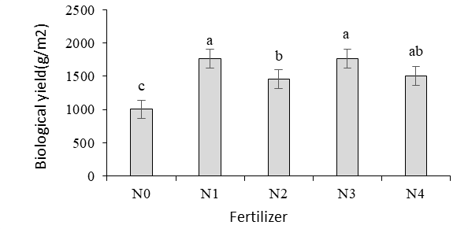
Results
Dill biological yield increased significantly by application of fertilizers, the highest yield and yield components were obtained for chemical fertilizers treatment (N1), but there was no statistically significant difference with the combined treatment (N3, Fungi + half a chemical fertilizer and N4, combination of bacteria + fungi + a half chemical fertilizers )

Slide 11
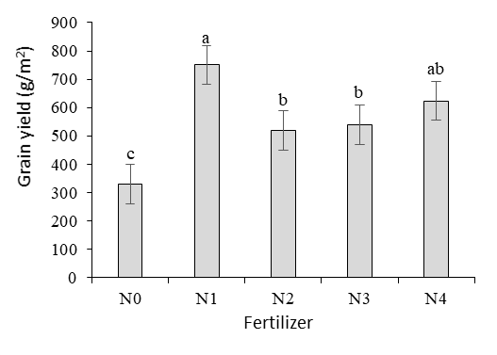
Results
The grain yield of dill ecotypes increased considerably by chemical and bio fertilizers, although the highest yield and yield components were obtained for chemical fertilizers treatment (N1), but there was no statistically significant difference with the combined treatment (N4 , combination of bacteria + fungi + a half chemical fertilizers )

Slide 12
Conclusion
Optimizing in dill grain yield under integrated treatments could be related to increasing in photosynthesis and plant shoot growth improvement by soil microorganisms. It seems that application of mycorhizal fungi has symbiotic effect on dill grain production improving by nitro-gen fixing bacteria. Accordingly, the application of combined treatment (N4, combination of bacteria + fungi + half of chemical fertilizers) can be a suitable treatment for the cultivation of medicinal plants, including dill.

Slide 13
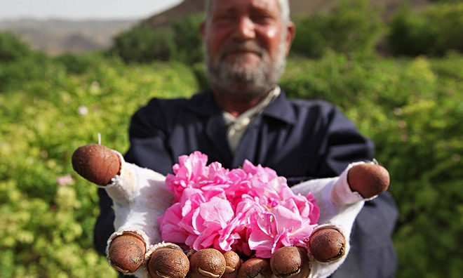
Thank You

