Slide 1
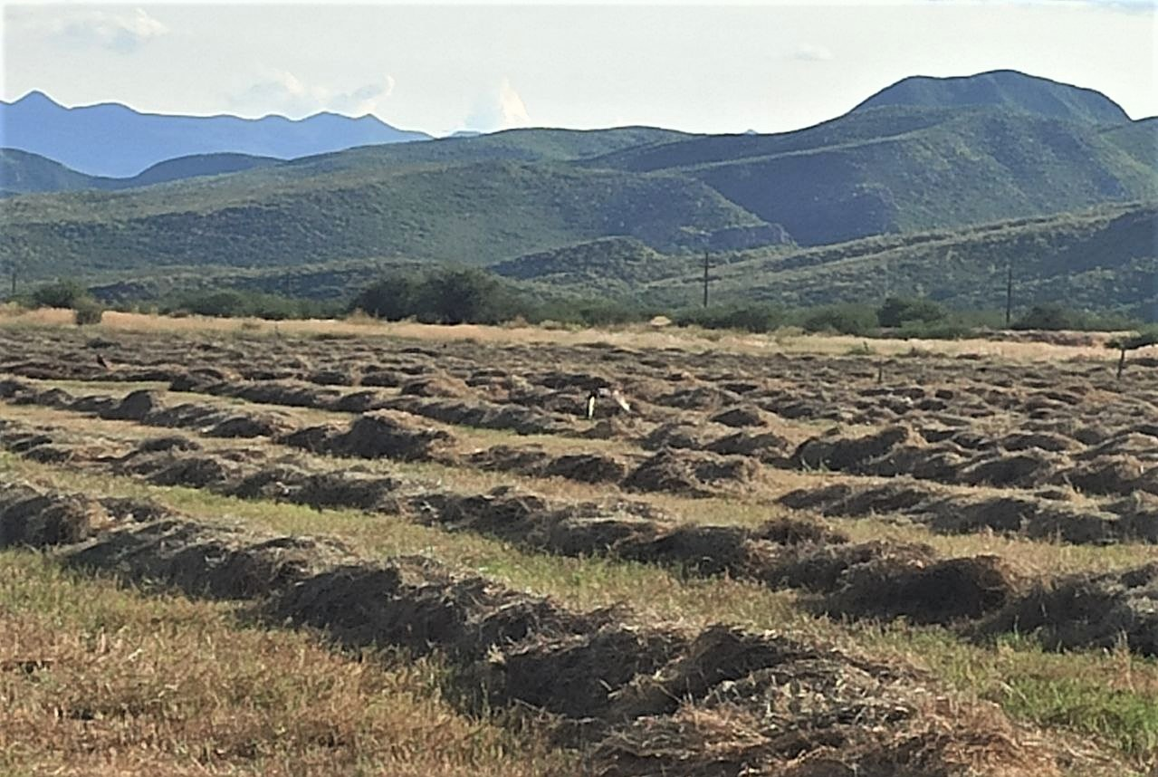
Sustainable Character of Agroproductive Nodes in Intermontane Arid Territories of Sonora, Mexico †
Héctor Tecumshé Mojica-Zárate ¹*
¹Universidad de la Sierra, Moctezuma, Sonora, México, C.P 84560; hectortecumshe@gmail.com
*Correspondence: hectortecumshe@gmail.com; phone: 00 52 (634) 3453622
†1st International Online Conference on Agriculture - Advances in Agricultural Science and Technology
10–25 Feb 2022

Slide 2
Highligths
The sustainability of the agro-productive nodes of the Sonoran Desert is a function of environmental and water limitations, the degree of eco-technological inclusion and the strategic diversification of its production processes.
The objective of this work is to evaluate the inclusion of the ecotechnological approach of an Agroproductive Node with a Sustainable Trend (NATS) in Moctezuma, Sonora, Mexico
The global evaluation of the activity is tending towards a decrease in sustainability and a value of the environmental compatibility trait of 25 BU.
The valuation of the same trait for the new productive approaches included in the node, result from collateral categories that contribute to production and sustainability, among which are distinguished a) Definition and practice of arid tourism with 47 BU, b) Buffer areas for protection of wildlife with 100 BU and c) the use of rescue grazing with 68 BU.

Slide 3
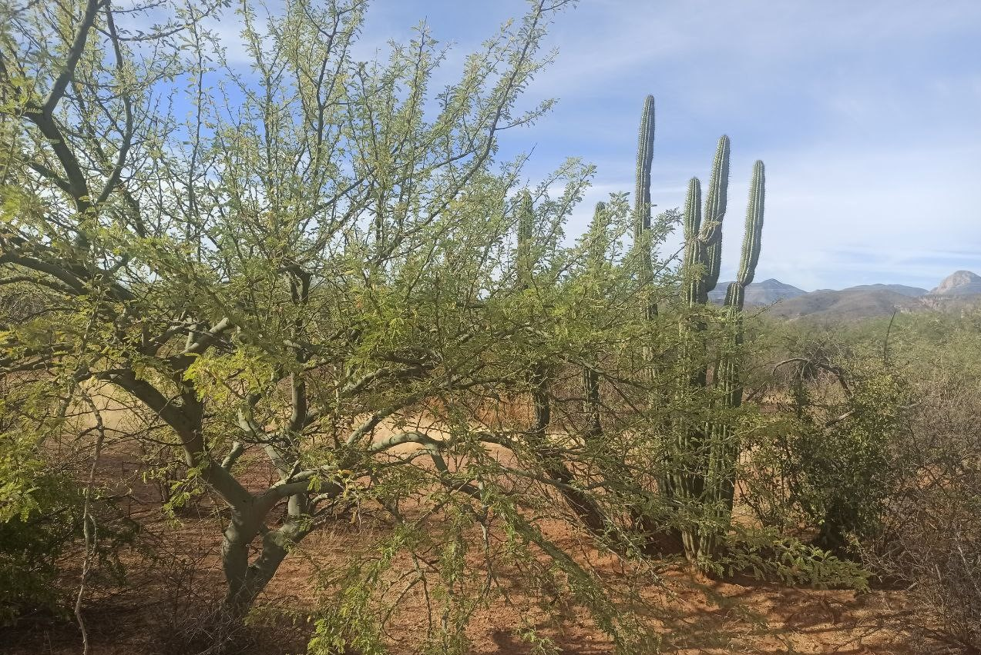
Presentation Items
1. Introduction
2. Methods
3. Results
4. Conclusions
References

Slide 4
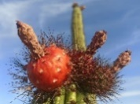
1. Introduction
Integrated and sustainable strategic management in agroproductive nodes
In the management of natural resources in arid Mexican territories, a complex and integrative approach cannot be postponed
There is a diversity of factors related to environmental and climatic risks or catastrophes, determining factors for effective development.
The combination of nodes and their productive interconnection with the sustainable management of resources constitutes the Sustainable Ecotechnological Agrópolis [4,5,16].
General Objective & Specific research aims
2) Define the inclusion of the activity suggested to the node based on the capacity and sustainable and ecotechnological trend from the processes inserted in that activity
1) Assess the aptitude of new sustainable activities for the potential development of the study agro-productive node
Apply an ecotechnological adoption evaluation methodology to an agroproductive hay node in Moctezuma, Sonora, Mexico.

Slide 5
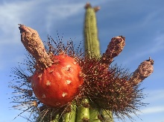
2. Methods
2.1. Study region and site
The study was managed in province of Moctezuma, Sonora, México, 658 above sea level (29°42´ 01´´ N; 109° 39´ 05´´W).
The study area corresponds to a landscape of the Sonoran desert located in an intermontane valley. (Figure 1)
2.2 Elements of the agroproductive node and its identification
The primordial activity is evaluated and compared with those activities of possible insertion to the node. it is necessary to identify:
a) The vulnerable points of the process
b) Establish the risks, respective indicators.
For both cases, a value from 0 to 1 is assigned, defined by the operator of the agroproductive node.
c) Identify the value of the threat (VT) using equation
2.4 Definition of the scale of ecotechnological and sustainable adoption
This scale is applicable in the agroproductive production process.
The pressure exerted must result in a change in the processes of the agroproductive node, thereby inducing an ecotechnological transition of the node
The change moves from a conventional approach to an ecotechnological state, which reduces the vulnerability and risk of the agroproductive node.
2.3 Selection criteria of the elements or activities of the agroproductive node
To choose the activities or elements of the agroproductive node in transition, the following conditioning criteria were taken
a) Vulnerable processes or with potential risks, that represent athreat to the existence of the node
b) The options for the use of natural resources generate a sustainable activity
c) Products or services with a sustainable category
d) Contributes to the development and food security of the comunity
Climate Dry semi-warm with rains in summer BS0hw (x '), with maximum and minimum temperatures in the range of -3 to 48 ° C

Slide 6
Figure 1. Location of the arid territory of Moctezuma, Sonora, Mexico.

Slide 7
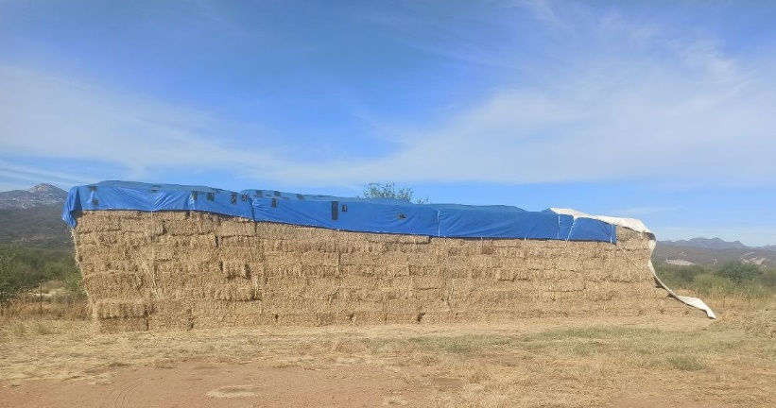
Risk identification
Vulnerability Quantification
The vulnerable points of the process
Establish the risks
Vulnerability traits
Respective indicators
Importance value and numerical value
The node operator assigns a value from 0 to 1
The node operator assigns a value from 0 to 1
Resulting threat
Identify the value of the threat
VT = PVV x RV
Low or tolerable: Between 0 – 5.
Medium or Latent: > 5 and < 10.
High or imminent: > 10
Figure 2: Elements of the agroproductive node and its identification

Slide 8
Figure 3: Selection criteria of the elements or activities of the agroproductive node (during the period 2021 – 2021)
2020
2021
Vulnerability
Sustainable I
Sustainable II
Development
Vulnerable processes or with potential risks, that represent a threat to the existence of the node
The options for the use of natural resources generate a sustainable activity
Results are products or services with a sustainable category
Contributes to the development and food security

Slide 9
1
Food security
Biophysical characteristics
Minimal environmental impact
3
Vision or projection
Selection criteria of the elements or activities
Local development
Technical characteristics
Results are products or services
Financial characteristics
2
Vulnerable processes
4
Options for the use of Natural Resources
Potential risks.
Figure 4: Selection criteria of the elements or activities of the agroproductive node

Slide 10
Table 1. Fundamentals of the Braden Scale adapted for the ecotechnological insertion in the elements of the agroproductive node
Score¹ | 1 | 2 | 3 | 4
Process versatility | Completely rigid | Rigid in some parts | Rigid but open to change | Completely innovative and open to change
Water requirement | More than 24 hours | Between 12 and 24 hours | One hour a day | Rarely, once a month
Resilience in the natural resources involved | Nil | Low resilience in all | Partial resilience | Resilience in all
Consumption dynamism | Consumed more than twice per week | Consumed more than twice per season | Consumed twice per season of the year | In one season of the year
Contribution to the ecosystem, economy or food security | Does not offer immediate contribution | Only to the ecosystem | To the ecosystem and flow in the local economy | Total contribution
Environmental compatibility | Not compatible | Moderate | High | Very high
¹ Each value represents a quartile of ecotechnological adoption in the agroproductive node process

Slide 11
3. Results
3.1 Analysis of the agroproductive process of the original activity in Moctezuma, Sonora, México
The original activity is oriented to the production of hay from Alfalfa and Sorghum, the vulnerable stages of the process and their respective score.
Identification of vulnerable stages of the process were: Planting, Irrigation, Growth – Development, Cut – baled, Storage with importance values ​​between medium and very high
3.2 Identification of Risk Indicators
Those directly linked to the main activity of hay production were identified as main risks. The faults, shortcomings or deficiencies of the inputs in some part of the process stand out.
3.3. Alternatives for the transition of node of study
The main attributes identified according to the criteria defined in the methodology were: a) Biophysical characteristics, b) Projection of the node, c) Technical capacity, and d) Financial capacity:
The alternative activities identified for the ecotechnological conversion of the node, were : The practice of aridtourism (14 - 93 BU), Areas for the protection of wildlife (12 - 100 BU), and Rescue grazing use 36 - 86 BU).
The assigned values ​​ranged, according to the operator, from 0.23 for germination failure, to 0.97 for the necessary irrigation water for growth; 0.95 for hours of irrigation with electricity and 0.62 for low prevalence of plants in the meadow

Slide 12
Table 2. Identification of vulnerable stages of the process
Process vulnerability | Vulnerability trait | Importance value | Assigned value*
Planting | The seed loses its germinative capacity | High | 0.85
Irrigation | Water is not available due to lack of electricity | Very high | 0.95
Growth - Development | Lack of water / nutrients | High | 0.85
Cut – baled | Machinery in bad condition or lack of fuel | Middle | 0.50
Storage | Putrefaction or combustion | Middle - high | 0.5 – 0.85
* Assigned by the operator of the agroproductive node

Slide 13
Table 3. Identification of risks indicators of the process
Risk | Indicator | Assigned value*
Lack or failure of germination (LFG) | Number of lost or unviable seeds | 0.23
Inefficient use of water (IUW) | Number of liters of water needed for growth | 0.97
Inefficient use of energy (UIE) | Number of hours of irrigation applied with electricity | 0.95
Infertile soil or soil with pathogens (ISP) | Number of hectares without vegetation or low plant density | 0.62
* Assigned by the operator of the agroproductive node

Slide 14
Table 4. Quantifying the value of the threat in the nodeo of Moctezuma, Sonora, México
VULNERABLE POINT OF THE PROCESS | VALUE | RISK | RISK VALUE | VALUE OF THE THREAT FOR EACH PROCESS
PLANTING | 0.85 | LFG | 0.23 | 0.1955
 | 0.85 | IUW | 0.97 | 0.8245
 | 0.85 | UIE | 0.95 | 0.8075
 | 0.85 | ISP | 0.62 | 0.527
IRRIGATION | 0.95 | LFG | 0.23 | 0.2185
 | 0.95 | IUW | 0.97 | 0.9215
 | 0.95 | UIE | 0.95 | 0.9025
 | 0.95 | ISP | 0.62 | 0.589
GROWTH - DEVELOPMENT | 0.85 | LFG | 0.23 | 0.1955
 | 0.85 | IUW | 0.97 | 0.8245
 | 0.85 | UIE | 0.95 | 0.8075
 | 0.85 | ISP | 0.62 | 0.527
CUT – BALED | 0.5 | LFG | 0.23 | 0.115
 | 0.5 | IUW | 0.97 | 0.485
 | 0.5 | UIE | 0.95 | 0.475
 | 0.5 | ISP | 0.62 | 0.31
STORAGE | 0.675 | LFG | 0.23 | 0.15525
 | 0.675 | IUW | 0.97 | 0.65475
 | 0.675 | UIE | 0.95 | 0.64125
 | 0.675 | ISP | 0.62 | 0.4185
 |  |  |  | 10.59525

Slide 15
Technical capacity
Projection of the node
Sufficient to moderate, with necessary technical support for the development of low-energy eco-technologies
To be a diverse node in the activities aimed at fulfilling the SDGs. Presents innovative activities and ideas
Biophysical characteristics
Financial capacity
Soils with 73% fertility level. 46% erosion, 67% vegetation cover; existence of native vegetation - pristine in 95% of the area, 5% slope of the land. Presence of faunal diversity
Sufficient for the development of ecological projects that require low investment
5. Conditioning criteria for the adoption of potential productive activities

Slide 16
Alternatives for the transition of node of study
Rg
HP
Hay production
Original activity
Rescue grazing use (36 - 86 BU)
Provides a healthy soil cover without pressure from trampling or soil erosion.
PW
At
Areas for the Protection of Wildlife (12 - 100 BU),
The purpose is to conserve undisturbed spaces on the site for the maintenance of migratory and local species
Aridtourism (14 - 93 BU), Values spaces that are direct to the environment and focused on the appreciation of nature
Rg
HP
PW
At
6. Alternatives for the transition towards a sustainable ecotechnological management of the agroproductive node of Moctezuma, Sonora, Mexico

Slide 17
Figure 6. Comparison of the level of ecotechnological inclusion in the activities of the agro-productive node under study using the Braden scale

Slide 18
Figure 6. Comparison between the main activity of the node and aridtourism

Slide 19
Figure 7. Comparison between the main activity of the node and Buffer areas to protect wildlife in the node of Moctezuma, Sonora, México

Slide 20
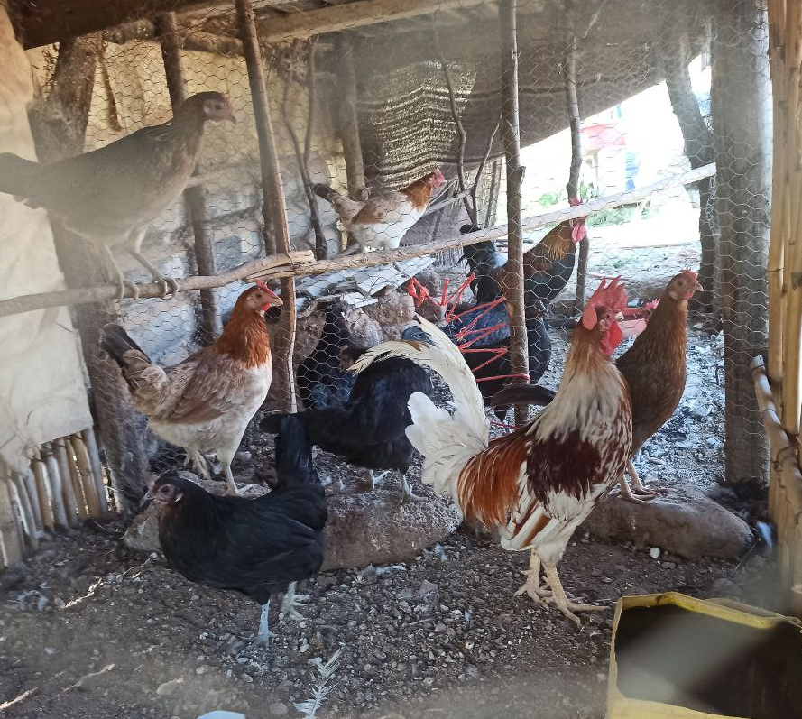
Represent an alternative for food security and for local-regional self-consumption
01
02
The level of ecotechnology adoption is influenced by the physical-climatic conditions and the climatic emergency.
03
Severe conditions of a climatic nature occur in various ways during the seasons of the year in the arid territories of study
04
It guarantees the existence of supplies and food for local users under an eco-technological production approach.
Figure 7. Importance of agricultural production systems in arid Mexican territories & Level of ecotechnology adoption

Slide 21
4. Conclusions
In the node for hay production in Moctezuma, Sonora, Mexico, diversity traits were identified in the existence of resources, capacities and biophysical aptitudes.
The complex integration as well as the link in the optimal and sustainable use of the natural resources of the node derives from the implementation of the integrated strategic management
Both the sustainable and ecotechnological capacity of the node, as well as its gradual changes in the processes over time, were determined in Braden Units.
The essential for the pragmatism of sustainability was valued with the various strategies applied in the activities included in the agroproductive node

Slide 22
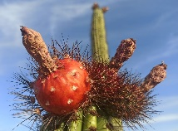
References
Shongwe, M.I.; Bezuidenhout, C.N.; Sibomana, M.S.; Workneh, T.S.; Bodhanya, S.; Dlamini, V.V. Developing a Systematic Diagnostic Model for Integrated Agricultural Supply and Processing Systems. Systems 2019, 7, 15. https://doi.org/10.3390/systems7010015.
Molina Benavides, R.A.; Campos Gaona, R.; Sánchez Guerrero, H.; Giraldo Patiño, L.; Atzori, A.S. Sustainable Feedbacks of Colombian Paramos Involving Livestock, Agricultural Activities, and Sustainable Development Goals of the Agenda 2030. Systems 2019, 7, 52. https://doi.org/10.3390/systems7040052
Langarudi, S.P.; Maxwell, C.M.; Fernald, A.G. Integrated Policy Solutions for Water Scarcity in Agricultural Communities of the American Southwest. Systems 2021, 9, 26. https://doi.org/10.3390/systems9020026
Balanay, R.; Halog, A. A Review of Reductionist versus Systems Perspectives towards ‘Doing the Right Strategies Right’ for Circular Economy Implementation. Systems 2021, 9, 38. https://doi.org/10.3390/systems9020038

Slide 23
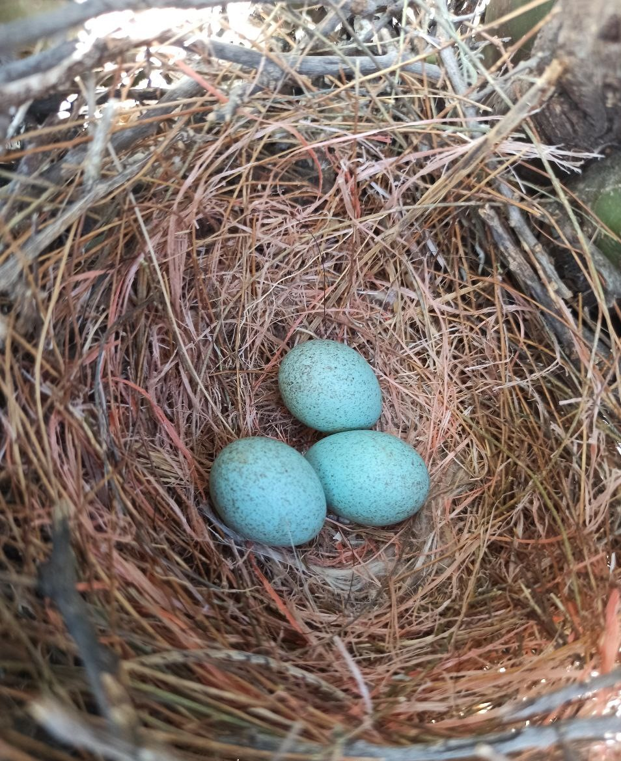
Very grateful for your attention !!
Héctor Tecumshé Mojica-Zárate ¹*
¹Universidad de la Sierra, Moctezuma, Sonora, México, C.P 84560; hectortecumshe@gmail.com/htecumshe@unisierra.edu.mx
*Correspondence: hectortecumshe@gmail.com; phone: 00 52 (634) 3453622
†1st International Online Conference on Agriculture - Advances in Agricultural Science and Technology
10–25 Feb 2022

Slide 24
Photo album
By Héctor T. Mojica

Slide 25
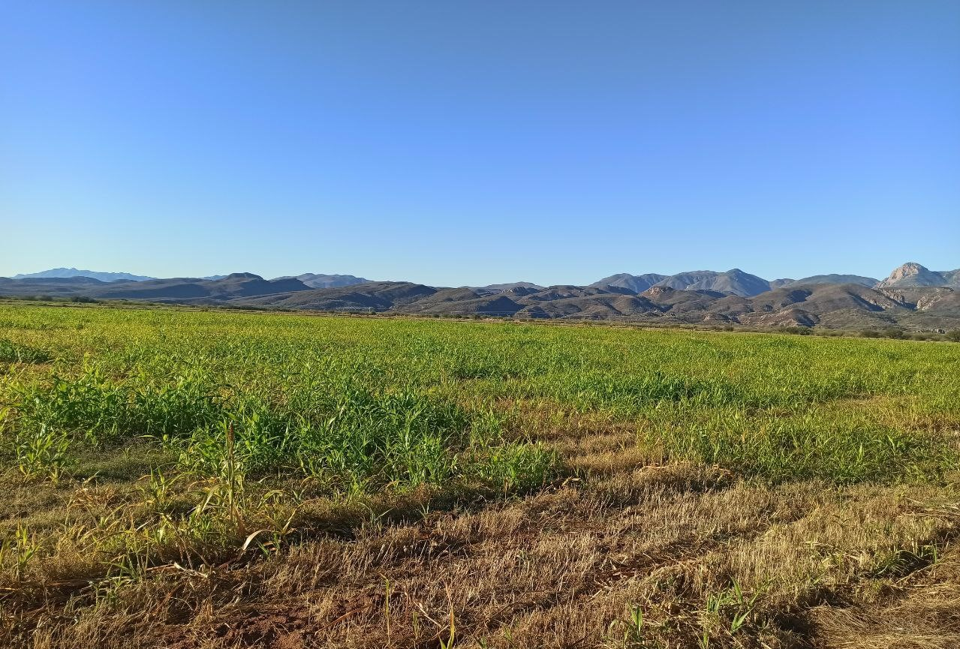
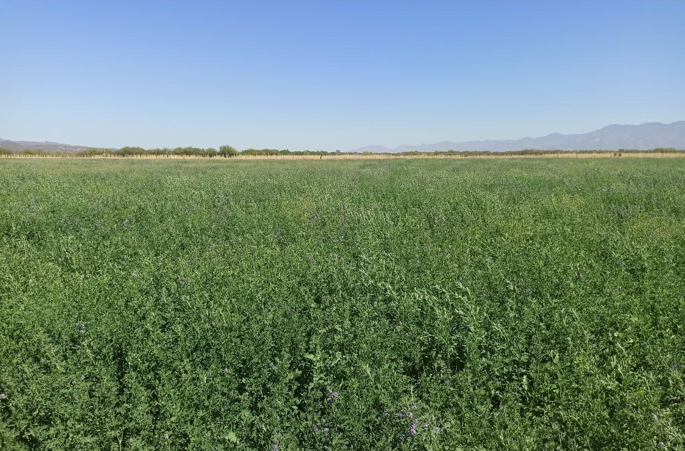
Grazing area & Alfalfa meadow for hay

Slide 26
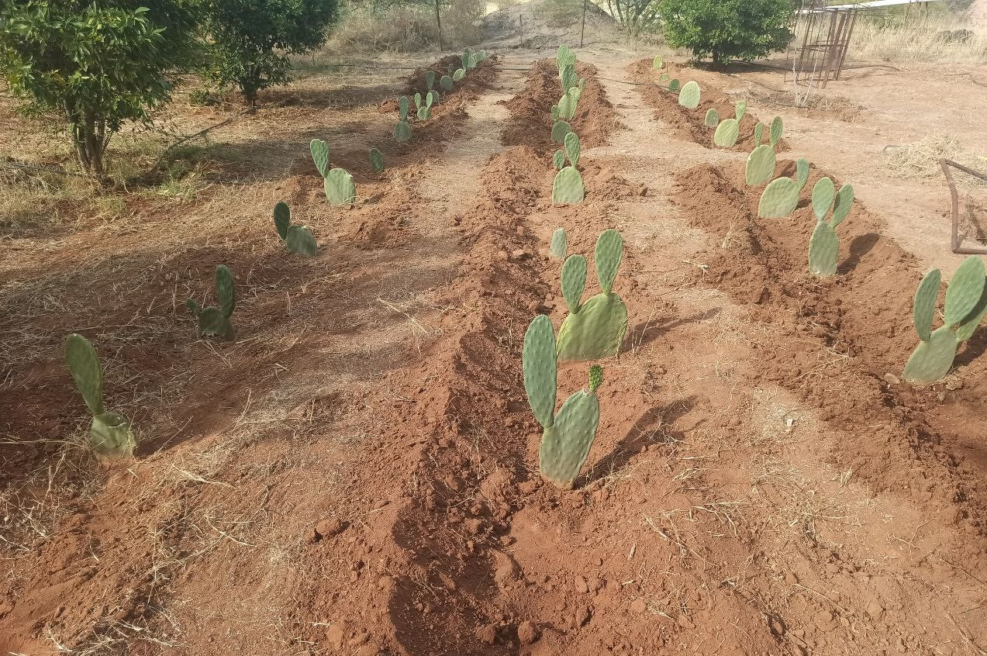
Xeric orchards and establishment of organic vineyards (next slide) as potential activities in the agro-production node

Slide 27
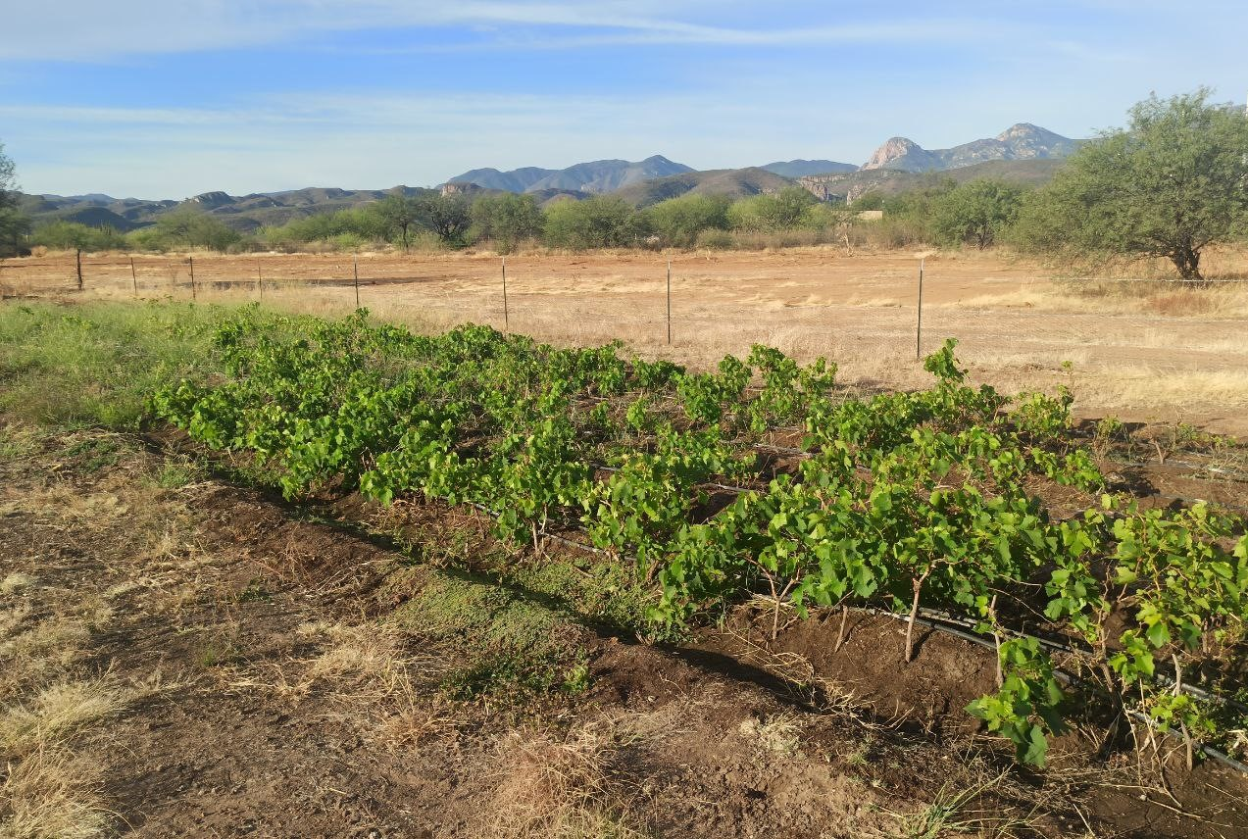
Establishment of organic vineyards

Slide 28
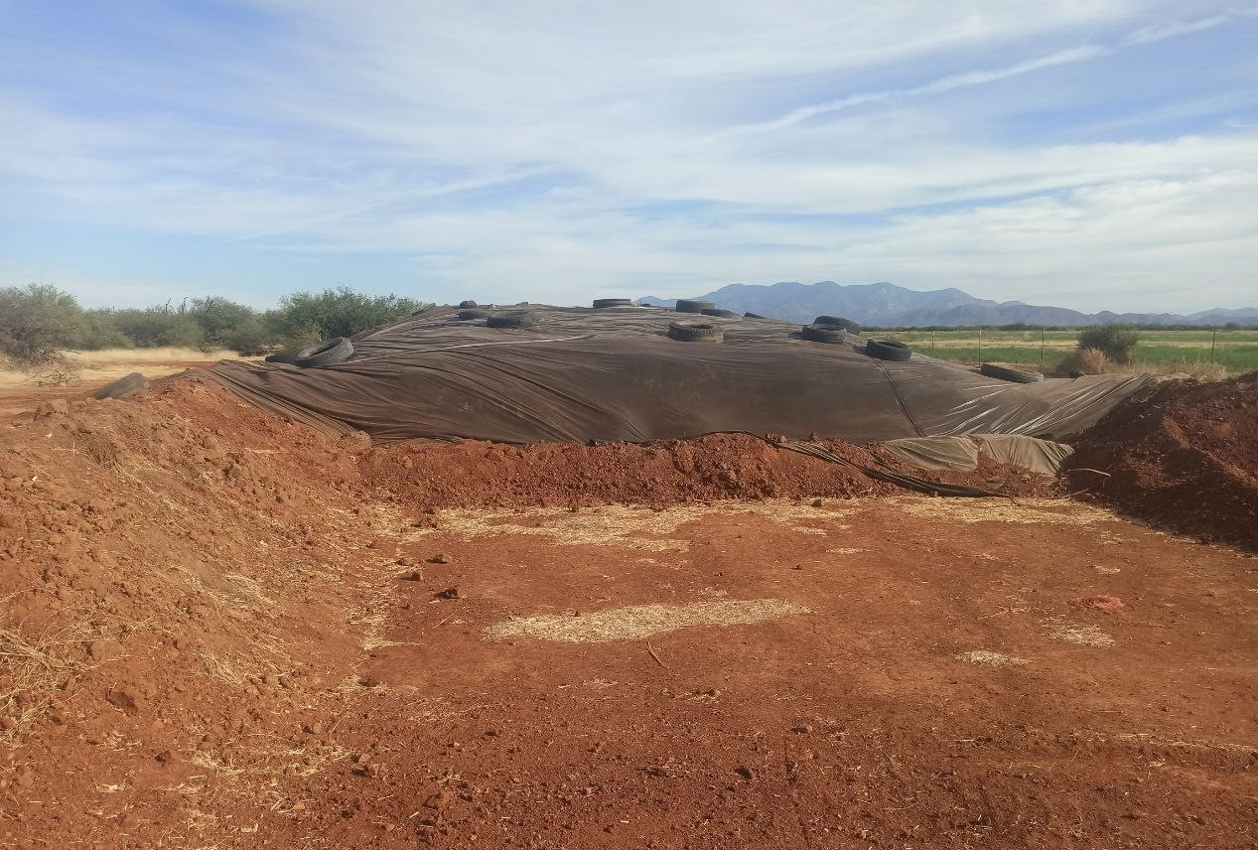
Silage generation processing in the study node in the arid territory of Moctezuma, Sonora, Mexico

Slide 29
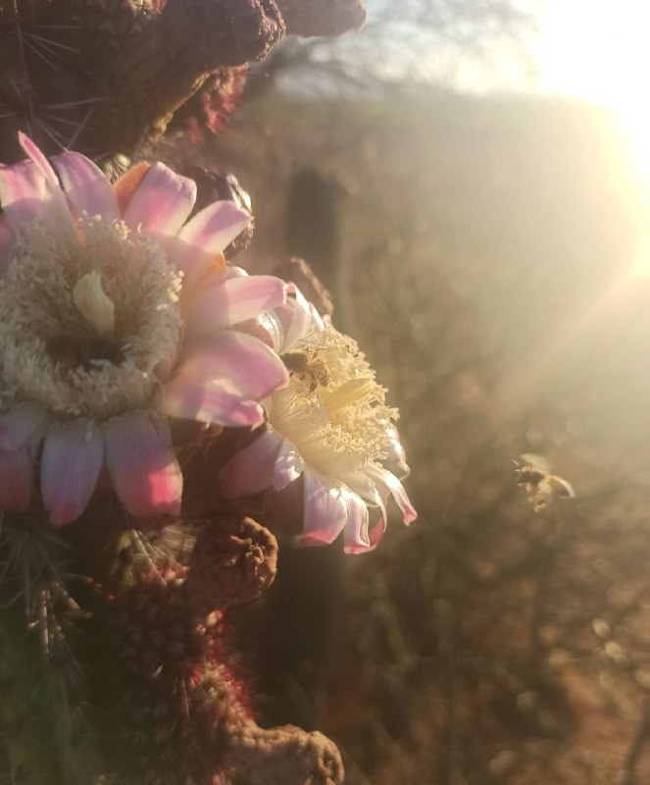
Buffer areas to protect the flora and fauna

Slide 30
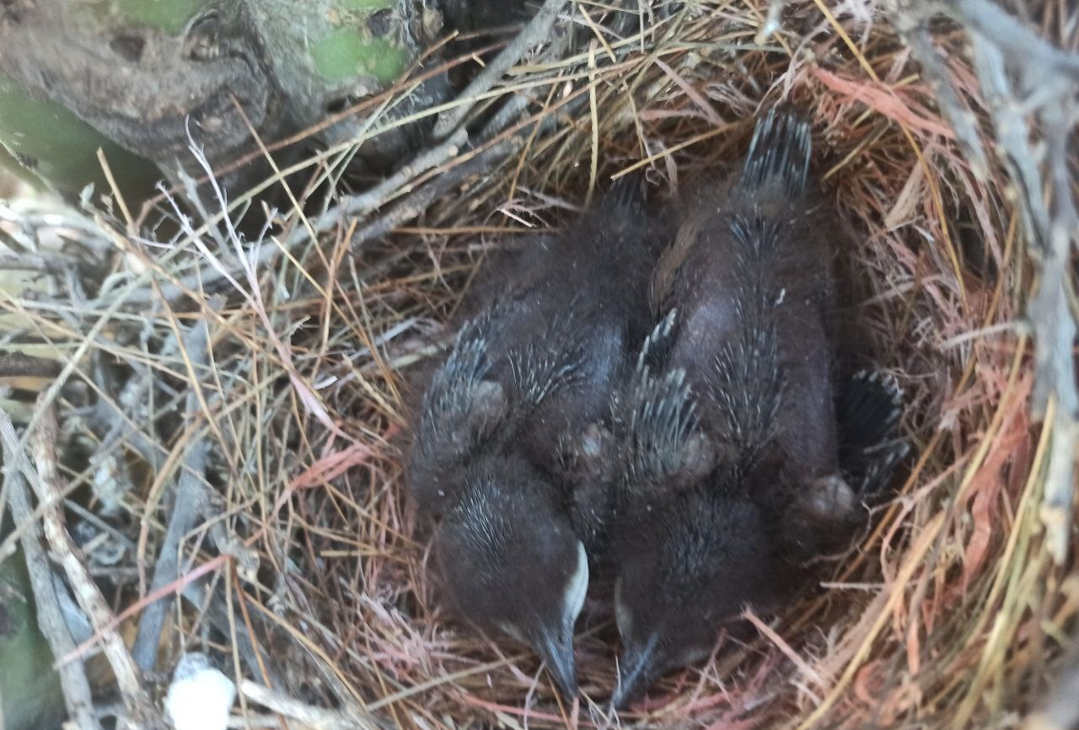
Buffer areas to protect the flora and fauna( continuation)

