Slide 1
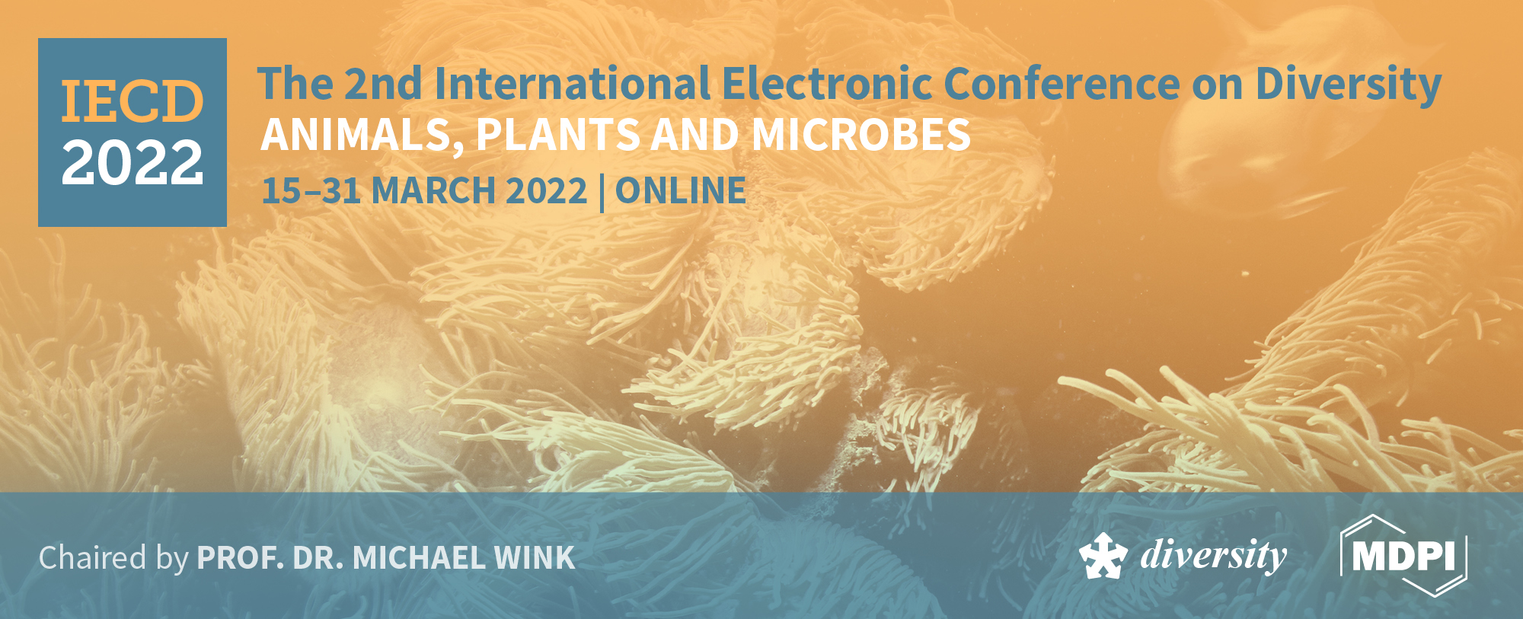



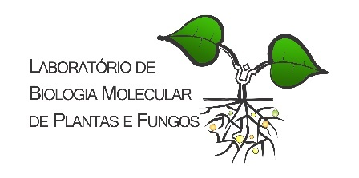


Title of the Presentation
Fábio São Pedro da Silva ¹; Itamar Garcia Ignácio ²; Sandra Zorat Cordeiro ¹, Orivaldo José Saggin-Júnior ² and Camila Maistro Patreze^{1*}
¹Department of Botany, Center for Life Sciences and Health, Federal University of Rio de Janeiro State (UNIRIO), 22290-255, Rio de Janeiro, RJ, Brazil; fabio_wk@hotmail.com; sandrazorat@hotmail.com; camila.m.patreze@unirio.br
²Embrapa Agrobiologia, Rodovia BR-465, km 7, Ecologia, 23891-000, Seropédica, RJ, Brazil; itamar.ignacio@embrapa.br; orivaldo.saggin@embrapa.br
*Corresponding author: camila.m.patreze@unirio.br

Slide 2

Contrasting Coastal Ecosystems in Cabo Frio, Brazil alter the correlations between Plant Species and Arbuscular Mycorrhizal Fungi Community
Abstract: Contrasting coastal ecosystems, dune and restinga, in Peró Beach, Cabo Frio, State of Rio de Janeiro altered the correlations between the spatial patterns of the Arbuscular mycorrhizal fungal (AMF) and the diversity of plants. We recorded, during rainy and dry seasons in 2014, a total of 35 plant species. Ipomoea imperati, Stenotaphrum secundatum, Hydrocotyle bonariensis and Remirea maritima were the most common. Higher plant species richness was found in restinga over dune in both seasons. Considering that coastal environments occupy large areas around the world, we consider that the AMF-plant relationships evidenced here may contribute to conservation of these environments.
Keywords: coastal ecosystems; dune; restinga; plant diversity; glomeromycota.

Slide 3
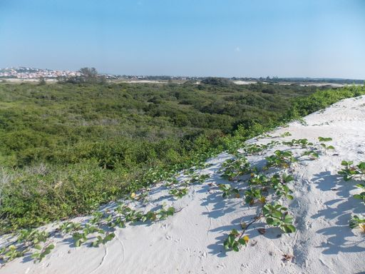
Peró Beach, Cabo Frio, Rio de Janeiro, Brazil
restinga
dune

Slide 4
Results and Discussion
Experimental area: Peró Beach, Cabo Frio, Rio de Janeiro State, Brazil
delimitation of one transect at the dune site
Visualization of one point of sampling in the dune site.

Slide 5
Results and Discussion
Table A1: Botanical species frequency and abundance at two sites (dune and restinga) in rainy (May) and dry (November) seasons

Slide 6
Results and Discussion

Slide 7
Results and Discussion
Table A1: Botanical species frequency and abundance at two sites (dune and restinga) in rainy (May) and dry (November) seasons

Slide 8
Results and Discussion

Slide 9
Table 1. Ecological indices by site (dune and restinga) in the rainy (May) and dry seasons (November) in Peró Beach, Cabo Frio, RJ.
Site | Sampling season | Total of individuals | Richness | Shannon (H´) | Dominance (D) | Equitability (J´)
Dune | Rainy (May) | 79 | 16 | 2.3480 | 0.1226 | 0.8468
 | Dry (Nov) | 92 | 10 | 1.9580 | 0.1685 | 0.8505
Restinga | Rainy (May) | 71 | 23 | 2.7940 | 0.0811 | 0.8912
 | Dry (Nov) | 45 | 19 | 2.6720 | 0.0913 | 0.9076
abundance
diversity

Slide 10
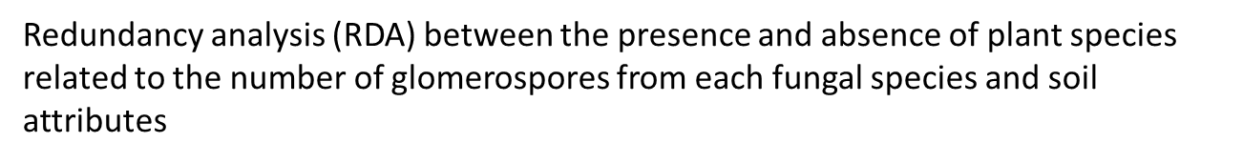
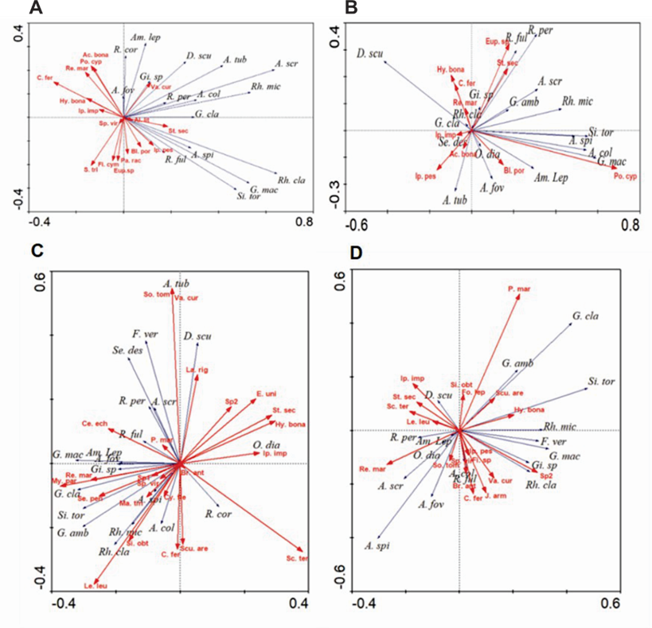
dune
Rainy
Dry

Slide 11



restinga
The same plant species was positively related to a fungus in one season and to another fungus species in another season, contributing to evidence that edaphic and environmental factors can govern these associations.

Slide 12
Supplementary Materials
Table. Results of the permutation test to compare the mean values of dune (D) and restinga (R) community`s richness, dominance, diversity (Shannon) and equitability between rainy (1) and dry (2) seasons

Slide 13


Acknowledgments
This research was funded by Coordination of Improvement of Higher Level Personnel (CAPES) and Research Support Foundation of the State of Rio de Janeiro (FAPERJ), grant number E-26/010.001075/2015.

