Slide 1
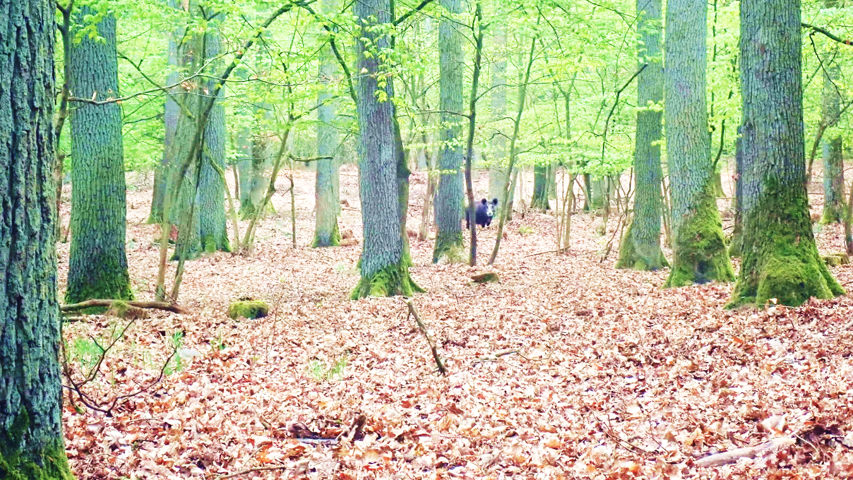
Determinants of diversity of caterpillars, leaf miners and gallers on individual oak trees in a forest
Freerk Molleman fremol@amu.edu.pl
Urszula Walczak
Iwona Melosik
Edward Baraniak
Łukasz Piosik
Andreas Prinzing
Funded by Naradowe Centrum Nauki
(Polish National Science Foundation)
OPUS grant 2018/29/B/NZ8/00112
IECD-2022

Slide 2
Introduction
Individual trees of a given species vary in
Phenology
Size/age
Genetic traits
Neighbourhood
Herbivorous insects vary in
Phenology
Life history traits
Feeding mode
Host plant specialization
Dispersal traits

Slide 3
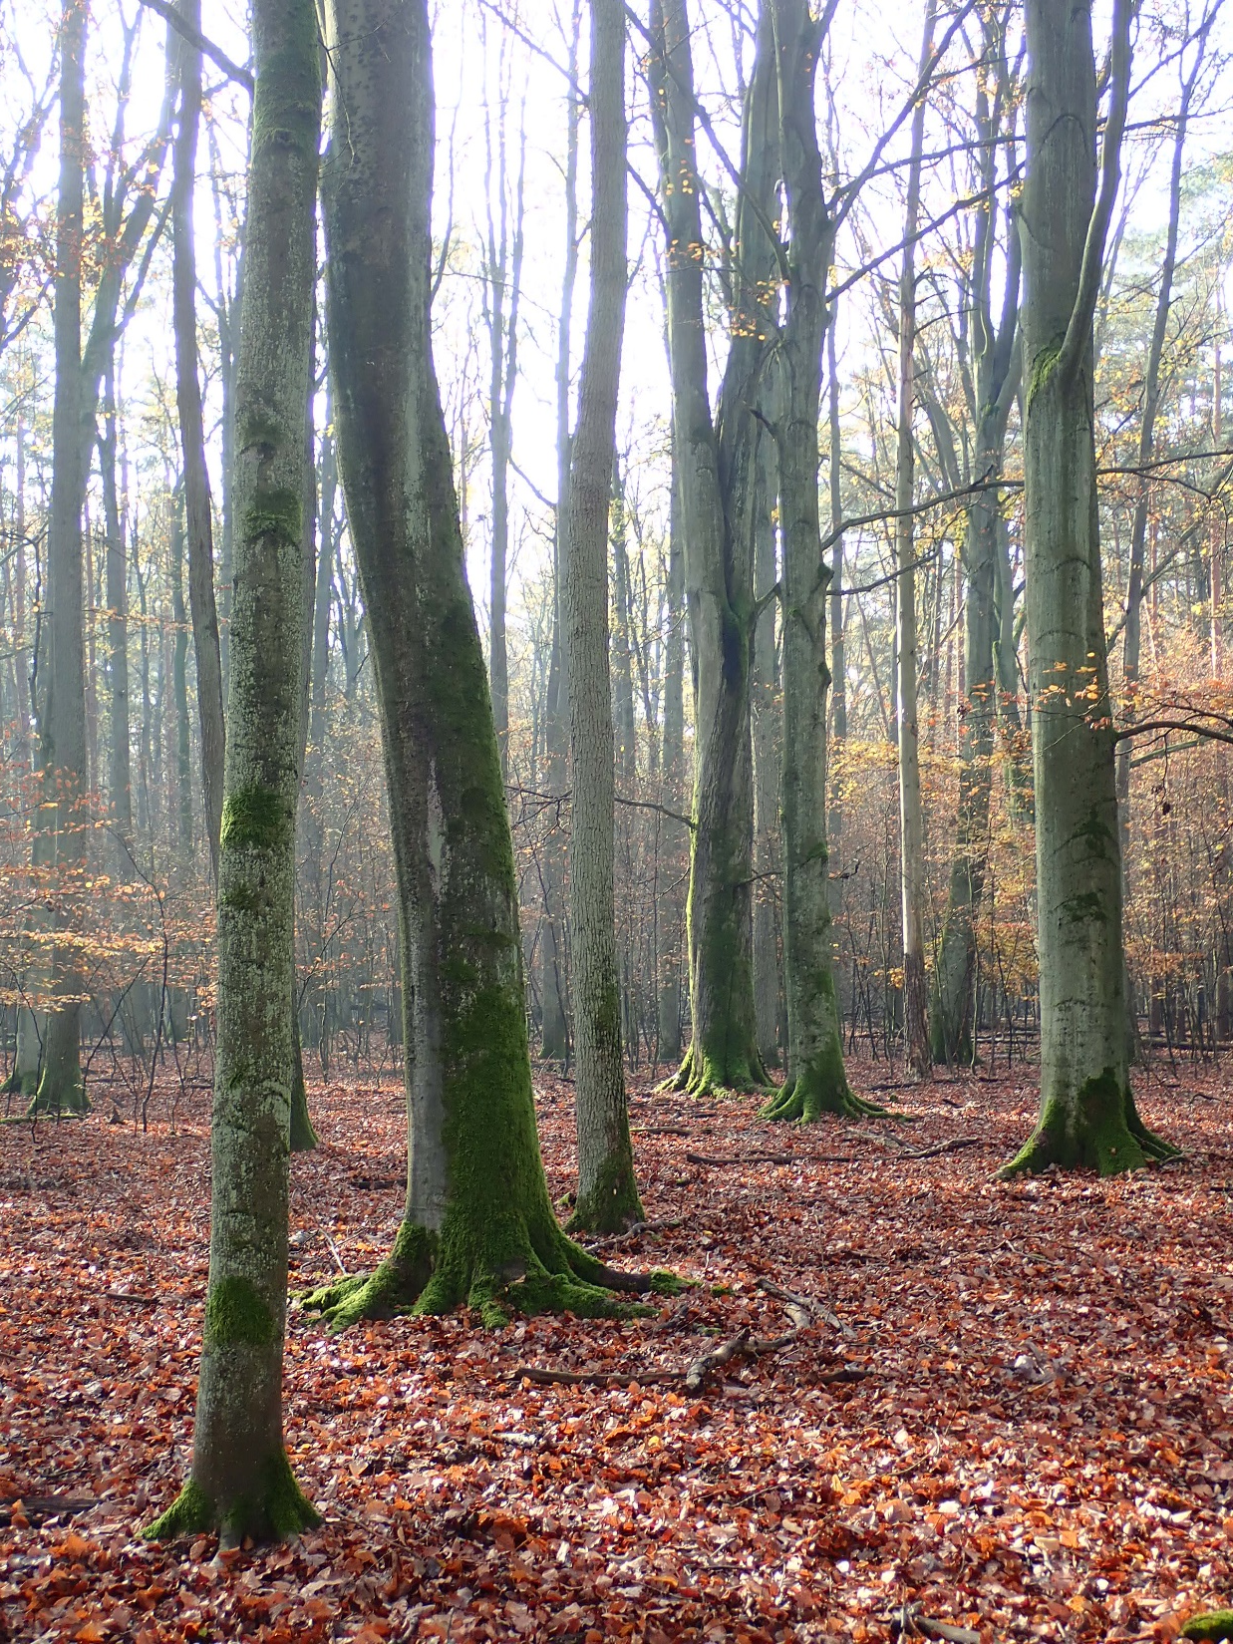
Question:
Introduction
What determines the…
… abundance,
… diversity,
… community composition
of different groups of herbivorous insects
on individual trees in a forest?

Slide 4
Introduction
Kuster et al. 2008
Leaf development
Budburst timing
Within populations variation among trees in budburst date ~ 3 weeks
Can affect certain herbivorous insects
Knock-on effects on other species, diversity
Time of sampling
Hunter, M.D. (1992), A variable insect–plant interaction: the relationship between tree budburst phenology and population levels of insect herbivores among trees. Ecological Entomology, 17: 91-95.

Slide 5
Introduction
Leaf development
Tree development
Budburst
Age
Time of sampling
size
Larger and older trees …
… have had more time to accumulate herbivorous insect species
… local insect populations experience lower rate of extinction
… are easier to find for insects
… offer a larger variety of micro habitats
Campos, R. I., H. L. Vasconcelos, S. P. Ribeiro, F. S. Neves, and J. P. Soares. 2006. Relationship between tree size and insect assemblages associated with Anadenanthera macrocarpa. Ecography 29:442-450.

Slide 6
Introduction
Leaf development
Tree development
Micro-evolution
Budburst
Lineage
Age
(Time of sampling)
Heterozygosity
size
Genome size
Within population variation in genetic traits
Insect community parameters
Wimp, G. M., G. D. Martinsen, K. D. Floate, R. K. Bangert, and T. G. Whitham. 2005. Plant genetic determinants of arthropod community structure and diversity. Evolution 59:61-69.

Slide 7
Introduction
Leaf development
Tree development
Micro-evolution
Neighbourhood
Lineage
Budburst
Distance
Age
Heterozygosity
(Time of sampling)
size
Genome size
Heterogeneity
Identity of neighbouring trees can affect insects through …
… the number of potential colonizers
… the propensity of insects to leave the tree
… affecting leaf quality (competition, allelopathy, mutualism)
Vialatte, A., R. I. Bailey, C. Vasseur, A. Matocq, M. M. Gossner, D. Everhart, X. Vitrac, A. Belhadj, A. Ernoult, and A. Prinzing. 2010. Phylogenetic isolation of host trees affects assembly of local Heteroptera communities. Proceedings of the Royal Society B: Biological Sciences 277:2227-2236.
Charnov, E. L. 1976. Optimal foraging, the marginal value theorem. Theoretical population biology 9:129-136.
Castagneyrol, B., D. Bonal, M. Damien, H. Jactel, C. Meredieu, E. W. Muiruri, and L. Barbaro. 2017. Bottom‐up and top‐down effects of tree species diversity on leaf insect herbivory. Ecology and evolution 7:3520-3531

Slide 8
Phylogenetic Isolation: average phylogenetic distance to neighbouring trees
Introduction
Insects use sets of closely related plant species
More exchange of insects between trees that are closely related
Trees with more closely related neighbours exchange more insects
High Phylogenetic isolation
Less insect movements

Slide 9
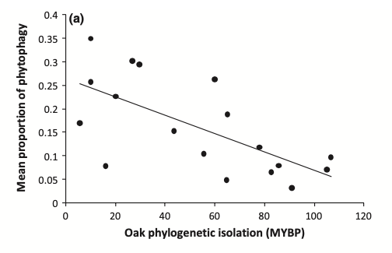
Evidence for phylogenetic isolation affecting insects
Introduction
Leaf damage
Less leaf damage in more phylogenetically isolated trees
Phylogenetic isolation
Yguel B, Bailey R, Tosh ND, Vialatte A, Vasseur C, Vitrac X, Jean F & Prinzing A (2011) Phytophagy on phylogenetically isolated trees: why hosts should escape their relatives. Ecology Letters 14: 1117-1124.

Slide 10
Local adaptation
Introduction
Less immigration -> less geneflow
Less genetic variation for selection to act on
Local adaptation swamped by non-adapted immigrants
Spatial isolation increases local adaptation in leaf miners
Tack, A. J., and T. Roslin. 2010. Overrun by the neighbors: landscape context affects strength and sign of local adaptation. Ecology 91:2253-2260.

Slide 11
Introduction
Time scale of processes:
Days
Years
Millennia
Millions of years
Leaf development
Mechanisms :
Tree development
Micro-evolution
Phylogenetic neighbourhood
Leaf quality affects insect performance
Lineage
Budburst
Distance
Age
Heterozygosity
(Time of sampling)
size
Genome size
Heterogeneity
Leaf quality
Insect
Abundance
Diversity
Community composition

Slide 12
Introduction
Time scale of processes:
Days
Years
Millennia
Millions of years
Leaf development
Tree development
Micro-evolution
Phylogenetic neighbourhood
Mechanisms :
Genome size
Insect movements between trees
Budburst
Distance
Age
Heterozygosity
(Time of sampling)
size
Lineage
Heterogeneity
Abundance
Diversity
Community composition

Slide 13
Introduction
Time scale of processes:
Days
Years
Millennia
Millions of years
Leaf development
Tree development
Micro-evolution
Phylogenetic neighborhood
Mechanisms :
Genome size
Budburst
Distance
Insect adaptation to traits of individual trees
Age
Heterozygosity
(Time of sampling)
size
Lineage
Heterogeneity
Leaf quality
Abundance
Diversity
Community composition

Slide 14
Introduction
Time scale of processes:
Days
Years
Millennia
Millions of years
Leaf development
Tree development
Micro-evolution
Phylogenetic neighbourhood
Mechanisms :
Genome size
Natural enemies reduce insect performance
Budburst
Distance
Age
Heterozygosity
(Time of sampling)
size
Lineage
Heterogeneity
Natural enemies
Movements of natural enemies can be affected by the neighbourhood of the tree and tree size/age
Abundance
Diversity
Community composition
Forkner, R. E., and M. D. Hunter. 2000. What goes up must come down? Nutrient addition and predation pressure on oak herbivores. Ecology 81:1588-1600.
Jactel H, Birgersson G, Andersson S, Schlyter F (2011) Non-host volatiles mediate associational resistance to the pine processionary moth. Oecologia 166:703–711. https://doi.org/10.1007/s00442-011-1918-z

Slide 15
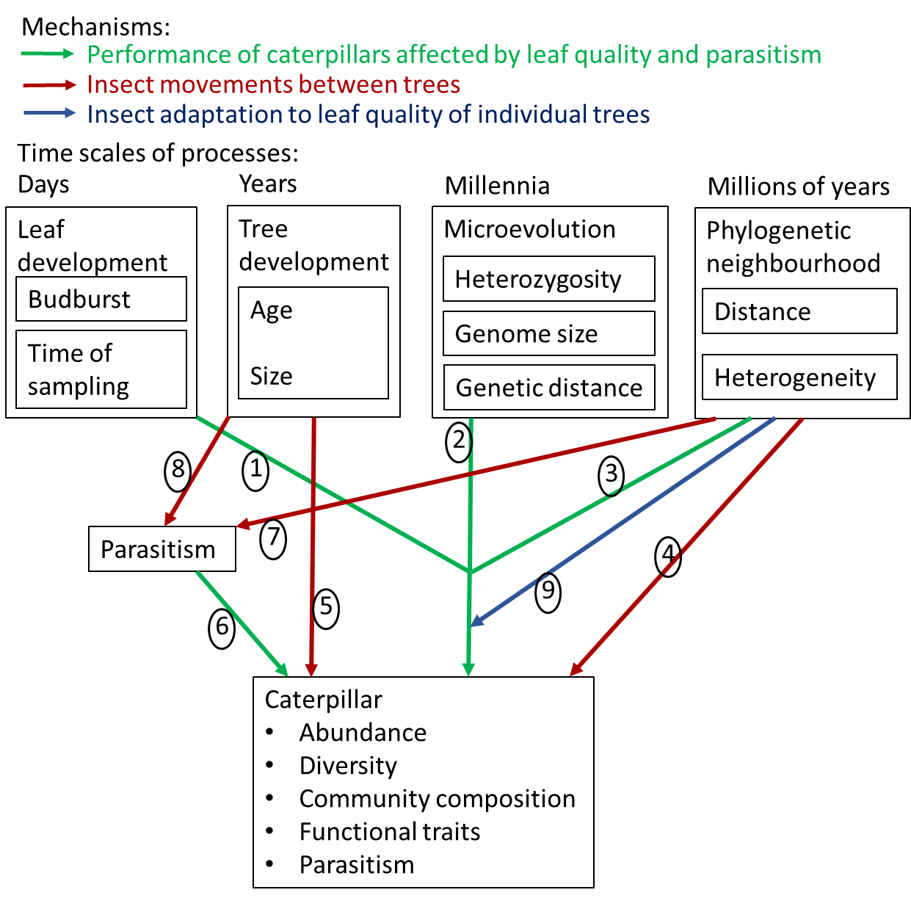
Introduction
Goal:
Relative importance of predictors
Abundances per Guild
Abundances of co-dominant species
Simpson Diversity
Community Composition
Functional Traits
Parasitism

Slide 16
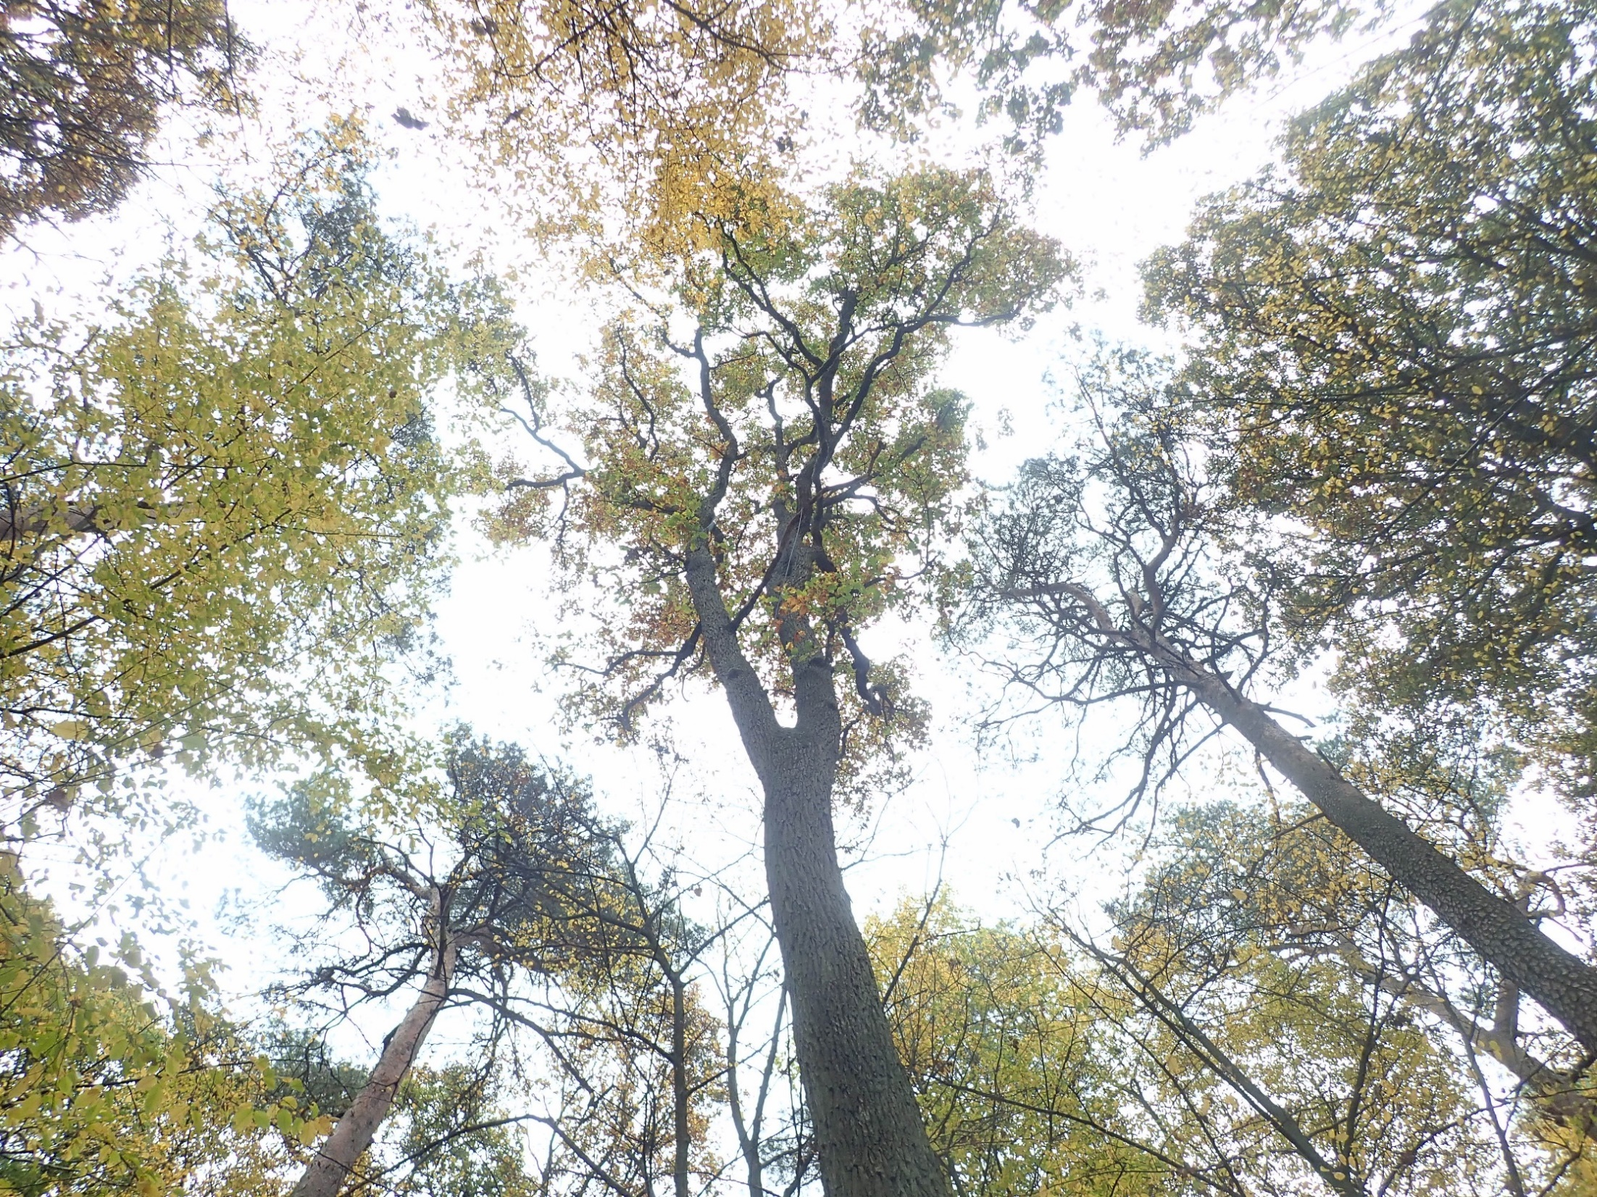
Methods
Puszcza Zielonka, Poland
25 Q. petraea
Budburst
Diameter
20 Micro-satellites
Genome size
Neighbours

Slide 17
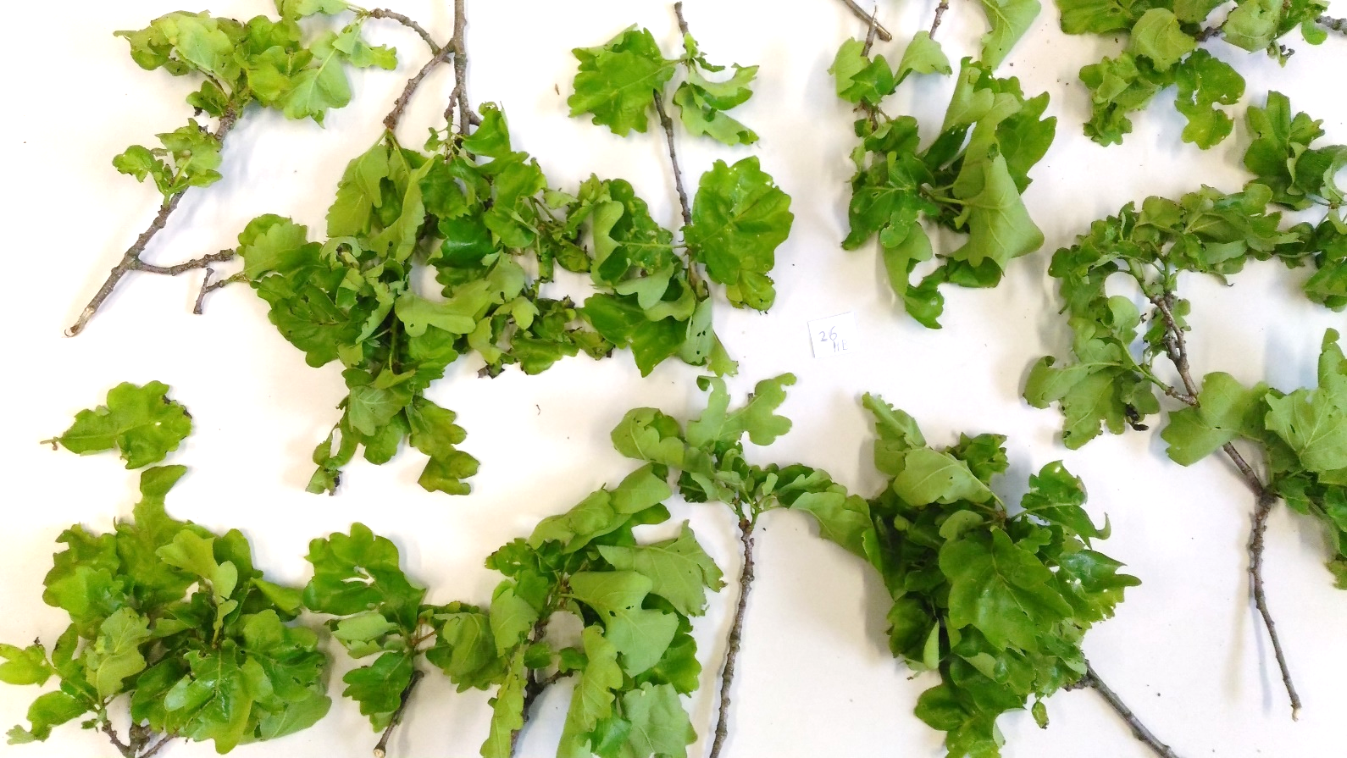
Caterpillar collection & rearing May 2019
Methods
2-4 branches per tree, total 75 samples
612 caterpillars
214 reared to adults
22 species
126 parasitoids

Slide 18
Caterpillar guilds sampled:
Methods
Free-living caterpillars
Semi-concealed caterpillars
Case bearers

Slide 19
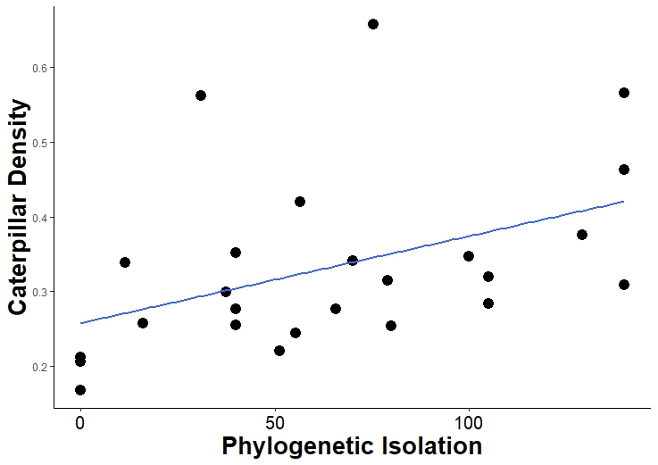
Results
Phylogenetic Isolation increased caterpillar abundance!
Free-living, semi-concealed, casebearers
In contrast to previous study in France...

Slide 20
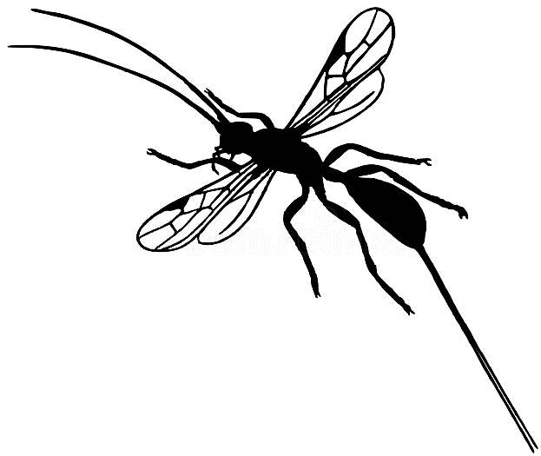
Higher parasitism rate associated with lower abundance in co-dominant species.
Results
Coleophora flavipennella
C. lutipennella
Carcina quercana

Slide 21
Main results for caterpillar abundance
Results
More phylogenetically isolated trees had higher caterpillar abundance (free-living, semi-concealed, and case bearers)
Abundance of co-dominant species lower with higher parasitism rate
Casebearers lower abundance on trees with higher heterozygosity
Hardly any effect of budburst date, diameter, or genetic traits

Slide 22
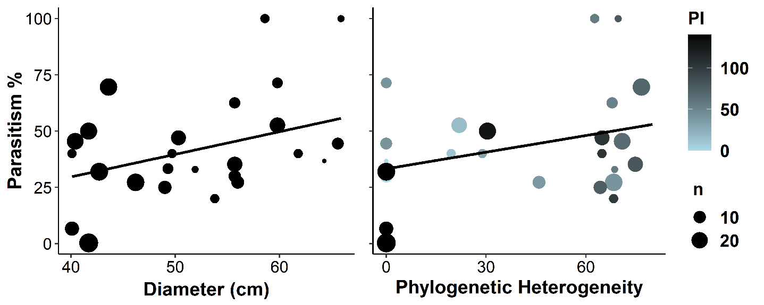
Results
Parasitism rate:
Higher on larger trees
Lower when all neighbours are distantly related (pines)

Slide 23
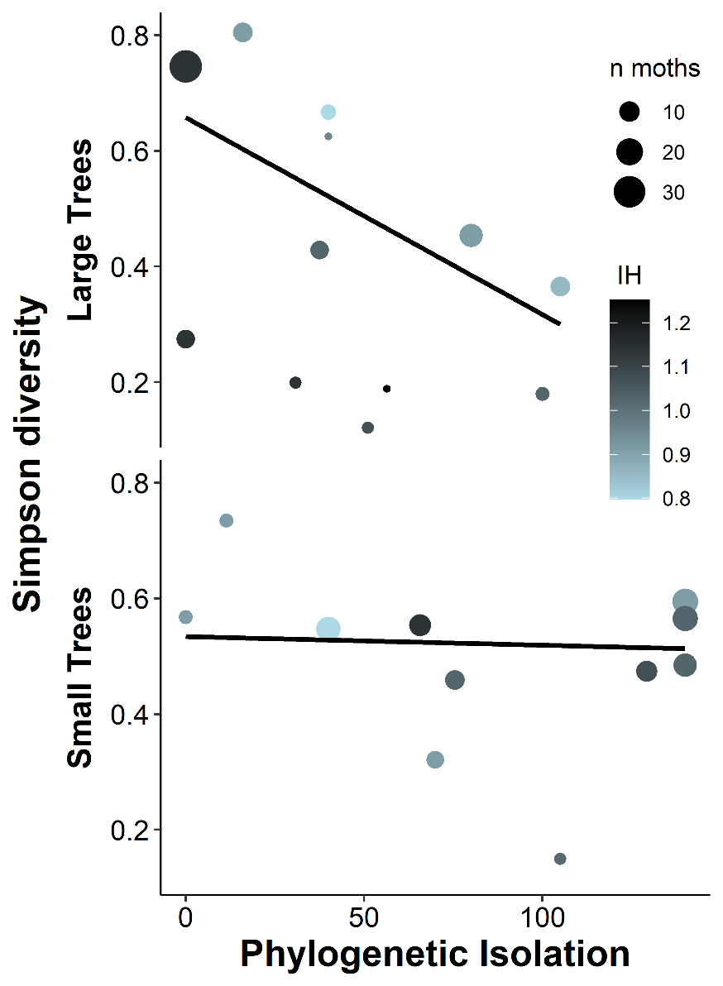
Simpson diversity:
On larger trees, Simpson diversity lower on more phylogenetically isolated trees
Effect of heterozygosity only in model with above interaction
(not robust)
Results

Slide 24
Community composition
Results
Species composition:
Effects of:
Day of sampling
Heterozygosity
Neighbourhood
Functional traits:
No effects on
Wingspan
Host-plant specialization

Slide 25
Discussion
Why higher abundance on more Phylogenetically Isolated trees?
Better leaf quality?
Dispersing insects concentrate on sparse suitable trees?

Slide 26
Random dispersal
Discussion

Slide 27
Nearest host
Discussion
Concentration effect. Haynes, K. J., and J. T. Cronin. 2003. Matrix composition affects the spatial ecology of a prairie planthopper. Ecology 84:2856-2866.

Slide 28
Discussion
Effect of phylogenetic isolation on entire guilds but not on co-dominant species.
Why is neighbourhood important for rarer species?
Rare species rely more on recolonizing trees each year,
while co-dominant species form local populations?
Effect of parasitism rate on co-dominant species but not on entire guilds.
Why is parasitism important for co-dominant species?
Parasitoids are specialists and have functional response: concentrate on common species where they are most abundant?
Common species form local populations -> local correlations?

Slide 29
Conclusions
Albeit only correlative, our results suggest that:
Leaf development across days
decreases free-living caterpillar abundance
Tree growth across decades increases parasitism of herbivores
Heterozygosity in genetic characters evolved across millennia decreases casebearer abundance
High phylogenetic isolation in millions of years
increases abundance of entire caterpillar guilds,
decreases herbivore diversity,
reduces parasitism when neighbours are
consistently distantly related
Parasitism decreases the abundance of dominant caterpillar species.

Slide 30
Message
Communities appear driven by local trophic interactions selecting for particular herbivore species rather than by random movements among trees.
Oaks are worse off in phylogenetically diverse stands, contrary to results of most previous studies.
Thank you!
Fieldwork was carried out with kind permission of the Forestry Experimental Station in Murowana Goślina (Poznan University of Life Sciences). Microsatellite fragment analysis by capillary electrophoresis was performed by the Molecular Biology Techniques Laboratory (Faculty of Biology, Adam Mickiewicz University in Poznań). We are grateful to Joanna Ziomek and Urszula Eichert-Nowak for their help with searching for caterpillars. The research was funded by grant No. 2018/29/B/NZ8/00112 to FM from the National Science Centre (NCN, Poland).

