Slide 1
Small Mammal Diversity and Abundance in Commercial Orchards in Relation to Habitat and Agricultural Factors
Vitalijus Stirkė*, Linas Balčiauskas, and Laima Balčiauskienė
Nature Research Centre, Akademijos 2, Vilnius, Lithuania
* Corresponding author: vitalijus.stirke@gamtc.lt
Notes:
Hello, I am Vitalijus Stirkė from Lithuania, Nature Research Centre. I am PhD student, and presentation on the small mammal diversity and abundance in orchards it is part of my dissertation work. Here is our team, Linas Balčiauskas is my supervisor.

Slide 2
Abstract: Diversity of small mammal communities (SMC) show sustainability of habitats, especially agricultural ones. Gathered over three years, data from 18 sites in Lithuania were used to analyse factors related to several dependent parameters, namely diversity (Shannon ’s H, dominance index and number of species trapped), the relative abundance of species in SMC and the abundances and proportions of the four most numerous species, specifically common vole, striped field mouse, yellow-necked mouse and bank vole. Using the General Linear Model, we assessed the influence of habitat type (commercial orchards, berry plantations, control meadows and control forests with at least two of these present at every investigation site), age of the orchard or plantation, intensity of agriculture, season and location (central, northern, eastern, southern and western parts of the country). To control temporal data variability, year was used as a continuous predictor. The model was valid and explained 14–31% of the listed parameters with p < 0.005 or higher, with the exception of the dominance index and the proportion of the common vole. Time factor (year and season, p < 0.001), intensity of agriculture and site location (p < 0.05) had the highest influences on the model, while that of habitat type and its age were not significant. Univariate results suggest that old commercial orchards with low intensities of agricultural practice play a role in maintaining diversity and abundance of SMC.
Keywords: rodents; population indices; spatio-temporal variation;
agricultural habitats; Lithuania.

Slide 3
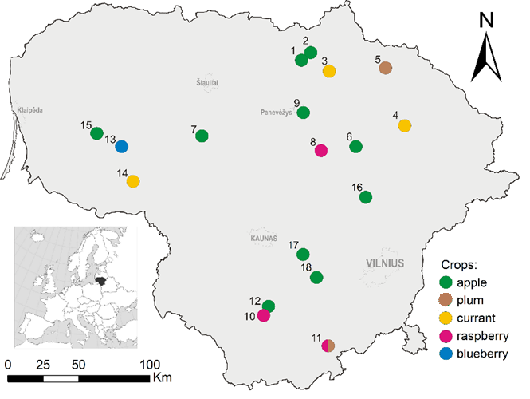
Study sites
Sites 1–3, 6–10 and 12 were investigated in 2018–2020, while sites 5, 7, 9, 11 and 13–15 were studied in 2018–2019 and sites 16–18 in 2020. Average size of the study site was 37.6±11.9 ha (63.7 ha of apple orchards, 0.81 ha of plum orchards, 22.0 ha of currant plantations, 2.3 ha of raspberry plantations and 3.80 ha of blueberry plantation).
Notes:
The investigation covered 18 study sites across Lithuania (northern Europe) in 2018–2020. Crops were the following: commercial apple and plum orchards, plus currant, raspberry and highbush blueberry plantations.

Slide 4
Material and methods
Parameter | Values | Sites | Trapping effort
Crop age | old | 1,2,6,7,9,12,16–18 | 9768
 | medium | 3,4,8,11,13–15 | 5050
 | young | 1,5,10,12 | 1900
Intensity of agriculture | high | 2,6,10–13,15,17 | 8218
 | medium | 1,5,9,14 | 4450
 | low | 3,4,7,8,11,16,18 | 4050
Control | forest | 11,17 | 525
 | mowed meadow | 1,2,4,6,8–10,12,13–16 | 5560
 | non-mowed meadow | 1,3,5,7–9,11,18 | 2700
Snap trapping (approval No GGY-7), summer and autumn 2018–2020, 18 sites
Trapping effort 25,503 trap days
Dissection
1450 small mammals
Notes:
Investigations were done in Summer and Autumn every year, with standard method.
Species were identified morphologically, with specimens of Microtus voles identified by their teeth. Age, reproduction status and body condition were recorded.
The control habitats were mowed meadows, unmoved meadows or forest ecotones. Crops were of different ages and intensities of agricultural practices. Crop age categories were old, medium-aged and young, while intensity categories were low, medium and high.

Slide 5
Material and methods
Indices of the small mammal communities: number of species, dominance, diversity (Shannon’s H) and relative abundance (individuals per 100 trap/days).
Categorical factors: habitat type (orchards, berry plantations, control habitats), age of the orchard or plantation, intensity of agriculture, year, season and location (central, northern, eastern, southern and western parts of the country). Continuous predictor: trapping effort.
Sampling unit: trapping session (3 day trapping in one habitat, particular year and particular season, n = 168).
Analyses: GLMM, ANOVA, G-test
Software used: PAST version 4.01 (Paleontological Museum, University of Oslo, Oslo, Norway), OpenEpi epidemiological software, WinPepi, version 11.39, Statistica for Windows, version 6.0 (StatSoft, Inc., Tulsa, OK, USA)
Notes:
So, we investigated, how small mammal number of species, dominance, diversity and relative abundance were influenced by temporal and spatial factors.
Our sampling unit was one three-days long trapping. We used general linear mixed model for evaluation of cumulative effect, and then ANOVA for investigation of separate factors. Differences in species proportions were assessed with G-test

Slide 6
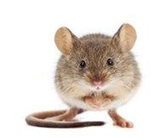
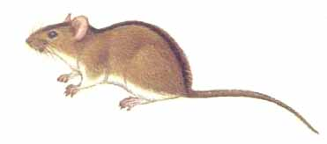
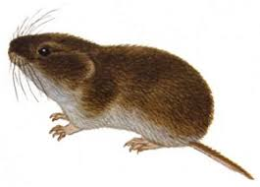
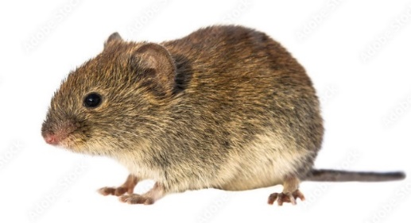
Material and methods
Dominant species
Species | Diet
Common shrew (Sorex araneus) | Insectivores
Pygmy shrew (Sorex minutus) | Insectivores
House mouse (Mus musculus) | Omnivores
Harvest mouse (Micromys minutus) | Granivores
Yellow-necked mouse (Apodemus flavicollis) | Granivores
Striped field mouse (Apodemus agrarius) | Granivores
Common vole (Microtus arvalis) | Herbivores
Field vole (Microtus agrestis) | Herbivores
Root vole (Microtus oeconomus) | Herbivores
Bank vole (Clethrionomys glareolus) | Omnivores
Water vole (Arvicola amphibius) | Herbivores
Notes:
A total number of 1450 small mammal individuals belonging to 11 species were caught during the 3 years study period (25503 trap/days). Diversity of small mammals in the commercial orchards (10 species) was lower than that in the control habitats (11 species). There were four groups according their diet, but insectivores were underrepresented, very few shrews trapped. Dominants were granivores – yellow necked and striped field mice, herbivores, that is common voles and omnivores represented by bank voles,

Slide 7
Results
Trapping effort controlled GLMM confirmed the cumulative influence of location (Hotelling’s T² = 0.69, p < 0.05), season (T² = 0.50, p < 0.001), year (T² = 0.79, p < 0.001), habitat (T² = 0.98, p < 0.05) and intensity of the agricultural practices (T² = 0.37, p < 0.05) on the proportions and relative abundance of the most numerous species as well as on the diversity and abundance of the small mammal communities. Age of the crop had no influence (T² = 0.28, p = 0.29). Dominance did not depend on these factors; 18–41% of the variations of the other indices were explained:
Index | Multiple R² | F_{17,150} | p <
RA of the community | 0.38 | 4.84 | 0.0001
Number of species | 0.37 | 4.46 | 0.0001
Diversity, Shannon’s H | 0.32 | 3.6 | 0.0001
Dominance in the community | 0.15 | 1.36 | 0.155
RA of M. arvalis | 0.24 | 2.52 | 0.001
% of M. arvalis | 0.18 | 1.75 | 0.05
RA of A. flavicollis | 0.26 | 2.67 | 0.001
% of A. flavicollis | 0.29 | 3.18 | 0.0001
RA of A. agrarius | 0.25 | 2.54 | 0.001
% of A. agrarius | 0.26 | 2.68 | 0.005
RA of C. glareolus | 0.41 | 5.34 | 0.0001
% of C. glareolus | 0.20 | 3.18 | 0.0001
Notes:
General model was significant for all listed factors, with except of dominance index. Year, season, location of the trapping site, habitat and intensity of agricultural measures explained from 18 to 41 percent of the variation of commmunity indices, relative abundance, and proportion of the four most numerous species.

Slide 8
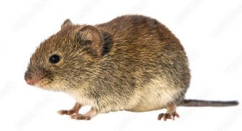
Results
Yearly changes in the proportions of the four most abundant small mammal species in the commercial orchards in 2018–2020.
Notes:
As a single factor, year had a significant influence on the diversity of small mammal communities (p < 0.01) and on the proportions of Apodemus agrarius (p < 0.001; minimum in 2019) and Apodemus flavicollis (p < 0.001; minimum in 2018). Proportions of Microtus arvalis were more stable p < 0.02; maximum in 2019), while those of Clethrionomys glareolus did not differ.

Slide 9
Results
Relative abundances (individuals per 100 trap-days) of the small mammal communities and the most numerous species in commercial orchards
Notes:
Differences in the relative abundances between years were not significant, not for any of the most abundant species nor the community as a whole, with even maximum abundances of the species being quite similar.

Slide 10
Results
Habitat-based differences of analysed small mammal populations
Crops:
AO – apple orchards,
PO – plum orchards,
CP – currant plantations,
RP – raspberry plantations, controls:
MM – mowed meadows,
NM – non-mowed meadows,
FO – forest ecotones.
Notes:
The relative abundance of M. arvalis were highest in current plantations and plum orchards, while the species proportion was negligible in the forest ecotone. The relative abundance of A. flavicollis were highest in the forest ecotones and apple orchards, significantly exceeding those in currant plantations, plum orchards and mowed meadows. Apple and plum orchards were characterized by the lowest relative abundance of A. agrarius. The abundance of C. glareolus was highest in the forest ecotones and non-mowed meadows, while the species was not present in plum orchards and raspberry plantations.

Slide 11
Results
Season-based differences of analysed small mammal populations
Relative abundances (individuals per 100 trap-days)
Notes:
The relative abundance of the whole small mammal community and the four dominant species were higher in the autumn than the summer. The relative abundance of M. arvalis and A. flavicollis during vegetative season become tripled, that of C. glareolus doubled and that of A. agrarius increased by nearly 15 times.

Slide 12
Results
Location-based differences of small mammal diversity and abundance
Notes:
The location in the country had no influence upon the number of small mammal species present in the commercial orchards, as nine species were trapped in each part.
The proportions of the four most abundant species, however, were different. As you see, proportion of A. flavicollis was smallest in the west and highest in the central part, proportion of A. agrarius was smallest in the east and highest in the north. M. arvalis proportions were highest in the east, significantly exceeding those in central and southern parts. The C. glareolus proportion in the orchards of northern Lithuania was negligible.
So we had western, central and southern parts characterised with high diversity, and northern and eastern parts with low diversity.

Slide 13
Conclusions
1. In Lithuania, the proportions and relative abundances of the most numerous small mammal species and the diversity of their communities in commercial orchards mainly depend on the season and the region within the country, with crop type being less significant.
2. In comparison to the summer season, the relative abundance of C. glareolus doubled in autumn, while that of M. arvalis and A. flavicollis tripled and A. agrarius increased by nearly 15 times.
3. The proportions of the most abundant small mammal species exhibited significant regional and crop based differences, while differences in relative abundances were less expressed.
Funding: In 2018 and 2019, this research was funded by the MINISTRY OF AGRICULTURE OF THE REPUBLIC OF LITHUANIA, grant number MT-18-3.

