Slide 1
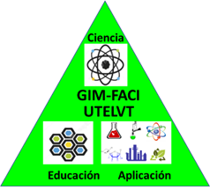
Lanostane Triol (Holothurin Group) Isolated from Triterpenic Fraction of Holothuria floridana Inhabiting in Shallow Waters of Cuban Archipelago
Enrique Tacoronte Morales,* Joseph Cruel Sigüenza, María Elizabeth Canchingre and Carla Bernal Villavicencio
Technical University of Esmeraldas, Campus New Horizons, Faculty of Science & Technology, Chemical Engineering Coordination, Esmeraldas, Republic of Ecuador, juan.tacaronte.morales@utelvt.edu.ec

Slide 2
Abstract:
Holothurians (Echinodermata, Aspirochirotida, Holothuridae, Holothuria), are marine, epibenthic organisms widely distributed on a planetary scale. Several species, especially in neotropical and subtropical regions, are used by coastal human populations as a nutritional source. These invertebrates are characterized by a great diversity of bioactive secondary metabolites, among them, the tri-terpene glycosides with a typical holostane (lanostane) molecular pattern. The present communication highlights the preliminary chemical-structural study (NMR-analytical drop reactions) of sea cucumbers (holothurias) that inhabit the coastal eco-zone of the Cuban archipelago, reporting as a case study, the isola-tion and molecular characterization of a holostane derivative isolated from the methanolic fraction of Holothuria floridana. After the chromatographic separa-tion (SiO₂—Amberlite) of the fraction containing triterpenic glycosides, and the corresponding spectroscopic study, it was identified as the major component of this fraction holost-Δ9,11-en12α,17α,22ξ triol tetraoside, a member of group A of holoturins; and the monosaccharide fraction consists of 3β-D-glucose, D-xylose, D-quinovose and 3-O-methyl-D-glucose.
Keywords: Holothuria floridana; triterpene glycoside; holothurin;
monosaccharides; chromogenic reactions

Slide 3
Results and Discussion
The raw glycosidic mixture is processed using chromogenic reactions via Lieberman-Buchard and with Cobalt chloride protocols, showing the presence of triterpenes. The FTIR study of the obtained chromatographically pure glycoside with a melting point of 263–264 °C, revealed the presence of bands in the regions of functional groups: hydroxyl, lactone, and olefinic system, corroborating the glycosidic nature of isolated compound, specifically, 3445 cm⁻¹, 1745 cm⁻¹, 1648 cm⁻¹, 1590 cm⁻¹, 825 cm⁻¹. The ¹³C-NMR assignments corroborate the presence of a lactone fragment (C-18/C-20), an olefinic bond (C-9/C-11), the presence of hydroxyl functional groups (C-12, C-17 y C-22) and a monosaccharide chain, via glycosidic bond in C3 composed of 4 unsubstituted components. The -OH functional group in C-12 carries α configuration (RMN-1H, δ 4,70 ppm, 1H J = 11–12 Hz). The glycoside was subjected to a hydrolysis process, generating a sum of holothurinogenins which, was subjected to a preparative column chromatography process, yielding a compound with a melting point of 285–286 °C, which was identified as a genin. During the acid hydrolysis a mixture of monosaccharides is generated, which were analyzed by gas chromatography in the form of aldonitrile-peracetates. The obtained data from specific rotation for a mixture of monosaccharides revealed a value of [α ] D25 +39.0 indicating a D configuration for the described monosaccharide chain composed of D-glucose, D-xylose,
D-quinovose, and 3-O-methyl-D-glucose in a ratio of 1:1:1:1

Slide 4
In the present communication, we report the preliminary study of the fraction enriched with triterpene glycosides isolated from the ethanol treatment of Holothuria floridana inhabiting the Cuban archipelago, recognition of the presence of triterpenic structure via chromogenic reactions, desalting by passing this fraction through Amberlite column, the subsequent elution with solvents of increasing polarity, and the isolation of its major component, whose aglycone is holost-Δ9,11-en-12α,17α,22ξ-triol and the monosaccharide fragment, obtained after treatment of the glycoside with 12 % hydrochloric acid, is characterized by the presence of 4 components: 3β-D-glucose, Dxylose, D-quinovose and 3-O-methyl-D-glucose in its side chain. The genic compound, is a genin of the holostanic series with a heteroannular dienic system Δ7,9(11).

Slide 5
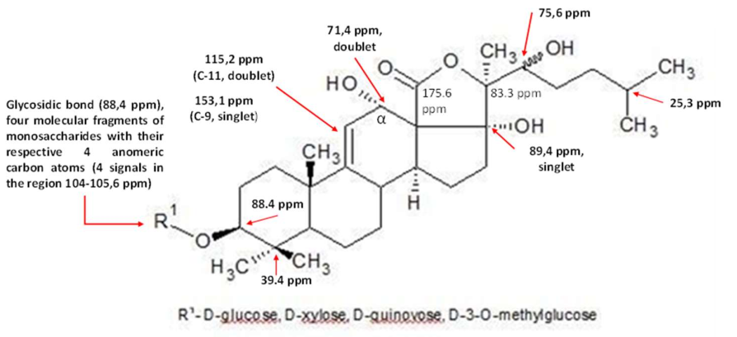
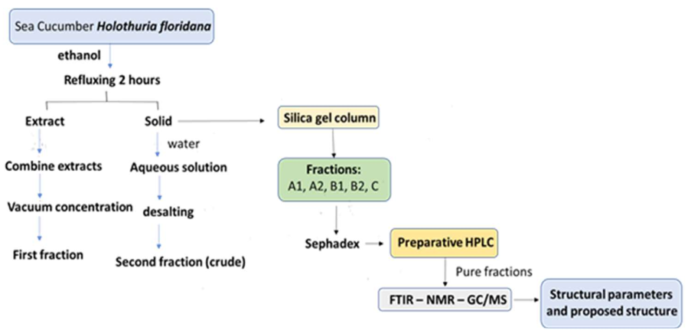
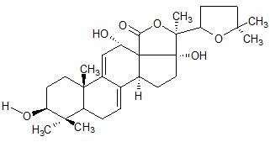
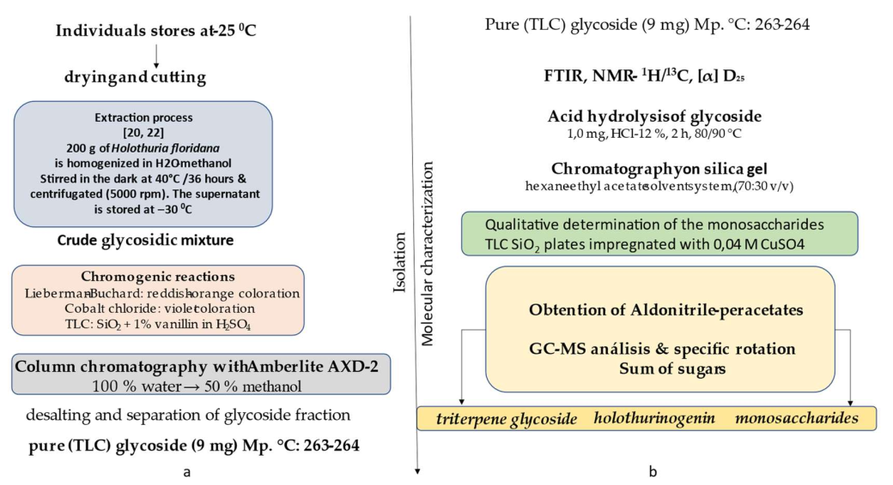
Supplementary Materials
Triterpenic glycoside I isolated from Holothuria floridana inhabiting the Cuban archipelago. Main ¹³C-NMR signals
Operational flows for processing Holothuria floridana from raw material to fractions
Genin, obtained after treatment with 12% hydrochloric acid of triterpene glycoside

Slide 6
Acknowledgments
Authors deeply thank M.Sc. Irma Alfonso (Cuba, CIIQ) for technical assistance
during taxonomical identification of collected sea cucumbers and Juan Antonio Mesa (CSIC Barcelona, Spain) for facilitating spectral data acquisition.
This study is a contribution of the Technical University of Esmeraldas “Luis Vargas Torres”, Republic of Ecuador in collaboration with Pontifical University of Ecuador, Campus Quito, which logistically supported the preliminary structural studies.

