Slide 1
The diversity of roadkilled semi-aquatic mammals depends on registration effort
Linas Balčiauskas*, Laima Balčiauskienė, and Jos Stratford
¹ Nature Research Centre, Akademijos 2, Vilnius, Lithuania.
* Corresponding author: linas.balciauskas@gamtc.lt

Slide 2
Abstract sciforum-052886: Previously, we showed that registration effort and traffic intensity explain 90% of variation in roadkill numbers, 70% of variation in numbers of recorded species and 40% of diversity variation (Balčiauskas et al., 2020). Here we analysed the comparatively rare roadkills of semi-aquatic mammals in Lithuania, northern Europe, covering the period of 2007–2021, relating these to monitoring effort. From over 30,000 roadkills, European beaver was registered 43 times, American mink 26 times, otter 22 times and muskrat two times, with the average roadkill indexes being 0.000065, 0.00076, 0.00061 and 0.00010 ind./km/day, and the maximum indexes being 0.067, 0.028, 0.048 and 0.016 ind./km/day, respectively. These data show the roadkills are not common events. Their occurrences did not correspond to population numbers (beaver over 40,000, American mink about 8–10,000 and otter about 3–5000 individuals in 2020–2021) nor to traffic intensity. However, for all these species, registration effort (number of times the route was driven, this being 300–400 on the most investigated routes) was the main factor, with more registrations being on the small number of best-sampled main roads. As two of these species, American mink and muskrat, are invasive species in EU, while otter is protected in most of the countries, registrations of their roadkills should be enhanced (using targeted efforts by hunters or citizen scientists for example) in order to obtain a better approximation of the roadkilled numbers of these species and thus be able to use this knowledge in species management.
Keywords: otter; beaver; muskrat; American mink; roadkill

Slide 3
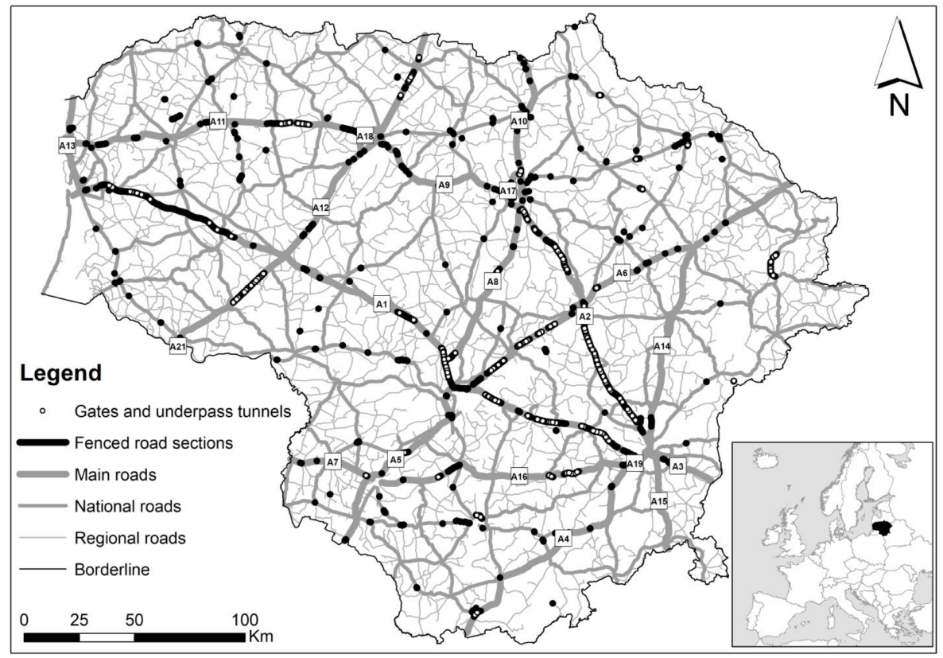
Study area: Lithuania
Labels – numbers of main roads/highways.

Slide 4
Material and Methods
Over 30,000 incidents with wild mammals analysed
Time span: 2007–2021
Professional registrations: 3378 sessions, 262,000 km
Database of Lithuanian Police Traffic Supervision Service
All records geotagged
Roadkill index (killed animals per 100 km per day) was calculated from professional registrations only, with known effort
We compared roadkill index with
Population size of these species
Hunting bag (for beaver, mink and muskrat)
Traffic intensity on the roads where roadkills were found
Sampling effort

Slide 5
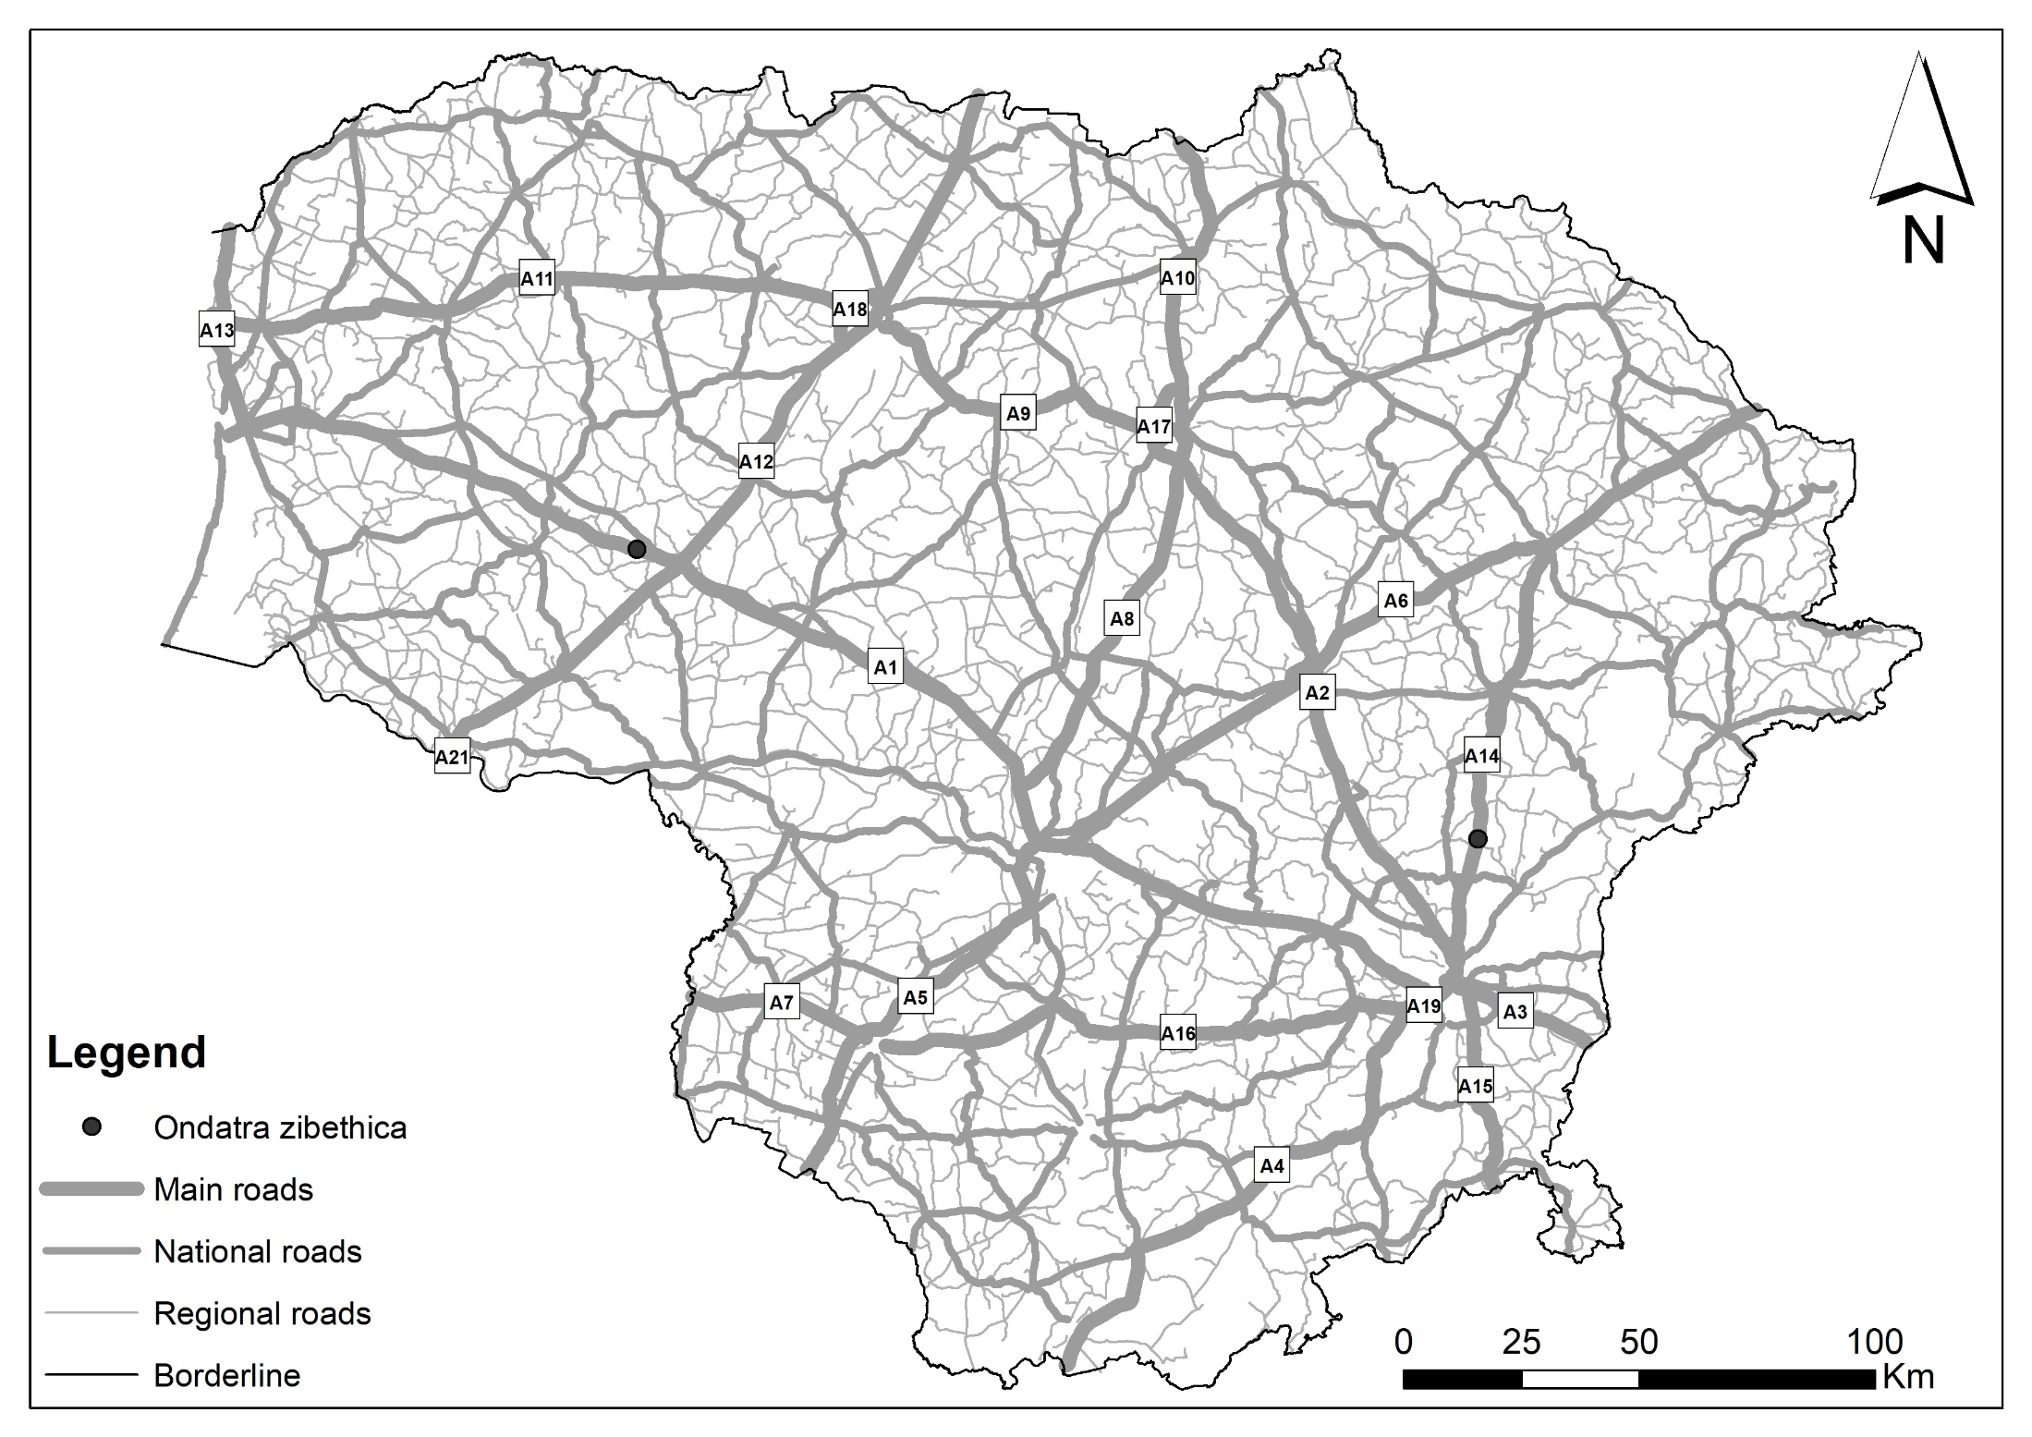
Results and Discussion

Slide 6
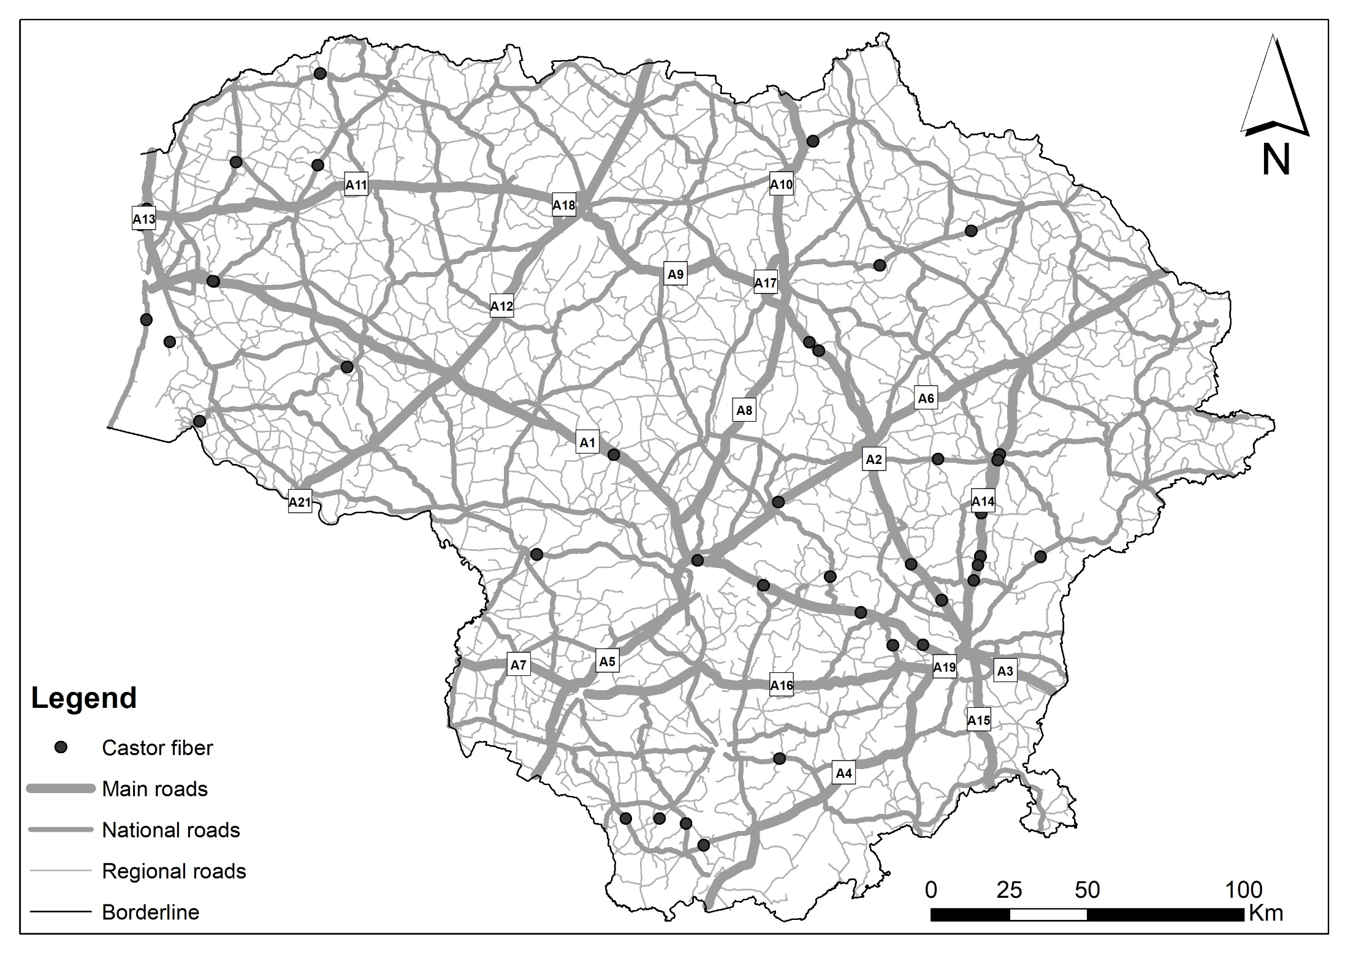
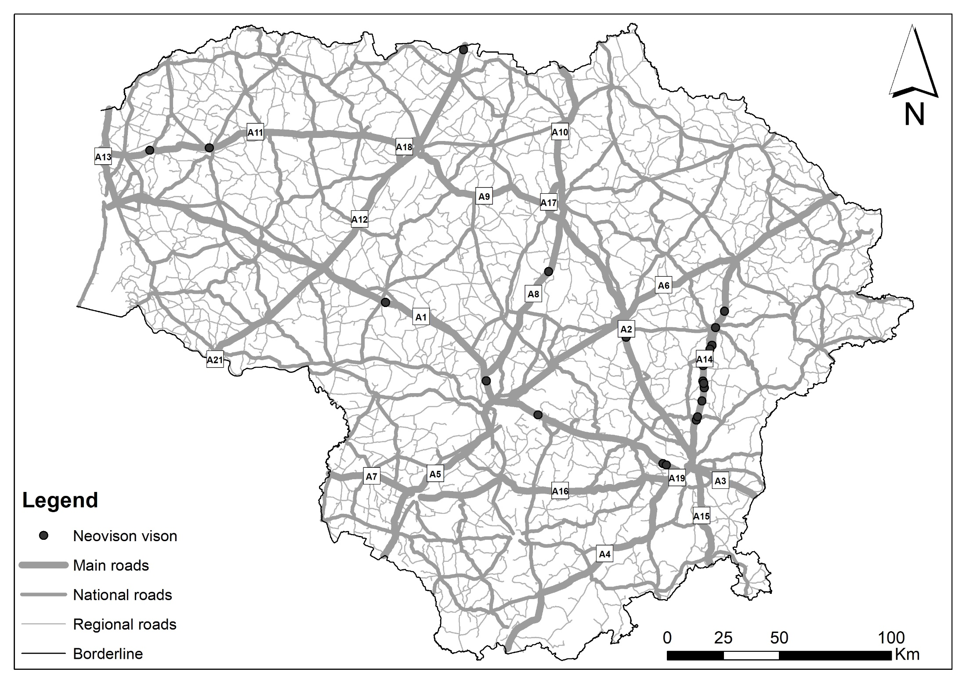
Results and Discussion
Roadkills of two very common species, the beaver (left) and American mink (right) do not correspond to their numbers in Lithuania, being beaver over 40,000 and American mink about 8–10,000 individuals

Slide 7
Results and Discussion

Slide 8
Results and Discussion
Registration of otter (left) and American mink (right) distribution in 2020–2021 show both species widely distributed across most of the water bodies in the country

Slide 9
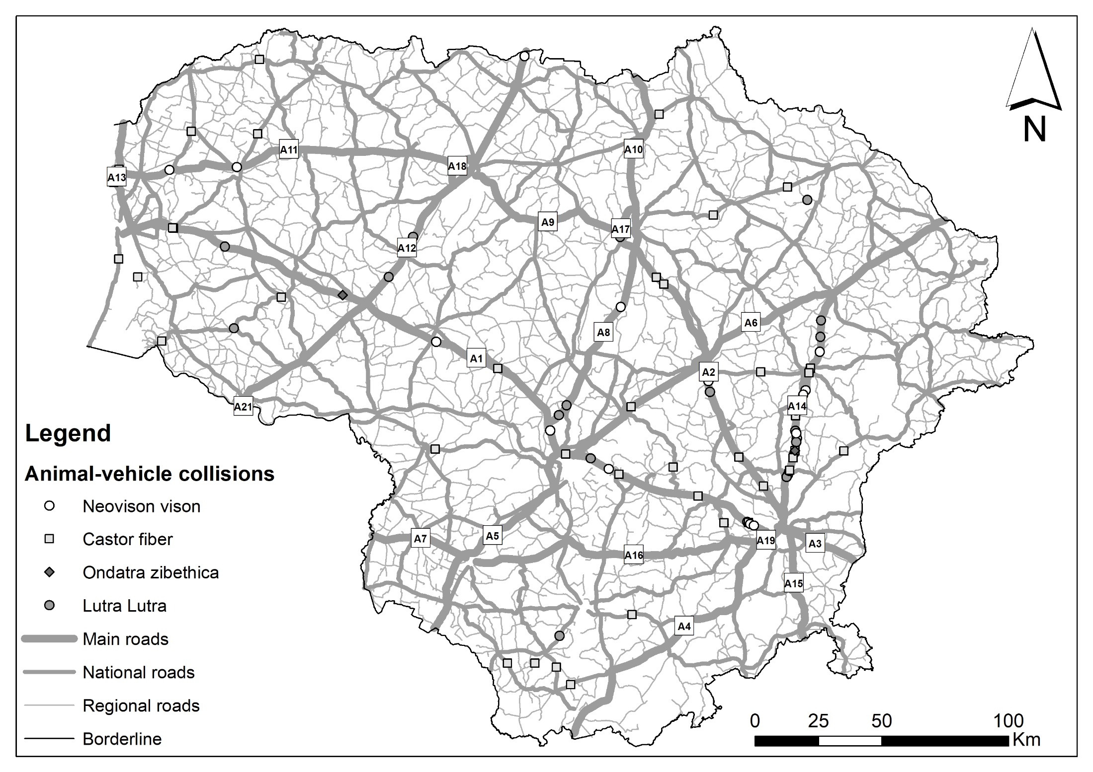
Results and Discussion
Conclusions
Roadkills of semi-aquatic species do not depend on population
Roadkill index heavily depend on registration effort
Therefore, roadkill index is not suitable for monitoring

Slide 10
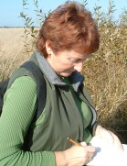
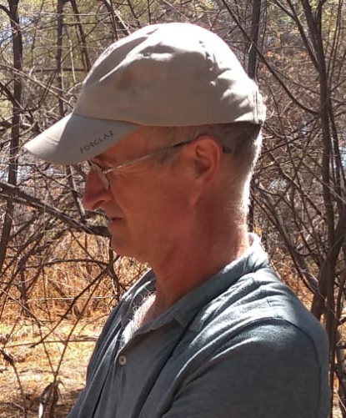
Acknowledgments
American mink research in 2019–2021 was funded by grant for “Investigations of the Status of Invasive and Alien Species in Lithuania” (Contract No. 05.5.1-APVA-V-018-01-0012) co-financed by the European Union Structural Funds according to the 5th Priority of the European Union Funds Investment Operational Program for 2014–2020 “Environment, Sustainable Use of Natural Resources and Adaptation to Climate Change” under the measure “Biodiversity protection” (05.5.1-APVA-V-018).
We thank dr. Andrius Kučas for maintaining roadkill database and production of maps.
Team

