Slide 1
Study of genetic diversity of Dagestan Mountain cattle based on STR-markers
Volkova V.^{1*}, Deniskova T.¹, Abdelmanova A.¹, Romanenkova O.¹, Khozhokov A.²,
Sermyagin A.¹ and Zinovieva N.¹
¹ L.K. Ernst Federal Research Center for Animal Husbandry, Dubrovitsy, Podolsk Municipal District, Moscow Region, Podolsk 142132, Russia;
² Federal agricultural research center of The Dagestan Republic, Akushinsky Ave., Science town 30, Makhachkala, 367014 The Dagestan Republic.
Federal Research Center for Animal Husbandry named after Academy Member L.K. Ernst
L.K. Ernst Federal Research Center for Animal Husbandry
* Corresponding author: moonlit_elf@mail.ru

Slide 2
Dagestan is a peculiar and interesting region located in the southernmost part of the Russian Federation, on the northeastern slopes of the Greater Caucasus and in the Caspian lowland. Almost half of the territory (48%) is occupied by a mountainous zone. At the same time, large areas of mountain pastures, cheap pasture fodder and a long pasture season favor cattle breeding in the region.
Mountain cattle, which were created by crossing of local cattle with Swiss, Kostroma, and Lebedin breeds, represent a valuable gene pool for obtaining new breeds of cattle. Thus, the Caucasian Brown breed (Dagestan offspring) was resulted from crossbreeding of mountain cattle with Swiss, Brown Carpathian and Lebedin breeds.
Valuable biological features:
A strong constitution and the presence of strong hooves
Survival rate
Unpretentiousness
Adaptability to extreme mountain conditions
Disadvantages:
Low milk productivity
Low live weight
Weak selection and breeding work

Slide 3
The aim of our study is to characterize modern allele pool and to assess genetic diversity of Dagestan Mountain cattle using STR markers
Sampling information for studied cattle breeds
Breed | Abbreviation | Sample number | Breeding region | Reference
Dagestan mountain | GS | 32 | The Dagestan Republic | Present study
Brown Swiss, Caucasian branch | BS | 13 | The Dagestan Republic | Present study
Brown Swiss, Germany | BS_G | 27 | Germany | Present study
Red Steppe | RS | 26 | The Dagestan Republic | Present study
Simmental | SIM | 32 | Oryol region | Present study
Holstein | HOL | 34 | Holstein Association USA | Holstein Association USA

Slide 4
Results
A total of 117 alleles at 11 loci were found in the studied populations. The total num-ber of alleles was 413 and 90 of them was identified in the GS group. We found that there was deficiency of heterozygotes in one locus in the cattle populations bred in the territory of Dagestan.
Allelic diversity was the highest in the mountain cattle group compared to other studied breeds.
The level of observed heterozygosity was 0.73 in mountain cattle.
Heterozygote deficiency was found in mountain and in the Red Steppe cattle, bred in Dagestan.
We identified a total of 29 private alleles (14 in the GS group) with frequencies vary-ing from 0.016 to 0.148 in the studied populations.
Genetic diversity parameters estimated for 11 microsatellite markers by cattle breeds
Breed |  | TGLA227 | BM2113 | TGLA53 | ETH10 | SPS115 | TGLA122 | INRA23 | TGLA126 | BM1818 | ETH225 | BM1824
GS | Na | 11 | 9 | 15 | 5 | 7 | 12 | 7 | 7 | 6 | 7 | 4
 | F | 0,069 | 0,102 | 0,250 | 0,123 | 0,024 | -0,080 | 0,040 | -0,154 | -0,019 | -0,034 | 0,044
BS | Na | 7 | 6 | 9 | 5 | 4 | 6 | 7 | 4 | 5 | 7 | 4
 | F | -0,059 | -0,238 | 0,449 | -0,212 | -0,083 | -0,243 | 0,096 | 0,129 | 0,100 | -0,099 | -0,022
BS_G | Na | 6 | 7 | 9 | 4 | 5 | 8 | 5 | 3 | 6 | 5 | 4
 | F | -0,051 | -0,027 | -0,101 | -0,130 | -0,115 | -0,004 | -0,187 | -0,043 | 0,048 | -0,259 | 0,016
RS | Na | 9 | 6 | 8 | 5 | 6 | 7 | 8 | 4 | 3 | 7 | 4
 | F | -0,081 | -0,134 | 0,200 | 0,065 | -0,161 | 0,050 | -0,030 | 0,439 | 0,156 | -0,099 | -0,102
SIM | Na | 8 | 5 | 11 | 4 | 6 | 8 | 8 | 5 | 4 | 6 | 5
 | F | -0,204 | -0,045 | -0,037 | -0,303 | -0,222 | -0,223 | 0,045 | -0,177 | -0,001 | -0,123 | -0,031
HOL | Na | 8 | 5 | 8 | 6 | 4 | 7 | 4 | 5 | 4 | 5 | 4
 | F | -0,069 | 0,176 | -0,060 | 0,027 | -0,175 | 0,167 | -0,214 | 0,067 | 0,047 | -0,086 | -0,225
N - No. Alleles; F – fixation index

Slide 5
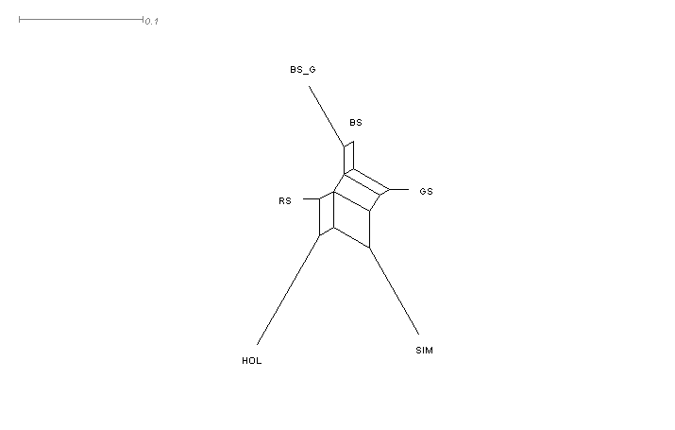
Results
Analysis of the Neighbor Net graph showed a presence of genetic relationships between the GS, BS, and RS groups as well as provided evidence of a common origin of the BS and BS_G groups. Holsteins and Simmentals formed separate branches.
Dendrogram based on pairwise genetic distances (DJost), plotted using the NeighborNet algorithm

Slide 6
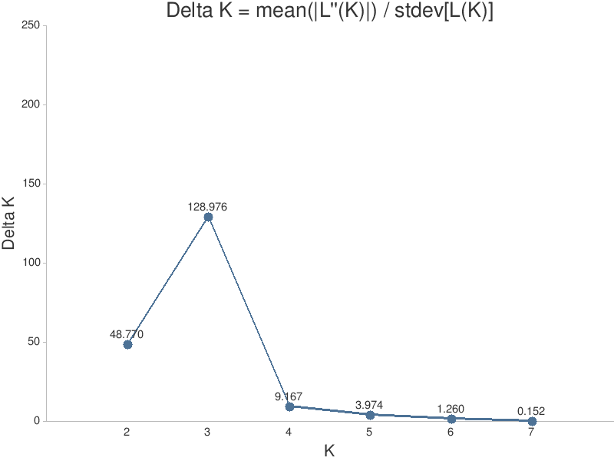
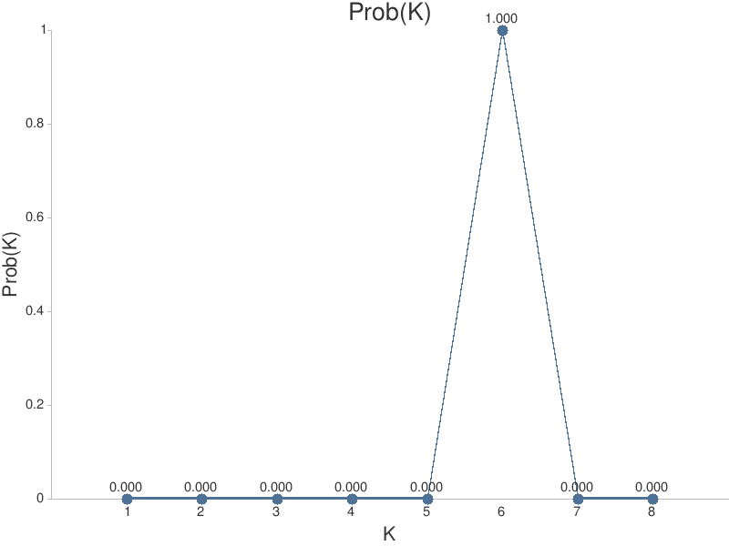
Based on cluster analysis, an endemic population of mountain cattle was identified. Most of the identified endemic animals belonged to the samples from the most remote area, characterized by rocky and rugged terrain. The remaining cattle groups showed a high degree of membership in their own cluster. In addition, we found differences between Brown Swiss from Caucasian branch and those, which were brought from Germany.

Slide 7
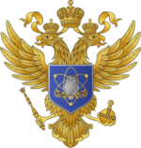
Acknowledgments
The study was funded by the Ministry of Science and Higher Education of the Russian Federation theme 0445-2019-0024
Thank you for your attention!

