Slide 1
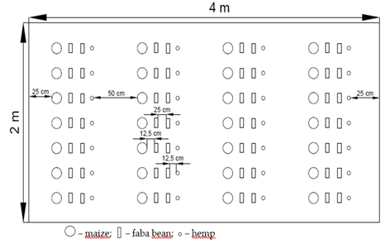
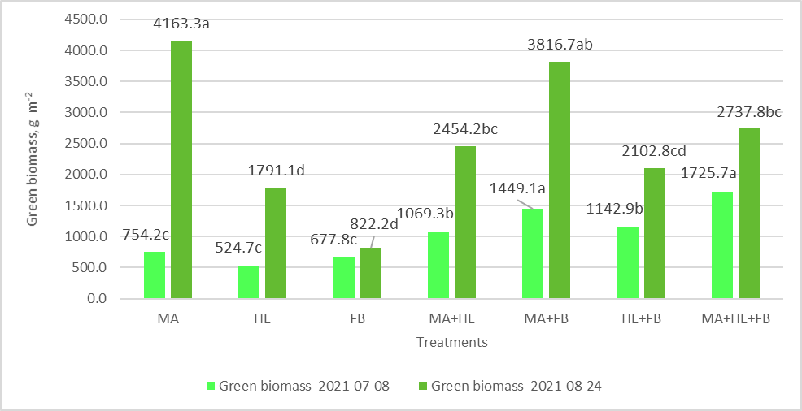
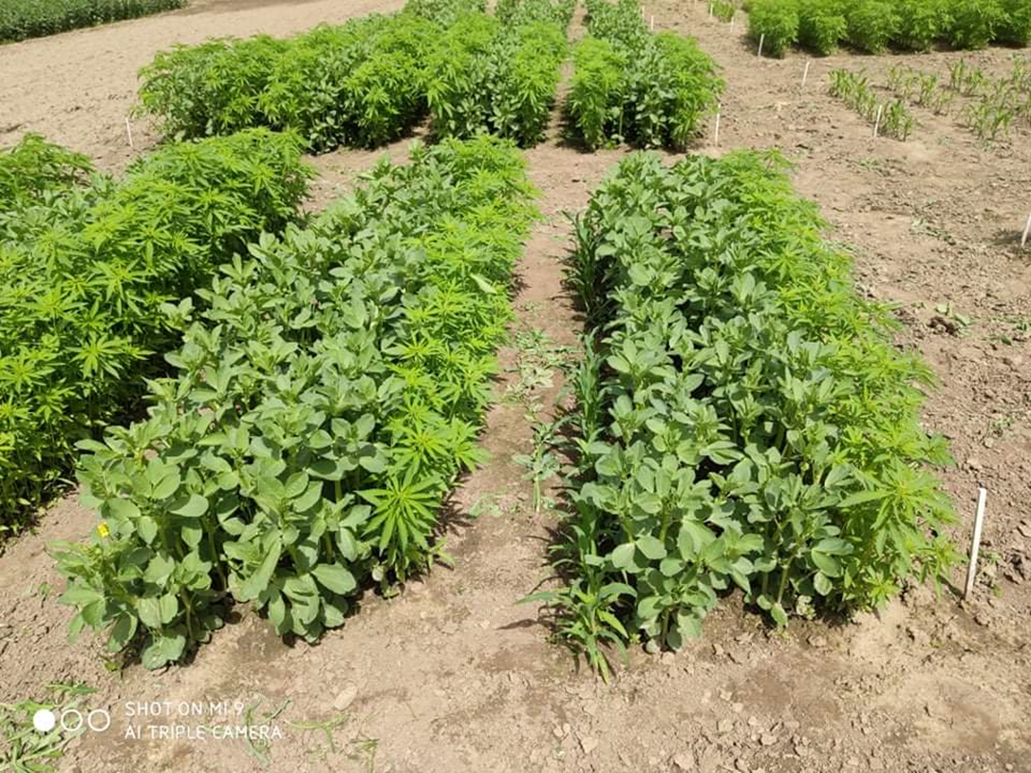
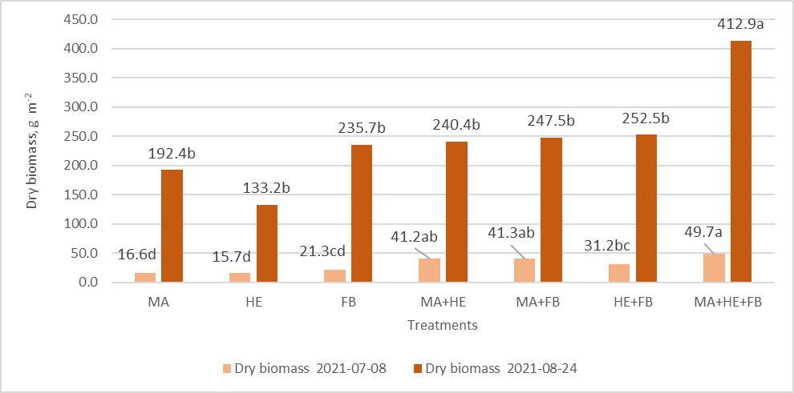
Impact of maize, hemp and faba bean inter-cropping on biomass productivity
Jovita Balandaitė, Kęstutis Romaneckas, Rasa Kimbirauskienė,
Ugnius Ginelevičius, Deividas Pakalnis
Agriculture Academy, Vytautas Magnus Uinversity, Lithuania
Introduction
Methodology
Currently, the requirements of the Green Deal are especially relevant, due to which in the coming 2023 – 2027 years, consumption of fertilizers and crop protection products will have to be significantly reduced. Nevertheless, it is still necessary to ensure proper crop nutrition and protection, but this must be done in other, much more environmentally friendly ways. Multifunctional crops make it possible to develop the idea of sustainable agriculture, where high yields are obtained by investing less money and time. In order to meet all the necessary conditions for biomass cultivation, experiments are being carried out in the cultivation of multifunctional crops with increased biodiversity. One way to increase crops biomass production is to increase crop functionality, whereby the main crop is seeded together with other crops species. Such crops provide not only the main nutritional and/or feed products (grains, seeds, sugar), but also the secondary products, including yield wastes, which can be used to produce feeds and to others energetic purposes like biofuel.
A stationary field experiment caring out at the Experimental Station of Vytautas Magnus University. Maize (Zea mays L.), true hemp (Cannabis sativa L.) and faba bean (Vicia faba L.) as mono, binary and ternary crops cultivations were investigated. The experiment has 7 combinations (treatments), 3 replications and 21 experimental plots.
These experiment treatments of multifunctional crops were investigated:
Maize;
Hemp;
Faba bean;
Maize + Hemp;
Maize + Faba bean;
Hemp + Faba bean;
Maize + Hemp + Faba bean.
Figure 1. The sowing scheme of ternary cultivations
Results
Note: * - the averages of the treatments not marked with the same letter (a, b, c, d) are essential.
MA – Maize; HE – Hemp; FB – Faba bean; MA+HE – Maize+Hemp; MA+FB – Maize+Faba bean; HE+FB – Hemp +Faba bean; MA+HE+FB – Maize+Hemp+Faba bean
Figure 2 . Impact of inter-cropping on green biomass productivity, g m⁻²
Picture 1. Ternary crop cultivation
Note: * - the averages of the treatments not marked with the same letter (a, b, c, d) are essential.
MA – Maize; HE – Hemp; FB – Faba bean; MA+HE – Maize+Hemp; MA+FB – Maize+Faba bean; HE+FB – Hemp +Faba bean; MA+HE+FB – Maize+Hemp+Faba bean
Figure 3. Impact of inter-cropping on dry biomass productivity, g m⁻²
Conclusions
A significant increase in green biomass in the middle of vegetation was found in trinomial crop (1725.7 g m⁻²). At the end of plant vegetation, 1.5 times lower green plant biomass (2737.8 g m⁻²) also was found in trinomial plots than in the treatments where maize was grown as mono-crop (4163.3 g m⁻²).
A significant less dry biomass in the middle and the end of plant vegetation was found in the plots where true hemp was grown as a mono crop (15.7 g m⁻²; 133.2 g m⁻²). At the end of vegetation, it was three times less than in the plots with trinomial crops cultivation (412.9 g m⁻²).

