Slide 1
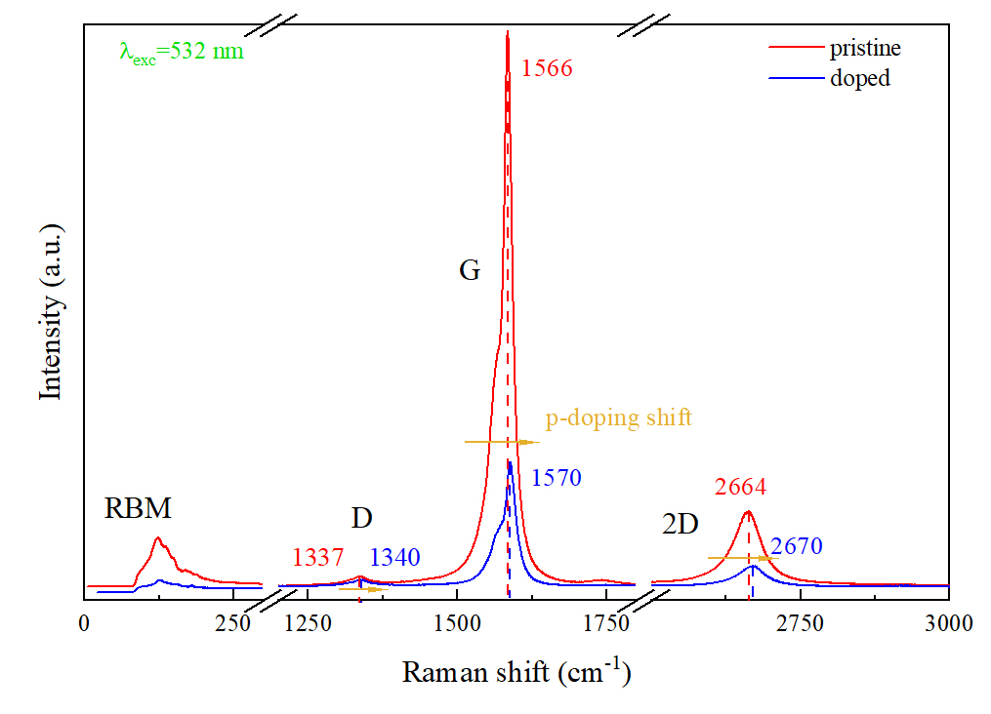
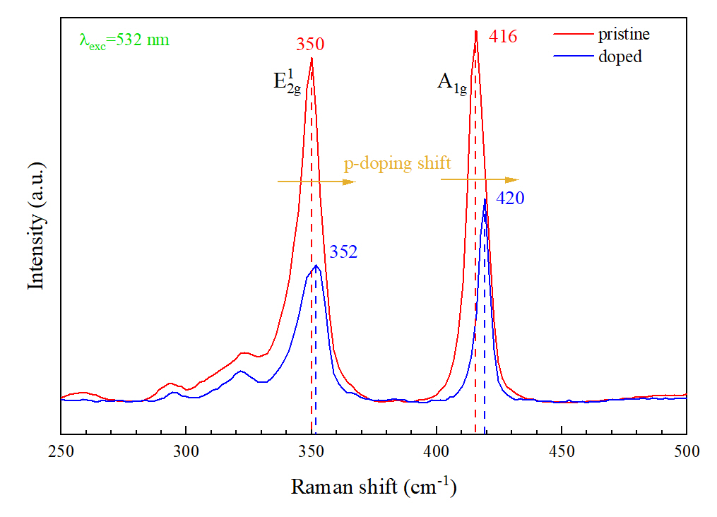
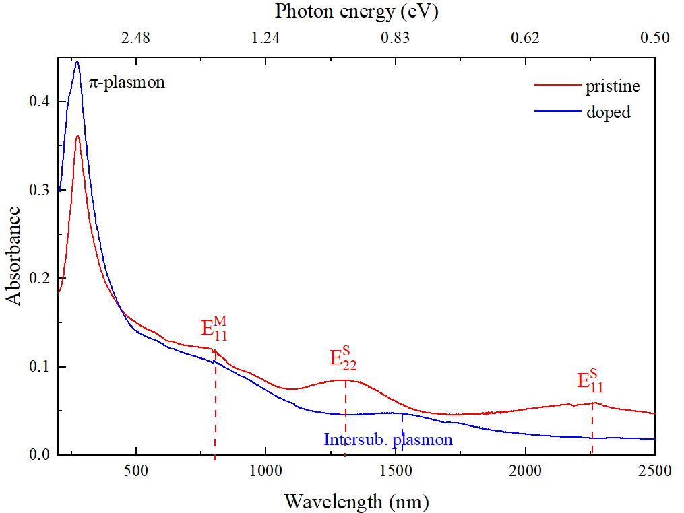
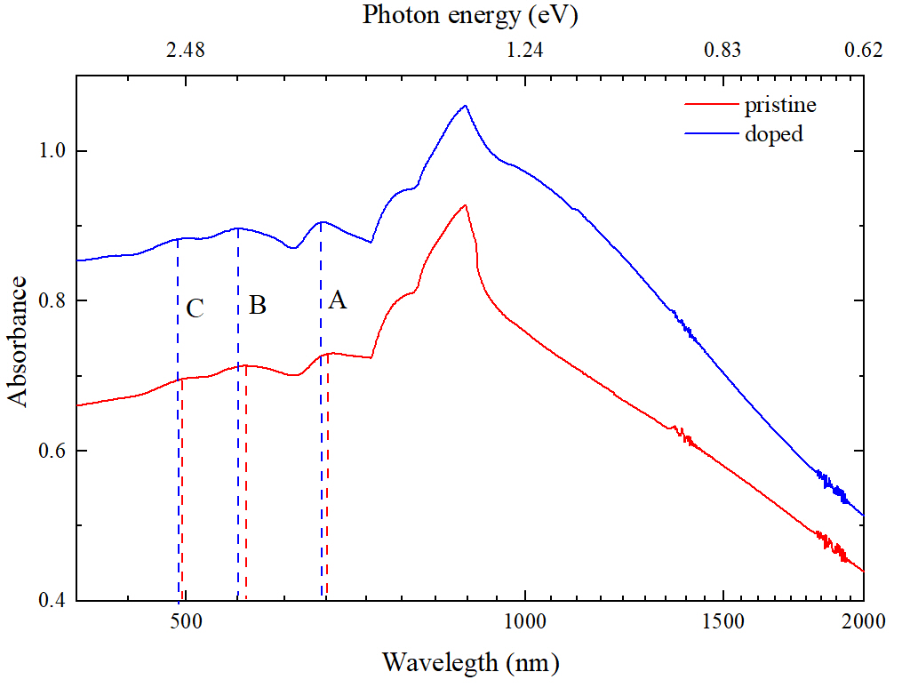
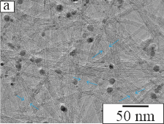
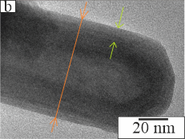
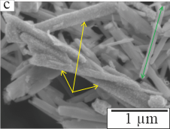
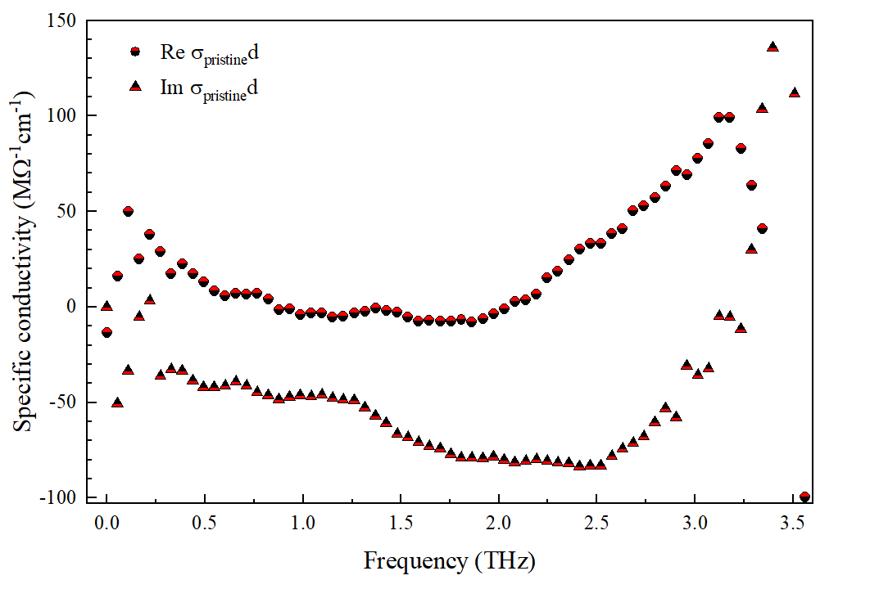
Comparison of Optoelectronic Properties of Doped and Pristine Nanotubes Based on Carbon and Tungsten Disulfide
Maksim Paukov, Anastasia Goldt, Gennadiy Komandin, Alexander Syuy, Dmitriy Yakubovskiy, Sergei Novikov, Alexander Polyakov, Reshef Tenne, Alla Zak, Albert Nasibulin, Aleksei Arsenin, Valentyn Volkov, Maria Burdanova
e-mail: paukov.mi@phystech.edu
Introduction
Optical properties
Aim: investigation of the optical and terahertz features of carbon (C) and tungsten disulfide (WS2) nanotubes (NT) and tuning of these properties by p-type doping with HAuCl4 (gold nanoparticles)
When the energy of incident photons matches these transitions the resonant enhancement of photophysical processes such Raman scattering, Absorption, and others are expected to be seen.
Approach: geometry of given samples was studied by transmission and scanning electron microscopy (TEM and SEM respectively), their optoelectronic features were examined via Raman spectroscopy, absorption spectroscopy in ultra-violet and visible range, and terahertz spectroscopy in time domain (TDS).
As it can be seen, the p-doping influences the position and lessens the intensity of Raman active modes. Compared to their 2D-counterparts, the NT show a difference of the resonant frequencies, which can be explained by the strain and curvature of the tube’s structure. Doping with HAuCl₄ results in the shift towards higher frequency in both CNT and WS₂ NT which indicates p-doping.
Organic and inorganic Nanotubes
Both CNTs and WS₂NTs are theoretically constructed by rolling up a 2D sheet of the corresponding material to form a single-walled or multi-walled cylinder (Fig. 1).
Regardless of the production method, 2/3 of obtained CNTs demonstrate metallic behavior and 1/3 - semiconducting, whereas WS₂NTs are semiconducting ones.
P-doping shifts the Fermi level of the materials, allowing to control their optoelectronic properties.
Fig. 3. Raman spectra of CNT (right) and WS₂NT (left).
Fig. 1. The scheme of tubes’ formation.
The absorption spectroscopy allowed us to detect the excitonic transitions in the NT as well as the impact of p-doping on shifting the Fermi level. Compare to their 2D analogues, NTs demonstrate a shift in the position of these transitions.
Sample preparation
CNTs films were synthesized using the aerosol method
WS₂NTs films were produced from commercially-available powder (NanoMaterials Ltd) using vacuum filtration method
Microscopy characterization
Fig.4. Absorbance spectra of CNT (left) and WS₂NT (right).
The morphology of studied samples was investigated using TEM and SEM.
The TEM images showed that CNTs tend to form bundles due to the interactions via Van der Waals forces. The averaged diameter of the bundle was 8.9 nm while the mean diameter of individual NT - 1.8 nm. The averaged length is >10 μm.
WS₂NTs appear to be multi-walled and have a wider diameter distribution of 79.6 nm. The SEM images allowed to determine the mean length of WS₂NTs, which is 1.3 µm.
Terahertz spectroscopy
Both types of NTs appear to have two contributions in their conductivity: 1) a Drude component, responsible for the motion of free charges in the presence of the electric field; 2) a Lorentz component, which describes the localized state of axial plasmons.
The peak, corresponding to axial plasmon, is red-shifted for WS₂NTs compared with CNTs due to the difference in the length. Doping leads to the broadening of the conductivity due to the additional free charges.
Fig. 2. TEM images of a) CNTs (blue arrows show the bundles, small particles are catalysts) and b) typical individual WS₂NT (the orange line shows the diameter, light green arrows - the thickness of NT’s walls); c) SEM image of doped WS₂NT (yellow arrows indicated NT dotted with gold nanoparticles, green arrow shows the typical length).
Fig.5. Terahertz conductivity of CNT(top) and WS2NT(bottom).
Conclusions
Overall, NT possesses the optoelectronic properties that are changed because of the curvature, quantum confinement, and localization. Doping with HAuCl₄ results in tunability of all optoelectronic properties.
Future plans
Different length and diameter WS₂NT with different morphology are to be investigated to understand the origin of the conductivity peak in THz region.
Acknowledgements
This project is supported by Russian Science Foundation (No. 21-79-10097), Ministry of Science and Higher Education of the Russian Federation (No. 075-15-2021-606), and Russian Foundation for Basic Research (No.18-29-27010 MK).
References
Burdanova M. G., et.al., A Review of the Terahertz Conductivity and Photoconductivity of Carbon Nanotubes and Heteronanotubes. Adv. Optical Mater., 2021, 210104.
Sinha S.S., et. al., MoS2 and WS2 Nanotubes: Synthesis, Structural Elucidation, and Optical Characterization. J. Phys. Chem. C, 2021, 125 (11), 6324-6340.

