Slide 1
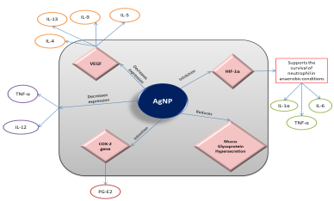
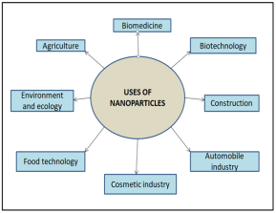
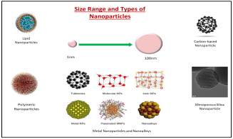
A DELVE INTO THE NOVEL FIELD OF ESSENTIAL OIL-BASED SILVER NANOPARTICLES AND ITS ANTI-INFLAMMATORY POTENTIAL
Shreyashi Pal, Shivesh Jha
Department of Pharmaceutical Science and Technology , BIT Mesra, Ranchi, JH, India.
Email ID: shreyashipal1997@gmail.com
Abstract: The overall interest in natural products is ever-increasing which clearly explains the involvement of various essential oils in different aspects of the day-to-day lives of common people. These pharmacologically relevant agents are categorised as secondary metabolites of plants extracted or distilled from different parts of plants, and that show pharmacological activities like anti-inflammatory, antioxidant, antimicrobial, larvicidal, etc.
The synthesis of metal nanoparticles has been developed by including different polymers, capping agents, and metal sources in the reaction. With the advancement of research, biological capping agents are being used for synthesizing metal nanoparticles like plant extracts, algae, fungi, etc. Essential oil is a newly added member of this list of capping agents. In the case of other metallic nanoparticles produced from biological capping agents, it was seen that the therapeutic activity of the plant material is also present within the produced nanoparticle. Similarly, for essential oil-derived nanoparticles, the therapeutic efficacy of the oil will be present within the nanoparticle. So, essential oils derived from plants like Eucalyptus, Clove, Lavender, etc. can be used to create nanoparticles that can act as anti-inflammatory agents. With work initiating on cumin oil and other oils like turmeric oil, it can be understood that the field of essential oil-derived nanoparticles is gaining much traction. The poster will present an accumulation of knowledge and show the available literature related to the anti-inflammatory potential of essential oil-mediated silver nanoparticle.
Keywords: Anti-inflammatory activity; Capping agents; Essential oils; Green synthesis; Metal nanoparticles; Silver nanoparticles.
Anti-inflammatory Potential of Essential Oils
Anti-inflammatory Potential of Silver Nanoparticles
Name of the Plant | Part Used | Main Component | Experimental Model | Mechanism of Action | References
Thymus carnosus, Thymus camphoratus | Flowering aerial parts | T. carnosus [Borneol (29%), Camphene (19.5%)] T. camphoratus [Borneol (20%), 1, 8-cineole (29%)] | RAW 264.7 and HepG2 cell lines | Inhibition of nitric oxide production; T. camphoratus inhibits COX-2 & iNOS | Zuzarte et al., 2018
Citrus limon, Citrus aurantifolia, Citrus limonia | Fruit peel | Limonene, β- pinene, γ-tripinene | In vivo anti-inflammatory tests: Hot plate test, Formalin test; Subcutaneous air pouch (SAP) model | Reduce increased levels of TNF-α, IL-1β, IFN- γ | Amorin et al., 2016
Citratus aurantium L. | Fresh blossoms | Linalool | Inflammatory paw edema test, cotton plate-induced granuloma | Inhibition of expression of prostaglandin synthesis through the COX pathway, inhibits formation or release of nitric oxide | Khodanakhsh et al., 2015
Biological Material Used | Characteristics of the nanoparticles | Inflammation Model used | Mechanism of Action | Reference
Leaves of Salvia coccinea | Size: 24nm; Shape: Spherical | THP-1 cell line | Inhibition of oxidative stress transcription factor NF-κB | Gobinath et al., 2021
Petals of Rosa indica | Size: 23.52-60.83nm; Shape: Spherical | Rat peritoneal macrophages | Inhibition of the production of nitric oxide and superoxide | Manikandan et al., 2015
Seeds of Acranythes aspera Linn. | Size: 20-35nm; Shape: Cuboidal, rectangular | Carrageenan-induced in albino rat | Inhibition of paw edema | Vijayaraj et al., 2016
Fig: Mechanism of action of silver nanoparticles
Anti-inflammatory Activity of Essential oil-mediated Silver Nanoparticles
Plant Name | Characterization | Experimental Model | References
Ginger (Zingiber officinale) | UV-Vis spectroscopy | In vitro assay; Inhibition of albumin denaturation assay | Aafreen et al., 2019
Cumin | UV-Vis spectroscopy | In vitro assay; Inhibition of albumin denaturation assay | Jain et al., 2019
Nanoparticles
Conclusion
Essential oils can be a great alternative medicine for the treatment of inflammation with less number of side effects.
Adding essential oil as a capping agent can act as synergistic action and show better anti-inflammatory agent than the essential oil alone.
There is lack of proper animal study which gives the scope for research in future.
Fig: Application of Nanoparticle
Fig: Types of Nanoparticles

