Slide 1
High-capacity zinc vanadium oxides
with long-term cyclability enabled by
in-situ electrochemical oxidation
for zinc-ion batteries
Zhangxi

Slide 2
Introduction
The rechargeable aqueous zinc ion batteries hold great promise
but are extremely limited by the lack of suitable cathodes.
The structural instability and poor conductivity of vanadide need
to be solved.
The introduction of metal ions at interlayers of host materials is
an effective modification strategy.

Slide 3
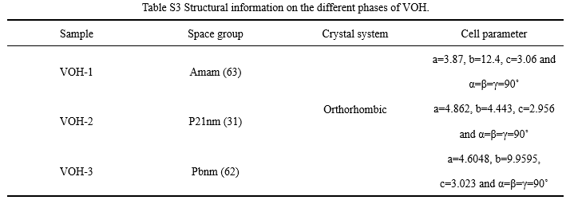
Experiment and Materials
Scheme 1. Schematic diagram of preparation of VOOH and conversion to ZVO and
V2O5·nH2O.
Fig. 1. V 2p spectra of ZVO and V2O5·nH2O (a) and EDS spectra of ZVO (b).

Slide 4
Experiment and Materials
Fig. 2. Electrochemical properties of ZVO and V2O5·nH2O. (a) Rate performance,
(b) cyclability at 0.5 A g⁻¹ and (c) cyclability at 5 A g⁻¹ of ZVO and V2O5·nH2O.

Slide 5
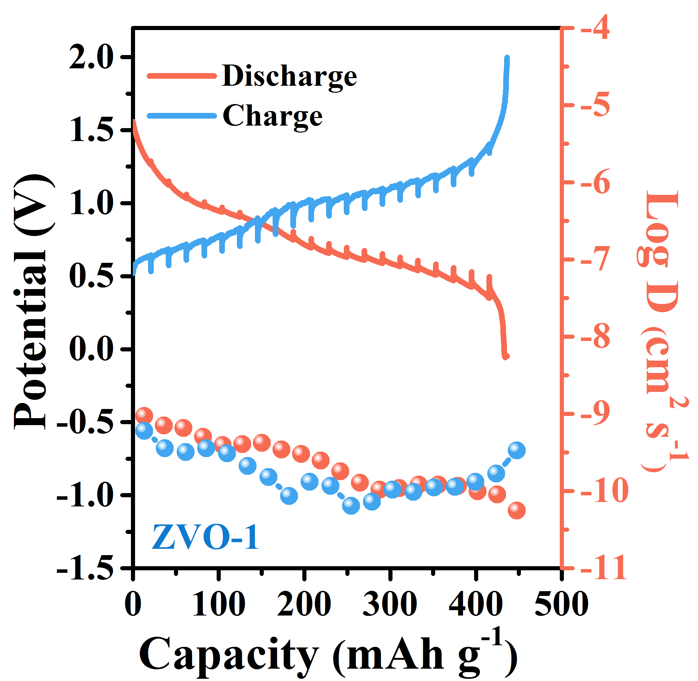
Electrochemical properties
Fig. 3. EIS patterns of all samples (a), CV profiles of ZVO-2 at different scan rates (b), the
contribution ratio of capacitive capacities in ZVO-2 (c), GITT profiles and diffusion
coefficients of all samples (d).

Slide 6
Thank you!
Email:1019208029@tju.edu.cn
sunxh@tju.edu.cn

