Slide 1
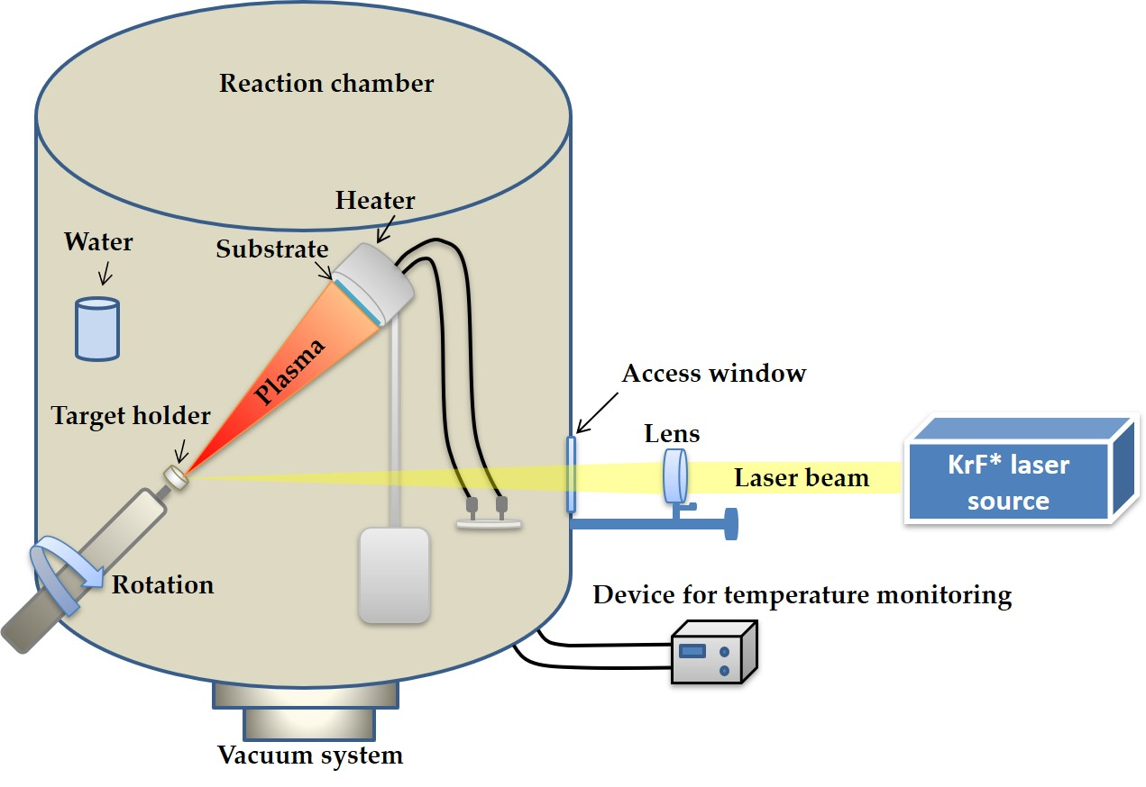
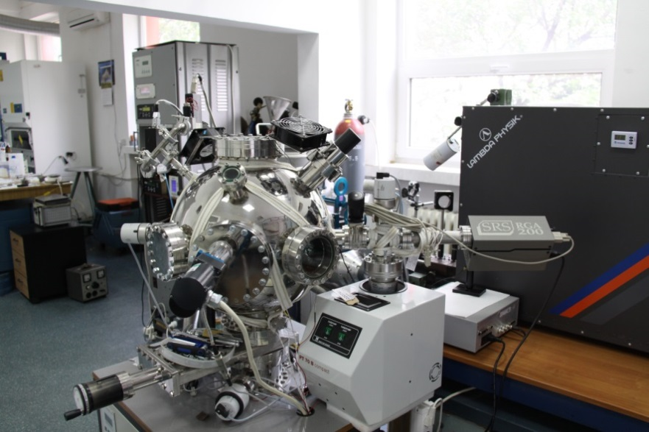
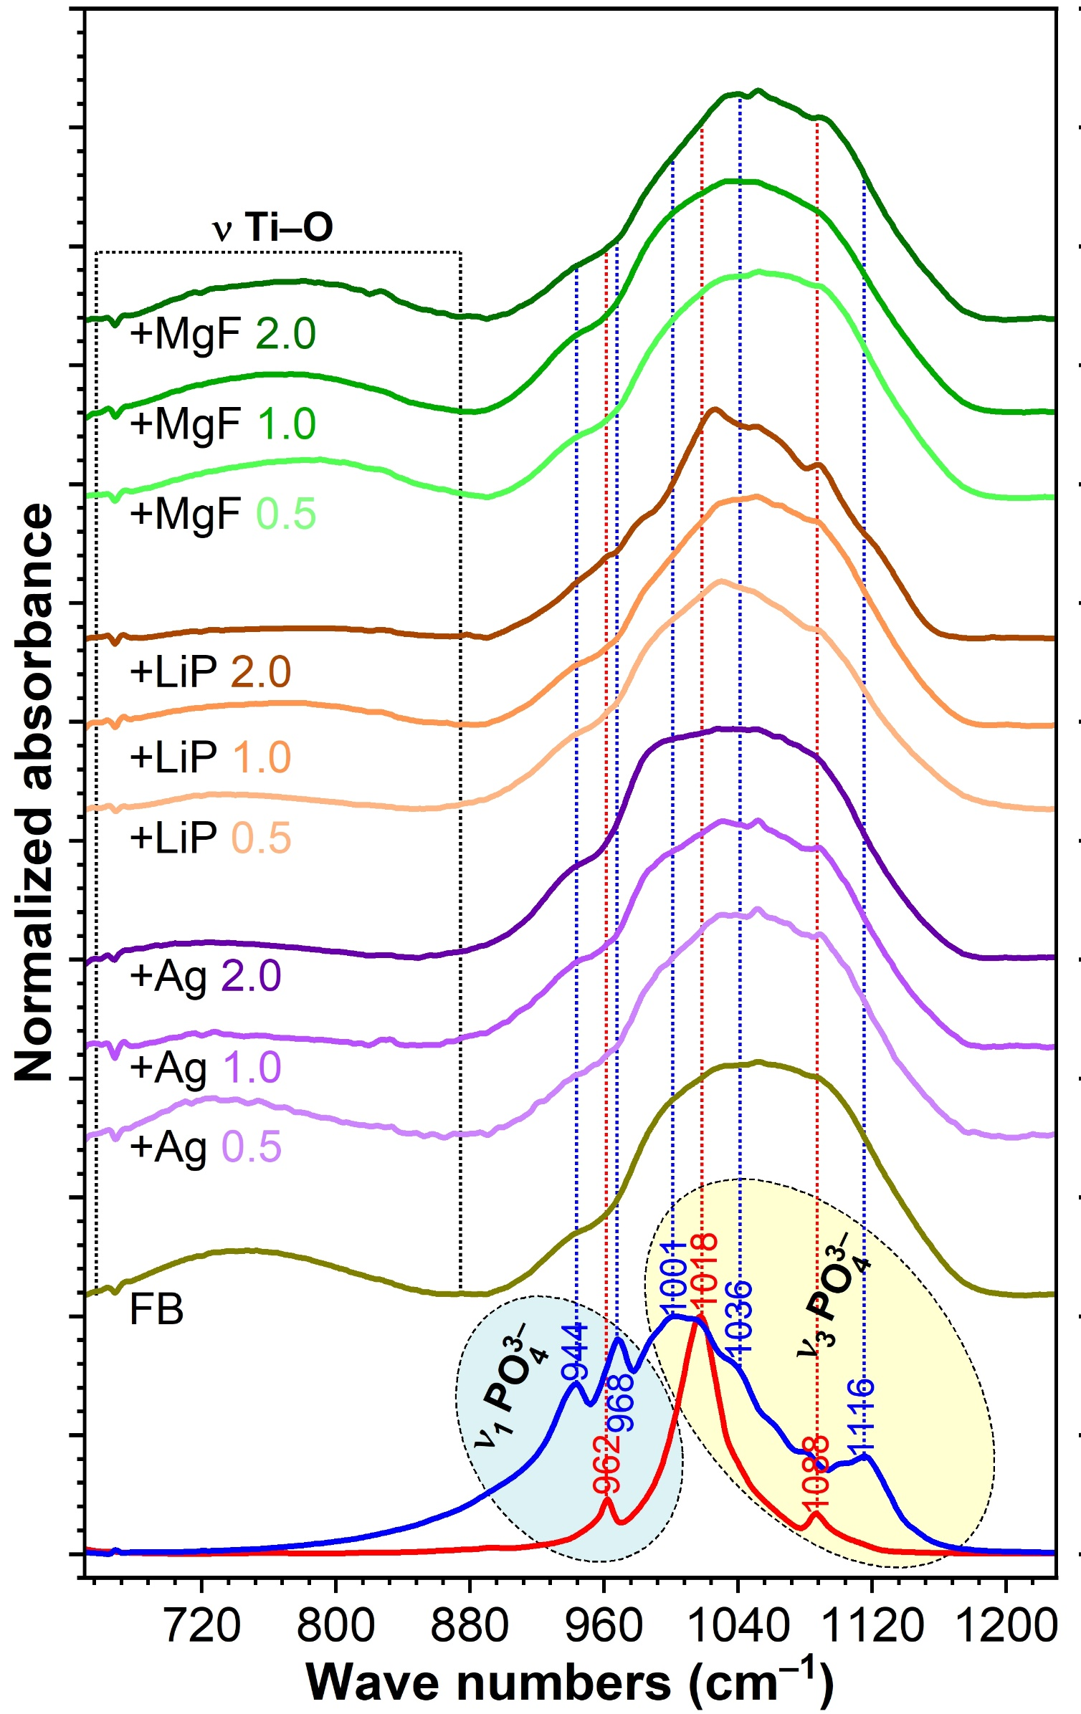
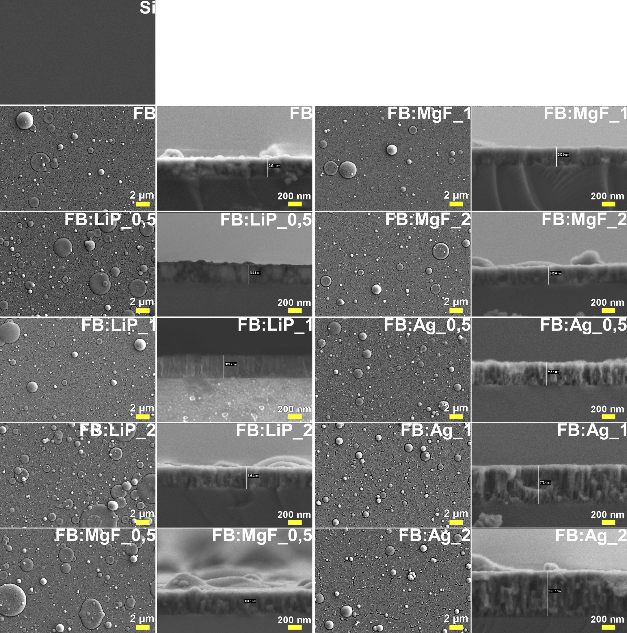
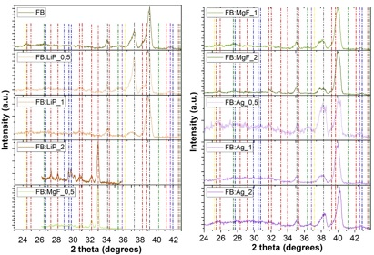
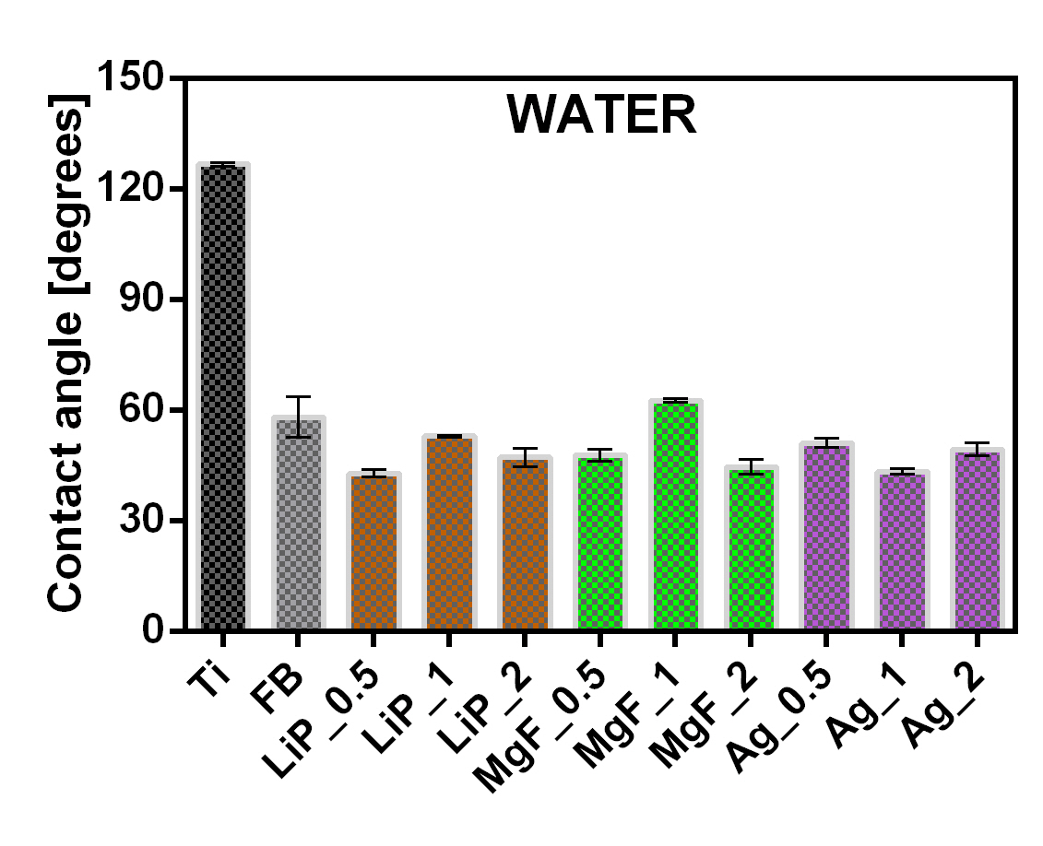
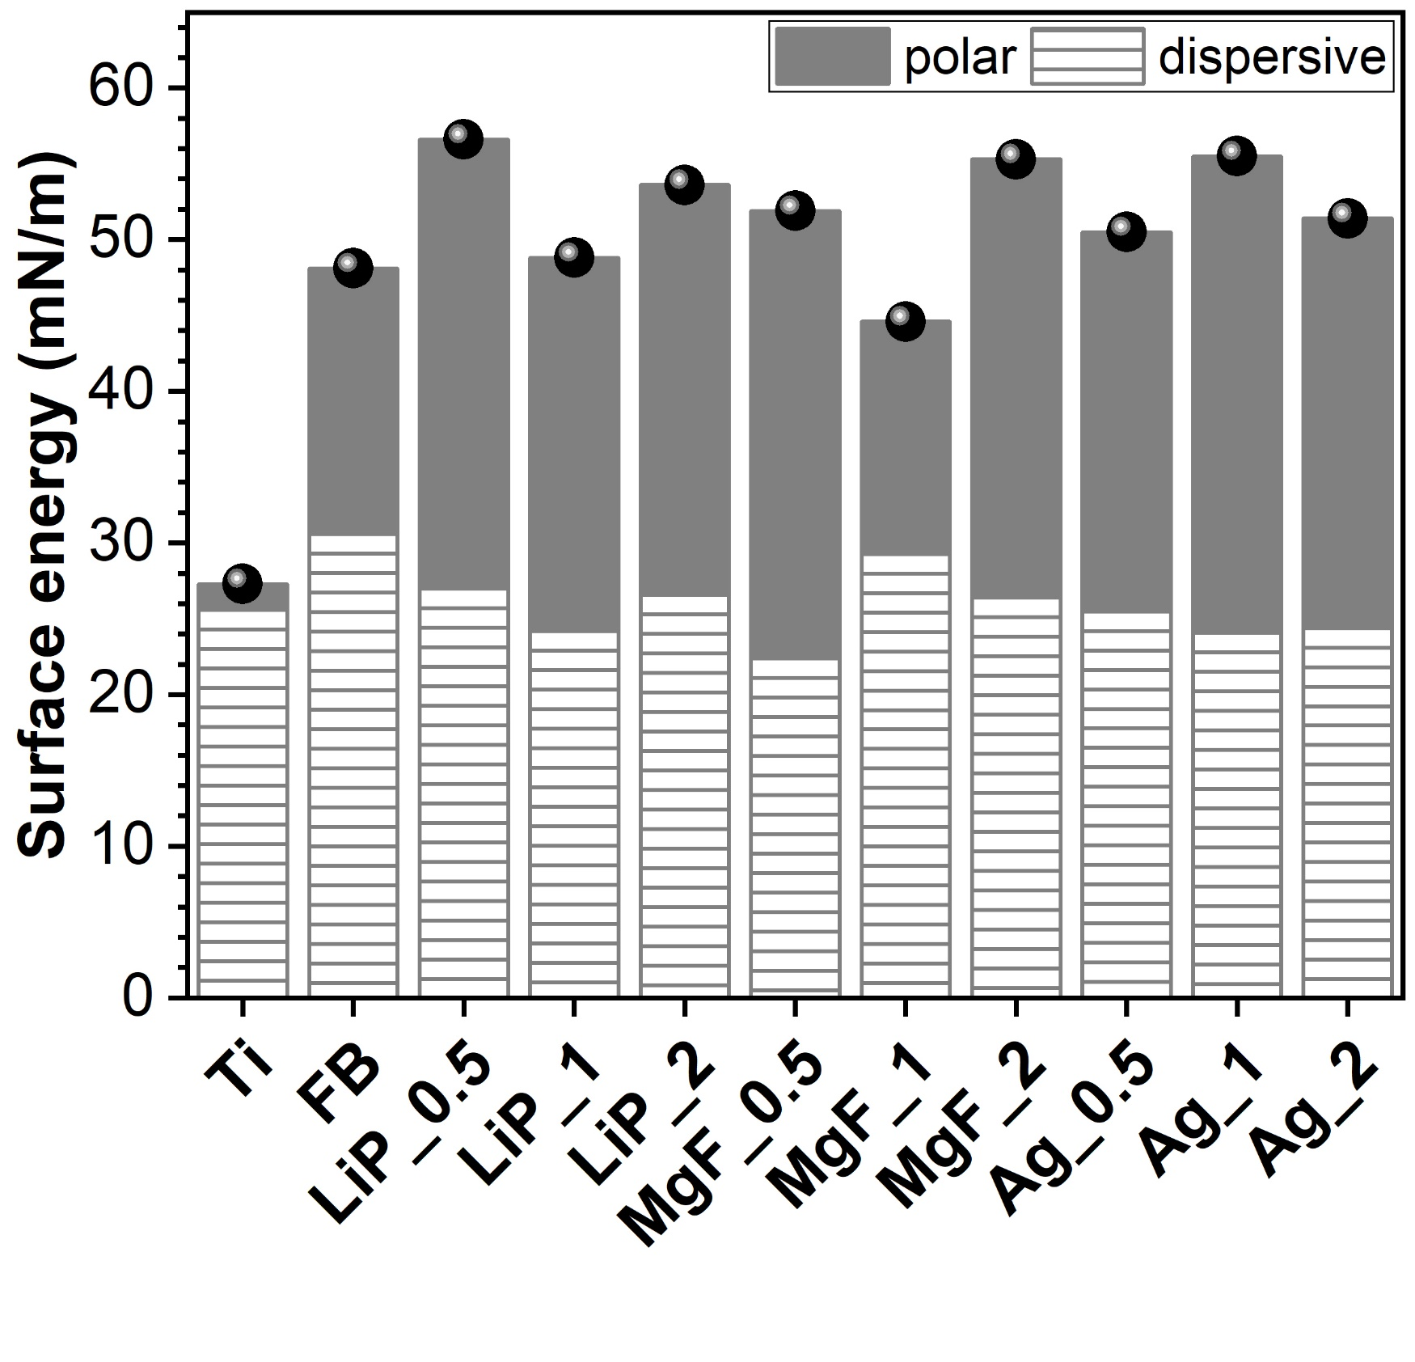
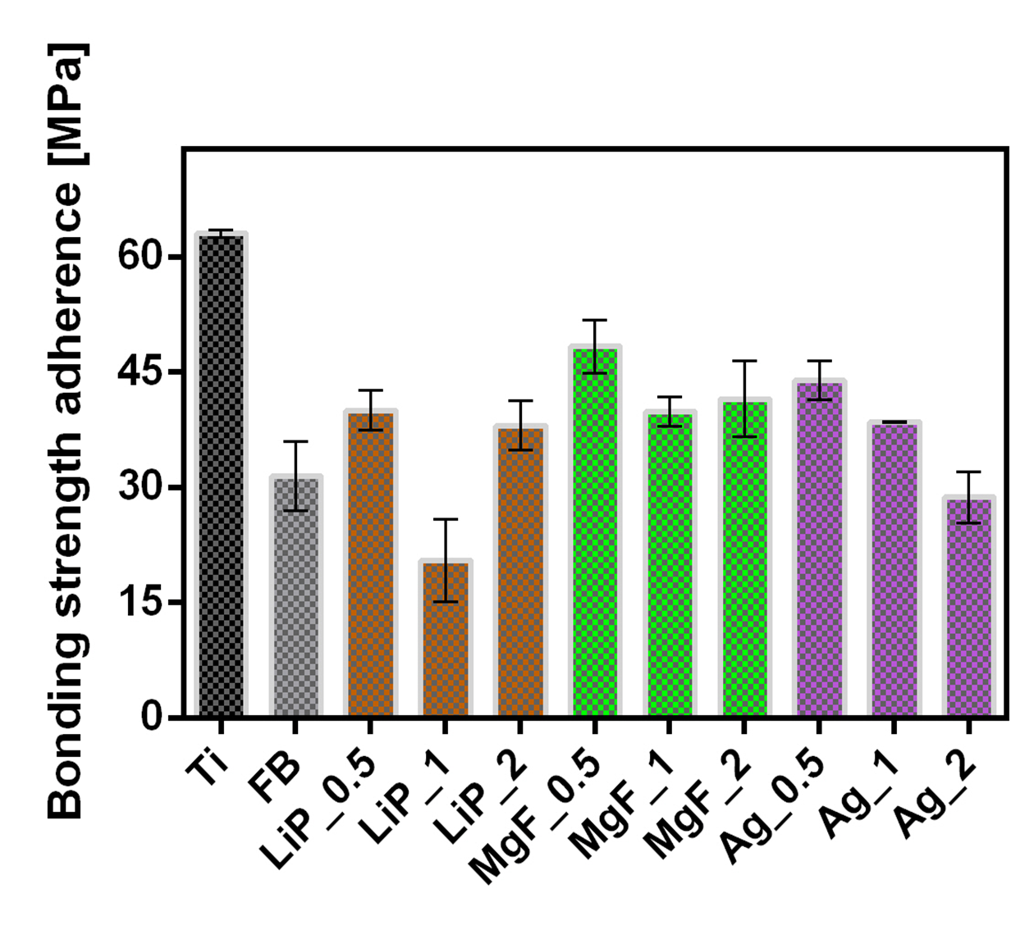
3^{-rd} International Online-Conference on Nanomaterials, 25 Apr–10 May 2022
Hydroxyapatites of marine origin as sustainable candidates for implantology
L. Duta¹, G.E Stan², V. Grumezescu¹, G. Dorcioman¹, E. Matei², I. Zgura², O. Gherasim^{1,3}, G. Popescu-Pelin¹, F.N. Oktar^{4,5}
¹National Institute for Lasers, Plasma and Radiation Physics, Lasers Department, Magurele, Romania, liviu.duta@inflpr.ro; ²National Institute of Materials Physics, Magurele, Romania; ³Department of Science and Engineering of Oxide Materials and Nanomaterials, Faculty of Applied Chemistry and Materials Science, Politehnica University of Bucharest, Bucharest, Romania; ⁴Department of Bioengineering, Faculty of Engineering, University of Marmara, Istanbul, Turkey; ⁵Advanced Nanomaterials Research Laboratory (ANRL), University of Marmara, Istanbul, Turkey
Motivation
Development of implants easily integrated into the living body by using biomaterials.
Route to obtain a material with a bone-like architecture and composition → fabricate it from sustainable resources, of biological origin, such as waste products (i.e., HA derived from fish bones, FB, or sea-shells).
Synthesis by PLD of bio-hydroxyapatite thin films (doping with 0.5, 1 and 2 wt.% of Li₃PO₄, MgF₂ and Ag).
Detailed morphological, structural, compositional and mechanical investigations → beneficial influence of doping agents on the characteristics of the synthesized structures.
Materials and Methods
PLD experiments, KrF* excimer laser source (λ = 248nm, τ_{FWHM} ≤ 25ns, ν = 10Hz), deposition parameters (p ≈ 50 Pa, H₂O vapors, d = 5 cm, E = 360 mJ, T = 500°C, F = 3.5 J/cm², N = 5000).
Simple (FB) and doped (with 0.5, 1 and 2 wt.% of Li₃PO₄, MgF₂ and Ag → FB:LiP, FB:MgF and FB:Ag).
Results
PLD experimental set-up
XRD diffractograms of simple and doped bio-hydroxyapatite thin films. Peaks were highlighted as following: Ti (grey), TiO₂ rutile (green), TiO₂ anatase (yellow), TiO (violet), Ca₃(PO₄)₂ whitlockite (blue) and Ca₅(PO₄)₃(OH) (red).
FT-IR spectra of simple and doped bio-hydroxyapatite thin films.
Top-view and cross-view SEM micrographs of simple and doped bio-hydroxyapatite thin films. Magnification bars: 2 µm (top-view) and 200 nm (cross-view).
ISO
Contact angle values inferred for simple and doped bio-hydroxyapatite coatings.
Surface free energy values inferred for Ti, and simple and doped bio-hydroxyapatite thin films (γ_{d} – hatched region, γ_{p} – grey region).
Pull out bonding strength adherence values measured in the case of simple and doped bio-hydroxyapatite thin films.
Conclusions
Structural investigations → synthesis of films with different degrees of crystallinity, mainly influenced by the nature of the dopant/concentration and by the source material;
Morphological examination → fabrication of films with rough surfaces, made of droplets, ideal for the good adhesion of cells and anchorage of implants in situ;
Contact angle measurements → hydrophilic behaviour→ rapid bone regeneration;
Bonding strength adherence → values more than three times higher than the threshold imposed by ISO standard regulating the load-bearing implant coatings (>15 MPa);
Preliminary results → incorporation of dopants into BioHA thin films can provide a delivery system for bioactive agents able to promote osseointegration, in correlation with an improved anchorage of bone metallic implants for suitable use in implantology.
Acknowledgements
This work was supported by a grant of Ministry of Research and Innovation, CNCS - UEFISCDI, project number PN-III-P1-1.1-TE2019-1449 (TE 189/2021) and Core Programme 16N/2019.

