Slide 1
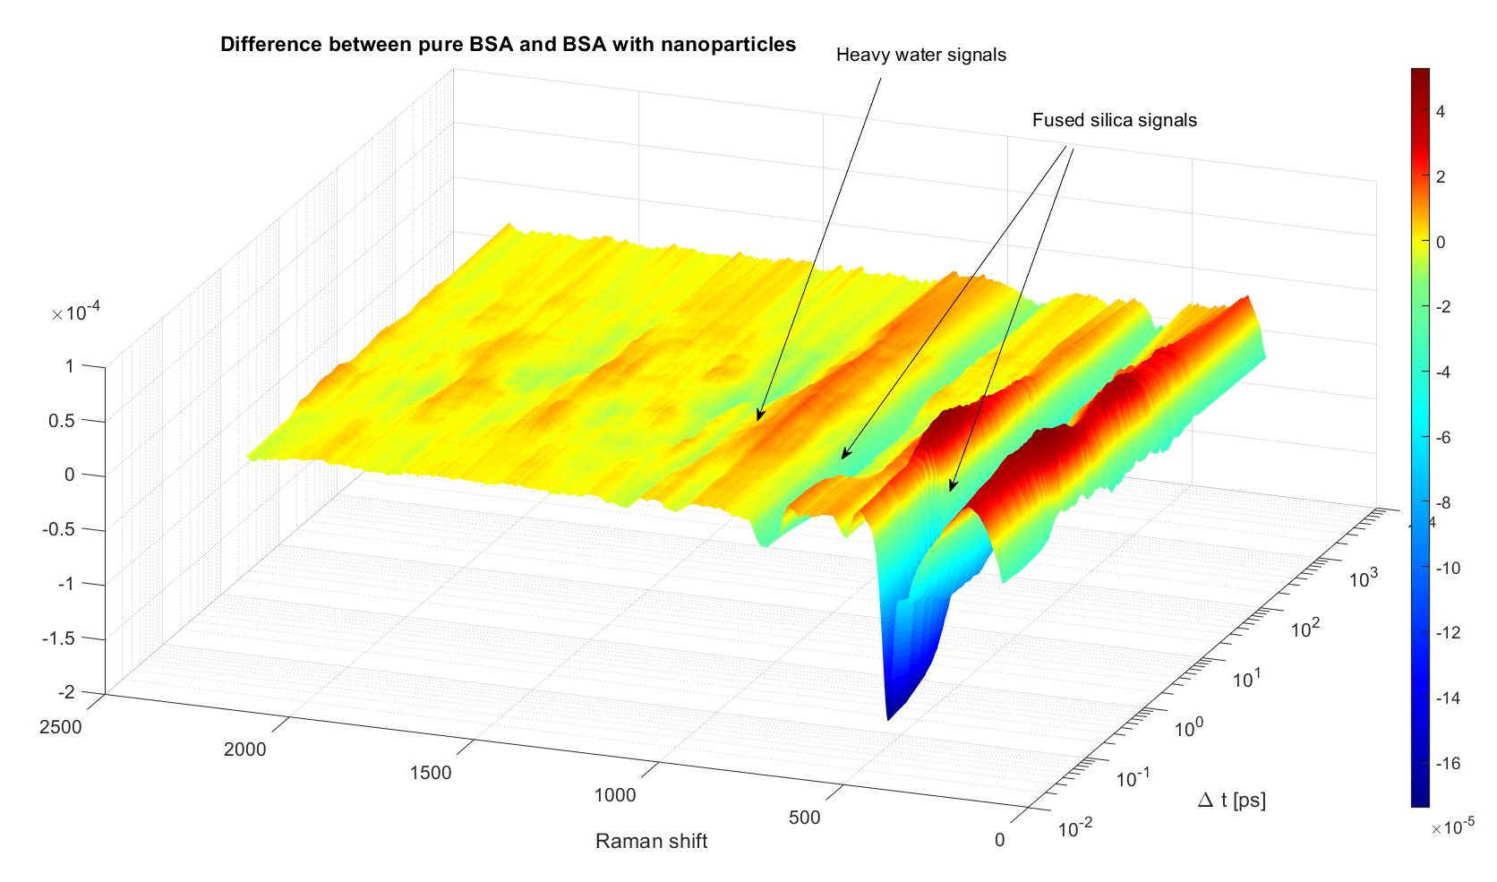
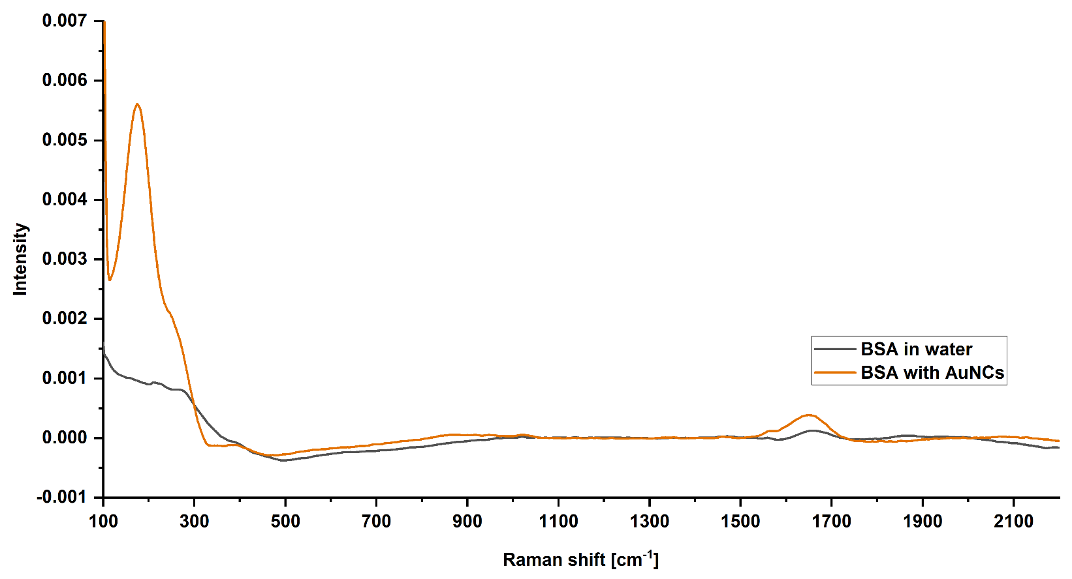
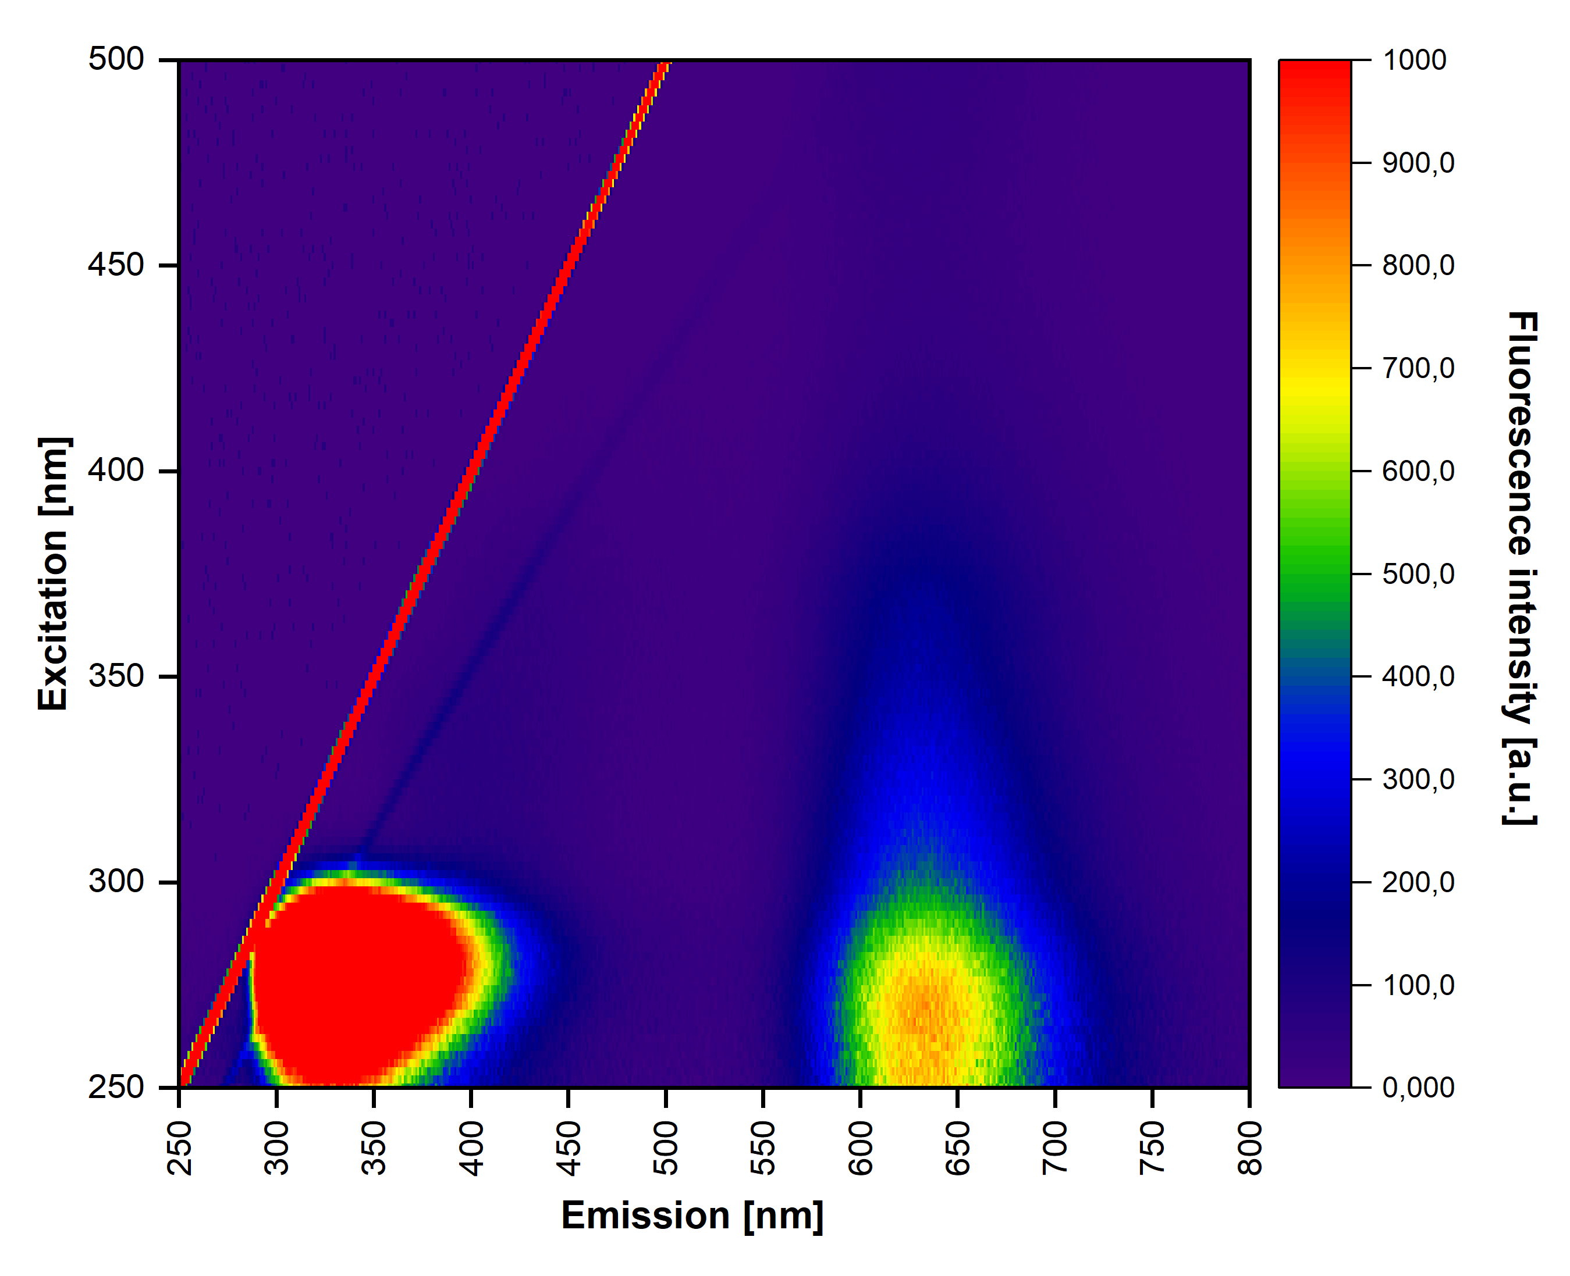
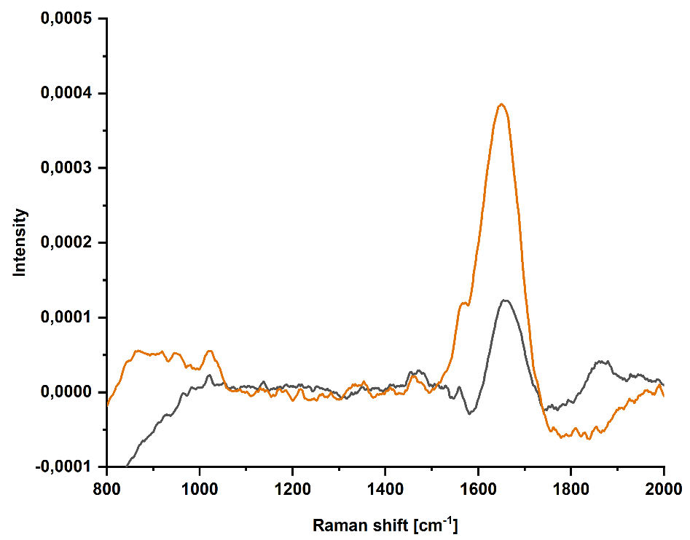
Gold nanoclusters investigated via femtosecond stimulated Raman spectroscopy
V. Svačinová^{1*}, M. Kloz², K. Šišková¹
¹ Department of Experimental Physics, Faculty of Science, Palacký University Olomouc, 17. Listopadu 12, 771 46 Olomouc, Czech Republic
² ELI Beamlines, Za Radnicí 835, Dolní Břežany, 252 41, Czech Republic
*veronika.svacinova02@upol.cz
Abstract:
Gold nanoclusters (AuNCs) with diameter less than 2 nanometres have fluorescent properties. These nanoclusters can be prepared by microwave assisted synthesis using BSA (bovine serum albumin) as a template and, simultaneously, as a reducing agent as demonstrated in our previous study (1). During the synthesis, Au(III) ions are reduced to Au(II), Au(I), and/or Au(0) which are bonded to BSA forming thus Au(II)-BSA, Au(I)-BSA complexes and/or Au(0)NCs-BSA, respectively (2). From now on, we are going to use the general label AuNCs-BSA for all the species included within the samples in this study. Femtosecond stimulated Raman spectroscopy (FSRS) an ultrafast nonlinear optical technique is used to study vibrational structure of AuNCs-BSA for the first time here. FSRS has a time resolution comparable to the vibrational period of molecular movements (ps to fs) and energy resolution less than 10 cm⁻¹. Three laser pulses are exploited in a typical FSRS experiment: actinic pulse, Raman pulse and probe pulse (3).
Chemicals: HAuCl₄; 98% BSA; NaOH; all purchased from Sigma-Aldrich
Methods of characterization: Femtosecond stimulated Raman spectroscopy (FSRS), steady-state fluorescence spectroscopy, dynamic light scattering (DLS), zeta potential measurements, UV-vis absorption spectroscopy.
Fig. 1: The first result from AuNCs-BSA FSRS measurements. There are signals from the cuvette and water, i.e., artefacts.
Main-take home message:
AuNCs-BSA system was investigated via FSRS for the very first time. According to our results, two main peaks are observed in FSRS spectrum: 176 cm⁻¹ belonging to Au and 1650 cm⁻¹ attributable to BSA.
Fig. 2: Results of FSRS measurements in flat jet mode (without laser beam passing through the wall of a cuvette). BSA in water serves as a reference. Inset - a part of spectrum in the region where BSA peak dominates.
Fig. 3: Fluorescence 3D excitation/emission map of AuNCs-BSA.
176 cm⁻¹ (Au)
0.0005
1650 cm⁻¹ (BSA)
1000
0.0004
900
900
Intensity
900
0.0003
800
0.0002
700
0.0001
600
0.0000
500
-0.0001
400
800
1000
1200
1400
1600
1800
2000
300
200
100
0
Tab. 1: Zeta pontential values and particle size distribution expressed as average hydrodynamic diameter (determined by DLS, based on measurements of changes in light intensity as a function of time) for BSA and AuNCs-BSA. Percentual content of particular average diameter is given in parantheses.
Outlook:
FSRS seems to be a very promising tool in gaining new information about nanostructures of noble metals. However, the intensity of AuNCs-BSA signal in FSRS has to be improved. Therefore, the next step is to investigate gold nanoparticles with BSA on their surfaces (AuNPs-BSA). These AuNPs-BSA possess surface plasmon at 525 nm which can lead to FSRS intensity increase. Consequently, the combination of Au and Ag nanostructures could be investigated by FSRS.
Sample | Zeta potential | Average hydrodynamic diameter
AuNCs-BSA | (-30.9 ± 1.1) mV | (31.7 ± 4.2) nm (51.9 %) | (6.2 ± 0.7) nm (26.3 %) | (213.6 ± 34.4) nm (21.8 %)
BSA | (-24.8 ± 0.9) mV | (142.6 ± 3.4) nm (100 %)
References:
(1) P. Andrýsková et al., The effect of fatty acids and BSA purity on synthesis and properties of fluorescent gold nanoclusters. Nanomaterials 2020, 10, 343; doi:10.3390/nano10020343
(2) R. Ostruszka et al., Evidence of Au(II) and Au(0) states in bovine serum albumin - Au nanoclusters revealed by CW-EPR/LEPR and peculiarities in HR-TEM/STEM imaging. under revisions in Nanomaterials
(3) P. Kukura et al. Femtosecond Stimulated Raman Spectroscopy. Annu. Rev. Phys. Chem. 2007. 58:461–88
Acknowledgement:
This research was funded by Grant Agency of the Czech Republic, grant number 19-03207S, and by Internal Grant Agency of Palacký University, grants numbers IGA_PřF_2021_003 and IGA_PřF_2022_003.

