Slide 1
Combination of coagulation-flocculation-decantation with sulfate radicals for agro-industrial wastewater treatment
Nuno Jorge^{1,2} *; Carlos Amor²; Ana R. Teixeira²; Leonilde Marchão²; Marco S. Lucas²; José A. Peres²
¹ Escuela Internacional de Doctorado (EIDO), Campus da Auga, Campus Universitário de Ourense, Universidade de Vigo, As Lagoas, 32004, Ourense, Spain
² Centro de Química de Vila Real (CQVR), Departamento de Química, Universidade de Trás-os-Montes e Alto Douro (UTAD), Quinta de Prados, 5001-801,
Vila Real, Portugal
* njorge@uvigo.es
The 1st International Electronic Conference on Processes: Processes System Innovation
Session 2. Environmental and Green Processes
17 – 31 May 2022

Slide 2
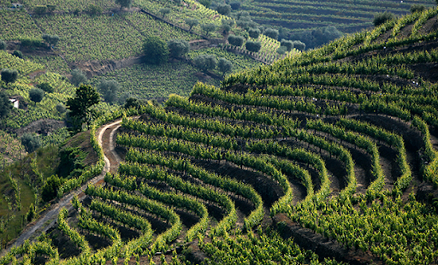
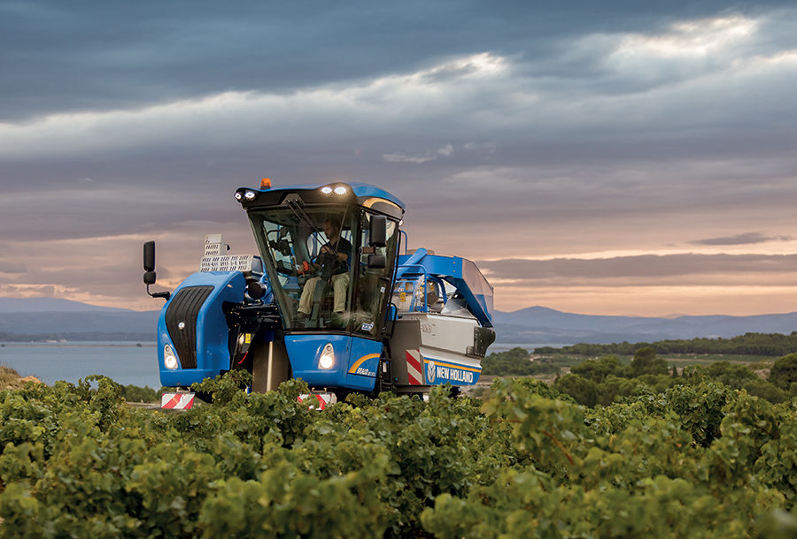
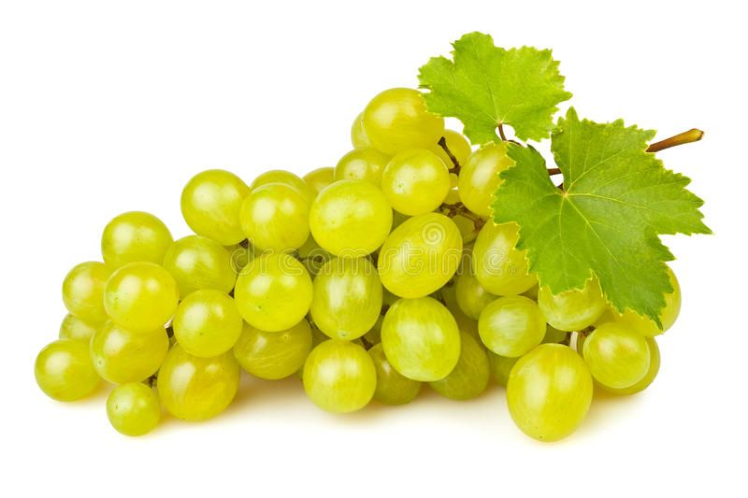
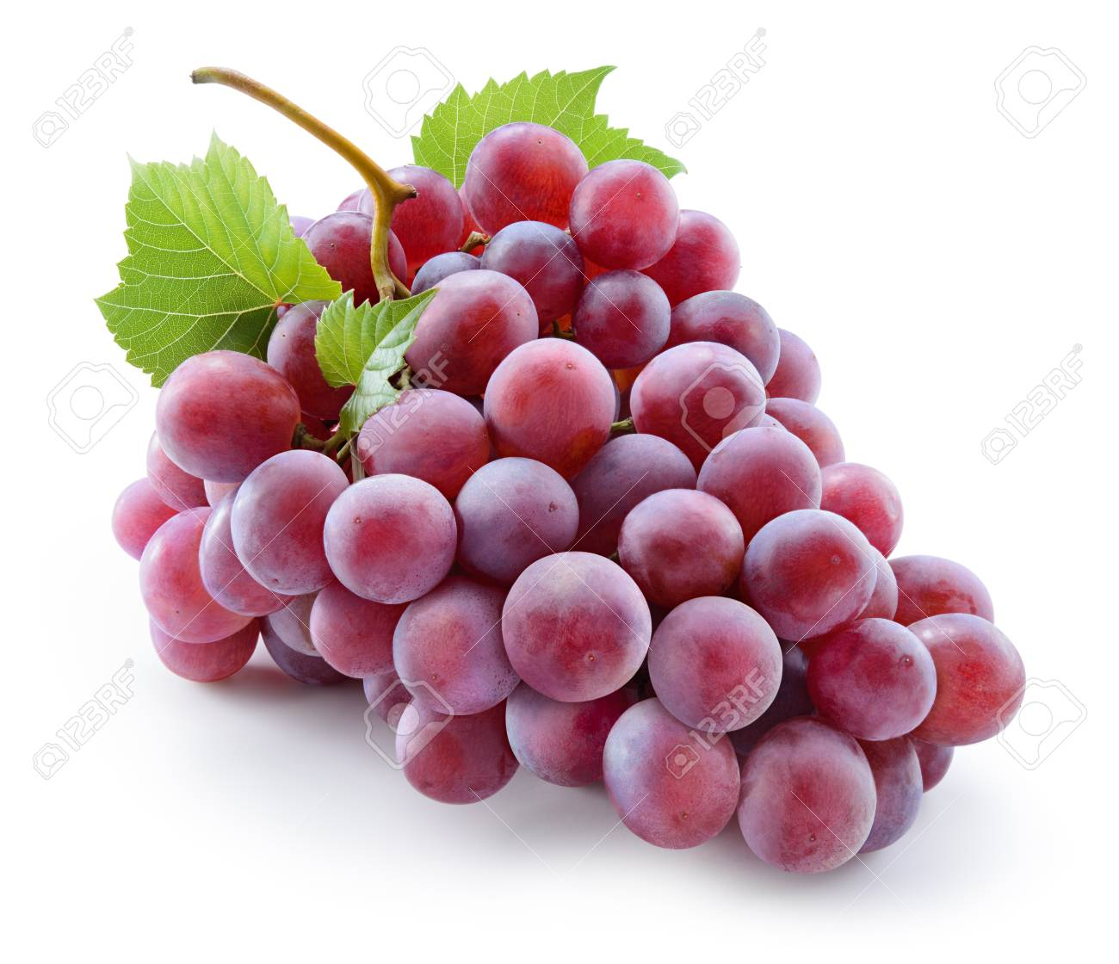
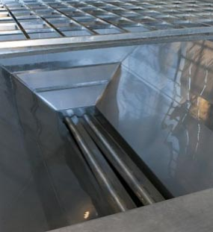
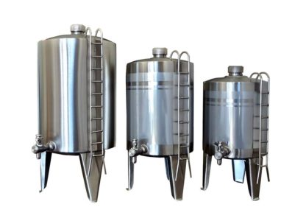
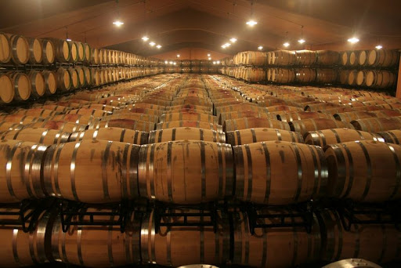
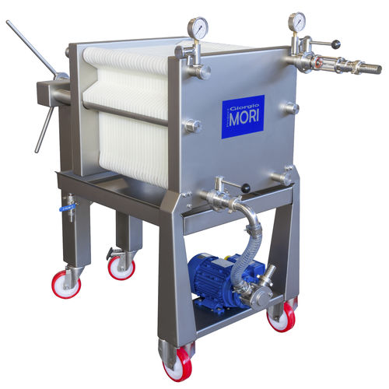
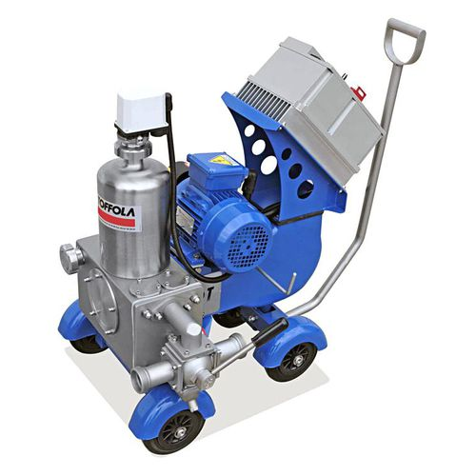
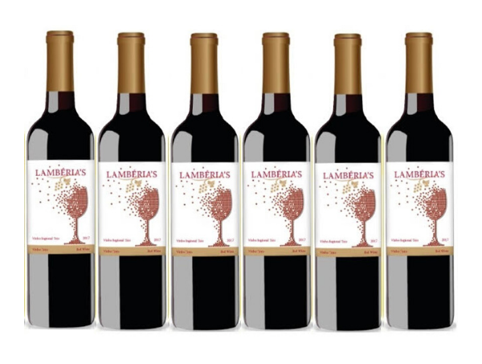
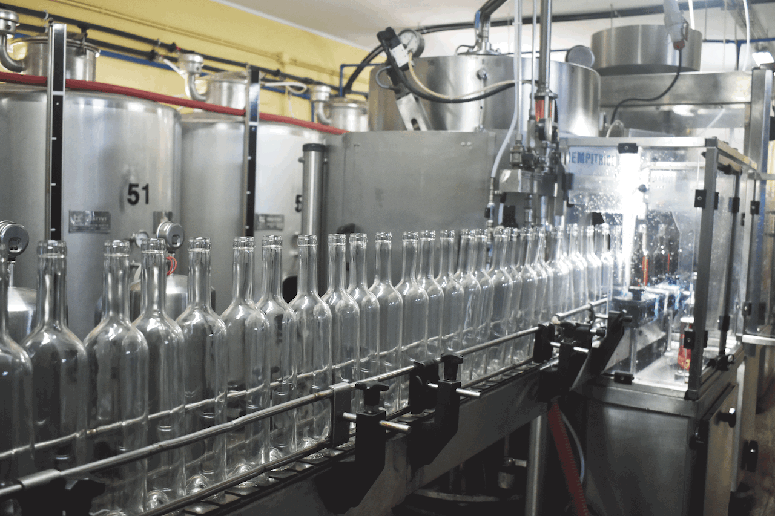
Introduction
In the vintage, the grapes are collected
In the grape reception, the grapes are selected and separated
In white wines the grapes are crushed and the must is fermented
In red wines, the grapes are marecerated and the must is fermented with the grapes
After must fermentation and wine stabilization, the wine is filtrated
Finally, the wine is bottled
Vintage
Grape reception
White grapes
Red grapes
Destemer/ Crucher
Tank Yeast add
Maceration
Must fermentation
Must fermentation
Rack
Rack
Malolactic fermentation
Rack
Finning operation
Wine stabilization
Filtration
Bottleling

Slide 3
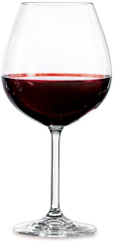
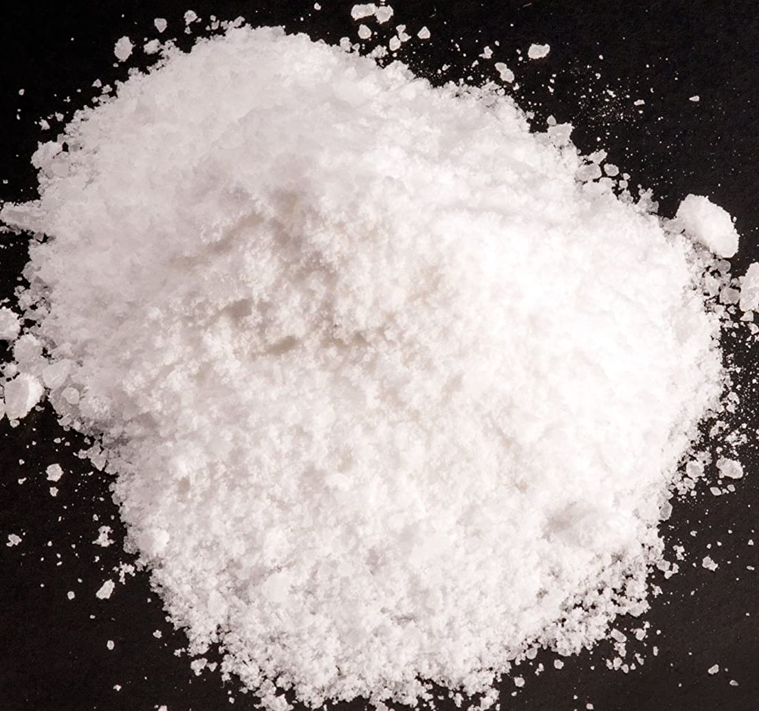
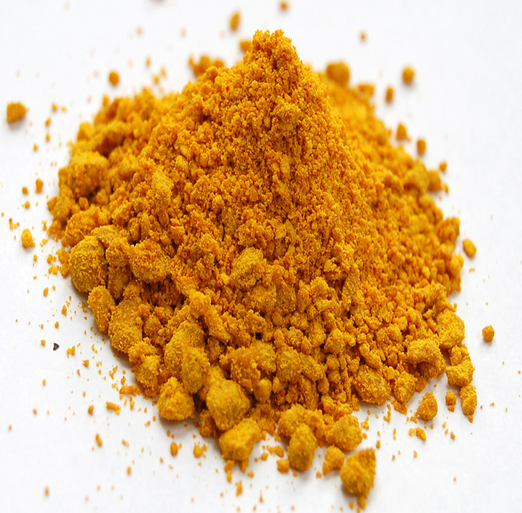
Introduction
Coagulation-flocculation-decantation (CFD)
Oenological coagulants
Used on wine treatment
Aluminum
Dialysis encephalopathy
Alzheimer's disease
Iron
Generally corrosive
Strongly dependent on the pH
The leach cannot be recycled
Stable colloids
Destabilised colloids
Aggregated colloids
Add coagulant/flocculant
Advantages
Alimentary use
Low cost and accessible
Do not affect pH
Leach can be recicled
Disadvantages
Hydrolysable metal salts (mainly, aluminum and iron)
Most used on waster treatment

Slide 4
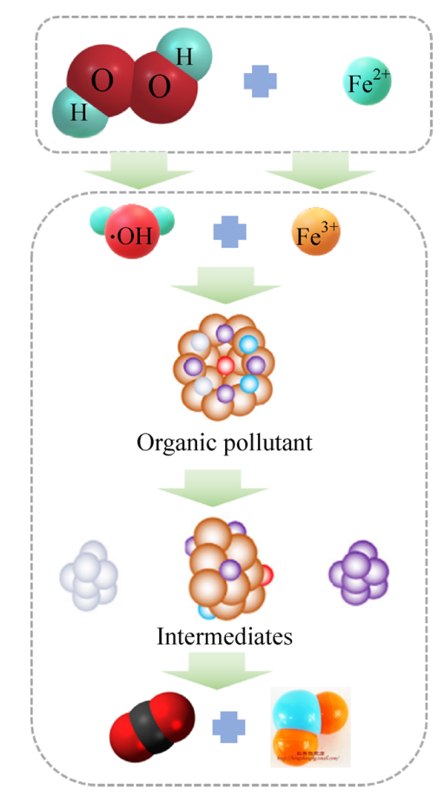
Introduction
Properties of PS and PMS
Advanced Oxidation Processes (AOP)
Application of sulfate radicals for degradation of organic matter
HR-AOP
SR-AOP
Mechanisms of activation
Ozone
Alkaline activation
Transition metal ions and metal oxide
For base activation of PS, a nucleophilic attack on the O-O bond is considered as the main mechanism
Transition metal and metal oxide can active the PS and PMS to degrade the organic contaminants
Thermal activation
Radiation activation
Carbonaceous-based materials
Production of radicals to degrade
the organic matter
In general, 254 nm is usually used as the radiation wavelength for persulfate.
For the activation of PS and PMS by carbonaceous-based materials, the mechanism is the electron conduction
Temperature (> 50 °C) can cause the fission of O-O bond to form the sulfate radicals

Slide 5
Objectives
Considering the low information regarding the treatment of winery wastewater (WW) by SR-AOP, the aim of this work is:
(1) To apply oenological coagulants potassium caseinate, bentonite and polyvinylpolypyrrolidone to increase the efficiency of SR-AOPs for the treatment of winery wastewater
(2) To apply a Box-Behnken design of Response Surface Methodology to optimize the SR-AOP
(3) To evaluate the efficiency of combined CFD-SR-AOP process in WW treatment.

Slide 6
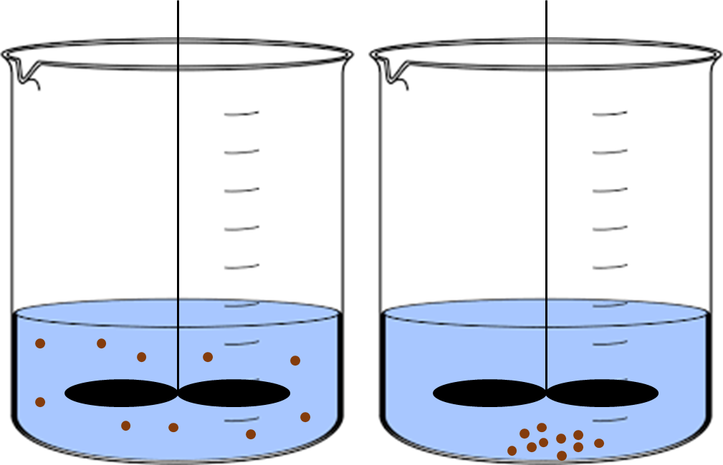
Material and methods
Two different winery wastewaters (WW) were studied, and different physical–chemical parameters were monitored in order to characterize the WW, including the chemical oxygen demand (COD), the biochemical oxygen demand (BOD₅), the total organic carbon (TOC) and the total polyphenols.
Characterization of WW1 and WW2
Coagulation-flocculation-decantation Set-up
The coagulation-flocculation-decantation experiments were performed in a conventional model jar-Test apparatus
[potassium caseinate] = 0.4 g/L, [bentonite] = [PVPP] = 0.1 g/L, pH = 3.0, rapid mix (rpm/min) = 150/3, slow mix (rpm/min) = 20/20, sedimentation time = 12 h
Sulfate radical oxidation Set-up
The oxidation process was optimized by application of a Box-Behnken design of Re-sponse Surface Methodology. In the Box-Behnken, three variables were studied (SPS, Fe²⁺ and HA) under three levels for a total of 15 assays, under fixed conditions as follows: pH = 3.0, Temperature = 298 K, time = 300 min
150 rpm/ 3 min
Coagulation:
Rapid Mix
20 rpm/ 20 min
Flocculation:
12 h
Decantation
Slow Mix
UV-A LED
(365 nm)
Values of operating parameters at 3 levels in Box-Behnken design
Fe²⁺
KPS
Fe²⁺
KPS
KPS
Fe²⁺
CFD process
SR-AOP

Slide 7
Results and discussion
In accordance with the statistical model, the following operational conditions were obtained
Box-Behnken design
Experimental and predicted percentage of TOC and COD removal for the generated runs in Box-Behnken design
[SPS] = 51.96 mM, [Fe²⁺] = 0,90 mM, pH = 3.0, radiation UV-A (365 nm), Temperature = 298 K, t = 300 min
TOC and COD removal of 19.7 and 31.2%
${{\text{S}}_{\text{2}}\text{O}}_{\text{8}}^{\text{2}\text{−}}$ + hv → ${\text{2}\text{SO}}_{\text{4}}^{\text{•}\text{−}}$ | (3)
${{\text{S}}_{\text{2}}\text{O}}_{\text{8}}^{\text{2}\text{−}}$ + Fe²⁺ → ${\text{SO}}_{\text{4}}^{\text{•}\text{−}}$ + ${\text{SO}}_{\text{4}}^{\text{2}\text{−}}$ + Fe³⁺ | (4)
TOC = 4.65 + 1.186 X1 – 2.99 X2 – 4.94 X3 – 0.01356 X1*X1 – 3.40 X2*X2 + 0.185 X3*X3 + 0.1568 X1*X2 – 0.0116 X1*X3 + 2.095 X2*X3 | (1)
COD = 26.86 + 0.488 X₁ + 6.0 X₂ – 1.50 X₃ – 0.00463 X₁*X₁ – 4.74 X₂*X₂ – 0.152 X₃*X₃ + 0.067 X₁*X₂ + 0.0057 X₁*X₃ + 1.600 X₂*X₃ | (2)

Slide 8
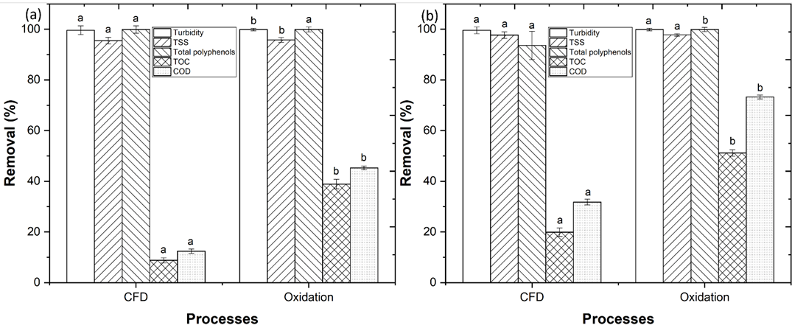
Results and discussion
Combination of coagulation-flocculation-decantation-oxidation processes
Decantation of WW
WW1
The CFD process achieved a turbidity, TSS, total polyphenols, TOC and COD removal of 99.6, 95.5, 99.9, 8.8 and 12.4%, respectively
With performance of oxidation process, it was observed a significant increase to 99.9, 95.8, 99.9, 38.9 and 45.3% removal, respectively
WW2
With performance of CFD process it was observed a removal of 99.6, 97.7, 93.6, 19.9 and 31.8%, respectively
With the application of oxidation process, it was observed a significant increase to 99.9, 97.8, 99.9, 51.2 and 73.3% removal, respectively
Coagulant/ flocculant
CFD process
Organic matter
UV-A LED
UV-A-SR-AOP
Assessment of the CFD and oxidation processes efficiency in the treatment of (a) WW1 and (b) WW2.

Slide 9
Conclusions
Based in this work’s results, it is concluded
1. With the optimization performed by the Box-Behnken design, it is achieved a TOC and COD removal of 19.7 and 31.2%, respectively
2. The application of CFD process to WW1 and WW2 achieves a high removal of turbidity, TSS and total polyphenols
3. The combination of CFD-oxidation processes achieves a high TOC and COD removal for the treatment of WW2 (51.2 and 73.3%, respectively)

Slide 10
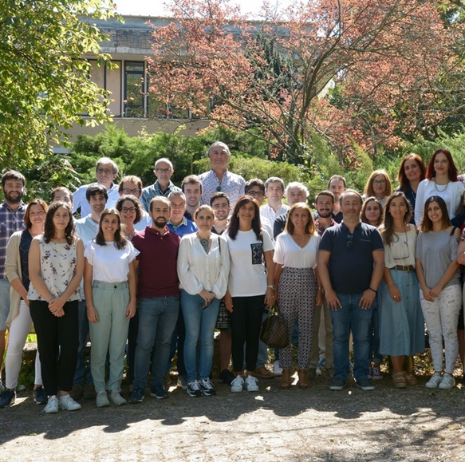
Acknowledgements
The authors thank the North Regional Operational Program (NORTE 2020) and the European Regional Development Fund (ERDF), and express their appreciation for the financial support of the Project AgriFood XXI, operation nº NORTE-01-0145-FEDER-000041, and to the Fundação para a Ciência e a Tecnologia (FCT) for the financial support provided to CQVR through UIDB/00616/2020. Ana R. Teixeira also thanks the FCT for the financial support provided through the Bolsa de Doutoramento UI/BD/150847/2020.

Slide 11
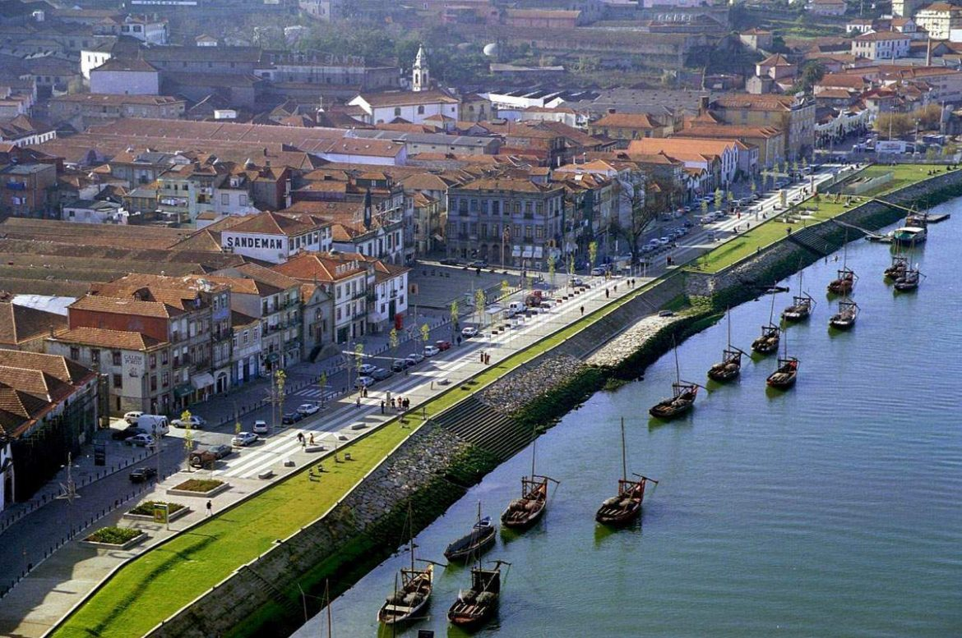
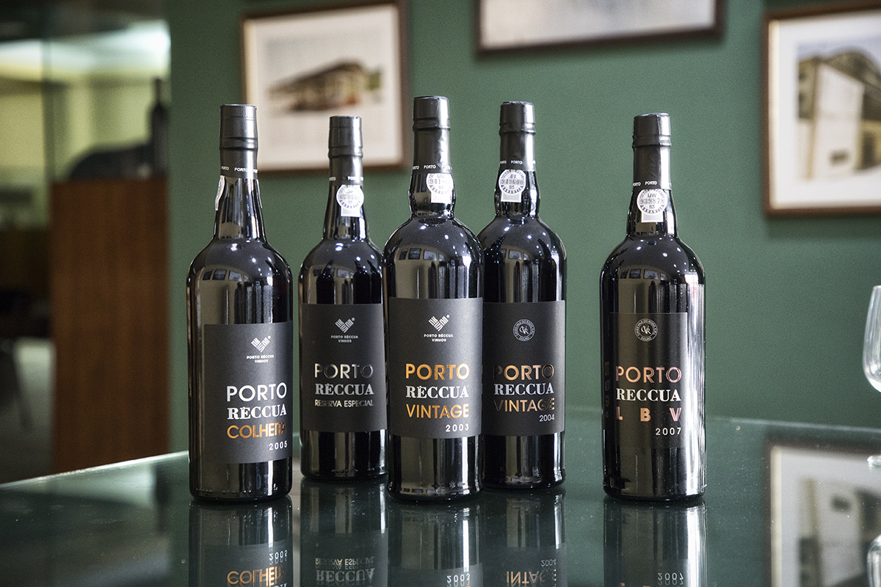
Thank you for your attention

