Slide 1
Fortification of traditional fermented milk “Lben” with date powder: physicochemical and sensory attributes
Wafa Mkadem¹, Khaoula Belguith¹, Malek BenZid¹, and Nourhene Boudhrioua mihoubi¹
¹Laboratory of Physiopathology, Alimentation and Biomolecules (LR17ES03), Higher Institute of Biotechnology Sidi Thabet, University of Mannouba, BP-66, 2020 Ariana, Tunisia
Session: Food Processes

Slide 2
MOTIVATION
High nutritional value
Functional effects
Carbohydrates
Dietary fibre
Proteins
Lipids and fatty acid
Vitamins and minerals
Protect against many chronic diseases
Inhibit the growth of pathological organisms
Enhance the digestive process

Slide 3
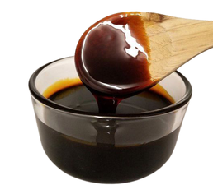
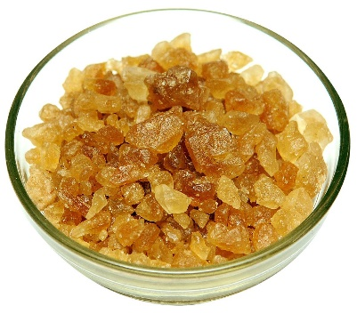
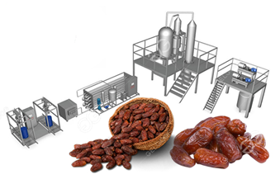
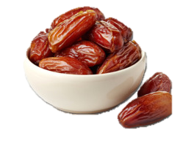
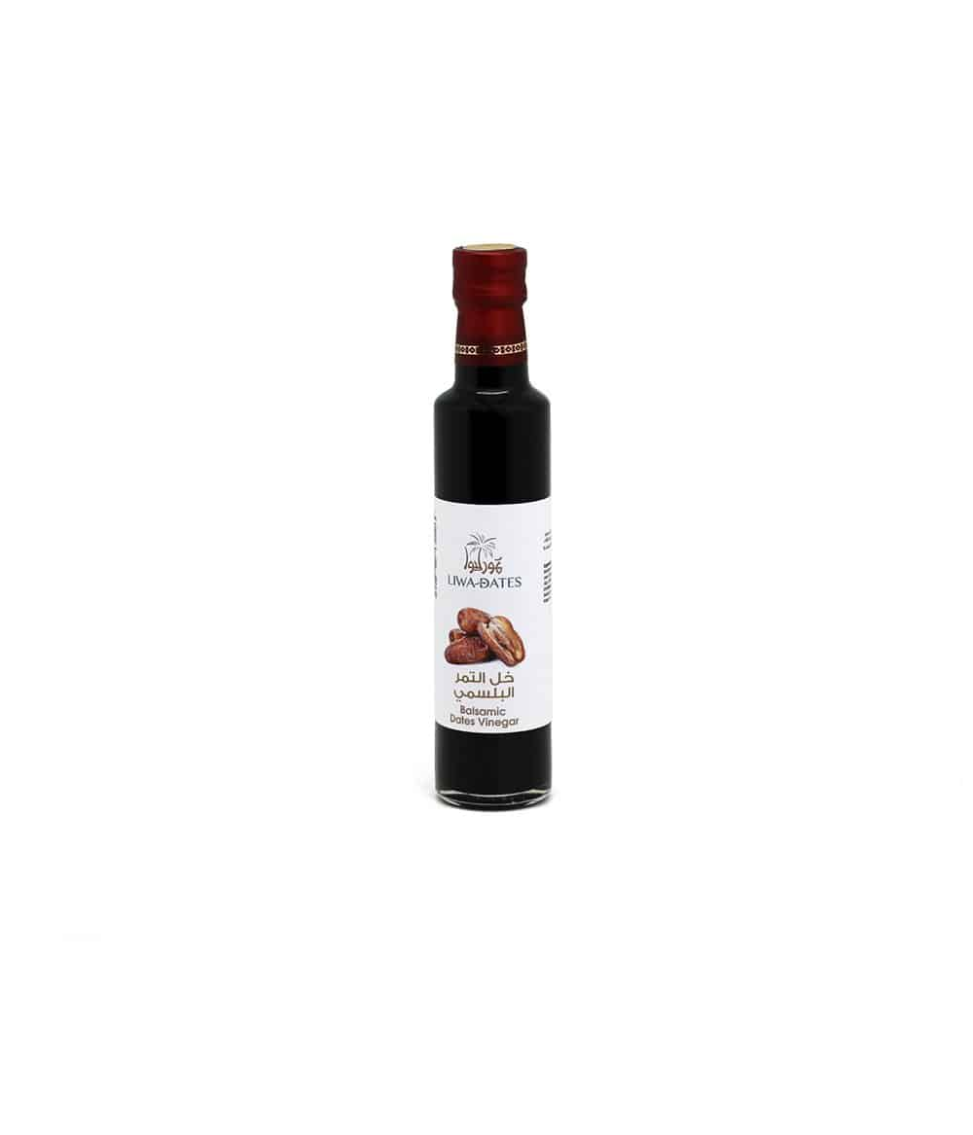
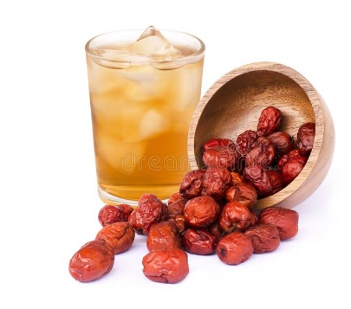
MOTIVATION
Honey/Syrup
sugar
Fresh date fruit
vinegar
juice
Dried powder

Slide 4
OBJECTIVES
To investigate some techno-functional and antioxidant properties of date powder
To study the effect of date powder supplementation on the physicochemical and sensory properties of Lben (fermented milk).

Slide 5
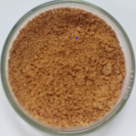
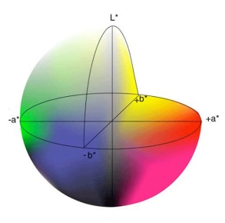
METHODOLOGY
Techno-functional properties : water holding capacity, oil holding capacity and milk holding capacity
bulk density
Phenolic, flavonoids contents and antioxidant activity
Date powder of Deglet Nour variety
(Boudjebel S.A. VACPA )
Color parameters C.I.E. L*a*b*

Slide 6
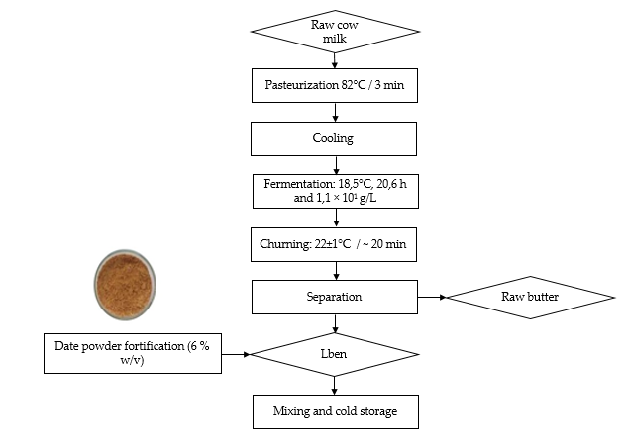
METHODOLOGY
pH
Acidity
Lactic bacteria
Color parameters
Sensory analysis

Slide 7
RESULTS
Date powder characterisation
No significant difference between holding capacities of date powder have been found in water, milk and corn oil
Evaluated parameters | Value*
WHC (mL/g) | 2.0±0.2
OHC (mL/g) | 1.7±0.5
MHC (mL/g) | 1.7±0.2
Bulk density (g/cm³) | 0.45±0.05
Total phenolic content (mg GAE/100 g _{db}) | 751.75±0.03
Total flavonoids content (mg QE/100g _{db}) | 385.39±0.04
DPPH scavenging capacity (%) | 55.3±0.9
Color parameters
L* | 63.4±1.7
a* | 19.1±0.5
b* | 29.9±0.08
Lower bulk density
Higher total phenol content (TPC) total flavonoids content (TFC) and antioxidant activity
Suitable ingredient with several nutritional and functional properties.

Slide 8
RESULTS
Effect of date powder supplementation on physicochemical and sensory attributes of Lben
The increase of pH with a decrease of acidity values of Lben after fortification
Evaluated parameters | pH | Acidity | Lactic bacteria (log CFU/mL) | Color parameters
 |  |  |  | L* | a* | b* | ΔE
Unfortified Lben | 4.5±0.01b | 84.1±1.6a | 9.28 | 79.1± 0.4a | -1.8±0.8c | 3.1± 0.1b | 0.76
Lben fortified with date powder (6% w/v) | 4.6±0.01a | 76.4±2.3b | 8.18 | 63.4±0.9b | 4.5±0.2a | 12.1±0.1a | 19.00
Industrial Lben | 4.4±0.01c | 87.7±3.8a | 5.71 | 79.1±1.7a | -1.1±0.4b | 2.95±0.2c | -
Inhibition effect of date powder on the viability of lactic bacteria could be attributed to phenolic content
Increase of a* and b* values with a decrease of lightness parameter L*.

Slide 9
RESULTS
The enhancement of overall appreciation with a significant contribution to the development of sweet taste, odor taste and flavored milk odor

Slide 10
CONCLUSIONS
Date powder proved to be a good ingredient for food supplementation with multifunctional properties
The Fortification of Lben with date powder allowed to an increase of pH with a decrease of acidity values and a slight decrease of lactic bacteria count
Sensory attributes were significantly affected after fortification due to date compositions : odor, flavor and taste are the main affected descriptors
The present work contributes to the valorization of date powder by fortification of dairy product

Slide 11
ACKNOWLEDGEMENTS
PRIMA project ARTISANEFOOD, PRIMA-S2-2018- PCI2019-103453 CALL: PRIMA-S2-2018-PCI2019
PromESsE project / PAQ PAES, The Tunisian Ministry of Higher Education and Scientific Research
Boudjebel S.A. VACPA industry

Slide 12
THANK YOU !
mkademwafa@gmail.com

