Slide 1
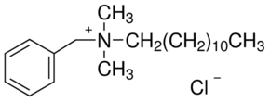
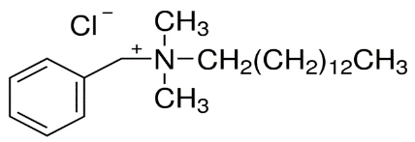
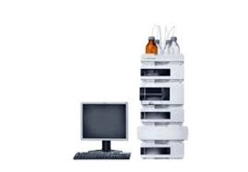
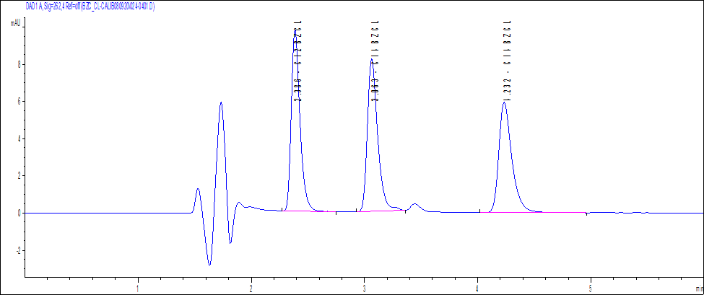
NEW HPLC METHOD FOR SURFACTANTS DETECTION IN WASTEWATERS SAMPLES
Paun Iuliana^{1,2}, Florentina Laura Chiriac¹, Florinela Pirvu^{1,2}, Vasile Ion Iancu¹, Cristina Ileana Covaliu²,
¹National Research and Development Institute for Industrial Ecology – ECOIND, 57-73 Drumul Podu Dambovitei Street, RO-060652, Bucharest, Romania.
²University POLITEHNICA of Bucharest, Faculty of Biotechnical Systems Engineering, 313 Splaiul Independentei Blvd., RO-060042, Bucharest, Romania
Introduction.
Benzalkonium chlorides (alkylbenzyldimethylammonium), widely used as cationic surfactants, are mixtures of alkyl homologues of dodecyl-(C12), tetradecyl- (C14) and hexadecyl- (C16) benzyl dimethylammonium chlorides. Benzyl dimethyl dodecyl ammonium chloride (BAC-12), benzyl dimethyl tetradecyl ammonium chloride (C14-BAC) and benzyl dimethyl hexadecyl ammonium chloride C16-BAC) are applied as bactericides and disinfectants in sanitary products and antistatic agents in the formula of laundry conditioners. After use, residual amounts of benzalkonium chloride and their degradation products are discharged into wastewater treatment plants or directly into surface water and groundwater. Benzalkonium chlorides belong to the category of emerging pollutants.
2. Materials and methods
The aim of this work was the development and validation of a new High Performance Liquid Chromatography (HPLC) combined with diode array detector method for simultaneous analysis of benzyl dimethyl dodecyl ammonium chloride (C12-BAC), benzyl dimethyl tetradecyl ammonium chloride (C14-BAC) and benzyl dimethyl hexadecyl ammonium chloride C16-BAC) in wastewater samples. Chemical structures of these surfactants are shown in Fig.1
C12-BAC
C14-BAC
C16-BAC
Fig.1 Chemical structures of cationic surfactants
Equipment: All analytical determinations were performed using an Agilent 1200 HPLC chromatograph (DIONEX) and UV-VIS diode array detector connected in tandem with Charged Aerosol Detector (Corona Veo RS). HPLC/DAD parameters: Column: Acclaim Surfactant Plus (3.0 x 150 mm, 3μm), temperature: 30⁰C, Injection volume : 20 µL, UV –VIS detection: λ = 262 nm for the three cationic surfactants Mobile phase: mixture of acetonitrile (A) and 0,2 M ammonium acetate solution (B) (50:50, v/v) . Flow-rate: 0.5 mL/min Instrument control / data processing: Agilent Chem Station
Solid phase extraction procedure: Off-line solid phase extraction(SPE) was performed by passing 100 ml sample through a Strata-X (500 mg/6 ml) cartridge from Phenomenex. The SPE protocol is presented in Table 1.
Table 1. Description of SPE protocol for wastewater samples extraction
Step | Eluents
Conditioning | 5 ml acetonitrile and 10 ml water
Load sample | 100 ml sample at constant flow rate of 2 ml/ min
Wash | 20 ml water with 10% (v/v) acetic acid, dry 10 min
Elution | 8.5 ml acetonitrile –water with 10% acid acetic (90/10, v/v) at constant flow of 1 ml/min
The extraction phase was evaporate and reconstitute in 1mL ammonium acetate 0.2M, transferred to a autosampler vial and analysed.
3. Results and Discussion
Table 2. The validation parameters for the proposed method: correlation coefficients (R²), intra-day and inter-day precision, analyte recovery, detection limits (DLs) and quantitation limit (QLs)
Surfactant | Concentration range (mg/L) | R² | Precision (RSD%) |  | Analyte recovery (% | DLs (µg/L) | QLs (µg/L)
 |  |  | Intra-day | Inter-day
BAC-12 | 1 - 100 | 0.9992 | 1.37 | 6.14 | 93.5 | 1.50 | 4.5
BAC-14 | 1 - 100 | 0.9996 | 2.27 | 6.49 | 90.29 | 1.87 | 5.6
BAC-16 | 1 - 100 | 0.9997 | 2.20 | 6.65 | 86.0 | 2.53 | 7.6
Fig. 2. Chromatogram of 50 mg/L cationic surfactants standard solution and their corresponding retention times
4. Conclusions
The new sensitive and selective HPLC/DAD developed method allows simultaneous determination of cationic surfactants mixture from wastewaters. Low limits of detection obtained for all surfactants (4.5 ug/l to 7.6ug/l) and acceptable recovery values (>90%) show that the method is sensitive and precise. The optimized method was tested from domestic wastewater from office buildings, hospital, car wash, as well as from gas stations, obtaining concentration values varying from few µg/L to few mg/L.

