Slide 1

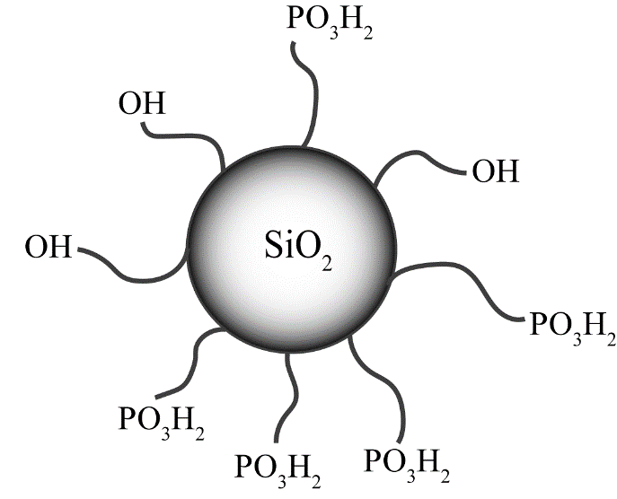
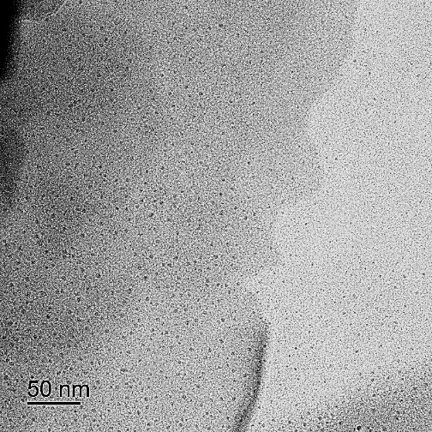
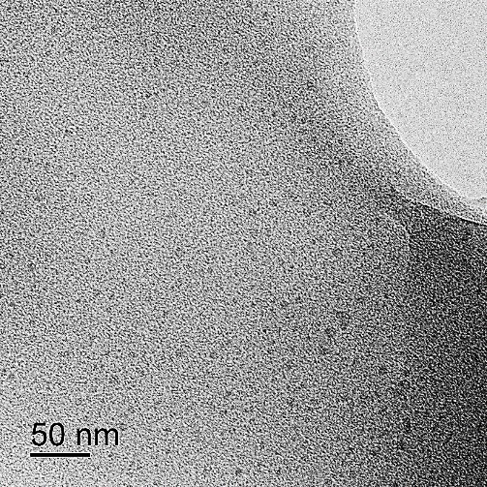
Hybrid membrane materials based on polybenzimidazole and silica with grafted phosphonic groups for fuel cell applications
Anna Lysova¹, I.I. Ponomarev²
¹Kurnakov Institute of General and Inorganic Chemistry RAS, Moscow, Russia
²Nesmeyanov Institute of Organoelement Compounds RAS, Moscow, Russia
* ailyina@yandex.ru, www.igic.ras.ru
Advantages of PBI
operation temperature 130-180°С
work at low humidity
requirements on fuel purity is reduced
(1-3% content of CO), cheap fuel
Disadvantages of PBI
                acid leaching from membrane matrix
material corrosion in the presence of hot phosphoric acid
Basic approaches for improving the properties:
incorporation of inorganic particles in PBI matrix capable to stabilize H₃PO₄
using of surface-modified particles
Structure of Polybenzimidazole (PBI) and modified silica
The aim of this work is
to study the properties of proton-conducting hybrid membranes based on PBI and silica particles surface-modified by ethylphosphonic-groups.
Membranes formation
Casting PBI polymer solution in N-MP with mixture of tetraethoxysilane and
(2-diethylphosphatoethyl)-
triethoxysilane. Mass fraction of the dopant was 5 or 10%, mole fraction of phosphonic groups was
x = 0–100%).
Drying at 60°C (air) and 120°C (vacuum)
a
b
Hydrolysis of
-(OEt)-groups by HCl (18%) treatment with (SiO₂)–PO₃H₂ formation
50% H₃PO₄ treatment
Fig. 1. TEM-micrograph for PBI/SiO₂-5 wt.%-x, x = 0 (a) and x = 100 (b).
Isolated silica particles 3-5 nm in size are uniformly distributed in the membrane.
Increase in phosphonic groups content leads to a little increase in particle size.
CONDUCTIVITY
Fig. 2. Dependence of the acid doping level (n H3PO4) on the mole fraction of functional groups (x) in hybrid membranes; the mass concentration of silica is indicated by numbers in the figure.
Fig. 3. Dependence of membrane conductivity on the mole fraction (х) of functional groups for (1, 3) PBI/SiP-5-x and (2, 4) PBI/SiP-10-x at (1, 2) 110°С and (3, 4) 160°С. The data points marked with squares refer to the conductivity of the original PBI-O-PhT membrane at 110 and 160°С.
The introduction of functional groups leads to an increase in the uptake of the acid. For the membranes with a dopant content of 10 wt %, its amount increases by ~10% with an increase in the mole fraction of –PO₃H₂ groups.
An increase in the concentration of –PO₃H₂ groups in the dopant facilitates the uptake of a larger amount of acid due to the formation of a system of hydrogen bonds with it.
The incorporation of the unmodified silica into the membrane leads to a slight increase in conductivity.
Along with an increase in the number of functional groups and, accordingly, in the uptake of phosphoric acid, the conductivity of the membranes also increases significantly, reaching 0.081 S/cm at 160°C, which is approximately 2.5 times the conductivity of the reference sample.
The conductivity of these systems is primarily determined by the transport of protons through the system of hydrogen bonds formed by phosphoric acid molecules, the concentration of which in the membrane is much higher. The acidic –PO₃H₂ groups of the dopant can also contribute to proton transport.
At a high concentration of –PO₃H₂ groups on the silica surface (10 wt % silica, x > 60), the phosphoric acid content in the membrane becomes too high and the membrane plasticizes at high temperatures.
CONCLUSIONS
The grafting of functional –PO₃H₂ groups onto the silica surface leads to a significant increase in the uptake of phosphoric acid, the concentration of which determines the functional properties of these materials.
The conductivity of the best samples reaches 0.081 S/cm at 160°C.
Due to the contribution of the introduced functional groups to the conductivity, it becomes possible to reduce the amount of introduced acid without a significant loss of conductive properties, which will also contribute to the preservation of mechanical characteristics.
This work was financially supported by the Russian Science Foundation (project no. 21-73-20229)

