Slide 1
Treatment of winery wastewater by an EDDS-photo-Fenton process. Assessment of UV-C, UV-A and solar radiation
Nuno Jorge^{1,2} *; Carlos Amor²; Ana R. Teixeira²; Leonilde Marchão²; Marco S. Lucas²; José A. Peres²
¹ Escuela Internacional de Doctorado (EIDO), Campus da Auga, Campus Universitário de Ourense, Universidade de Vigo, As Lagoas, 32004, Ourense, Spain
² Centro de Química de Vila Real (CQVR), Departamento de Química, Universidade de Trás-os-Montes e Alto Douro (UTAD), Quinta de Prados, 5001-801,
Vila Real, Portugal
* njorge@uvigo.es
The 1st International Electronic Conference on Processes: Processes System Innovation
Session 2. Environmental and Green Processes
17 – 31 May 2022

Slide 2
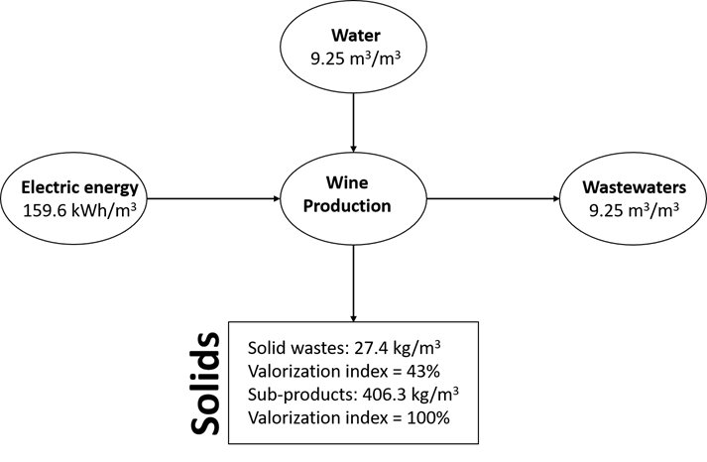
Introduction
Winery wastewater main characteristics
Fructose
Glucose
Winery wastewater
Soluble sugars
pH
Alcohols
Organic acids
BOD₅
High-molecular-weight compounds
COD
Tartaric acid
Lignin
Lactic acid
Tannins
Acetic acid
Polyphenols
Glycerol
Mass balance applied to ACPB winery representing specific values, i.e., values per cubic meter of produced wine. Losses of water by evaporation were neglected [1].
320 – 296 000 mg O₂ L⁻¹
Ethanol
[1] Brito, A. G., Peixoto, J., Oliveira, J. M., Oliveira, J. A., Costa, C., Nogueira, R., & Rodrigues, A. (2007). Brewery and winery wastewater treatment: some focal points of design and operation. In Utilization of by-products and treatment of waste in the food industry (pp. 109-131). Springer, Boston, MA.
3 - 4
125 – 130 000 mg O₂ L⁻¹

Slide 3
Introduction
Radiation
UV-C Mercury lamp
UV-A LED lamps
Solar light
Photo-Fenton process
Catalyst
Oxidant
Chelating agents
Iron
Copper
Cobalt
Magnesium
Manganesium
Zinc
Hydrogen peroxide (H₂O₂)
Oxalate
EDDS
EDTA
NTA

Slide 4
Objectives
The aim of this work is
(1) Study the impact of EDDS on Fe²⁺ regeneration in photo-Fenton process
(2) Study the effects of EDDS and HA on hydroxyl radical production in photo-Fenton process
(3) Study the impact of radiation type in organic matter removal

Slide 5
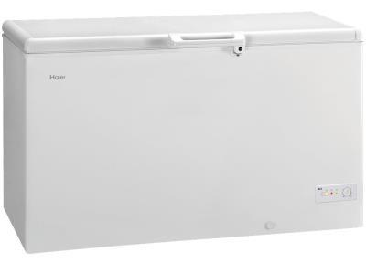
Material and methods
Winery wastewater characterization
Winery wastewater collection and storage
Main chemical characteristics of winery wastewater (WW)
Parameters | Portuguese Law Decree nº 236/98 | WW
pH | 6.0-9.0 | 4.0
Biochemical Oxygen Demand - BOD₅ (mg O₂/L) | 40 | 550
Chemical Oxygen Demand - COD (mg O₂/L) | 150 | 2145
Biodegradability – BOD₅/COD |  | 0.26
Total Organic Carbon – TOC (mg C/L) |  | 400
Turbidity (NTU) |  | 296
Total suspended solids – TSS (mg/L) | 60 | 750
Electrical conductivity (μS/cm) |  | 62.5
Total polyphenols (mg gallic acid/L) | 0.5 | 22.6
Iron (mg/L) | 2.0 | 0.05
Aluminium (mg/L) | 10.0
Cobalt (mg/L) |  | 0.00
Manganese (mg/L) | 2.0
Potassium (mg/L) |  | 20.5
Calcium (mg/L) |  | 1.07
Magnesium (mg/L) |  | 0.51
Sodium (mg/L) |  | 0.19
Storage in small containers
Conservation at -40ºC
Winery wastewater used in this work

Slide 6
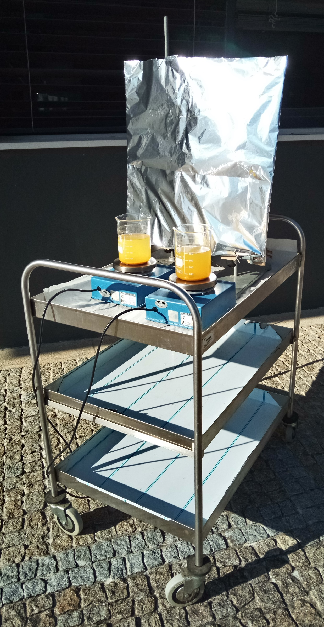
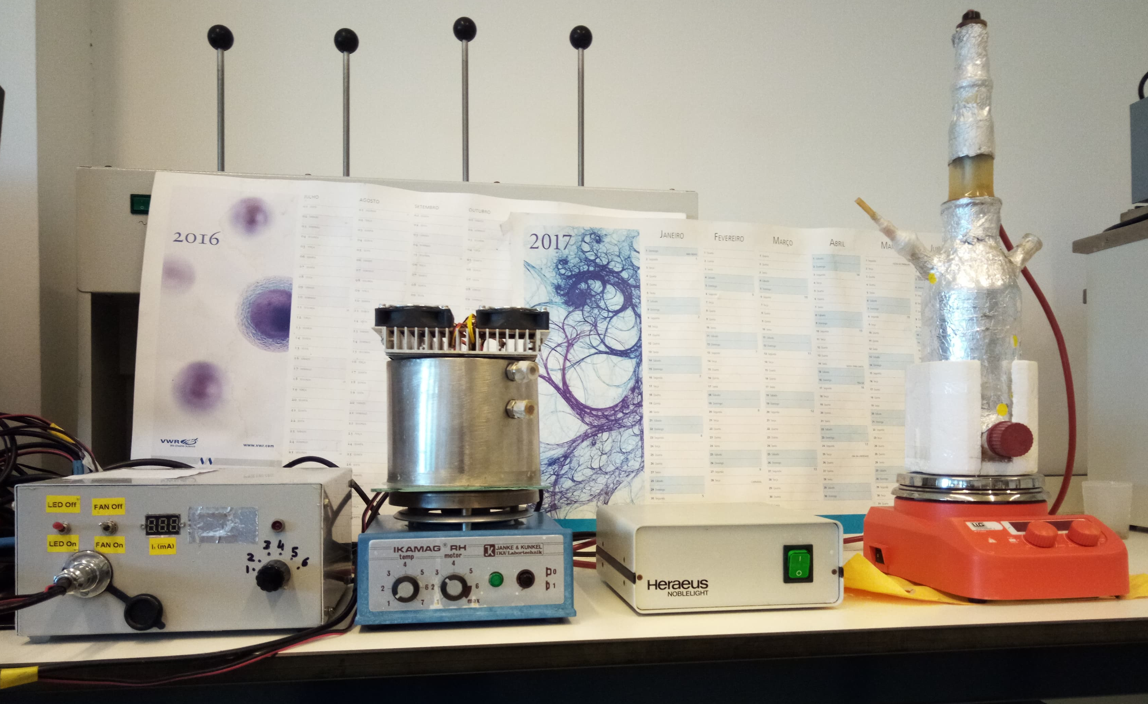
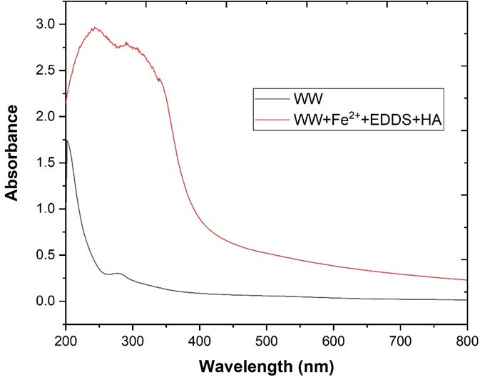
Material and methods
Equipment used in photo-Fenton process
Solar reactor
UV-A LED
reactor
UV-C mercury lamp
reactor
Silver
coated
panel
Magnetic agitators
UV absorption spectra corresponding to WW and WW+Fe²⁺+EDDS+HA.

Slide 7
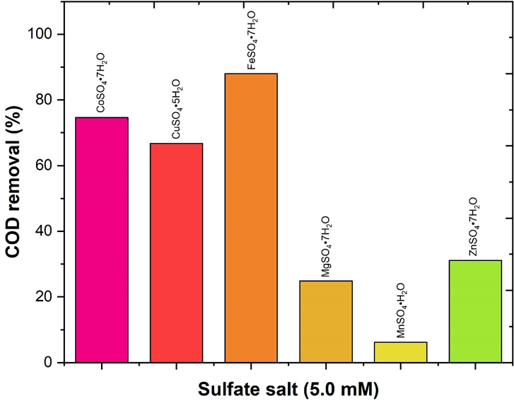
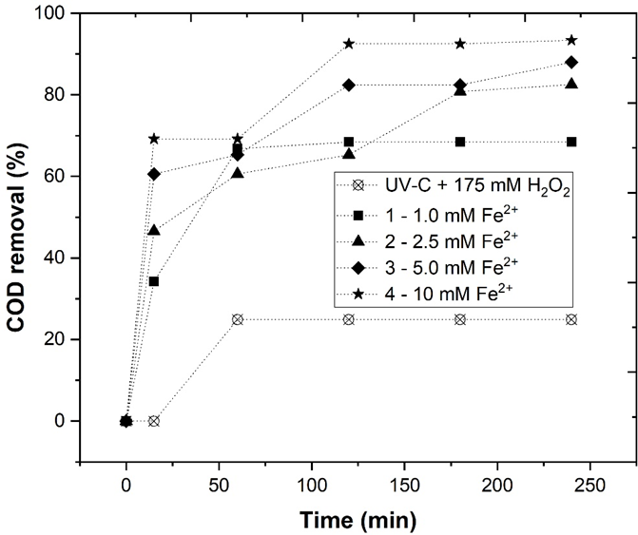
Results and discussion
(1) Variation of [H₂O₂]
(3) Variation of catalyst type
(5) Variation of the HA dosage
(2) Variation of [Fe²⁺]
(4) Variation of the EDDS dosage
(6) Variation of radiation type vs pH
Effect of catalyst type
93.4%
88.0%
82.5%
68.4%
Effect of catalyst concentration
Influence of different sulfate salts in the removal of COD.
${\text{HO}}^{\text{•}}$ + H₂O₂ → H₂O + ${\text{HO}}_{\text{2}}^{\text{•}}$ | Eq. 1
${\text{HO}}_{\text{2}}^{\text{•}}$ + ${\text{HO}}^{\text{•}}$ → H₂O + O₂ | Eq. 2
Evolution of COD removal through the photo-Fenton experiments, using different catalyst dosages
Fe²⁺ + H₂O₂ → Fe³⁺ + ${\text{HO}}^{\text{•}}$ + ${\text{HO}}^{−}$ | Eq. 3
Fe³⁺ + H₂O₂ → Fe²⁺ + ${\text{HO}}_{\text{2}}^{\text{•}}$ + H⁺ | Eq. 4

Slide 8
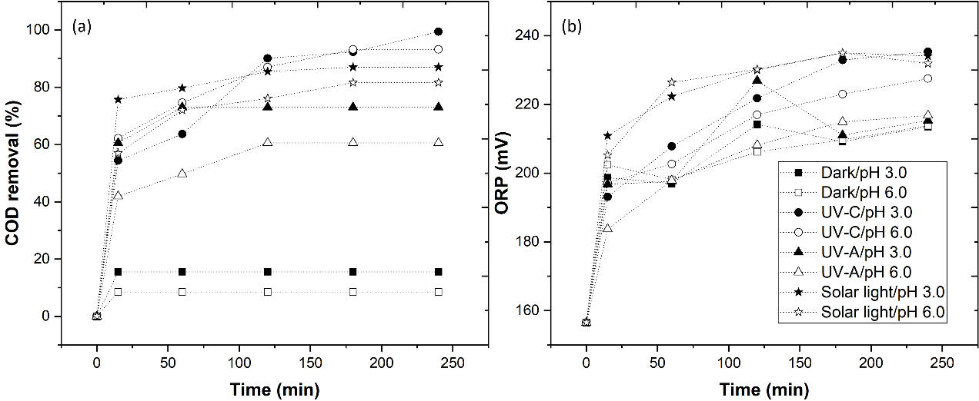
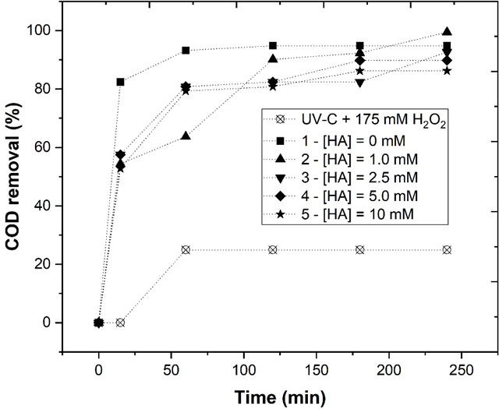
Results and discussion
(1) Variation of [H₂O₂]
(3) Variation of catalyst type
(5) Variation of the HA dosage
(2) Variation of [Fe²⁺]
(4) Variation of the EDDS dosage
(6) Variation of radiation type vs pH
Effect of radiation type
99.5%
94.8%
92.6%
89.8%
86.2%
Effect of hydroxylamine concentration
Evolution of the (a) COD removal, (b) ORP value through the photo-Fenton experiments, under the influence of different UV sources at pH 3.0 and 6.0.
Evolution of COD removal through the photo-Fenton experiments, using different HA concentration.

Slide 9
Conclusion
Based in the results it is concluded
1. The application of 175 mM H₂O₂ achieves a high COD removal (82.5%), high HO• radical production (240.3 mV) and low metal leaching (1.79 mg Fe/L)
2. The type of catalyst has a great influence in the organic matter removal, and that the Fe²⁺ is concluded to be the most efficient catalyst
3. The radicals generation are greatly promoted with the addition of hydroxylamine and the molar ratio of EDDS-Fe/HA system (1/5/1) achieves higher COD removal (99.4%)
4. With application of the Fe²⁺-EDDS/HA system it is concluded that the photo-Fenton process at pH 6.0 achieves similar COD reductions regarding pH 3.0.
5. The solar radiation achieves similar COD removal than UV-A radiation and is concluded to be a viable alternative.

Slide 10
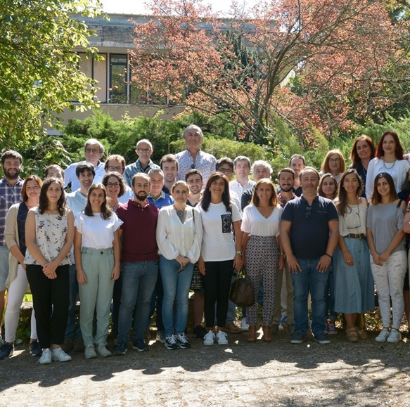
Acknowledgements
The authors thank the North Regional Operational Program (NORTE 2020) and the European Regional Development Fund (ERDF), and express their appreciation for the financial support of the Project AgriFood XXI, operation nº NORTE-01-0145-FEDER-000041, and to the Fundação para a Ciência e a Tecnologia (FCT) for the financial support provided to CQVR through UIDB/00616/2020. Ana R. Teixeira also thanks the FCT for the financial support provided through the Bolsa de Doutoramento UI/BD/150847/2020.

Slide 11
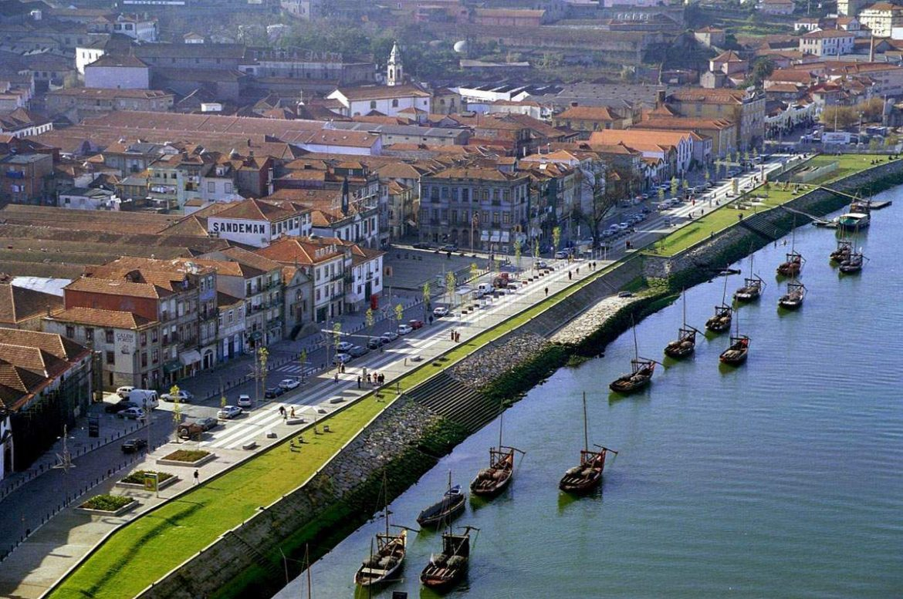
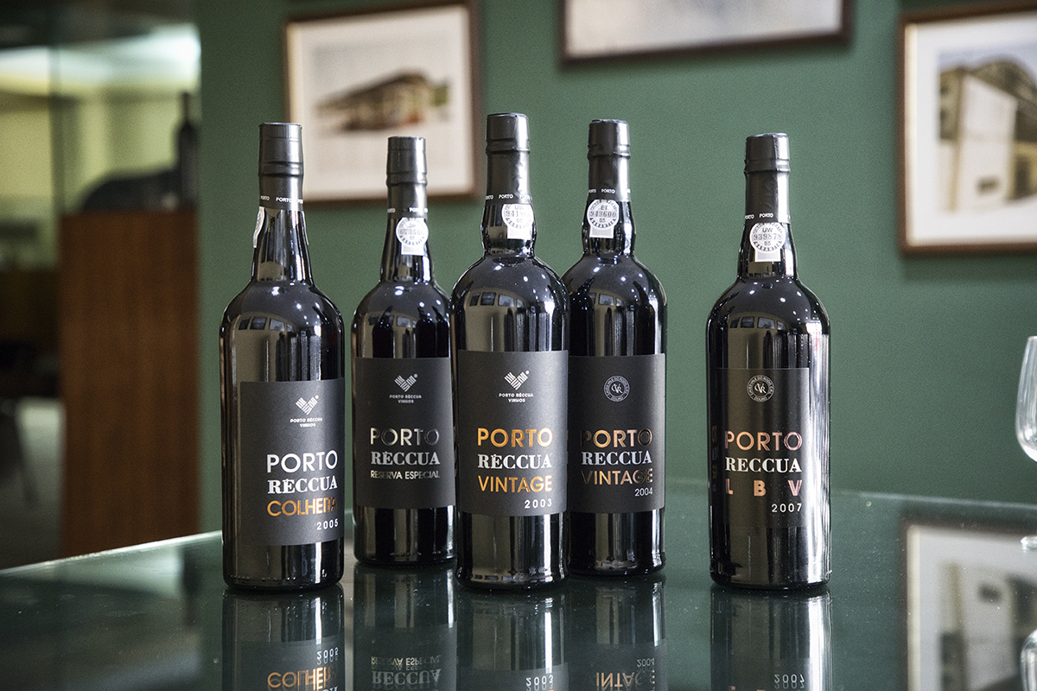
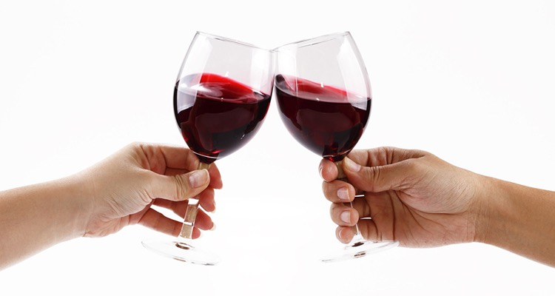
Thank you for your attention

