Slide 1
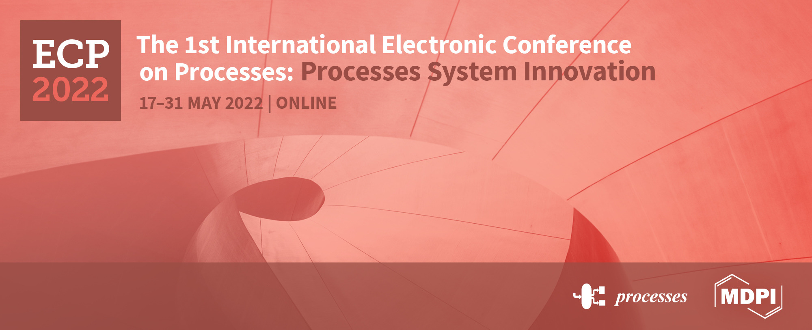
An environmental and green process for Pb⁺² pollution: An experimental research from the perspective of adsorption
Hakan Çelebi ^{1*}, Tolga Bahadır ², İsmail Şimşek ³ and Şevket Tulun ⁴
Aksaray University, Department of Environmental Engineering
¹Aksaray University, Department of Environmental Engineering
²Aksaray University, Department of Environmental Engineering
³Aksaray University, Department of Environmental Engineering
⁴Aksaray University, Department of Environmental Engineering
* Corresponding author: hakancelebi@aksaray.edu.tr

Slide 2
Abstract: Today, the increase in the need for quality and potable water resources is one of the most crucial issues that all countries of the world are focused on. Particularly, large amounts of highly polluted wastewater are formed together with water consumption that need to be treated in every sector. The toxic and harmful effects of pollutants such as lead still pose a challenge in terms of both environmental and human health in wastewater. Pb+2 ion is an amphoteric, toxic and bio accumulative type of primary pollutant commonly found in industrial wastewater. The adsorption process for Pb+2 treatment is a basic method, and in recent years, adsorption studies have been carried out with various waste adsorbents from the aquatic system. Adsorption is considered the most widely used environmental and green process to remove heavy metal ions among the different processes. So, waste-based adsorbents that do not induce pollution have been evaluated. Therefore, unmodified tea waste, banana, almond and egg shells were studied for removal of Pb+2 ions from the aqueous matrix. With the current process, Pb+2 removal capacities were investigated by utilizing tea waste, banana, almond and egg shells to the aqueous solution. The effects of adsorbent concentrations (0.5-10 g), contact time (5-120 minutes), pH (2-12), and temperature (283.15-308.15 K) on removal efficiency of Pb+2 were evaluated by batch mode adsorption experiments. Adsorption capacities were calculated using different isotherm and kinetic models due to the experimental datas. The maximum removal efficiencies of Pb+2 were obtained as 89%, 93%, 98% and 99% for the four adsorbents under optimum operating conditions respectively. Adsorption was fitted with Langmuir and pseudo-second order kinetics at the equilibrium state. Experimental results showed that the selected adsorbents are environmentally friendly, economical and easily obtainable for Pb+2 removal compared to other adsorbent types.
Keywords: adsorbent; adsorption; environmental process; lead ion; pollution

Slide 3
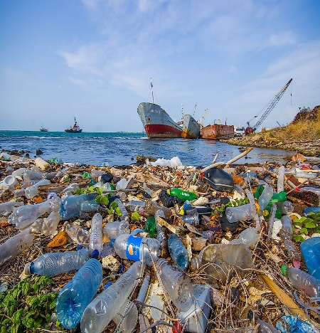
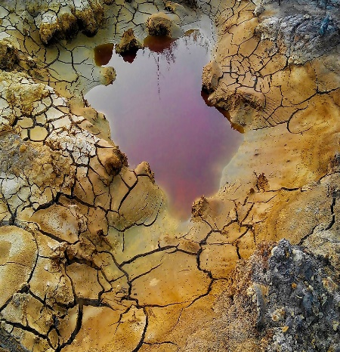
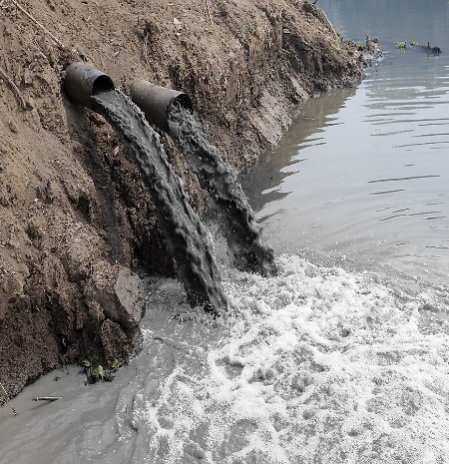
Introduction
The development of all living species is based on a sustainable unified ecosystem. Today, the main cause of many deaths and diseases is environmental pollution occurring as a result of industrial and technological developments. Pollution has shown an ever-increasing graph, either consciously or unconsciously, from the first human to the pre-sent. In the early ages, environmental pollution was ignored due to the idea that the environment had a large area and by taking refuge in sentences such as “Running water does not hold dirt” and “Nature always renews itself”.
https://www.worldatlas.com
https://www.theguardian.com
https://www.worldatlas.com
https://www.worldatlas.com
https://www.theguardian.com
https://www.worldatlas.com

Slide 4
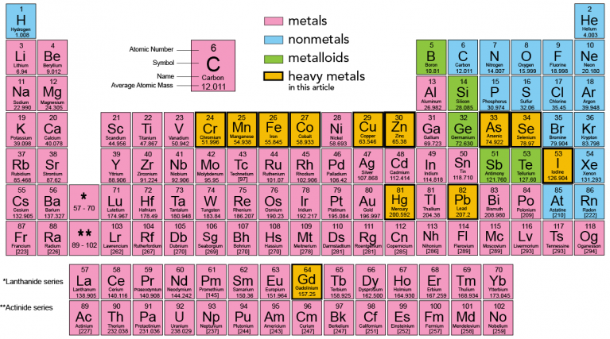
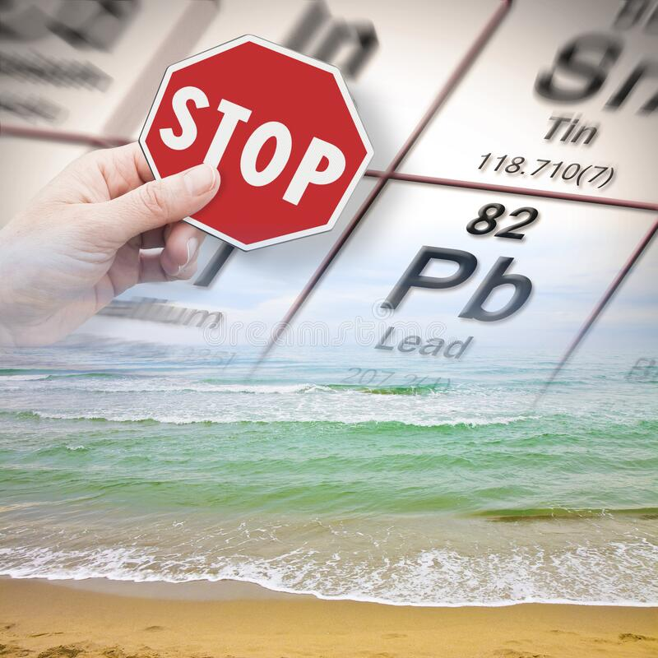
Introduction
Among the many pollutant groups, heavy metals (density >5.0 g/cm³ and atomic mass > 20 amu) have been one of the most contributing sources of environmental pollution for many years [3]. The fact that heavy metals are not biodegradable in nature and cause toxic and fatal health problems for humans when they enter the food chain makes them be one of the most important sources causing environmental pollution [4]. Lead (Pb⁺²), which has an amphoteric structure, is a metal with a high toxic level among heavy metals. Pb⁺² is easily transported through the soil and water ecosystem, and by reaching the food chain, it causes negative effects on human health [5]. When exposed to Pb⁺² for a long period, in particular, the kidneys, central nervous, and immune systems can be damaged severely.

Slide 5
Table 1 shows some specific features, sources, and permissible limit values of Pb⁺² on an international scale [5,6]. Therefore, a large number of treatment methods, including mem-brane [7], ion exchange [8], electrochemical [9], chemical precipitation [10] and adsorption [11] have been developed to remove Pb⁺² and other heavy metals from the receiving medium [3]. The methods other than adsorption have disadvantages such as low efficiency, high cost, and excessive production of sewage sludge. Adsorption, on the other hand, is an environmentally friendly method. Because it is efficient and economical, it is an effective process in wastewater treatment [12]. Studies have been conducted on the potential of ad-sorbents, which have functional properties different from each other, to remove heavy metals. However, new adsorbents, whose adsorption rate and capacity will be able to be at the maximum level practically, are constantly being studied as a subject of research.
Table 1. Specific properties, sources and international limits of Pb⁺² [6].
Permissible Limits
WHO | USEPA |  | EPA
0.01 mg/L | 0.01 mg/L |  | 0.015 mg/L
Properties
Density |  | Atomic Weight |  | Heat of fusion | Heat Capacity
11.34 g/cm³ |  | 207.2 g/mol |  | 4.77 kJ/mol | 0.13 J/g K
Electron affinity |  | Boiling point |  |  | Melting Point
35.1 kJ/mol |  | 1740 °C |  |  | 327.5 °C
Sources
Metal plating, Paint, Laundry process, Mining sector, Battery manufacturing, Steel industries, Alloys, Ceramics, Plastics, Glassware

Slide 6
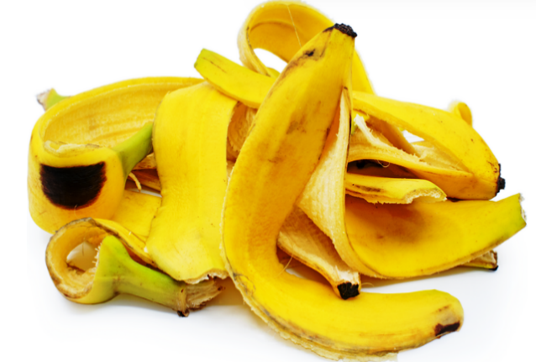
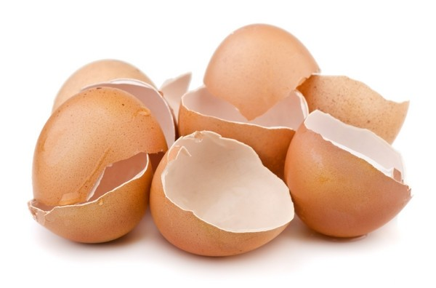
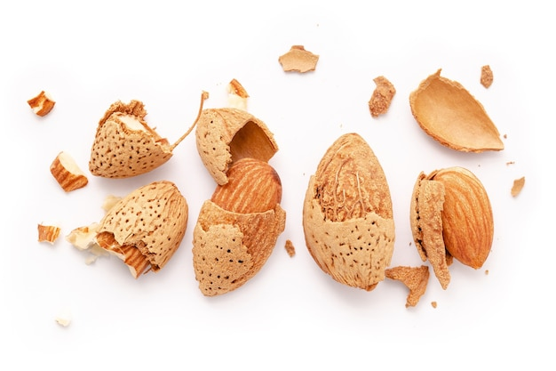
Although there is a great variety of adsorbent materials in the literature, the use of food and agricultural qualified waste materials, which are classified as waste, is a specific approach in terms of both treatment and removal of pollution by waste [3]. The use of waste in the removal of pollutants and the prioritization of this concept are increasing day by day [4]. Tea, almond, egg, and banana peels are also utilized in many countries of the world both in terms of consumption and production. For this study, tea waste (TW), almond shell (AS), egg shell (ES), and banana peel (BP) wastes were used as natural adsorbents in adsorption because they are usually very abundant, low cost, easily accessible, and applicable. The removal of Pb⁺² ions in an aqueous solution by adsorption and the factors affecting adsorption have been studied. Therefore, the effects of the optimum solution pH, contact time, and amount of adsorbent on the removal efficiency were investigated, the obtained results were evaluated, and comparisons of them were made.

Slide 7
Material and Methods
A stock solution of 1000 mg/L was prepared with Pb(NO₃)₂. Different concentrations of solutions were prepared by diluting for use in batch experimental studies. All experiments were per-formed at constant pollutant concentration (100±1.2 mg/L), mixing speed (150±5 rpm), and temperature (293.15±2 K) in Erlenmeyer flasks with an operating volume of 100 ml. The adsorbents utilized in the study were collected from houses and cafeterias. First of all, the collection and sorting of tea, almond, banana, and egg products, which were widely consumed both in our country and in other countries, was carried out. Then, in order to eliminate the color change that might occur in the water, TW, BP, AS, and ES were washed with pure water and kept in an open area at room temperature for several days. To eliminate dirt, dust, etc. situations that may be caused by the keeping stage, TW, BP, AS, and ES were washed with pure water again and dried at 100 °C in a Memmert brand drying-oven for 24 hours. After these stages, the adsorbent use stage was started. Table 2 shows some specific properties of adsorbents determined based on other studies in the literature.
Table 2. Specific properties of TW, BP, AS, and ES [4, 13-17].
TW (%) | BP (%) | ES (%) | AS (%)
Cellulose: 18 | Cellulose: 18-60 | Moisture: 0.46 | Cellulose: 30-51
Hemicellulose: 40 | Hemicellulose: 17-40 | Protein: 3.92 | Hemicellulose: 20-30
Lignin: 37 | Xylose: 12 | Ash: 94.61 | Lignin: 20-50
Ash: 3.74 | Pectin: 10-20 | Fat: 0.35 | Ash: 99.2
Moisture: 7.2 | Lignin: 16-31 | Calcium: 34.12 | Carbon: 44.80
Carbon: 52.72 | Ash: 1.5 | Magnesium: 0.29 | Hydrogen: 7.10
Hydrogen: 6.34 | Moisture: 9.8 | Phosporus: 0.04 | Nitrogen: 0.43
Oxygen: 38.15 | Protein: 5.13 | Sodium: 0.05 | Oxygen: 47.60

Slide 8
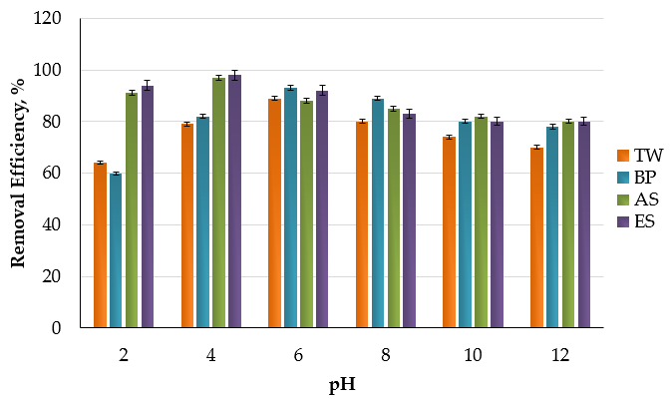
Results and Discussions
Effects of pH Changes
pH is important as a measure of the acidity (pH < 7) or basicity (pH > 7) of the solution in the adsorption. The pH differences also change the interaction between the adsorbent and the adsorbate due to the displacement of the H+ and OH- ions in the adsorption area. Figure 1 shows the effects of TW, BP, AS, and ES on the adsorption of Pb+2 in the 2-12 pH range. In experiments carried out with TW, BP, AS, and ES within the specified pH range, the maximum Pb+2 removal was found to be 89% for TW (at pH 5.75), 93% for BP (at pH 6.00), 97% for AS (at pH 3.86) and 98% for ES (at pH 4.02). It was concluded that the pH values measured for TW, BP, AS, and ES were the result of the interaction between the H+ and OH- ions in the synthetic Pb+2 solution and the functional groups on the surfaces of adsorbents. The decrease in the removal of Pb+2 under basic conditions (pH>7.0) can be attributed to poor electrostatic adhering to negatively charged surfaces of TW, BP, AS, and ES, or excessive OH- density. As a result of the conducted studies, it has been stated that the optimal pH values for adsorption of Pb+2 are pH < 7. [3-6].
Figure 1. The effect of pH changes on Pb⁺² removal efficiency.

Slide 9
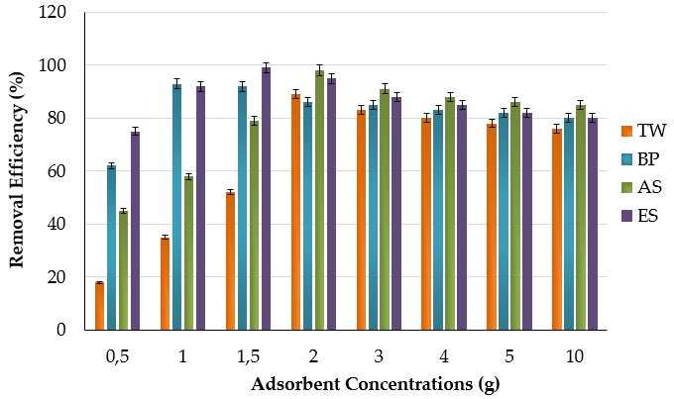
TW, BP, AS, ve ES dose interactions
The effects of TW, BP, AS, and ES doses on the removal of Pb+2 ions by the adsorption method were evaluated at 100 mg/L of Pb+2 solution, 293.15±2 K, 150±5 rpm, and at doses between 0.5 and 10.0 g. In all adsorbents, the removal efficiency of Pb+2 ions increased rapidly up to 2.0 g doses of TW, BP, AS, and ES, and then decreases occurred at doses between 3-10 g (Figure 2). At 0.5, 1.0, 1.5, 2.0, 3.0, 4.0, 5.0 g doses of TW, the removals of Pb+2 ions were measured as approximately %18, %35, %52, %89, %83, %80, %78, and 76%, respectively. As can be seen, a maximum removal rate of 89% was achieved at a 2.0 g TW dose. For BP, AS, and ES, the maximum removals of Pb+2 ions were determined as 93% (1 g), 98% (2.0 g), and 99% (1.5 g), respectively. In all adsorbents, surface adsorption was fast due to the initially active surface area. In terms of the dose-efficiency relationship, the order was determined as ES>AS>BP>TW. These results are consistent with the results of many studies in the literature [5,18,19].
Figure 2. Effect of TW, BP, AS, and ES doses on Pb⁺² removal efficiency.

Slide 10
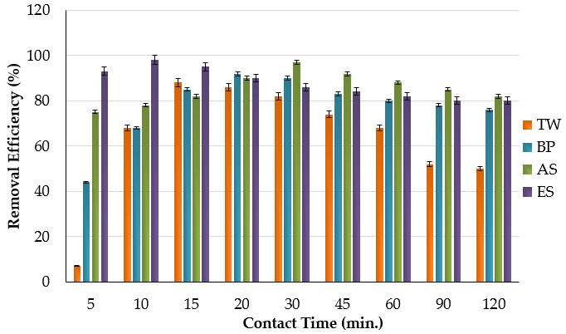
The Effect of Contact Time
As shown in Figure 3, the adsorption of Pb+2 to TW, BP, AS, and ES began to reach its maximum level from the first 10 minutes. For TW, BP, AS, and ES, the maximum removal efficiencies of Pb+2 ions were determined as 88%, 92%, 92%, and 98% at the 15th, 20th, 30th, and 10th min, respectively. It was concluded that in laboratory-scale studies, the rapid increases might have been caused by the larger free surface area. For TW, BP, AS, and ES, rapid adsorption occurred in the first 30 min period and saturation was reached afterward. This may indicate that physical adsorption occurs on the outer surface of the adsorbents and then there is slow adsorption in the inner pores. Similar results were also obtained by Qi et al. [20] and Pham [21].
Figure 2. The effect of time on the removal of Pb+2 ions.

Slide 11
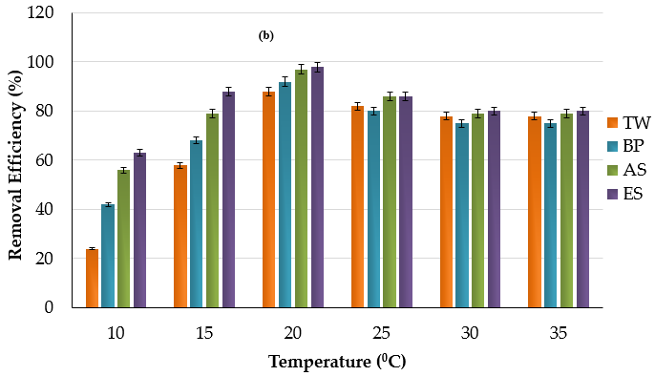
The effect of the temperature factor
As seen in Figure 4, when the temperature was increased from 283.15 to 308.15 K in the batch adsorption experiments, an increase in the removal of Pb+2 ions was also observed. This shows that there is a linear relationship between the temperature and the removal of Pb+2. In the experiments conducted with TW, BP, AS, and ES in the specified temperature range, the maximum Pb+2 removal efficiency was found to be 88% for TW, 92% for BP, 97% for AS, and 98% for ES at 20 °C. In Figure 4, it is observed that the adsorption of Pb+ 2 occurs in two levels: fast (283.15-293.15 K) and slow (298.15-308.15 K). The increase occurring with temperature indicates that the adsorption is endothermic in the natural environment. In cases where the temperature is ≥308.15 K, the removal of Pb+2 increases minimally, but this increase is not so significant. According to the literature, there may be only a 4% change [22]. Therefore, it was concluded that the use of TW, BP, AS, and ES as biosorbents at a room temperature of 293.15 K is advantageous.
Figure 2. The effect of temperature on the removal of Pb+2 ions.

Slide 12
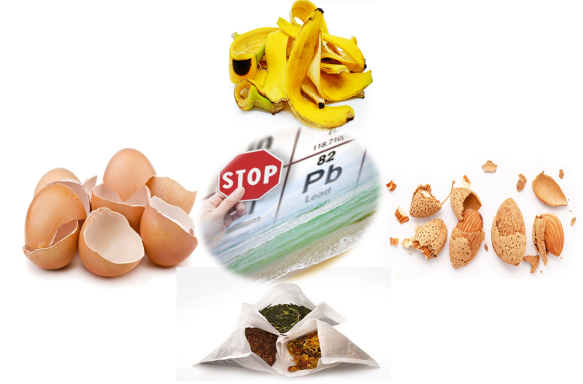
CONCLUSIONS
CONCLUSION-1
CONCLUSION-2
It was determined that the optimal conditions at this operating temperature were as follows: TW (dose: 2.0 g, pH: 5.75, time: 15 min)
It was determined that the optimal conditions at this operating temperature were as follows: BP (dose: 1.0 g, pH: 6.0, time: 20 min), AS (dose: 2.0 g, pH: 3.86, time: 30 min), ES (dose: 1.5 g, pH: 4.02, time: 10 min).
Infographics
Infographics
CONCLUSION-4
CONCLUSION-3
Infographics
As a result, it was concluded that the adsorbents examined in this study were environmentally friendly, economical, easily available, and efficient adsorbents for the removal of Pb+2.
According to the results of Pb+2 adsorption on TW, BP, AS, and ES, the optimal operating temperature for all adsorbents was found to be 293.15±2 K.
Infographics

Slide 13
Thank You

Slide 14
Use of Dunaliella salina in environmental applications
Hakan Çelebi ^{1*}, Tolga Bahadır ², İsmail Şimşek ³ and Şevket Tulun ⁴
Aksaray University, Department of Environmental Engineering
¹Aksaray University, Department of Environmental Engineering
²Aksaray University, Department of Environmental Engineering
³Aksaray University, Department of Environmental Engineering
⁴Aksaray University, Department of Environmental Engineering
* Corresponding author: hakancelebi@aksaray.edu.tr

