Slide 1
Removal of methylene blue from aqueous solution by application of plant-based coagulants
Nuno Jorge^{1,2} *; Ana R. Teixeira²; Leonilde Marchão²; Pedro B. Tavares²; Marco S. Lucas²; José A. Peres²
¹ Escuela Internacional de Doctorado (EIDO), Campus da Auga, Campus Universitário de Ourense, Universidade de Vigo, As Lagoas, 32004, Ourense, Spain
² Centro de Química de Vila Real (CQVR), Departamento de Química, Universidade de Trás-os-Montes e Alto Douro (UTAD), Quinta de Prados, 5001-801,
Vila Real, Portugal
* njorge@uvigo.es
The 1st International Electronic Conference on Processes: Processes System Innovation
Session 2. Environmental and Green Processes
17 – 31 May 2022

Slide 2
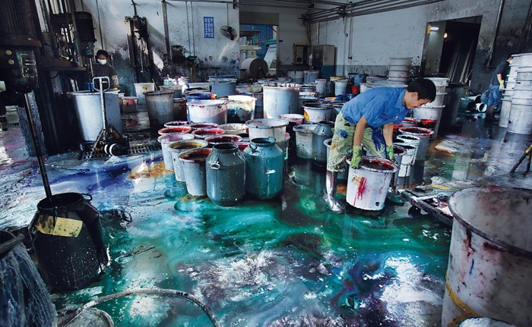
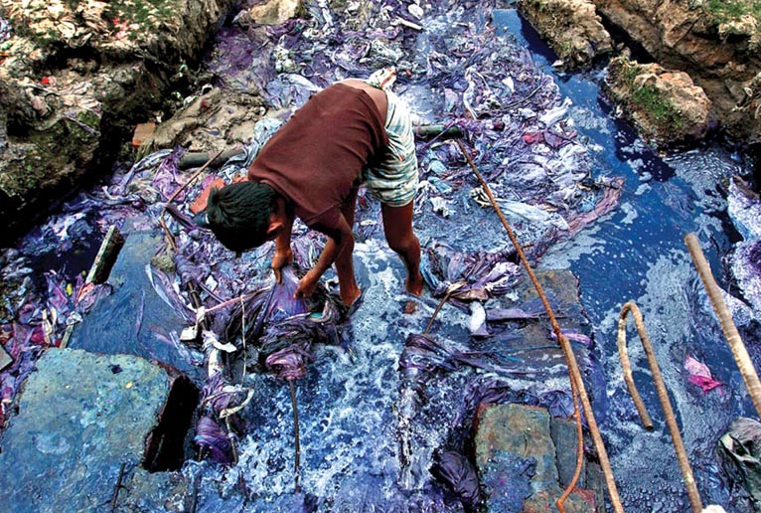
Introduction
Contributes to fulfilling the basic living (clothing) requirements of human life;
The wastewater discharged from textile dyeing industry contains a total of 72 toxic chemicals, out of which 30 chemicals cannot be removed by waste treatment processes;
Formation of many types of cancers of different organs such as bladder, spleen, liver and normal aberrations in model organisms and chromosomal deformities in mammalian cells;
Textille dyes are characterized by high color density, high concentration of recalcitrante organics and pH and high turbidity.
Textile dye factory
River polluted by textile dyes

Slide 3
Introduction
Types of textille dyes
Chemical classification
Water soluble dyes
Insoluble dyes in water
Insoluble dyes in water
Vat
Sulfur
Disperse
Pigments
Chemical classification
Azo
Anthraquinone
Indigo
Xanthene
Phthalocyanine
Nitrated
Water-soluble Dyes
Acid or anionic
Basic or cationic
Metalliferous
Reactive
Direct

Slide 4
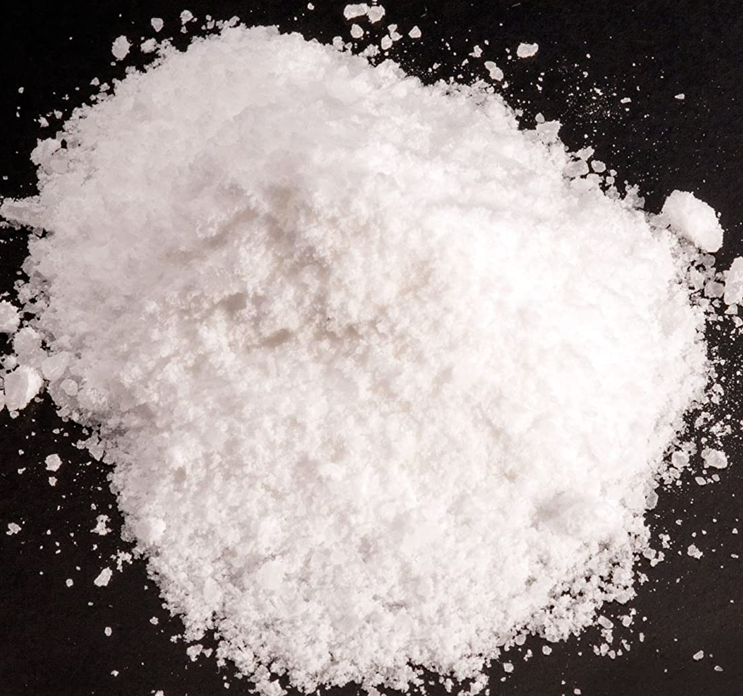
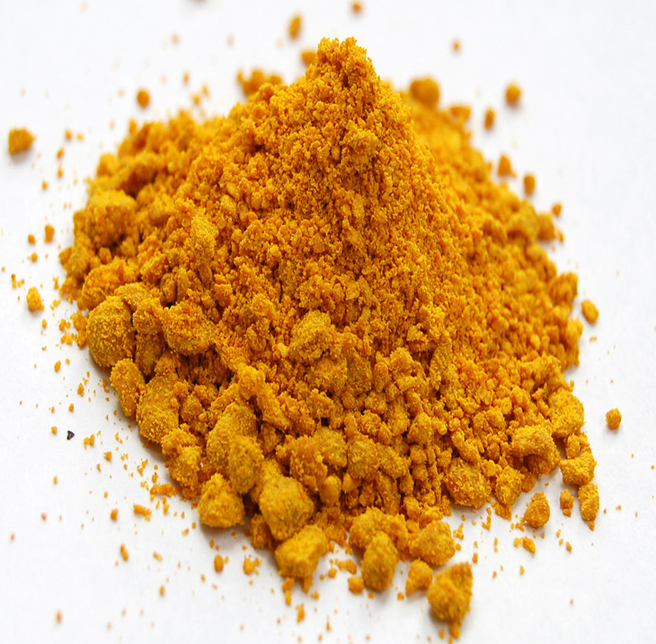
Introduction
Coagulation-flocculation-decantation (CFD)
Disadvantages
Aluminum
Dialysis encephalopathy
Alzheimer's disease
Iron
Generally corrosive
Strongly dependent on the pH
The leach cannot be recycled
Stable colloids
Destabilised colloids
Aggregated colloids
Add coagulant/flocculant
Hydrolysable metal salts (mainly, aluminum and iron)
Most used on waster treatment

Slide 5
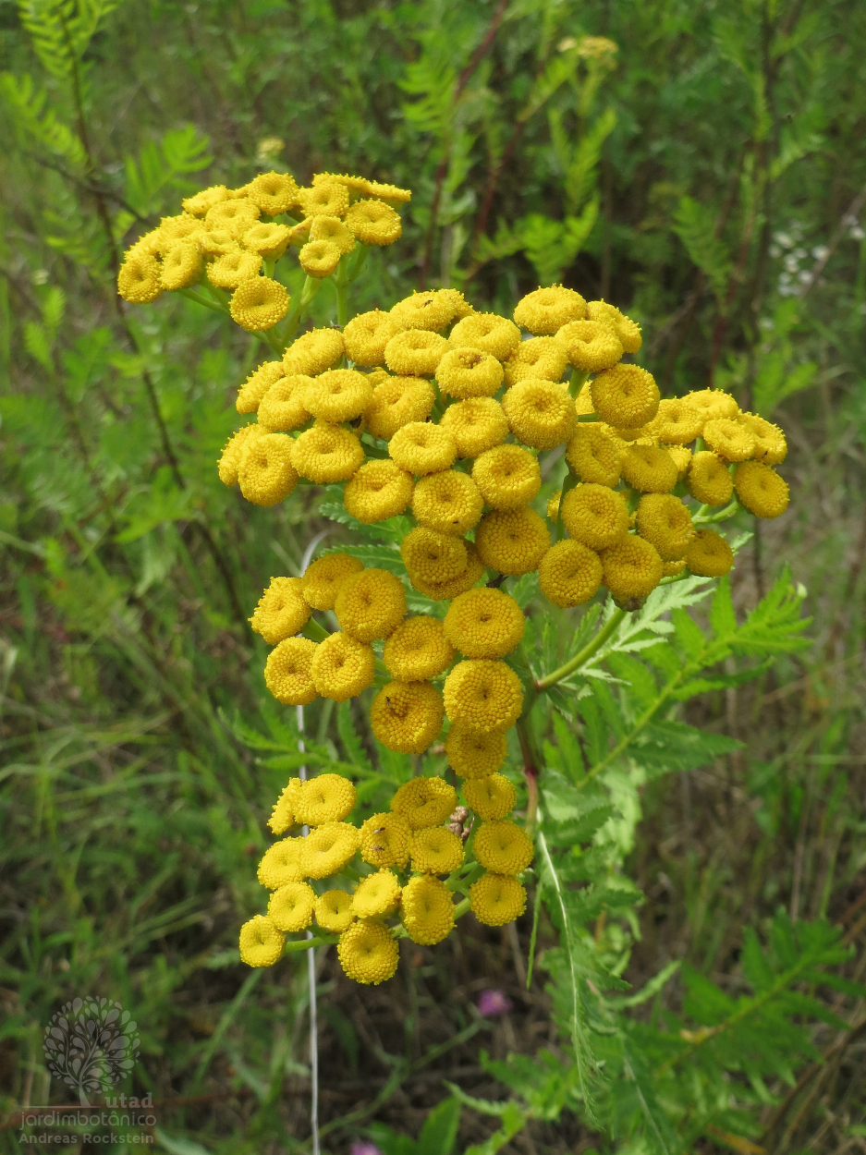
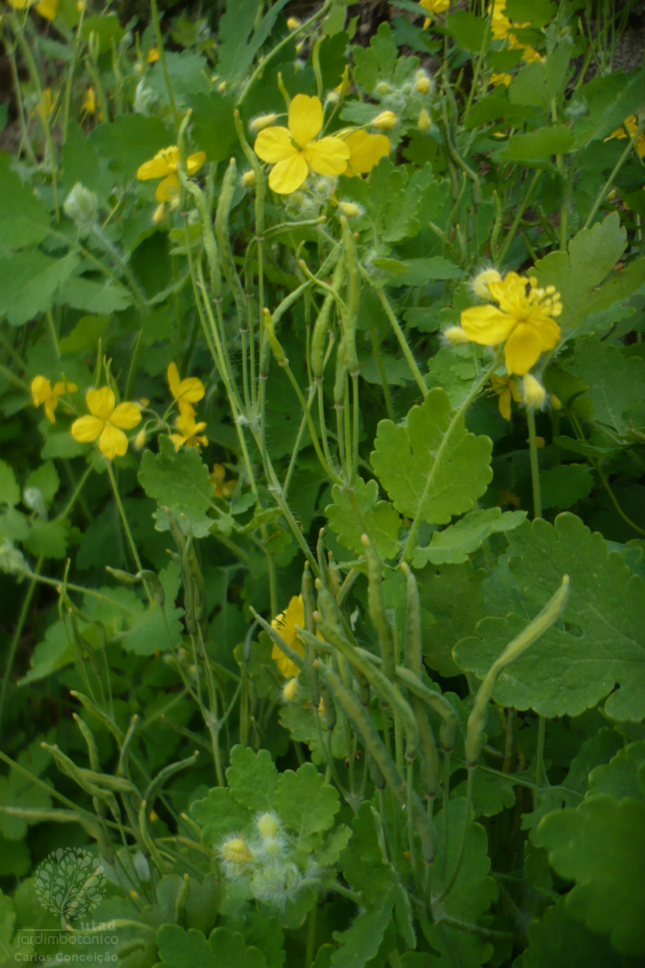
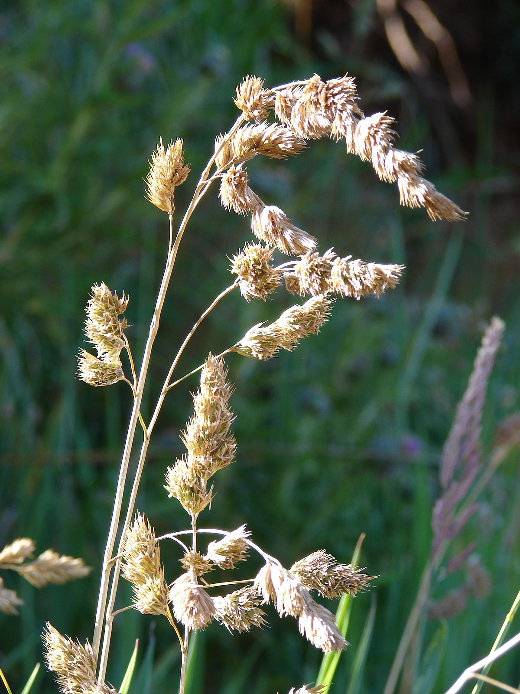
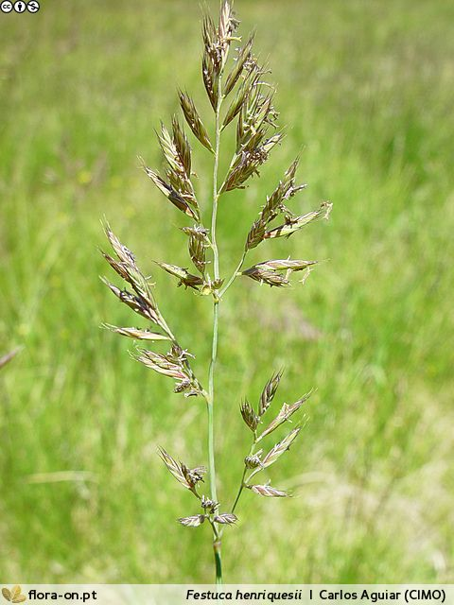
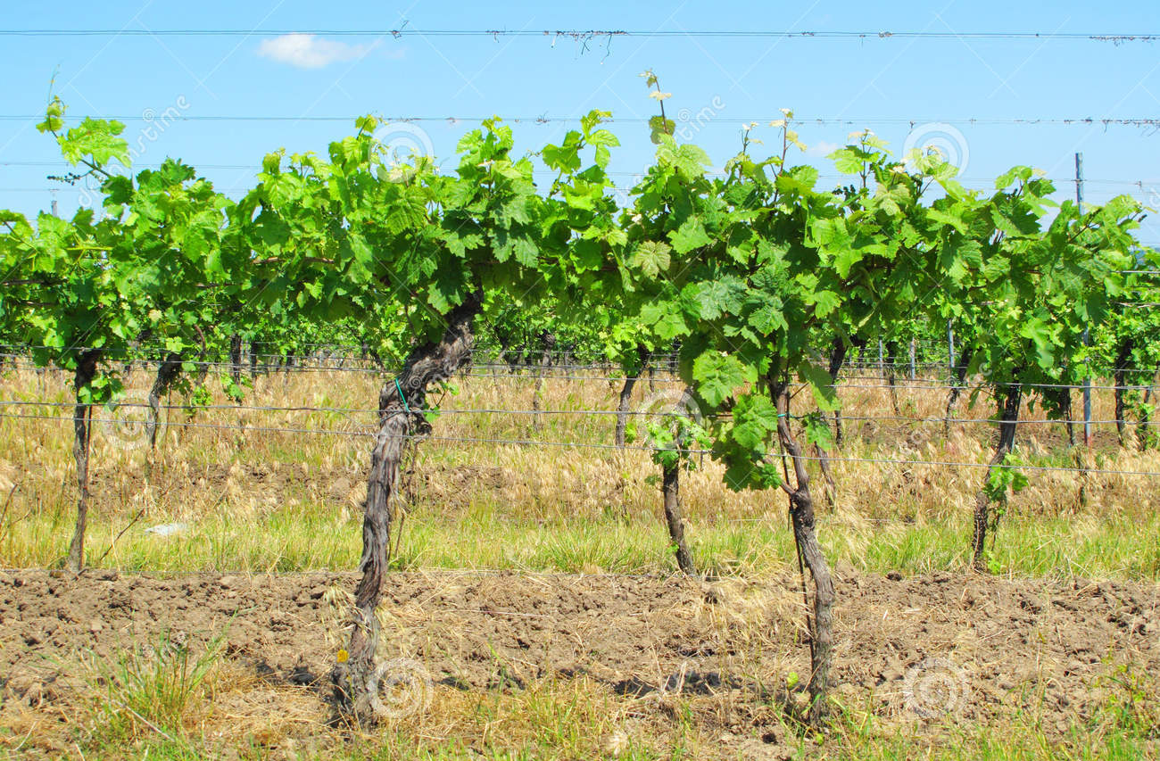
Introduction
Plant species colected during this work, for the development of plant-based coagulants
Works performed with plant-based coagulants
Tanacetum vulgare L. (seeds)
Chelidonium majus L. (seeds)
Dactylis glomerata L. (seeds)
Festuca ampla Hack. (seeds)
Vitis vinífera L. (rachis)

Slide 6
Objectives
Considering the necessity to perform treatment of textile wastewater by eco-friendly coagulants, the aim of this work is:
(1) To produce and characterize the plant-based coagulants
(2) To optimize the CFD process
(3) To evaluate the application of bentonite as a flocculant agent

Slide 7
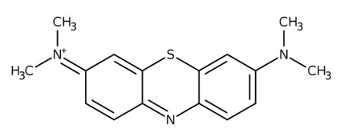
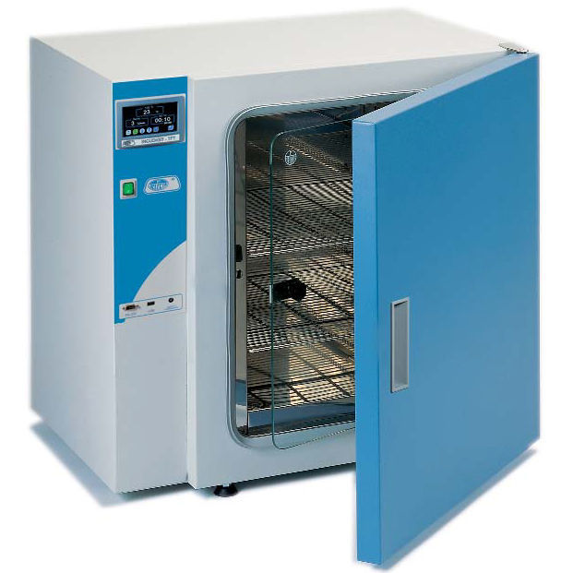
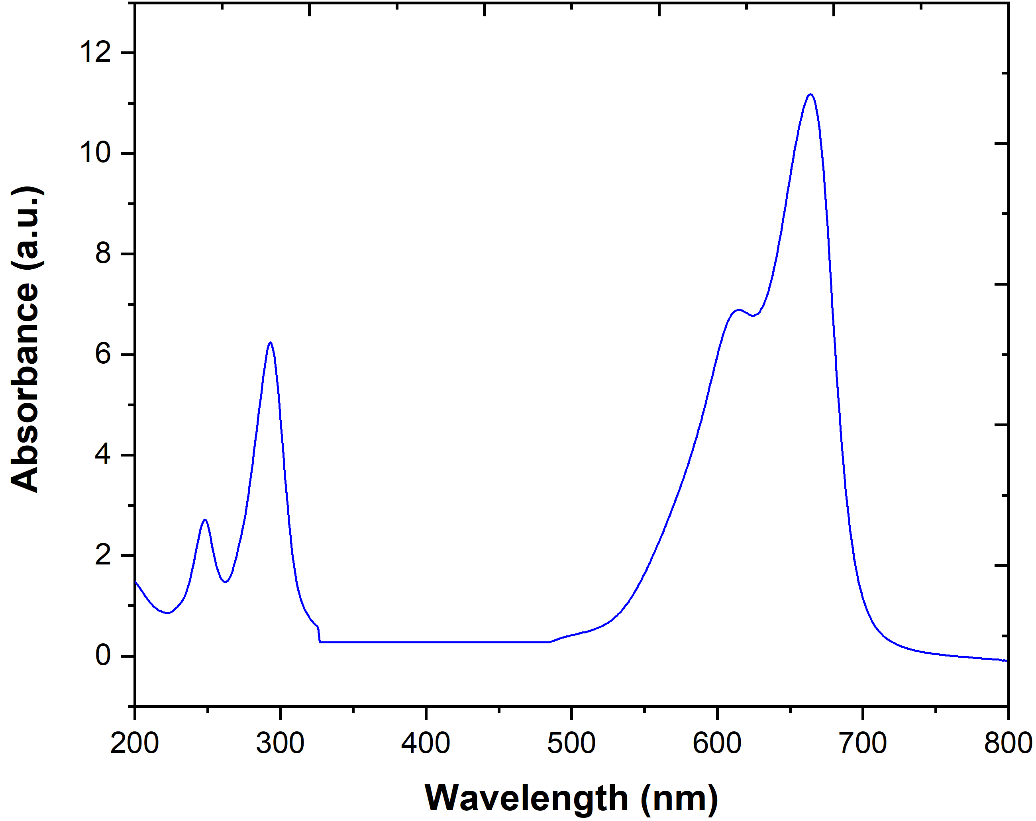
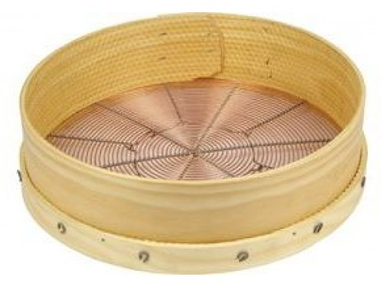
Material and methods
Plant-based coagulants preparation
Name, chemical structure, maximum absorbance and molecular weight of MB
Name | Chemical structure | λ_{max} (nm) | Molecular weight (g/mol)
Methylene blue (azo dye) |  | 665, 300 and 250 nm | 319.85
Separation of seeds from plants
Washing and drying at 70ºC/ 24h
Crushing
Sieve
Drying at 70ºC/ 24 h
Laboratory
incubator
Benzene rings
Chromophore group
Device used for CFD process
Groundnut
miller
Sieve
(Mesh of 150 µm)
Jar-Test apparatus (ISCO JF-4)

Slide 8
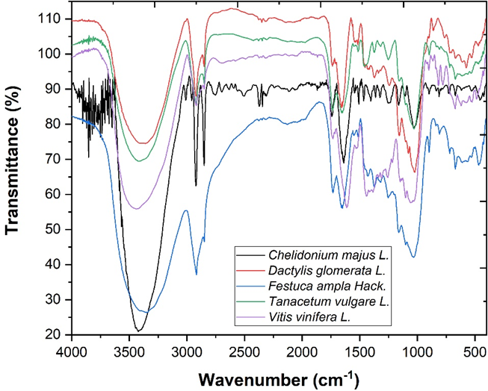
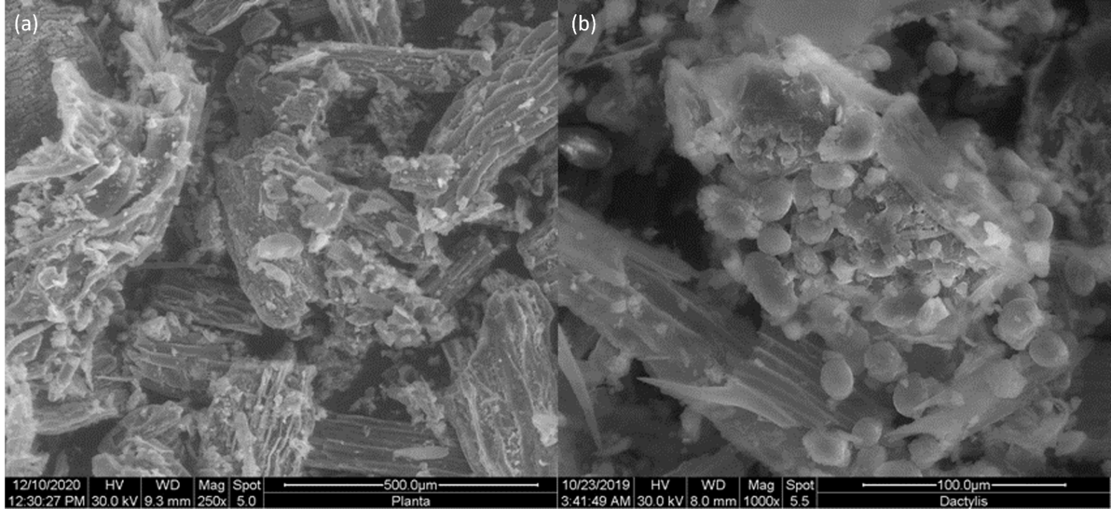
Results and discussion
Characterization of plant-based coagulants
Vibration bands (cm⁻¹) | Compounds
3421.72 | Stretching vibrations of OH groups (from water, alcohols, phenols, carbohydrates, peroxides) as well as amides
2920.23 and 2850.79 | C-H stretching vibrations specific to CH₃ and CH₂ from lipids, metoxy derivatives, C-H (aldehydes), including cis double bonds
898.83 – 1253.73 | C–O–C, C–C, and C–O stretching vibrations from carbohydrates
FTIR analysis of plant-based coagulants
The BET analysis showed that all plant-based coagulants had a low BET surface area. The shape of its N₂ adsorption-desorption isotherm was of type I isotherm, typical of microporous solids having relatively small external surfaces as de-fined by the International Union of Pure and Applied Chemistry (IUPAC) classification
B.E.T. analysis of the plant-based coagulants
Coagulants | S_{BET} (m²/g) | V_{total pore} (cm³/g) | Particle size (nm)
C. Majus | 0.05 | n.q. | n.q.
D. Glomerata | 0.06 | n.q. | n.q.
F. Ampla | 0.18 | n.q. | n.q.
T. Vulgare | 0.03 | n.q. | n.q.
V. vinifera | 0.50 | n.q. | n.q.
Plant-based coagulants exhibited a heterogeneous and relatively porous morphology. The spaces available (represented in dark) may facilitate adsorption of the MB contaminant.
SEM images of (a) C. majus and (b) D. glomerata

Slide 9
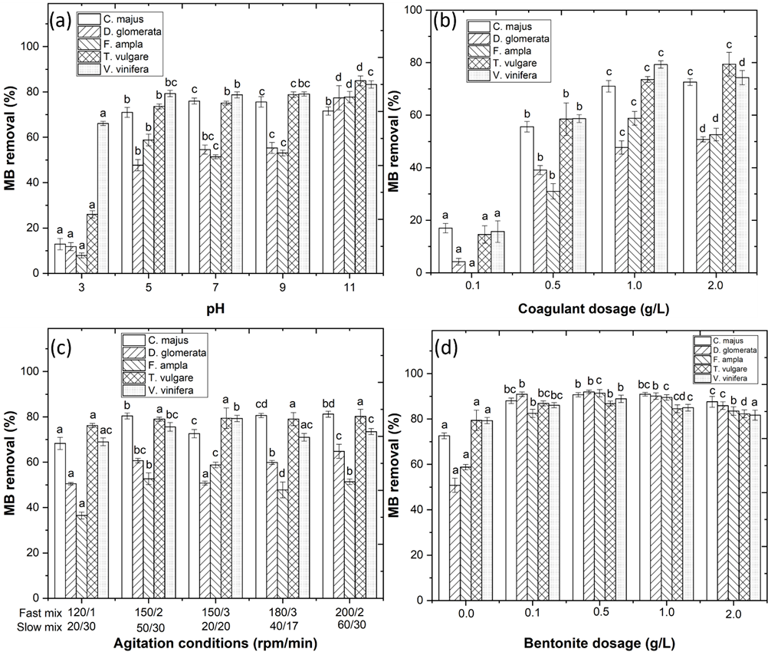
Results and discussion
Coagulation-flocculation-decantation process optimization
Coagulants | pH | Coagulant dosage | Fast mix | Slow mix | [Bentonite]
 |  | (g/L) | (rpm/min) | (rpm/min) | (g/L)
C. majus | 5.0 | 2.0 | 200/2 | 60/30 | 1.0
D. glomerata | 5.0 | 2.0 | 200/2 | 60/30 | 0.5
F. ampla | 5.0 | 1.0 | 150/3 | 20/20 | 0.5
T. vulgare | 5.0 | 2.0 | 150/3 | 20/20 | 0.1
V. vinifera | 5.0 | 1.0 | 150/3 | 20/20 | 0.5
Best operational conditions
The pH was varied from 3.0 to 11.0 and the results showed a MB removal of 71.0, 47.7, 58.8, 73.6 and 79.3%, respectively
The coagulant dosage was varied (0.1 – 2.0 g/l) and results showed a MB removal of 72.6, 50.8, 58.8, 79.4 and 79.3%, respectively
The effect of mixing conditions was also considered in this work and results showed a MB removal of 81.2, 64.8, 58.8, 79.4 and 79.3%, respectively
Bentonite was added as a flocculant aid and results showed a MB removal of 90.9, 91.9, 91.4, 86.9 and 88.9%, respectively
Optimization of CFD process with variation of (a) pH (3.0 – 11.0), (b) coagulant dosage (0.1 – 2.0 g/L), (c) agitation conditions and (d) bentonite dosage (0.0 – 2.0 g/L), with sedimentation time = 30 min. Means in bars with different letters represent differences (p < 0.05) within each coagulant (C. majus, D. glomerata, F. ampla, T. vulgare and V. vinifera) by comparing wastewaters

Slide 10
Conclusions
Based in the results, it is concluded:
(1) The plant-based coagulants are carbon-based materials with porous structures that can adsorb the contaminants
(2) Under the best operational conditions, the plant-based coagulants achieve a high removal of MB from aqueous solution
(3) The addition of bentonite significantly increase the efficiency of the CFD process

Slide 11
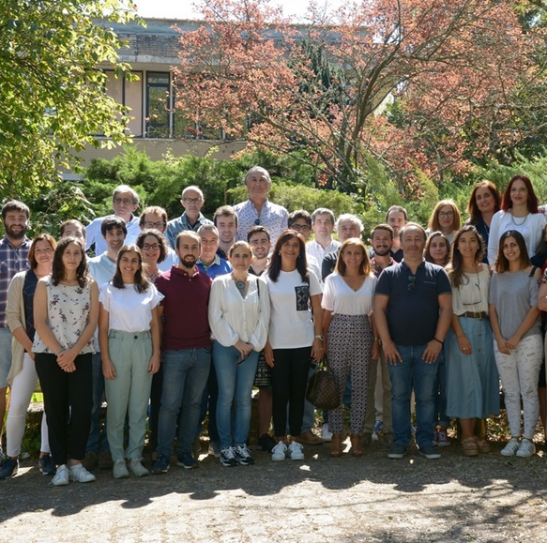
Acknowledgements
The authors thank the North Regional Operational Program (NORTE 2020) and the European Regional Development Fund (ERDF), and express their appreciation for the financial support of the Project AgriFood XXI, operation nº NORTE-01-0145-FEDER-000041, and to the Fundação para a Ciência e a Tecnologia (FCT) for the financial support provided to CQVR through UIDB/00616/2020. Ana R. Teixeira also thanks the FCT for the financial support provided through the Bolsa de Doutoramento UI/BD/150847/2020.

Slide 12
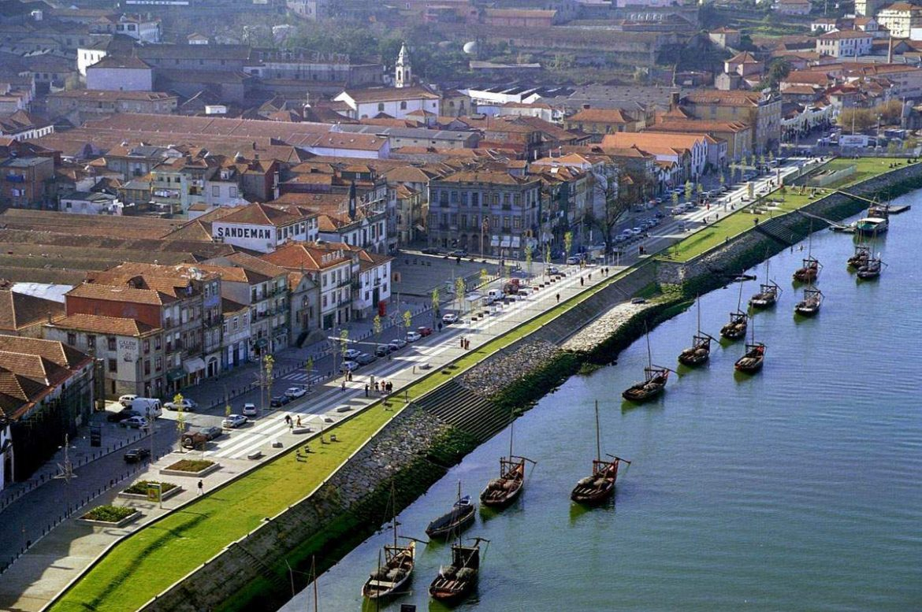
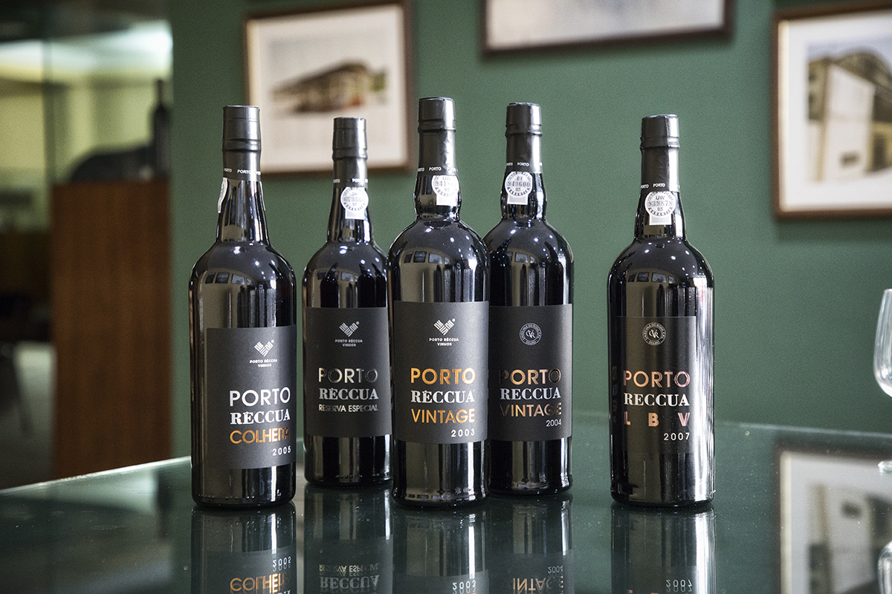
Thank you for your attention

