Slide 1
Treatment of municipal activated sludge by ultrasound-Fenton process
Carolina Santos ^{1,}*, Nuno Jorge ^{1,2}, Ana R. Teixeira ¹, José A. Peres ¹ and Marco S. Lucas ¹
¹ Centro de Química de Vila Real (CQVR), Departamento de Química, Universidade de Trás-os-Montes e Alto Douro (UTAD), Quinta de Prados, 5001-801, Vila Real, Portugal
² Escuela Internacional de Doctorado (EIDO), Campus da Auga, Campus Universitário de Ourense, Universi-dade de Vigo, As Lagoas, 32004, Ourense, Spain
* al66647@utad.eu
The 1st International Electronic Conference on Processes: Processes System Innovation
Session 2. Environmental and Green Processes
17 – 31 May 2022

Slide 2
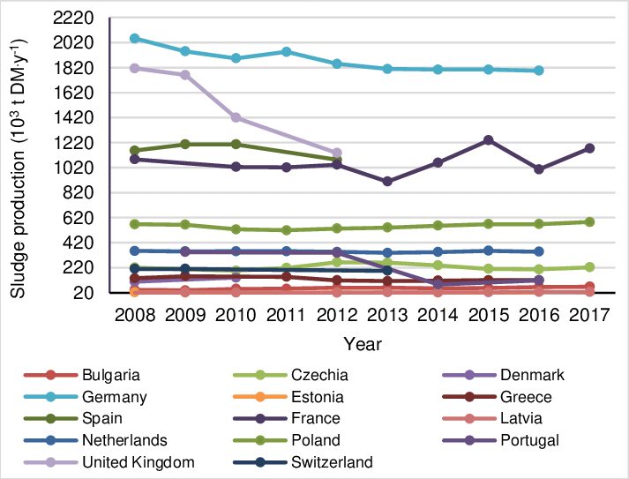
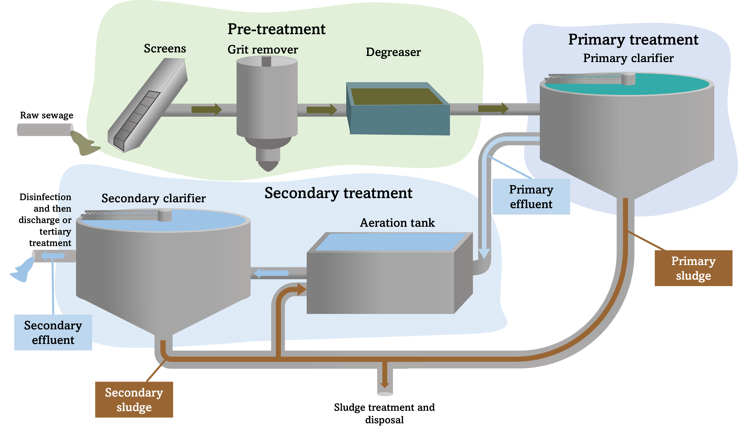
Introduction
The production of sewage sludge in selected countries of EU
Source: [1]
Municipal wastewater treatment produces significant volumes of sludge
Municipal wastewater treatment
These sludges contains, normally, high values of organic matter, macronutrients and micronutrients and can also contain high content in metals and pathogenic microorganisms.
Therefore, they need the right treatment so they can be reused and don’t constitute a threat to the environment.
1 Ghacha A, Ammari M, Ben Allal L. (2020) Sustainable sewage sludge management in Morocco: Constraints and solutions. J. Water L. Dev., 46(October), 71–83.

Slide 3
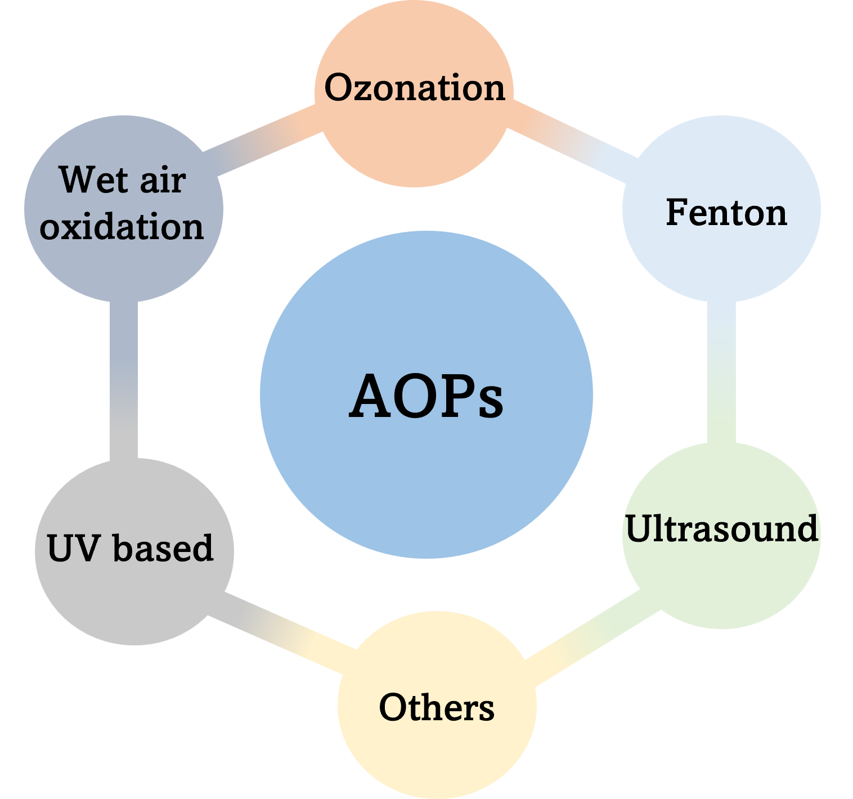
Introduction
Advanced oxidation processes (AOPs)
AOPs are methods that generate radicals, such as hydroxyl radicals (HO• ), with high oxidizing power (${\text{E}}_{{\text{HO}}^{\text{•}}}^{\text{º}}$ = 2.80 V) that reduces contaminated organic composites and can be used to water and soil treatment.
The Fenton reaction produces HO• radicals through the interaction between ferrous ion (${\text{Fe}}^{\text{2+}}$) and hydrogen peroxide (${\text{H}}_{\text{2}}{\text{O}}_{\text{2}}$).
$${\text{Fe}}^{\text{2+}}\text{+ }{\text{H}}_{\text{2}}{\text{O}}_{\text{2}} \text{→} {\text{Fe}}^{\text{3+}}\text{ + }{\text{OH}}^{\text{−}}\text{ + }{\text{HO}}^{•}$$
Catalyst
Oxidant
High oxidizing power
It is a complex mechanism because the reaction depends on several factors, such as the pH, H₂O₂ concentration, Fe²⁺ concentration, etc.

Slide 4
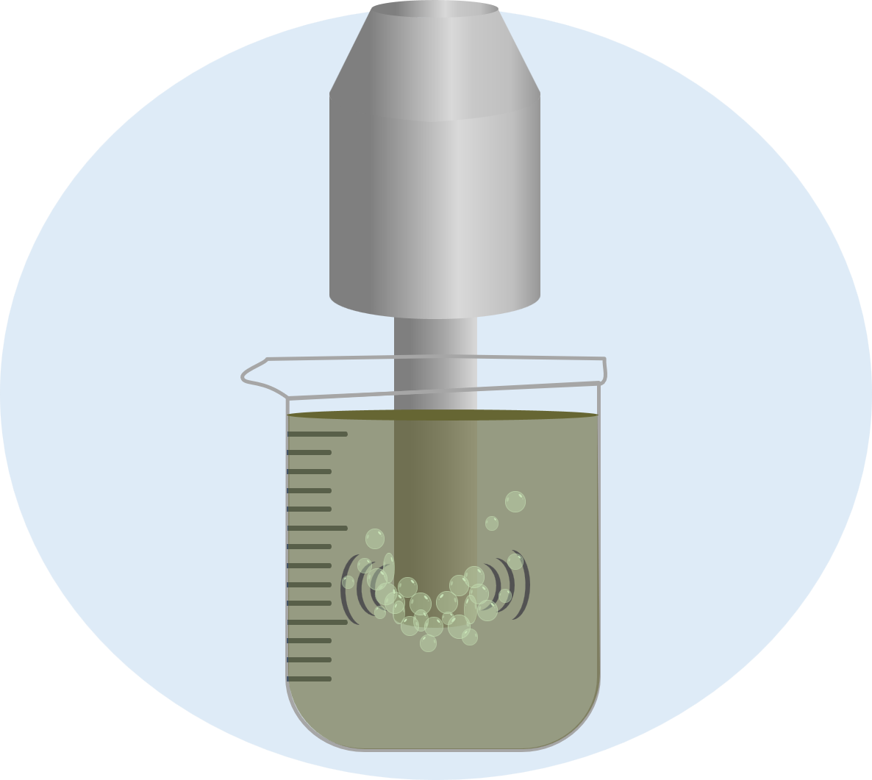
Introduction
High acoustic pressure
H₂O + US → ${\text{H}}^{\text{•}}$ + ${\text{HO}}^{\text{•}}$
O₂ + US → ${\text{2}\text{O}}^{\text{•}}$
H₂O + ${\text{O}}^{\text{•}}$ → ${\text{2}\text{HO}}^{\text{•}}$
Bubbles
Under ultrasound radiation, the waves interact with dissolved gases in the water body which leads to acoustic cavitation that can generate short-lived radicals. These phenomena, include the following steps: the formation, growth, and implosive collapse of bubbles.
Ultrasound-Fenton (US-Fenton) is the combination of these two methods. In addition to ${\text{HO}}^{\text{•}}$ radical production, the application of ultrasounds allows the regeneration of the ferric iron to ferrous iron, increasing the kinetic rate of the Fenton process.
FeHOO²⁺+ US → Fe²⁺ + ${\text{HO}}^{\text{•}}$

Slide 5
Aim of this work
(1) the characterization of the municipal activated sludge
(2) optimization of US-Fenton process
(3) the study of efficiency between ultrasound, Fenton and US-Fenton treatment processes applied to the sludge

Slide 6
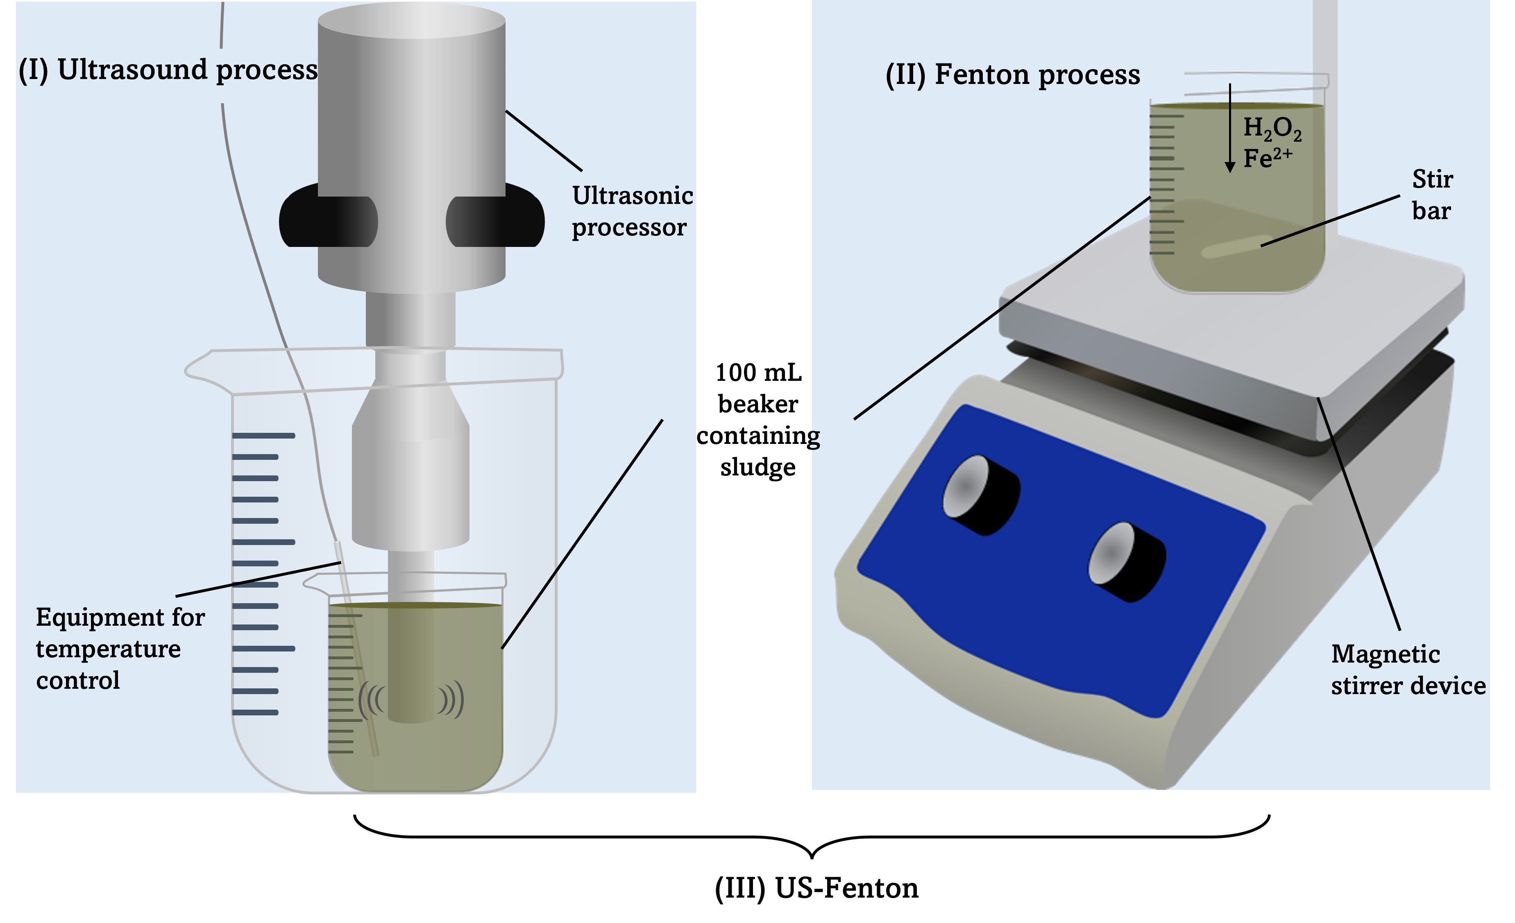
Material and methods
Municipal activated sludge characterization
For COD determination, it was used a closed reflux method, for total solids (TS) and volatile solids (VS) it were applied gravimetric methods, in accordance with standard methods of water and wastewater experiments.
Parameters | Values
pH | 6.48
Chemical oxygen demand (mg O₂/L) | 8512
Total solids (mg/L) | 3250
Volatile solids (mg/L) | 1920
Volatile solid/Total solids (mg/L) | 0.59
Electrical conductivity (µS/cm) | 1249
Experimental Set-up
The optimization of US-Fenton was performed in the following order: (1) variation of pH (3.0 - 7.0), (2) variation of H₂O₂ concentration (30 - 200 mM), (3) variation of Fe²⁺ concentration and (4) cavitation time ON (1 – 5 s), OFF (5 s).

Slide 7
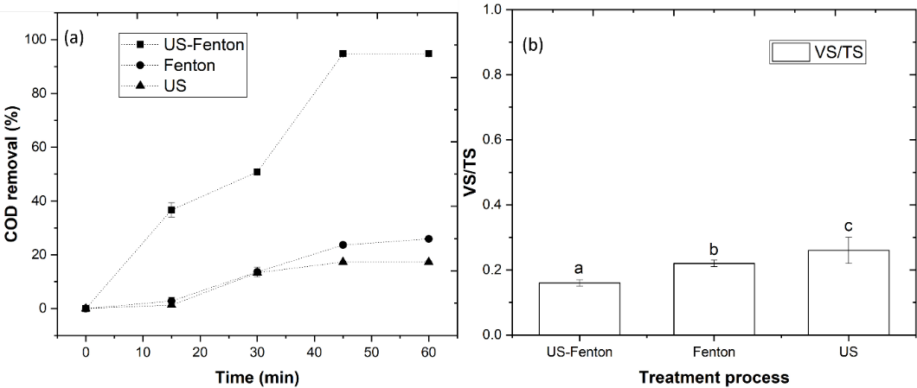
Results and discussion
Ultrasound vs Fenton vs US-Fenton treatment process
It’s possible to see that the process that showed best results was, without a doubt, US-Fenton, reaching 94.8% of COD removal, while ultrasound and Fenton reached 17.3 and 25.9%, respectively. The VS/TS ratio, was observed to be in the following order: US-Fenton (0.16) < Fenton (0.22) < US (0.26). Clearly, with the combination of US with Fenton, a higher ${\text{HO}}^{\text{•}}$ radical production occurred, increasing the kinetic rate of COD removal.

Slide 8
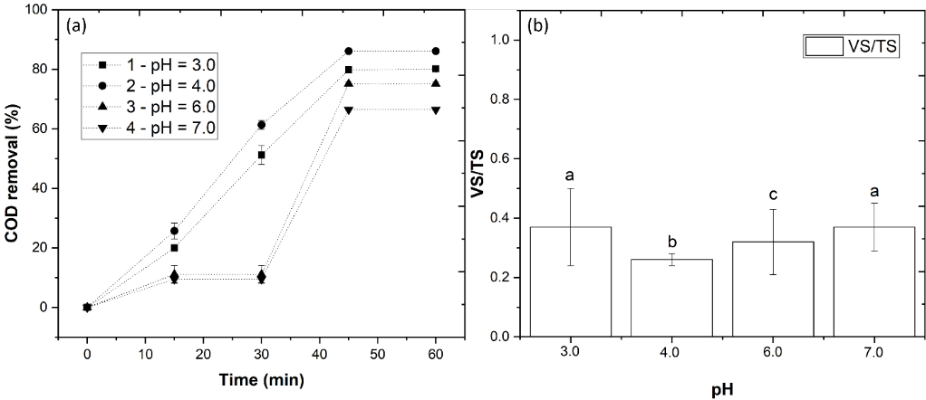
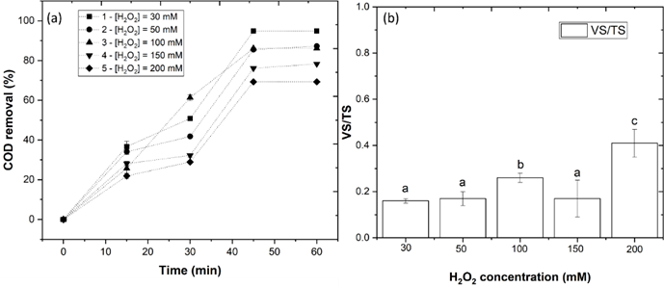
Results and discussion
Effect of pH
As can be observed, pH = 4.0 showed the highest efficiency, with a COD removal of 86.1%. Increasing the pH to 6.0 and 7.0, the COD removal suffers a reduction to 75.1% and 66.4%, respectively. The efficiency reduction at alkaline pH, resulted from the iron hydroxides precipitation, which lead to a lower production of ${\text{HO}}^{\text{•}}$ radicals and inhibits Fe²⁺ regeneration.
Effect of H₂O₂ concentration
The highest efficiency was achieved with application of [H₂O₂] = 30 mM, with a COD removal of 94.8%. In addition, the VS/TS ratio was reduced to 0.16. It was observed a COD reduction of 87.2, 86.1, 78.3 and 69.3%, respectively, for 50, 100, 150 and 200 mM. By increasing the H₂O₂ concentration to values > 30 mM, the excess of H₂O₂ induces the consume of HO• radicals and produces ${\text{HO}}_{\text{2}}^{•}$ which has a low reduction potential, so, less degradation occurs.
H₂O₂ + ${\text{HO}}^{\text{•}}$ → ${\text{HO}}_{\text{2}}^{\text{•}}$ + H₂O

Slide 9
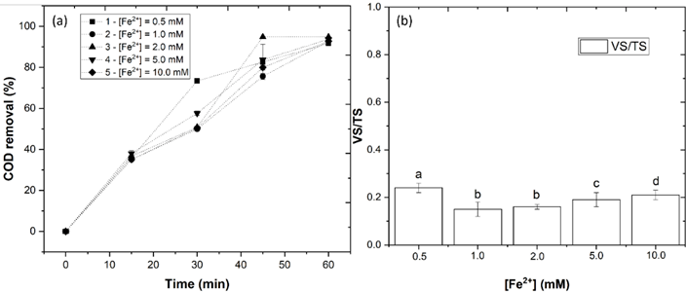
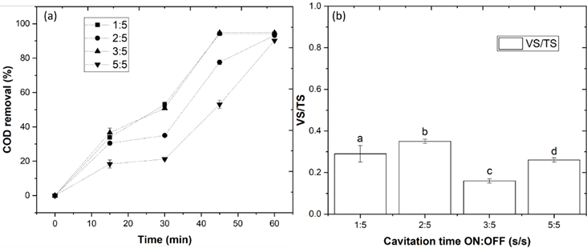
Results and discussion
Effect of iron concentration
In this section, the Fe²⁺ concentration was varied from 0.5 to 10.0 mM, and in accordance with the results, with application of 2.0 mM Fe²⁺ it was achieved a COD removal of 94.8%. Above 2.0 mM, it was observed a decrease of COD removal and higher values of VS/TS ratio. The excess of ferrous ions can lead to a consume of HO• radicals producing ${\text{Fe}}_{ }^{\text{3+}}\text{and}{ \text{OH}}^{\text{−}}$, resulting less degradation.
Fe³⁺ + HO• → Fe³⁺ + HO⁻
Effect of cavitation time ON
The cavitation time plays an important role in the degradation of organic carbon. Therefore, the US-Fenton process was optimized by variation of the cavitation time ON:OFF (1:5, 2:5, 3:5 and 5:5 s:s). The most efficient cavitation time, with a COD removal of 94.8 % and a VS/TS ratio of 0.16, was 3 s ON and 5 s OFF (Figure 6). By increasing the contact time (5:5 s:s), the COD removal was observed to decrease to 90.2% with a VS/TS ratio of 0.26.

Slide 10
Conclusions
Through the results obtained we can conclude that :
(1) the US-Fenton has a higher efficiency for COD removal and VS/TS ratio decrease
(2) the efficiency of US-Fenton process depends on several variables, mainly pH, concentrations of hydrogen peroxide, ferrous ion and cavitation time
(3) under the optimal conditions it is achieved 94.8% of COD removal and 0.16 VS/TS ratio

Slide 11
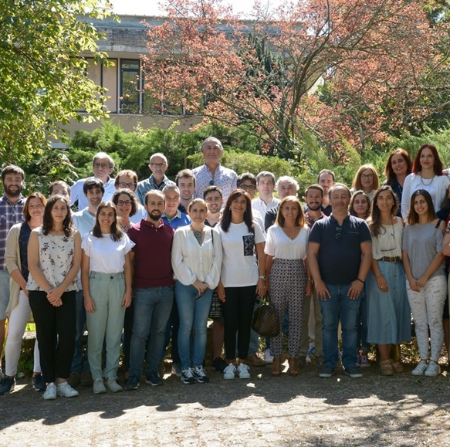
Acknowledgements
The authors thank the North Regional Operational Program (NORTE 2020) and the European Regional Development Fund (ERDF) and express their appreciation for the financial support of the Project AgriFood XXI, operation nº NORTE-01-0145-FEDER-000041, and to the Fundação para a Ciência e a Tecnologia (FCT) for the financial support provided to CQVR through UIDB/00616/2020. Ana R. Teixeira also thanks the FCT for the financial support provided through the Bolsa de Doutoramento UI/BD/150847/2020.

Slide 12
Thank you for your attention

