Slide 1
Design of On-Grid Photovoltaic System Considering Optimized Sizing of Photovoltaic Modules for Enhancing Output Energy
Muhammad Tamoor engr.muhammadtamoor@gmail.com
ORCiD: 0000-0003-0981-9904
Presented at the 1st International Electronic Conference on Processes: Processes System Innovation

Slide 2
Presentation Outlines
Introduction
Research Methodology
Results and Discussion
Conclusions

Slide 3
Introduction

Slide 4
Research Background
Photovoltaic systems play a significant role for decreasing global warming and achieving climate change targets like carbon emission and environmental issues .
Industrial, commercial and domestic customer are highly benefitted by standalone or grid connected PV system to reduce their peak demand.
Energy security challenges have arisen as a result of increased energy demand in developing countries.
On-grid Photovoltaic energy generation systems have proven to be the most cost-effective large-scale renewable energy source.

Slide 5
Research Background
A PV system that is properly designed and sized eliminates extra costs from an oversized system and insufficient power delivery from an undersized system.
The performance of PV systems is influenced by a multitude of parameters, including the type of photovoltaic modules used, PV modules power rating, the sun irradiance potential, and the geographic location of the system.
Photovoltaic power systems installed at the optimal inclination angle and row spacing generate maximum energy, avoid unnecessary costs, and make optimal use of the available space.

Slide 6
Aim of Study
The aim of this study to analyze the simulated photovoltaic output of different PV module sizes have identical efficiency in the same fixed area using the Helioscope. With the variation of the PV module size having nearly identical efficiencies, there is a wide variation in power output. This research strongly recommended that optimum PV module size for a certain location should be evaluated using available simulation tools to ensure maximum energy from photovoltaic system.

Slide 7
Research Methodology

Slide 8
Research Methodology
In order to evaluate the optimal sizing of PV modules and PV energy potential at a proposed location, a number of experiments were carried out in this study.
There were four different rating of PV modules are analysed for each location in the experiment.
An azimuth angle of 180° and a tilt angle of 15° were used in all four scenarios.

Slide 9
Research Methodology
The study was conducted at following locations:
Location 1: Energy generation by PV system installed at GC University Faisalabad
Location 2: Energy generation by PV system installed at University of Agriculture Faisalabad
The surface area of each location is 30,224.5 ft2 for GC University Faisalabad and 54,994.4 ft2 for Agriculture University Faisalabad.

Slide 10
Research Methodology
In this study, the Meteonorm programme and database were utilised to measure solar energy resources. For PV energy output assessment irradiance data, sunlight hours, temperatures and precipitation are all important parameters to evaluate. Seasonally, the weather change from a cold winter to a warm summer, with a high temperature of 46.0°C

Slide 11
Research Methodology
The monocrystalline photovoltaic module manufactured by Trina Solar are used in this study and their power rating vary from (340 watt to 540 watt).
Specification of all Photovoltaic module
Rated Maximum Power | 340 | 380 | 450 | 540
V_{MP} | 38.200V | 40.300V | 41.000V | 31.200V
V_{OC} | 46.200V | 48.800V | 49.600V | 37.500V
I_{MP} | 8.900A | 9.430A | 10.980A | 17.330A
I_{SC} | 9.500A | 9.940A | 11.530A | 18.410A

Slide 12
Research Methodology
Ginlong Technologies (Solis-50K) solar inverters were used for each design.
Specification of PV Inverter.
Parameters | Value
Manufacturer | Ginlong Technologies (Solis-50K)
Maximum Power | 50.0 kW
Minimum Power | 250.0 W
Maximum Voltage | 1,100V
Maximum MPPT Voltage | 1,000V
Minimum MPPT Voltage | 200V
Minimum Voltage | 200V
AC Output | 380Y/220V

Slide 13
Results & Discussion

Slide 14
Energy Generation by PV System Installed at GC University Faisalabad
PV Rating | Installed PV Capacity | Annual Energy Generation | Performance Ratio | kWh/kWp
340 | 294.4 kW | 440.4 MWh | 81.2% | 1495.8
380 | 329.1 kW | 492.0 MWh | 81.2% | 1495.2
450 | 360.9 kW | 541.7 MWh | 81.5% | 1500.9
540 | 383.4 kW | 576.7 MWh | 81.7% | 1504.2

Slide 15
By comparison, we analyse that the photovoltaic energy generation system installed with 540.0 watt PV modules are more efficient installed at fixed area in GC University Faisalabad.
For this case, the simulation results show that the annual energy generation of the photovoltaic system is 576.7 MWh, and the performance ratio (PR) of the system is 81.7%.

Slide 16
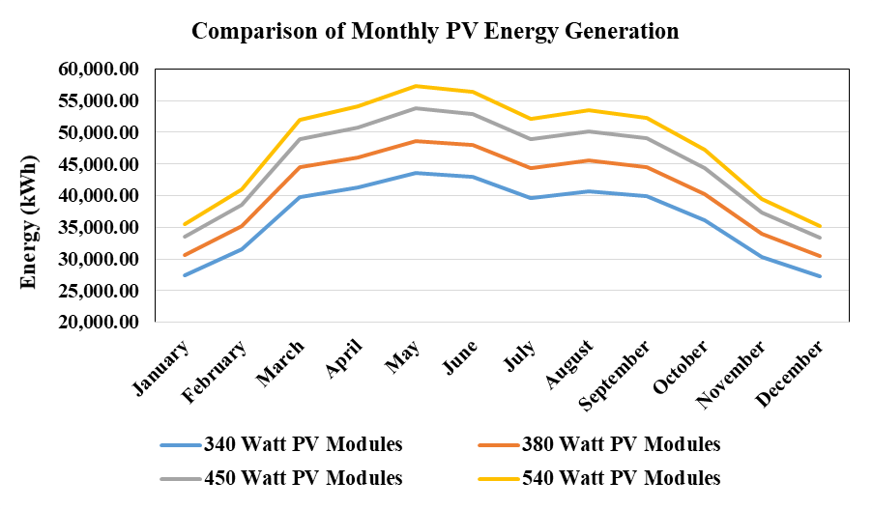
Comparison of Monthly PV Energy Generation

Slide 17
Energy Generation by PV System Installed at University of Agriculture Faisalabad
PV Rating | Installed PV Capacity | Annual Energy Generation | Performance Ratio | kWh/kWp
340 | 658.2 kW | 944.5 MWh | 78.1% | 1434.9
380 | 735.7 kW | 1.056 GWh | 78.1% | 1435.6
450 | 782.1 kW | 1.125 GWh | 78.3% | 1438.0
540 | 789.5 kW | 1.131 GWh | 78.0% | 1433.2

Slide 18
By comparison, we analyse that the photovoltaic energy generation system installed with with 450.0 watt PV modules are more efficient (having high PR ratio and kWh/kWp) installed at fixed area in University of Agriculture Faisalabad.
For this case, the simulation results show that the annual energy generation of the photo-voltaic system is 1.125 GWh, and the performance ratio (PR) of the system is 78.3%.

Slide 19
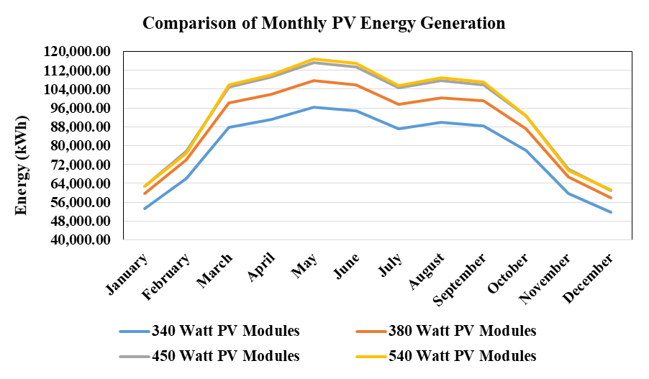
Comparison of Monthly PV Energy Generation

Slide 20
CONCLUSION
This study intends to emphasize the fact that when designing an On-Grid photovoltaic system, relatively little consideration is given to selecting the appropriate type and size of PV modules.
In this research, different PV modules of various sizes and power ratings with nearly identical efficiencies were analyzed in two selected locations.
For GC University Faisalabad, the annual energy generation of the photovoltaic system is 576.7 MWh and for University of Agriculture Faisalabad, the annual energy generation of the photovoltaic system is 1.125 GWh.
This research strongly recommended that optimum PV module size for a certain location should be evaluated using available simulation tools to ensure maximum energy from photovoltaic system.

Slide 21
Q & A

