Slide 1
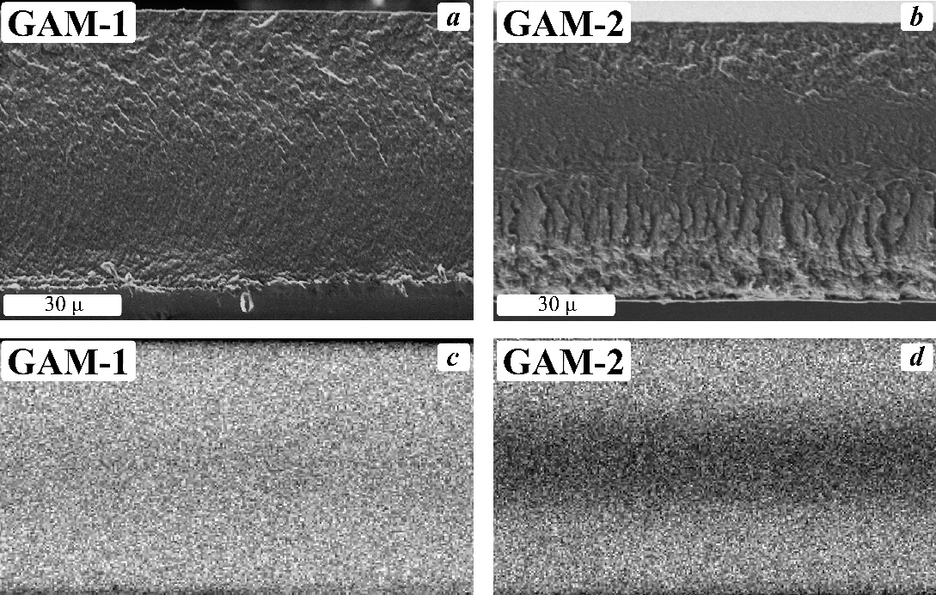
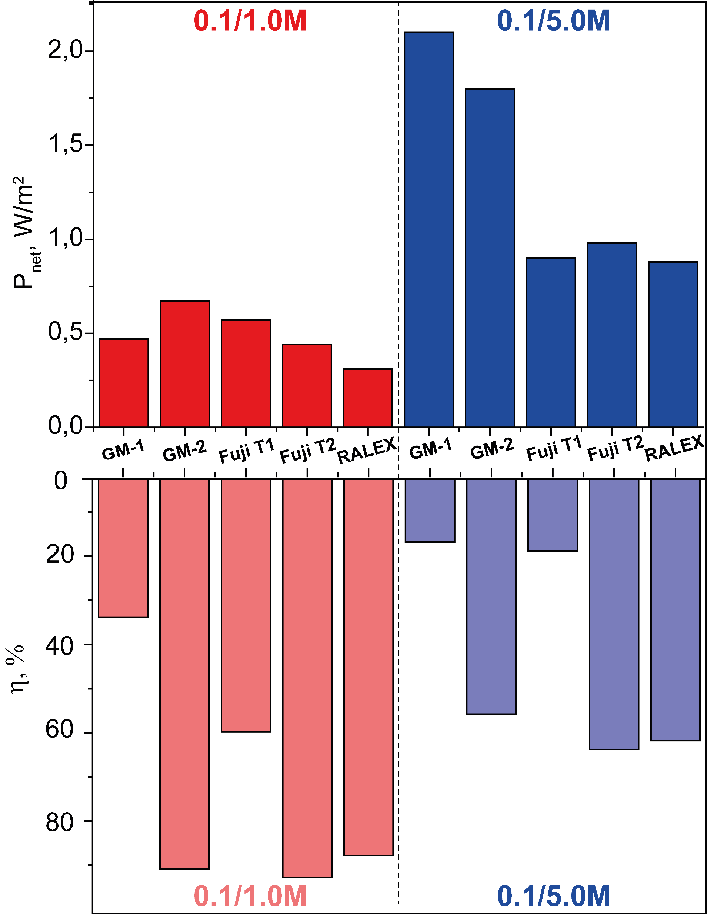
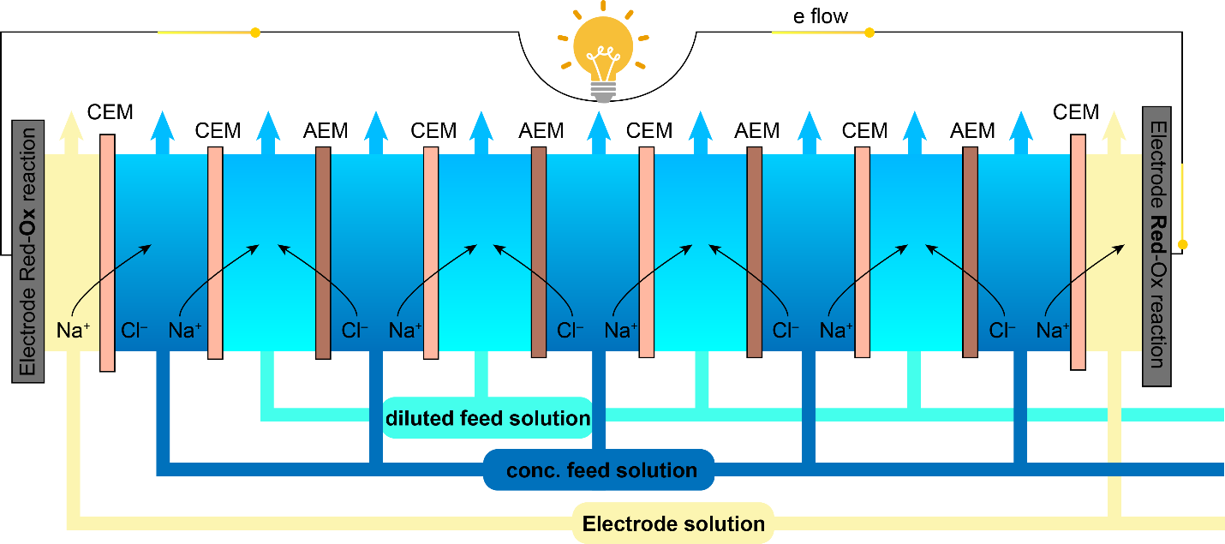
Reverse electrodialysis (RED) stack with new grafted ion-exchange membranes shows net power density up to 2 W/m²
Key results:
Grafted ion exchange membranes (GM-1 and -2) based on polystyrene соpolymer films prepared by radiation-induced grafting were tested in reverse electrodialysis for the first time. For 0.1 M/1 М NaCl electrolyte concentrations, the stack with GM-2 membranes provides the highest net power density up to 0.67 W m⁻², which is 18% higher than that for Fuji T1 (Fig. 2). It is noteworthy that the GM-1 stack with low resistance membranes has a net power density of only 0.47 W m⁻². For the 0.1 M/5 М NaCl electrolyte concentrations, the highest power density of 2.1 W m⁻² was provided by the GM-1 membranes; the GM-2 stack was somewhat inferior (1.8 W m⁻²), and the power density of the Fuji T1 stack was considerably lower (0.98 W m⁻²).
Fig. 3
Methodology
Synthesis of grafted cation and anion exchange membranes based on polymethylpentene and poly(styrene-divinylbenzene) graft соpolymer was performed according to next scheme:
Golubenko D.V., Yaroslavtsev A.B.
Introduction
In recent years, the search for alternative renewable energy sources has been actively carried out. Considerable attention of scientists is attracted by energy generation methods based on the mixing of electrolyte solutions of different concentrations ‒ Blue Battery systems. Among these methods, a promising system is reverse electrodialysis, the principle of which is the generation of electrical potential over a stack of ion-selective membranes when a concentrated and diluted electrolyte is passed at different sides of the membrane (Fig. 1). The development and testing of membranes are among the main trends for RED optimization. Due to the outstanding transport properties, it was suggested that grafted membranes could be potentially effective in the RED process.
Figure 2. Experimental and calculated RED net power densities and current efficiency values for 0.1 M/1 М NaCl and 0.1 M/5 М electrolyte concentrations (GM-1, GM-2 – tailor made grafted IEMs, Fuji T1 and T2 – Fujifilm® homogeneous Type 1 and Type 2 membranes, RALEX –RALEX® heterogeneous IEMs.
Figure 4. Electron micrographs of the transverse cleavages of grafted membranes: GAM-1 (a), GAM-2 (b) and EDX distributions of chlorine (c,d) across the sample.
The membrane performance in the RED was evaluated using a tailor-made PMMA stack containing two platinum-coated Ti electrodes, 1.0 mm thick polyethylene gaskets with 9.0 cm² active area (6.0×1.5 cm²), non-conductive spacers made of polyethylene mesh (Fig. 3), four pairs of cation and anion exchange membranes, and a pair of FujiFilm® CEM Type 2 membranes separating the electrode solution from sodium chloride solutions.
Figure 1. Scheme of the membrane electrode assembly and flow in a reverse electrodialysis unit.
You can read more about the results and methods here
[J. Power Sources. Elsevier B.V., 2021. Vol. 511, № March. P. 230460.]
Figure 3. Used RED PMMA stack

