Slide 1

Occupational risk assessment in E-waste plant: Progress achieved over years †
Giulia Simonetti^{1,}*, Leonardo Romani¹, Carmela Riccardi², Donatella Pomata², Patrizia Di Filippo², Francesca Buiarelli¹

Slide 2

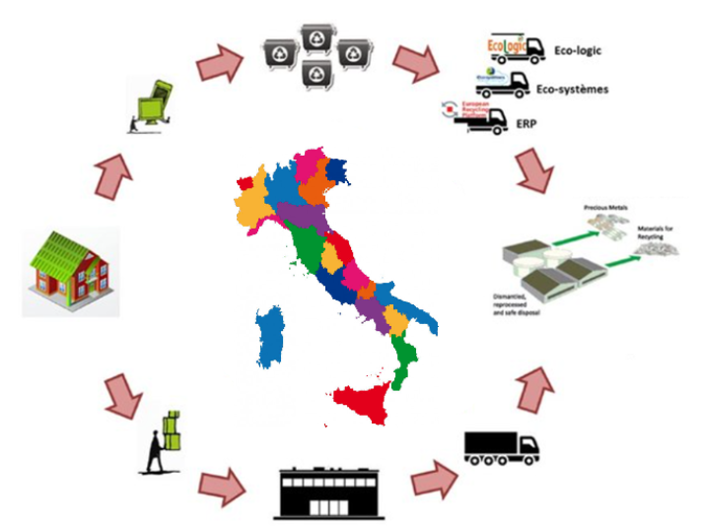


‘Electrical and electronic equipment’ or ‘EEE’ means equipment which is dependent on electric currents or electromagnetic fields in order to work properly and equipment for the generation, transfer and measurement of such currents and fields and designed for use with a voltage rating not exceeding 1 000 volts for alternating current and 1 500 volts for direct current;
E-waste is the fastest growing waste stream in the EU and less than 40% is recycled.
D.Lgs. 49/2014
Directive 2012/19/EU
an obligation for producers and distributors to finance a system for the recovery and recycling of products placed on the market (“extended producer responsibility” principle)
measures aimed primarily at preventing the production of WEEE and their reuse, recycling and other forms of recovery to reduce the disposed waste volume.

Slide 3

Risks Associated with the End-of-Life Treatment of Electrical and Electronic Equipment
The major hazards in the recycling chain are associated with the size reduction and separation steps. Shredding, grinding or other size reduction processes lead to generation of dust on which harmful substances can be absorbed
Components | Found in | Substances of concern
Cathode ray tubes | Old TV sets, PC monitors, oscilloscopes | Pb in cone glass Ba in electron gun getter Cd in phosphors
Printed circuit boards | Ubiquitous, from beepers to PCs | Pb, Sb in solder Cd, Be in contacts Hg in switches BFRs in plastics
Plastics | Wire insulation, plastic housing, circuit boards | Polyvinyl chloride (PVC) Brominated flame retardants (BFR) Polychlorinated biphenyl (PCB)

Slide 4
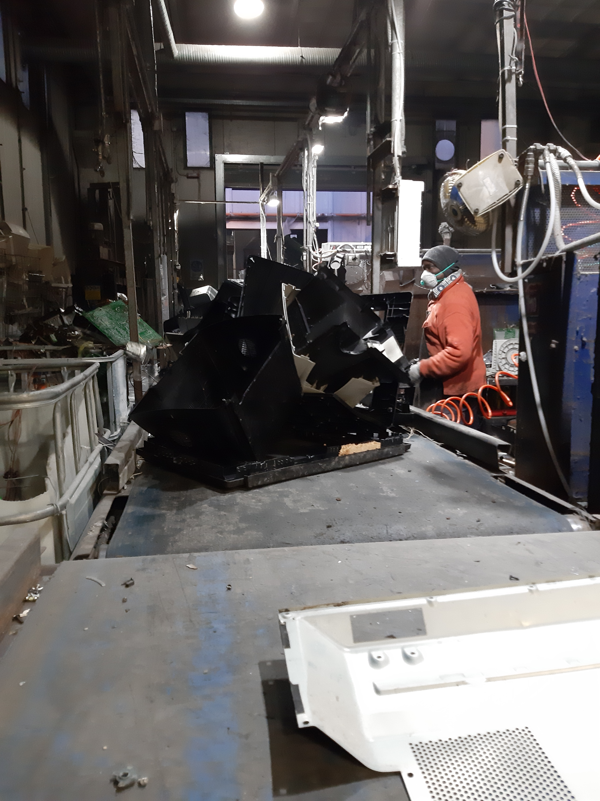
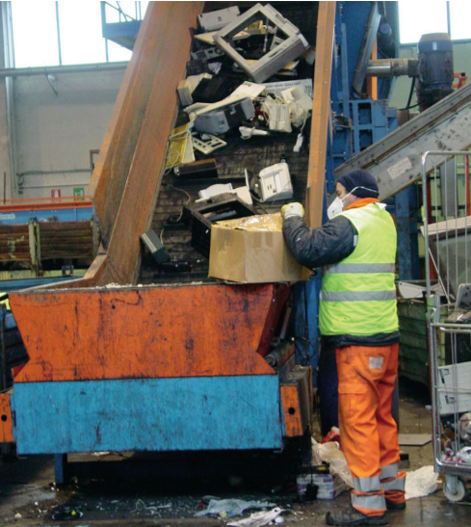
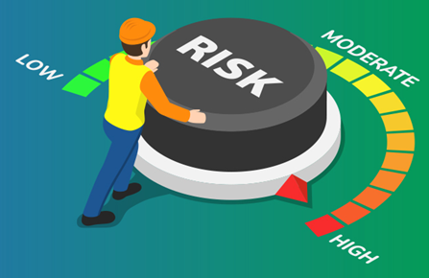
….HUMAN HEALTH RISK??
E-waste recycling can lead to direct or indirect exposure to a variety of hazardous substances that are contained in EEE or formed and released by unsafe recycling practices
Individuals who directly engage in e-waste recycling with poor protection are exposed to non-negligible risks
Unsafe recycling techniques used to regain valuable materials often increase the risk for hazardous exposures.

Slide 5
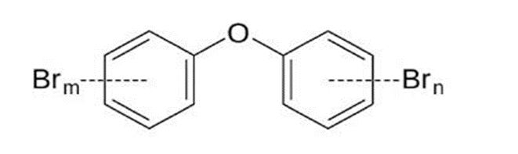
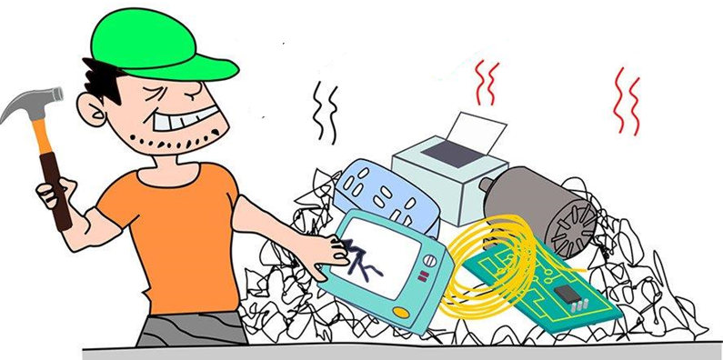
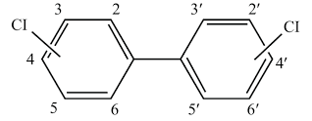
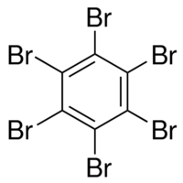
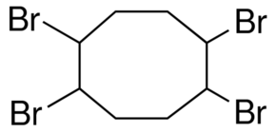
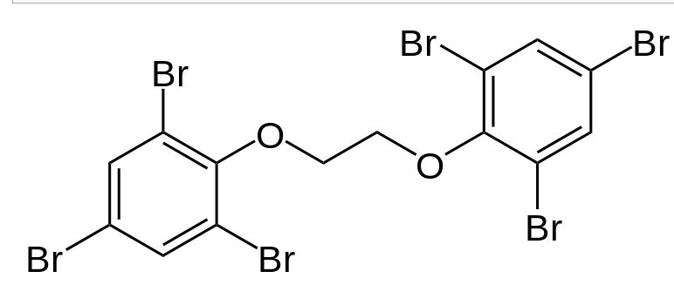
Aim of work
Study of Risk Assessment of Workers Exposed to three different classes of compounds in both settled dust and airborne particulate matter (PM) over the years
PBDEs
PCBs
BFRs

Slide 6
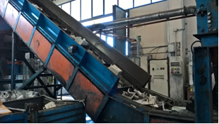
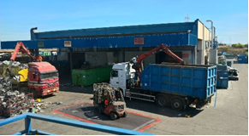
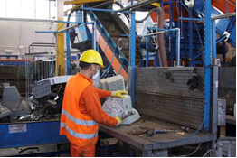
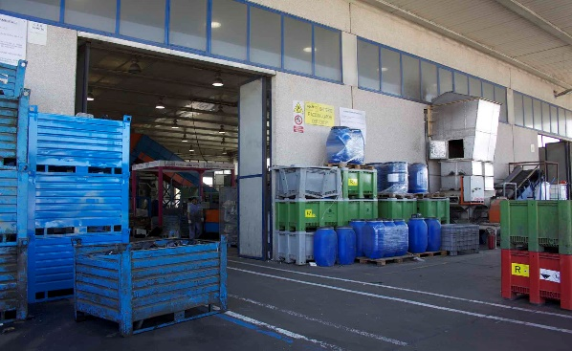
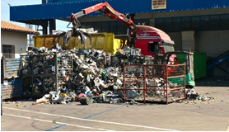
Evolution of WEEE plant from 2017 to 2021
2017
Weighing
Disassembling + Shredding
2021
Storage
Z1
Z2
Discharge
Shredding
Disassembling

Slide 7
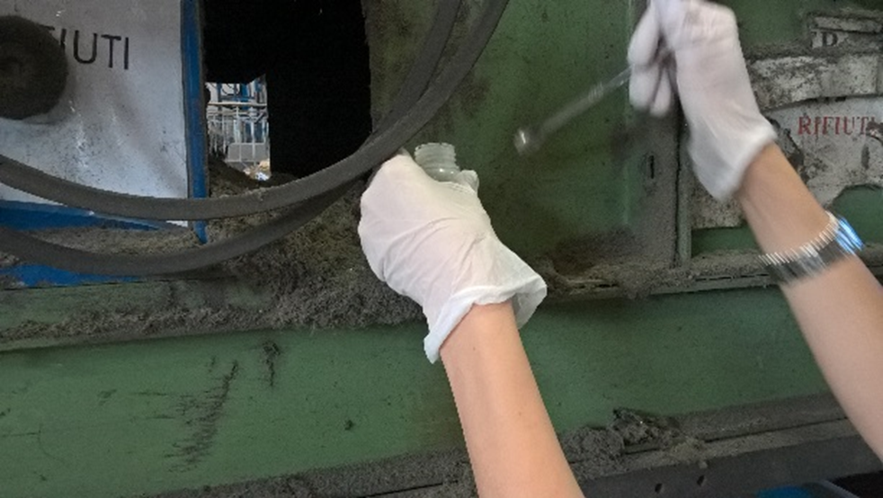
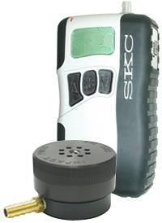
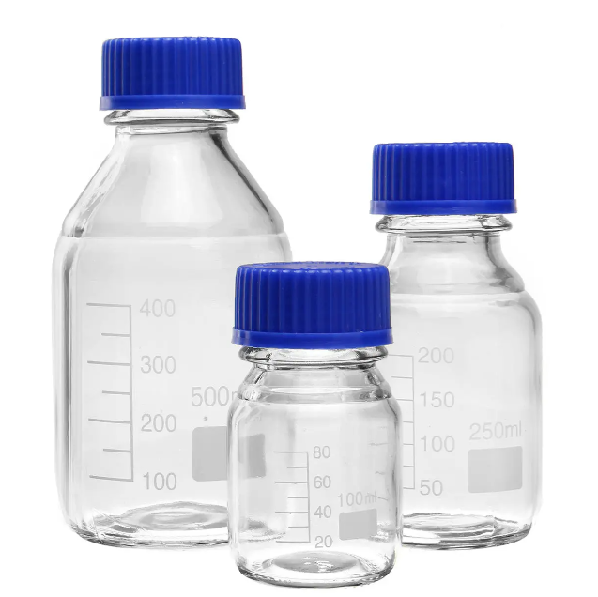

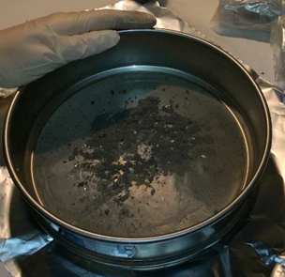
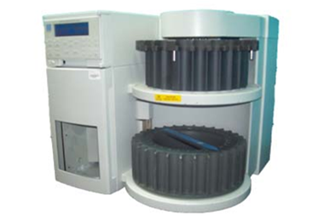
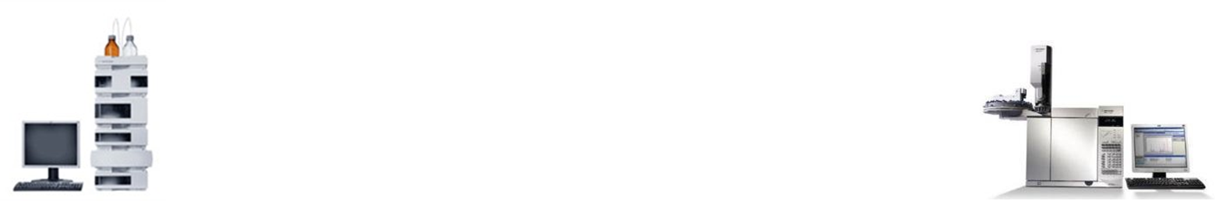
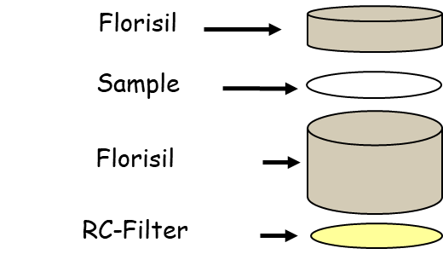
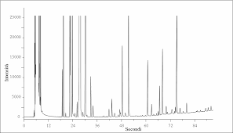
Sample collection
Dust collection
PM₁₀
→ SKC impactors 37 mm teflon filters
Dust sieved to 63 µm
Extraction and purification
HPLC-MS/MS and GC-MS analysis

Slide 8
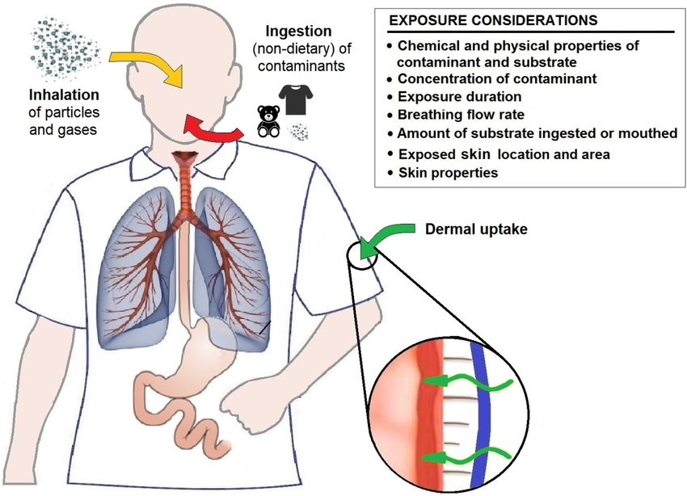
EXPOSURE PATHWAYS
Inhalation of particles
Accident ingestion of dust
Dermal absorption via particle contact
European Aerosol Conference 2021

Slide 9






CR_{inhalation} =
$$\frac{Ci x EF x ET x ED }{AT∗∗365∗24} x IUR$$
HQ_{inhalation} =
$$\frac{Ci x EF x ET x ED }{AT∗∗365∗24∗1000}$$
/ RfC
$\frac{Ci x IngR x EF x ED x CF}{BW x AT}$ x SFO
HQ_{ingestion} =
$$\frac{Ci x IngR x EF x ED x CF}{BW x AT}$$
/ RfD
CR_{ingestion} =
CR_{dermal} =
$\frac{Ci x SA x AF x ABS x EF x ED x CF}{BW x AT}$ x$\frac{SFO}{ GIABS}$
HQ_{dermal} =
$$\frac{Ci x SA x AF x ABS x EF x ED x CF}{BW x AT}$$
/ RfD x GIABS
TCR =∑ CR_{inhalation} + CR_{ingestion} + CR_{dermal contact}
THQ =∑ HQ_{inhalation} + HQ_{ingestion} + HQ_{dermal contact}
Ci Ci is the contaminant concentration for each compound in PM (µg/m³) and in settled dust (µg/g),
IngR Ingestion rate (mg/day)
EF Exposure frequency (days/year)
ED Exposure duration (years)
BW Average body weight (kg)
AT Averaging time (days or hours*)
CF Conversion factor (kg/mg)
SFO Oral slope factor (mg/kg/day)⁻¹
SA Surface area of the skin that contacts soil (cm²/day)
AF Skin adherence factor for soil (mg/cm²)
ABS Dermal absorption factor (dimensionless)
GIABS Gastrointestinal absorption factor (dimensionless)
ET Daily exposure time (8 h/d)
IUR Inhalation unit risk (mg/m³)⁻¹
RfC Reference dose for inhalation (mg/m³)
RfD Reference dose for ingestion/dermal contact
→PRECAUTIONARY APPROACH
European Aerosol Conference 2021

Slide 10
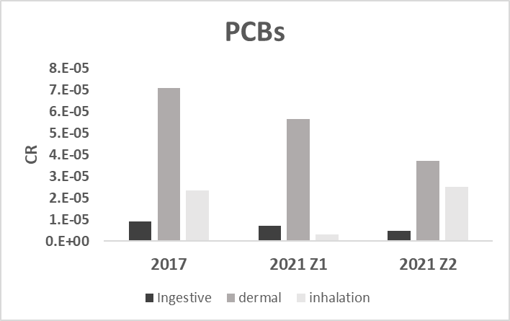
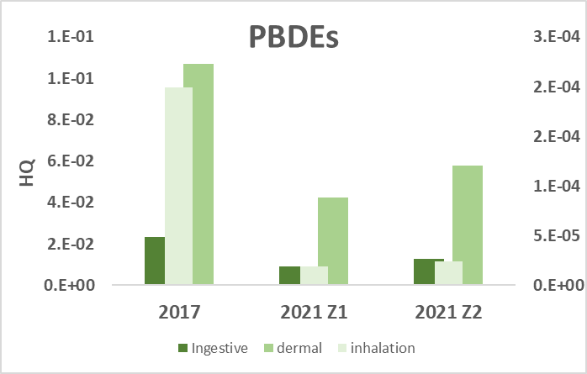
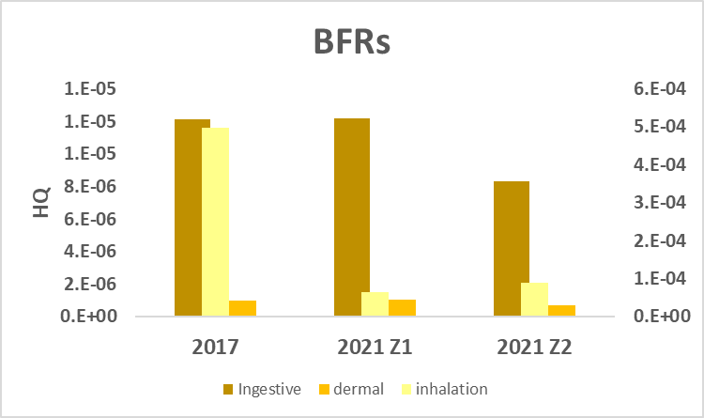

Slide 11
Conclusion
 | 2017 | 2021-Z1 | 2021-Z2 | USEPA Recommended Values
TCR | 1.03E-04 | 6.67E-05 | 6.68E-05 | CR < 1 × 10−6 acceptable risk CR< 1 × 10−4 tolerable risk
THQ | 1.31E-01 | 5.18E-02 | 7.09E-02 | HQ <1 no appreciable risk HQ>1 appreciable risk
In 2017, TCR data exceeded the tolerable values set by USEPA, whereas THQ results were lower than acceptable risk limits. In 2021, both TCR and THQ are lower than recommended values and about 60% below those found in 2017.
Therefore, the plant modifications seem to have resulted in a risk reduction for the workers involved in the treatment of e-waste.

