Slide 1
Tropical waves and their transit through Cuba during the period 2012-2020.
Authors:
Laura E. Guerra Rodríguez
laura.guerra@insmet.cu
Miguel A. Hernández Martínez
miguel.hernandez@insmet.cu
Evelio A. García Valdés
evelio.garcia@insmet.cu
1
1
1
Meteorology Institute, 11200 Havana, Cuba
1.

Slide 2
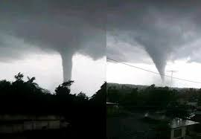
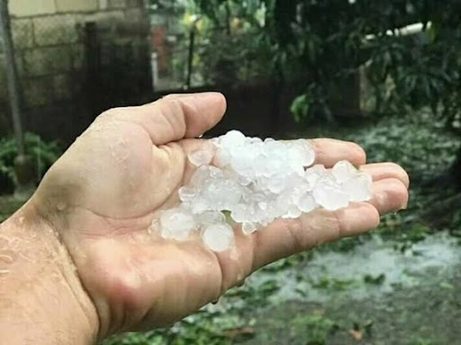
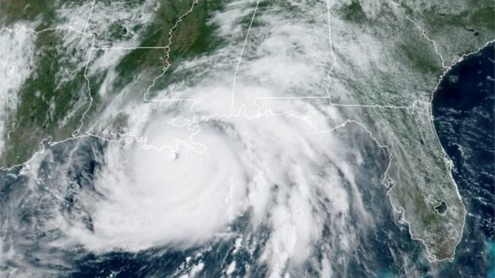
Tropical waves and their transit through Cuba during the period 2012-2020.
Rainy
Period
Tropical
Waves
Rains and/or severe weather
Tropical Cyclones

Slide 3
Abstract
Fundamentally, during the rainy season, the transit of tropical waves through the seas adjacent to the Cuban archipelago occurs, stimulating deep convection and later the occurrence of severe local storms; that is why the general objective is to analyze the behavior of the tropical waves that passed through Cuba during the 2012-2020 period. This research will examine the most relevant characteristics of tropical waves, the associated dangerous phenomena and the number of intensifications or dissipations that occurred after passing through the country. The results obtained contribute to the expansion of knowledge on Tropical Meteorology and to a better effectiveness in the meteorological forecast related to these systems.
Keywords: tropical waves, rainy period, severe local storms, intense rains.

Slide 4
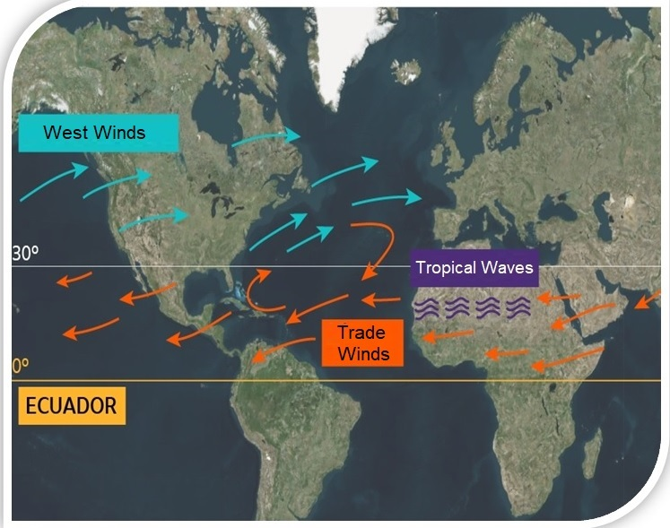
Origin near West African coast
Average of 60 tropical waves
Translation speed= 20-40 km/h

Slide 5
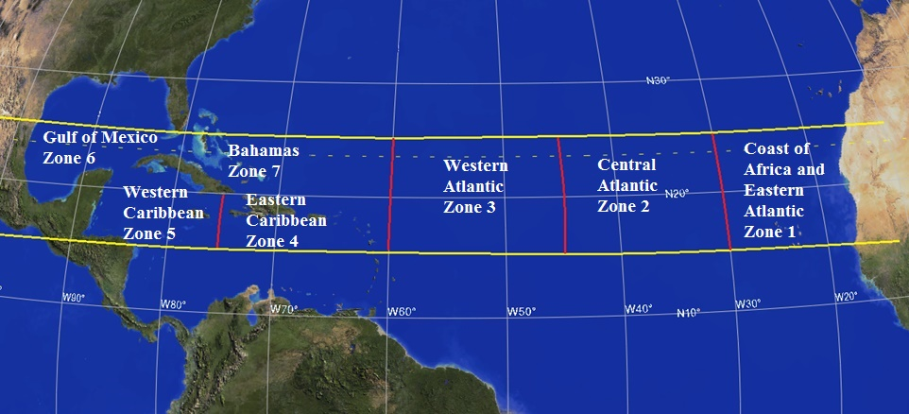
Formation, intensification and dissipation zones
Golfo
de México
Zona 6
Bahamas
Zona 7
Atlántico Oriental y
costa de África
Zona 1
Caribe
Occidental
Zona 5
Caribe
Oriental
Zona 4
Atlántico
Occidental
Zona 3
Atlántico
Central
Zona 2

Slide 6
Rankings
Traslation speed
Slow (<15 km/h)
Normal (15-25 km/h)
Convective activity
Fast (>25 km/h)
Inactive
Active

Slide 7
Data Processing
Descriptive statistics
Average and percentage values
Graphic analyst
Microsoft Excel version 2019
Distribution of annual and monthly frequencies.

Slide 8
Annual distribution of tropical waves in Cuba
Total= 323 tropical waves

Slide 9
Monthly distribution of tropical waves in Cuba

Slide 10
Tropical waves distribution with respect to the formation zone

Slide 11
Tables 1 and 2. Tropical waves that dissipated or intensified after passing through Cuba
Year/DZ | 5 | 6 | 7 | Total
2012 | 4 | 5 | 1 | 10
2013 | 1 | 1 | 0 | 2
2014 | 2 | 2 | 0 | 4
2015 | 2 | 0 | 0 | 2
2016 | 1 | 0 | 0 | 1
2017 | 0 | 0 | 0 | 0
2018 | 0 | 3 | 0 | 3
2019 | 2 | 0 | 0 | 2
2020 | 1 | 0 | 0 | 1
Total | 13 | 11 | 1 | 25
% | 52 | 44 | 4 | 100
Year/IZ | 4 | 5 | 6 | Total
2012 | 0 | 1 | 0 | 1
2013 | 0 | 1 | 1 | 1
2014 | 0 | 0 | 1 | 1
2015 | 0 | 0 | 0 | 0
2016 | 0 | 1 | 1 | 2
2017 | 0 | 2 | 1 | 3
2018 | 0 | 0 | 0 | 0
2019 | 0 | 0 | 0 | 0
2020 | 2 | 2 | 1 | 5
Total | 2 | 7 | 5 | 14
% | 13,4 | 50 | 35,7 | 100
1
2

Slide 12
Annual analysis of the tropical waves in relation to the speed of traslation

Slide 13
Behavior of tropical waves in the Eastern and Western half of Cuba

Slide 14
Convective activity in the Eastern and Western half of Cuba

Slide 15
Intense rains and associated severe phenomena

Slide 16
Conclusions
The study carried out on tropical waves in the period 2012-2020 gave a total of 579 tropical waves in the Atlantic basin, of which 323 passed through Cuba (representing 56% of the total), confirming that they are not only important in the possible formation of tropical cyclones, but by the accumulation of rain.
More than 50% of the waves had their origin in the African and Eastern Atlantic coasts (zone 1), the most frequent being those that moved with “normal” speeds.
Over the western Caribbean Sea, 52% of the tropical waves dissipated, after passing through Cuba, while 50% of the intensifications of these systems occurred in the same area.
The transit of tropical waves through the archipelago presented severe phenomena and/or intense rains associated with "active" waves.
In the years 2012-2020, the activity of tropical waves was 28% higher than that of the 2003-2011 period, a behavior that was reflected in the months of June-July-August with a difference of 21% compared to what was found in Añón (2012).

Slide 17
Tropical waves and their transit through Cuba during the period 2012-2020.
Authors:
Laura E. Guerra Rodríguez
laura.guerra@insmet.cu
Miguel A. Hernández Martínez
miguel.hernandez@insmet.cu
Evelio A. García Valdés
evelio.garcia@insmet.cu
1
1
1
Meteorology Institute, 11200 Havana, Cuba
1.

