Slide 1
Projecting the Potential Evapotranspiration of Egypt using a high resolution regional climate model (RegCM4)

Slide 2
Motivation
Calculating potential Evapotranspiration (PET) is important especially for long term of water management on a regional scale.
Penman-Monteith (PM) is the best method to calculate PET as recommended by Food and Agriculture Association (FAO). However it requires a large number of meteorological input (not available for a long time), also uncertainty of the meteorological input can amplify the error of the calculated PET.
So there an urgent need for the PET to be calculated using a simple empirical method. Hargreaves-Samani (HS) was selected because it is recommended by the FAO as the best alternative method after the PM and it only requires global incident solar radiation and mean air temperature (available from the regional climate model; RegCM4).

Slide 3
Target of study
Examine the capability of the RegCM4 model to calculate PET using the HS method in comparison with the CRU product in the historical period 1981-2005.
Correct the projected PET under the two future scenarios using the LRM approach (Shiri et al. 2014) between the RegCM4 and CRU of the historical period.

Slide 4
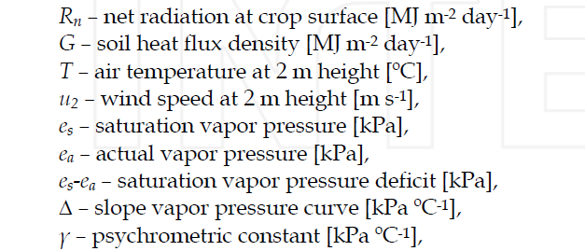
Penman-Monteith Equation

Slide 5
Hargreaves-Samani Equation
R_{s} is in units of water evaporation, in mm day⁻¹, and T in ºC.

Slide 6
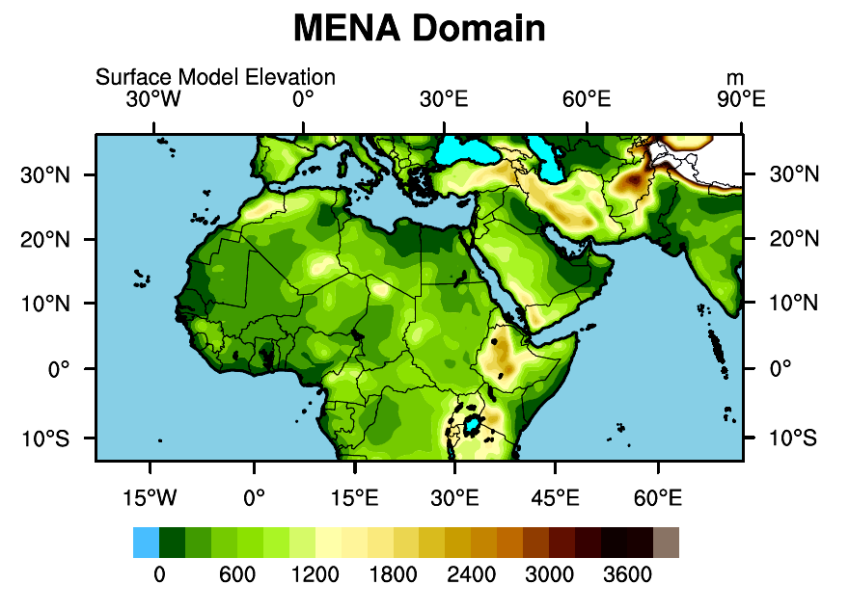
Experiment design: 1 – Domain configuration A – MENA Domain

Slide 7
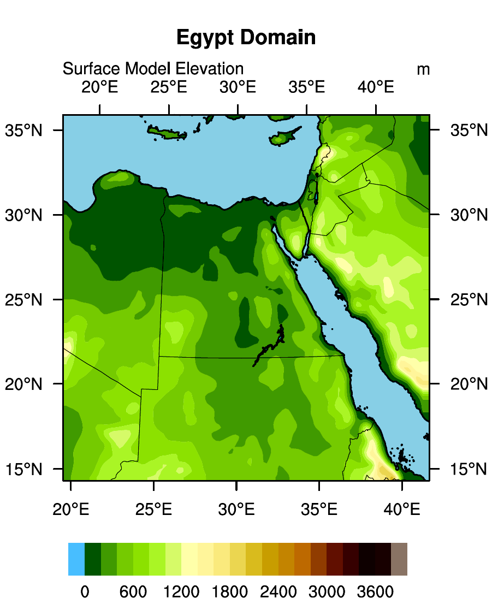
B – Egypt Domain

Slide 8
Experiment Design : 2 – Physical configuration
Domain Dimension | Coarse domain (50 km with 235 grid points in the zonal direction and 121 grid points in the meridional direction, clat = 19.5, clon = 24.5); Nested domain (20 km with 121 in zonal and meridional direction, clat = 25.5, clon = 30.5)
Model Projection | Lambert-conformal
Lateral Boundary condition and SST | Max Planck Institute (MPI) with resolution 1.8 x 1.8 degrees Historical : 1981-2005 RCP45 and 85 : 2006-2100
Convection scheme | Grell over land and Emanuel over ocean
Radiation scheme | CCM3
Land surface scheme | Biosphere Atmosphere Transfer System (BATS)

Slide 9
Climate Research Unit (CRU)
The gridded Climatic Research Unit (CRU) Time-series (TS) data version 4.05 data are month-by-month variations in climate, provided on high-resolution (0.5x0.5 degree) grids, produced by CRU at the University of East Anglia.
The CRU TS4.05 variables are cloud cover, diurnal temperature range, frost day frequency, potential evapotranspiration (PET), precipitation, daily mean temperature, monthly average daily maximum and minimum temperature, and vapour pressure for the period January 1901 - December 2020.
Despite of uncertainty associated with the CRU product due to biases in and availability of the meteorological input data and due to simplifications in the equation - it is considered as one of the best available global reference PET dataset (Mitchell and Jones 2005; Droogers and Allen 2002; IPCC 2007).

Slide 10
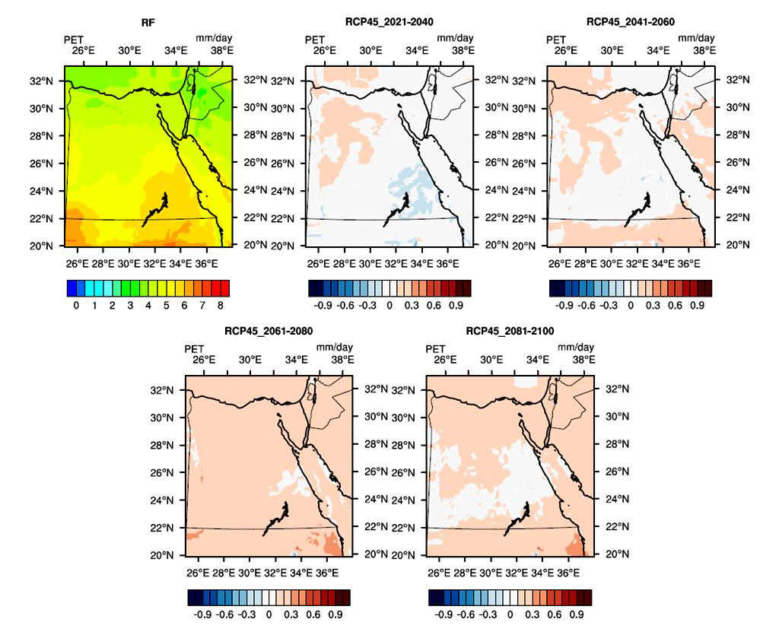
Average evapotranspiration (mm / day) over Egypt during 1986-2005 (RF) (a) and potential change during the period 2021-2040 (b), the period 2041-2060 (c), the period 2061-2080 (d), period 2081-2100 (e) according to the RCP4.5 scenario

Slide 11
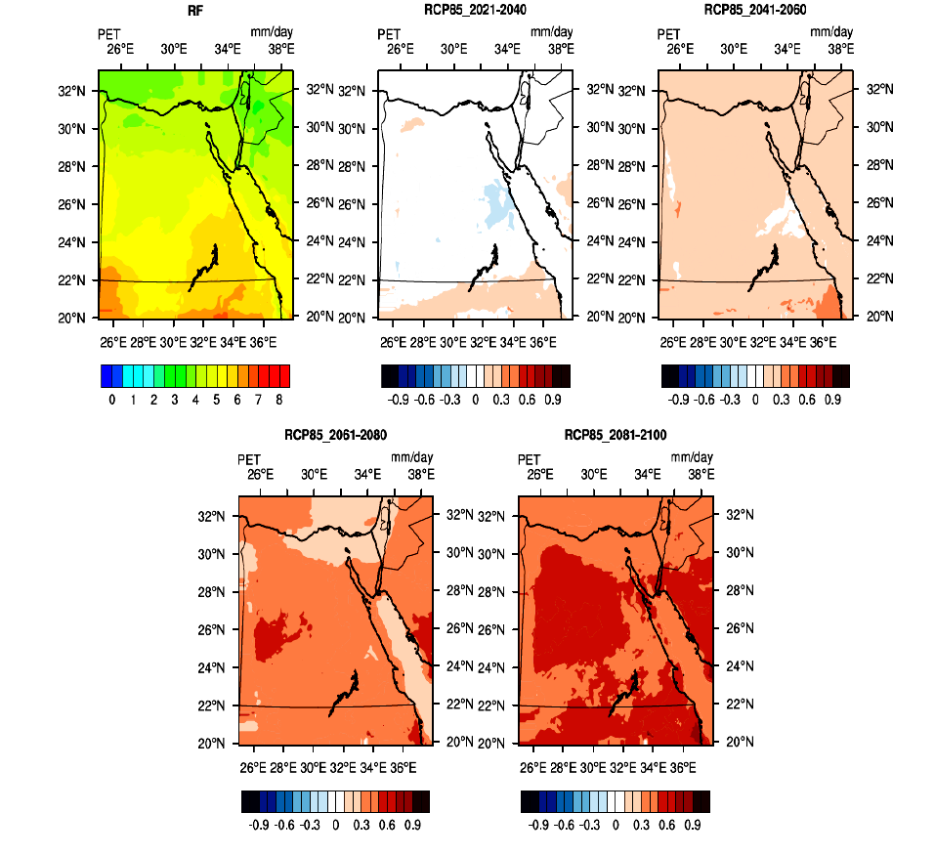
Average evapotranspiration (mm / day) over Egypt during 1986-2005 (RF) (a) and potential change during the period 2021-2040 (b), the period 2041-2060 (c), the period 2061-2080 (d), period 2081-2100 (e) according to the RCP8.5 scenario

Slide 12
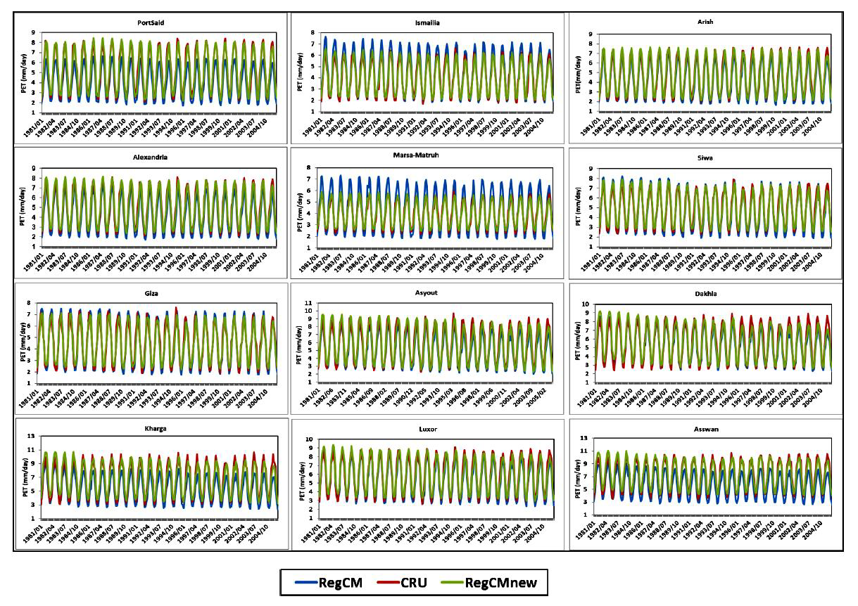
Monthly times series of Potential Evapotranspiration (PET; in mm/day) of by the RegCM4 in the historical period (1981-2005) of the twelve locations in comparison with the CRU product (in red), before applying the linear regression model (RegCM; in blue) and after applying the linear regression model (RegCMnew; in green)

Slide 13
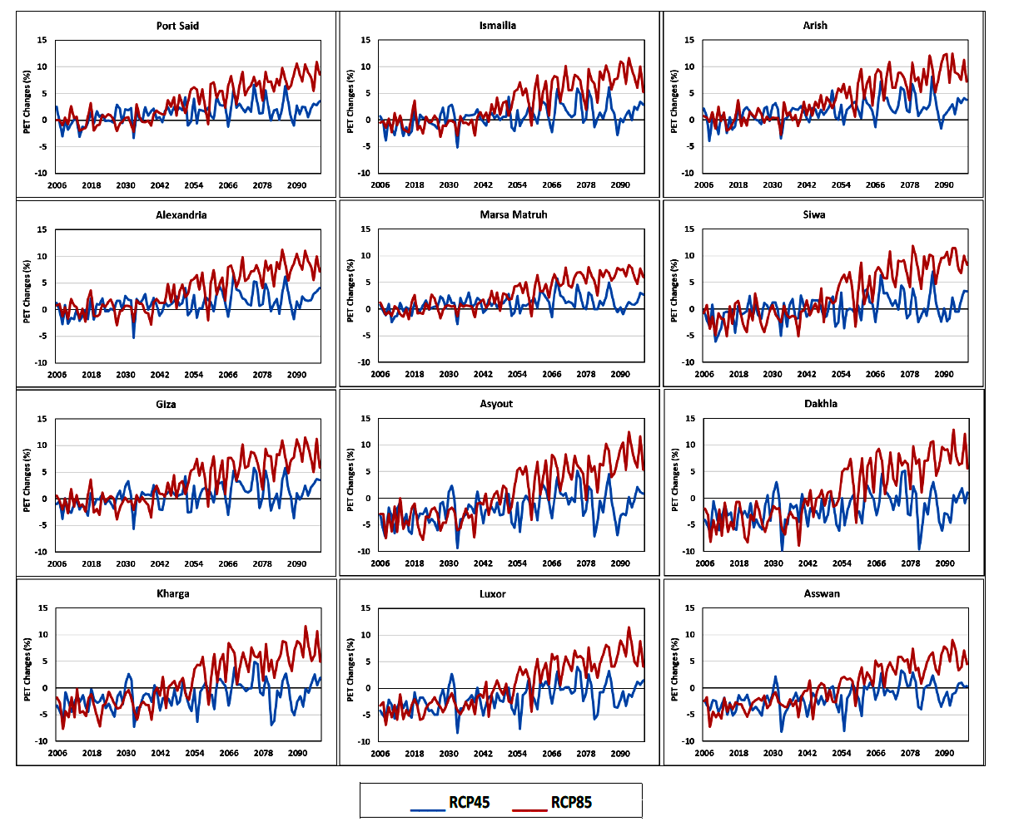
Future corrected PET changes (in %) under the two future scenarios (RCP45; in blue) and (RCP85; in red) for the twelve locations

Slide 14
Thank you, any questions???

