Slide 1
DEVELOPMENT AND TRAJECTORY OF HURRICANE ETA. CASE STUDY USING THE WRF MODEL WITH DYNAMIC UPDATE OF THE SEA SURFACE TEMPERATURE (SST).
¹Lic. Gretell Sosa Martínez. gretellsosa.1999@gmail.com
²PhD. Maibys Sierra Lorenzo. maibyssl@gmail.com
³MsC.Osniel Armas Forteza. leinsoarmas3@gmail.com
¹Department of Meteorology, Higher Institute of Technologies and Applied Sciences, University of Havana, Havana, Cuba.
²Center for Physics of the Atmosphere, Institute of Meteorology, Casablanca, 10900, Havana, Cuba.
³Forecast Center, Institute of Meteorology, Casablanca, 10900, Havana, Cuba.
The 5th International Electronic Conference on Atmospheric Sciences, ONLINE, 16-31 JULY 2022.

Slide 2
The 2020 Atlantic hurricane season recorded a record of 30 named tropical storms.
It was the sixth consecutive season with above-average stormy activity.
ETA:
Cuba
heavy cloudy areas
165 direct deaths
Central America Southern Mexico.
+100 missing persons
locally intense rains
gave rise to coastal and river flooding
Irregular Trajectory
Unusual Behavior
25.000 evacuations

Slide 3
Abstract:
This research aims to describe the synoptic and general circulation environment in which Eta developed using the ERA5 reanalysis; design experiments with the WRF model; and describe, from the numerical outputs, the meteorological conditions that influenced the two analyzed Eta life periods. When analyzing the maps of the ERA5 reanalysis system, a general underestimation of the wind speed during the analyzed periods was identified. The first moment was characterized by a system in the development phase that failed to intensify under the influence of a trough over the southeastern Gulf of Mexico that generated shear conditions that were maintained during the second moment. Through the experiments that were carried out with the WRF-SST and from the numerical outputs, it was possible to describe with greater precision the meteorological conditions that influenced the development, trajectory and intensity changes of Eta.
Keywords: tropical cyclone; Eta; re-analysis system; numerical model.

Slide 4
Introduction
It has been shown that the ocean-atmosphere interaction plays a fundamental role in the weather and climate variability, as well as the importance of considering this relationship in studies for the forecast of storms, wind on the coasts for their use as an energy resource and the forecast of atmospheric phenomena such as tropical cyclones (TC). The use of a dynamic ocean surface temperature introduces improvements in the atmospheric and oceanic representation obtained from models such as the WRF [1]. In addition, the coupling to an ocean model allows a more realistic representation of the ocean thermal field [2][3] as well as a good representation of the ocean and atmospheric processes that occur during a TC [4].
The need to delve into the complex mechanisms and factors that intervened in the genesis and development of this system, as well as the use of numerical weather modeling with dynamic updating of the sea surface temperature (SST) for its understanding, motivated the realization of this research, which aims to: describe the synoptic and general circulation environment in which Eta was developed using the ERA5 reanalysis; design experiments with the WRF model, for the simulation of the case study with greater spatial and temporal resolution; describe, based on the numerical outputs, the meteorological conditions that influenced the development and the change in intensity that Eta experienced between November 7 and 11, 2020, which will be divided into two moments.

Slide 5
WRF
ERA5
Materials and Methods
ARW
Dynamic Core
Global Climate Monitoring Tool
4.2.2
Reanalisys of the
Planet’s Global Climate
Initialized with GFS-analysis
Best possible understanding of past climate
Atmosferic Model Settings
What happened during a particular weather event and why
SisPI
9 km of resolution
Relate current and past weather events

Slide 6
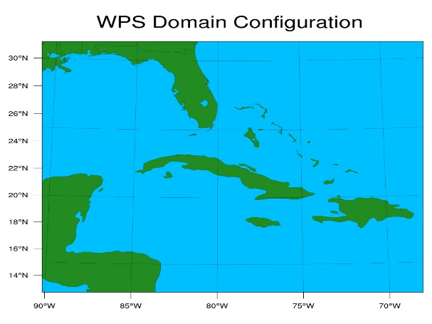
Simulation Domain used in the WRF model

Slide 7
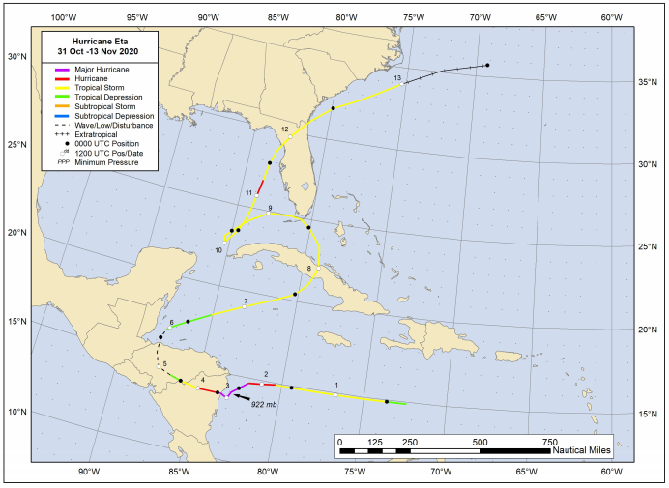
Results and Discussion
ETA:
Moments of interest:
First moment: November 7 to 8, 2020
Second moment: November 9 to 11, 2020

Slide 8
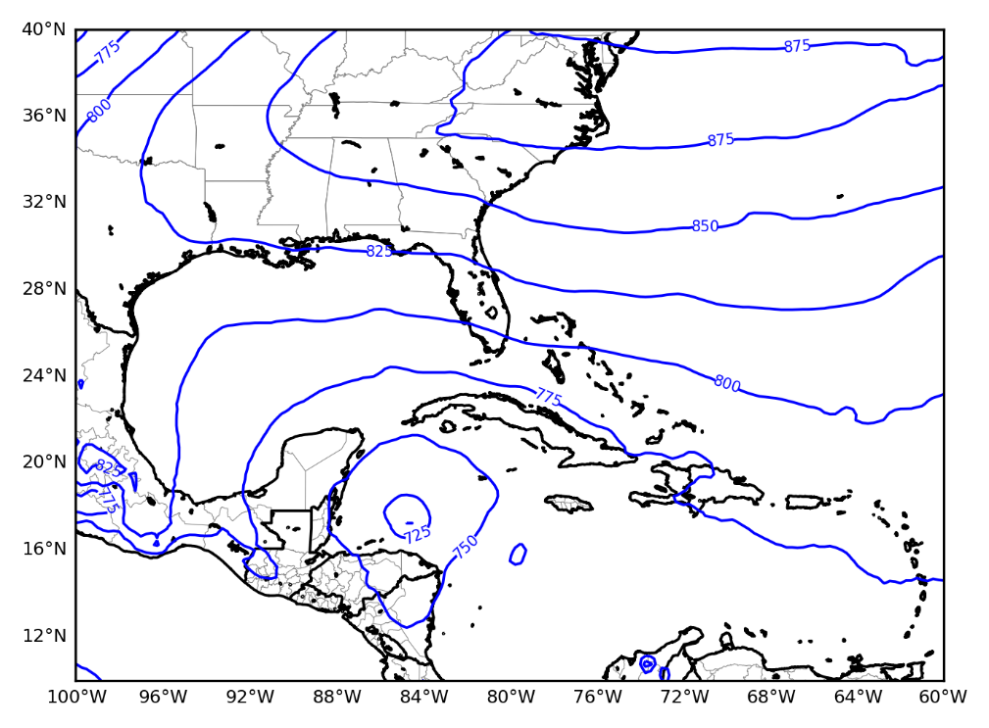
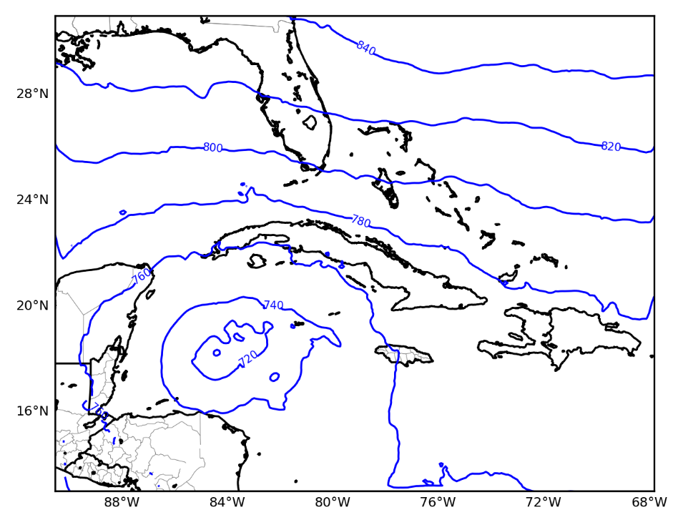
First moment: November 7 to 8, 2020
ERA5
WRF-SST
T
T
06:00 UTC November 7, 925hPa

Slide 9
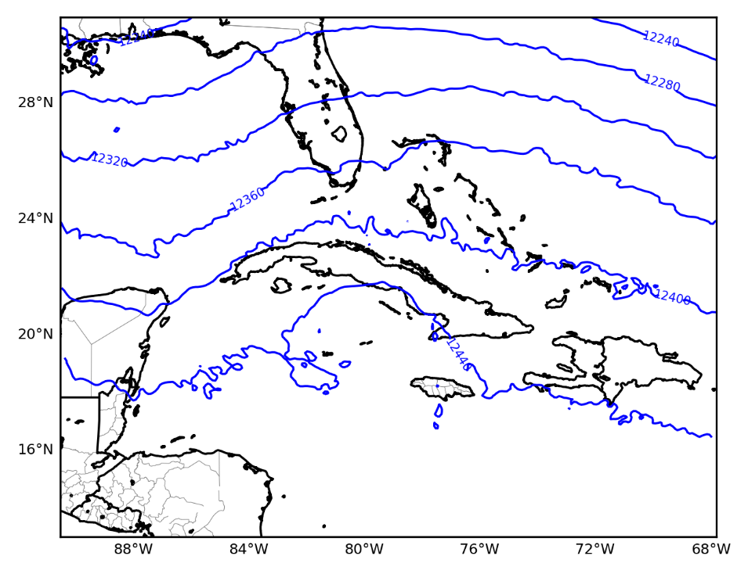
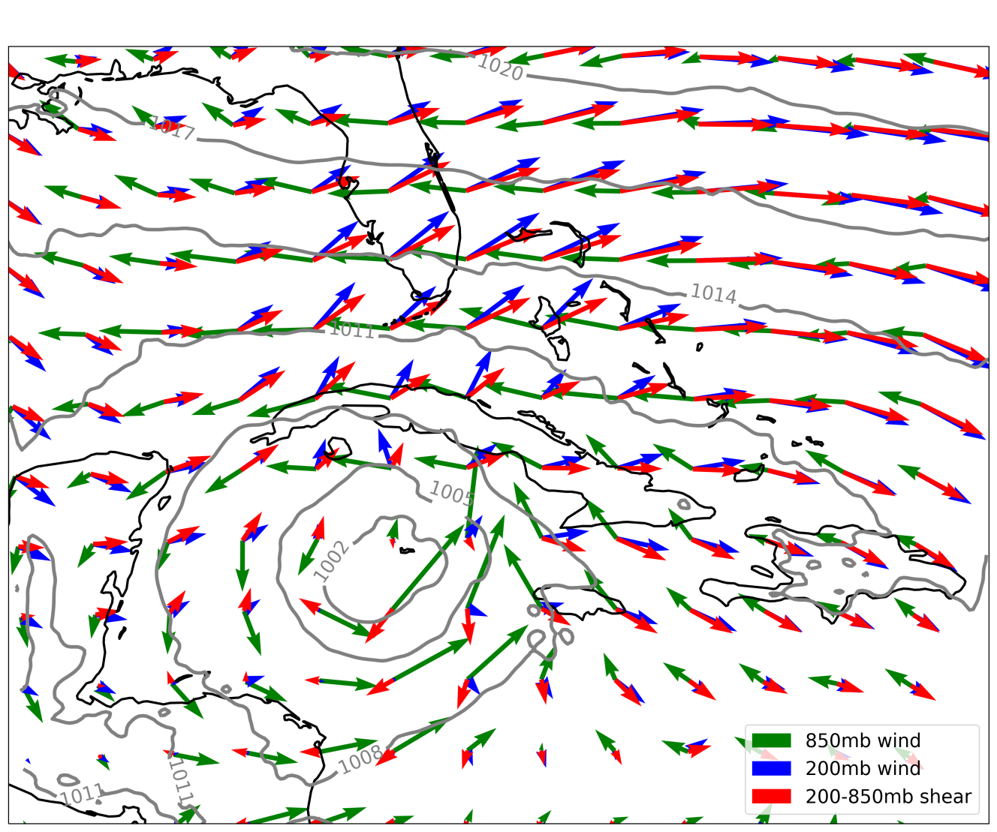
15:00 UTC November 7, 200hPa
WRF-SST
Generated a shealed environment on Eta
Introduced a third quadrant flow
Induced its northeast shift

Slide 10
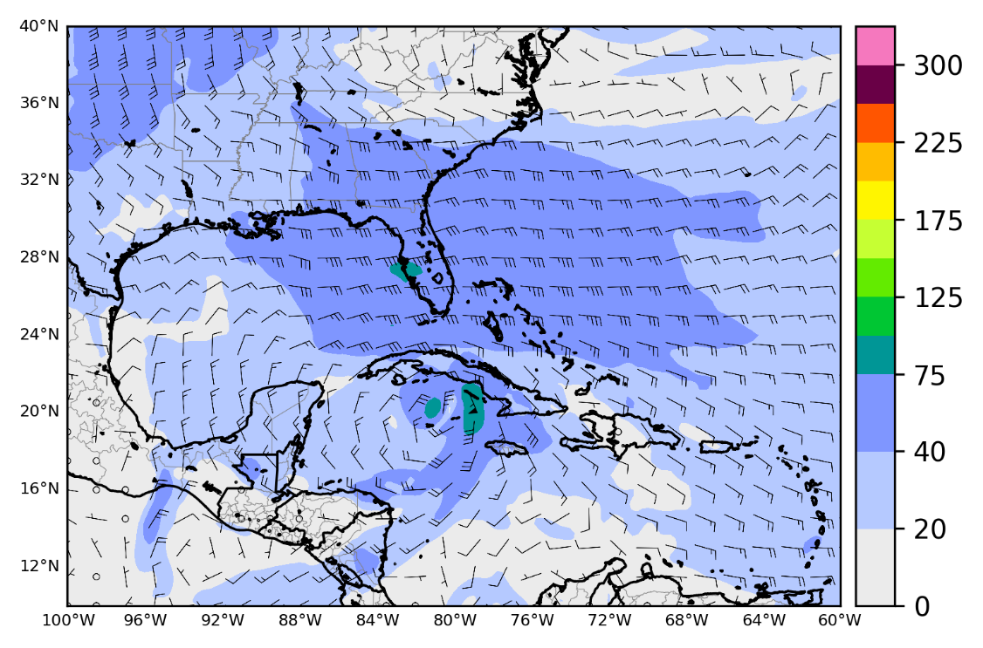
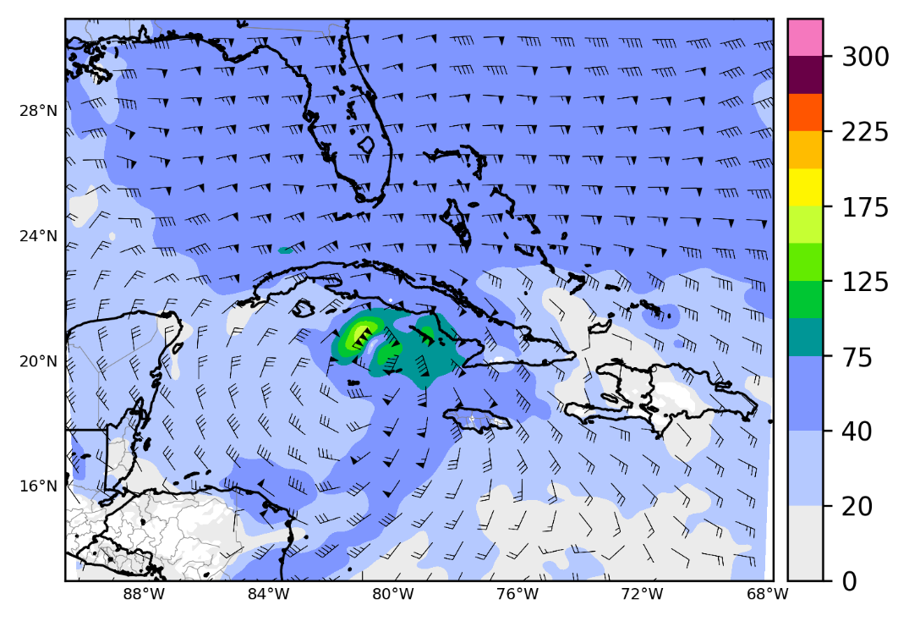
ERA5
WRF-SST
40-75 km/h
80-150 km/h
T
T
00:00 UTC November 8, 925hPa

Slide 11
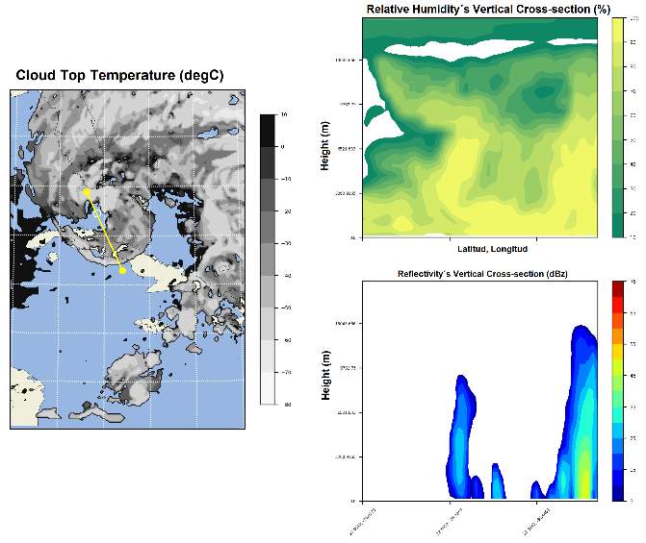
WRF-SST
Relative Humidity‘s Vertical Cross-section and Reflectivity
21:00 UTC of November 8
Notes:
Los menores valores de reflectividad se concentraron en el centro del sistema y los mayores valores en las bandas externas del mismo

Slide 12
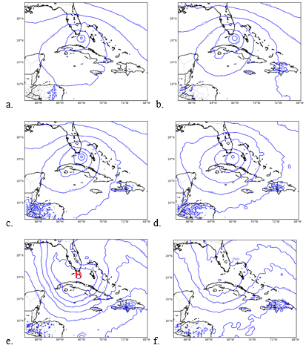
Second moment: November 9 to 11, 2020
WRF-SST Geopotential Height Maps of 9 November at 00:00 UTC in the levels: a) 925hPa, b) 825hPa, c) 700hPa, d) 500hPa, e) 300hPa y f) 200hPa.

Slide 13
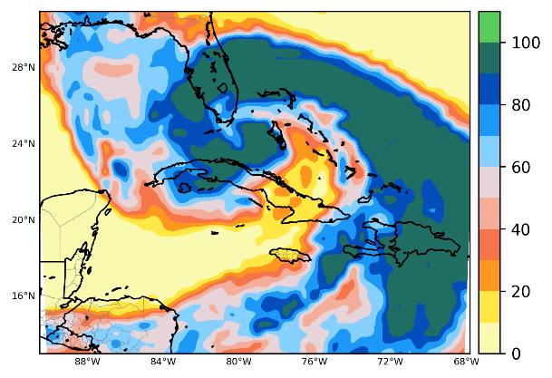
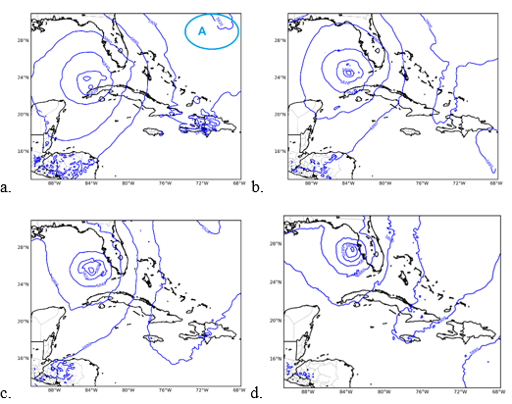
Second moment: November 9 to 11, 2020
Relative Humidity Map of November 9 at 00:00 UTC in 500hPa level.
Geopotential Height Maps of November 11, 2020 in 500hPa level at: a) 00:00 UTC, b) 06:00 UTC, c) 12:00 UTC y d) 21:00 UTC.

Slide 14
WRF-SST
Overestimates
The smallest errors
Underestimates

Slide 15
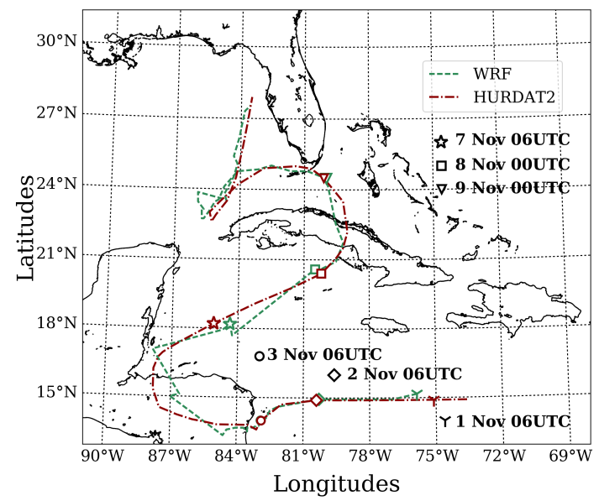
WRF-SST
The system made a very good estimation in general

Slide 16
Conclusions
1. When analyzing the maps of the ERA5 reanalysis system, a general underestimation of wind speed during the analyzed periods. The first moment was characterized by a system in the development phase that failed to intensify under the influence of a trough over the southeastern Gulf of Mexico that generated a sheared environment. These conditions were maintained during the second moment, when the organism described an erratic trajectory due to the fact that it was under the influence of weak directing currents, until it entered the flow of a ridge that led it to re-direct its trajectory towards the north.
2. Through the experiments that were carried out with the WRF-SST and from the numerical out-puts, it was possible to describe with greater precision the meteorological conditions that influenced the development, trajectory and intensity changes of Eta.

Slide 17
Conclusions
3. With the WRF-SST flow maps, an improvement was observed in terms of the estimation of wind speed and geopotential found in the ERA5 maps during the study periods. It was possible to specify, through the vertical cross sections, the behavior of the vertical wind speed, the reflectivity and the relative humidity in the vertical that allowed one to have a more realistic vision of the evolution of Eta.

Slide 18
DEVELOPMENT AND TRAJECTORY OF HURRICANE ETA. CASE STUDY USING THE WRF MODEL WITH DYNAMIC UPDATE OF THE SEA SURFACE TEMPERATURE (SST).
Thanks a lot!
¹Lic. Gretell Sosa Martínez. gretellsosa.1999@gmail.com
²PhD. Maibys Sierra Lorenzo. maibyssl@gmail.com
³MsC.Osniel Armas Forteza. leinsoarmas3@gmail.com
The 5th International Electronic Conference on Atmospheric Sciences, ONLINE, 16-31 JULY 2022.

