Slide 1
Particulate matter (PM_{2.5} ) concentration forecasting through an artificial neural network in port city environment
Bárbara a. macias-hernandez
Edgar Tello-Leal
Ulises m. Ramirez-Alcocer
Jaciel d. hernandez resendiz

Slide 2
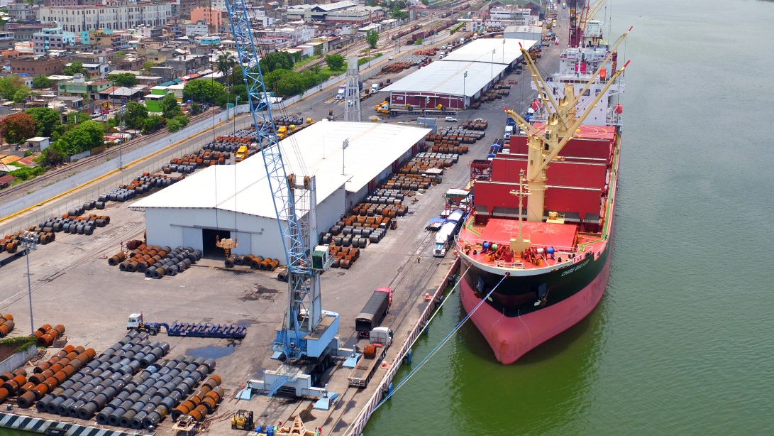
Introduction

Slide 3
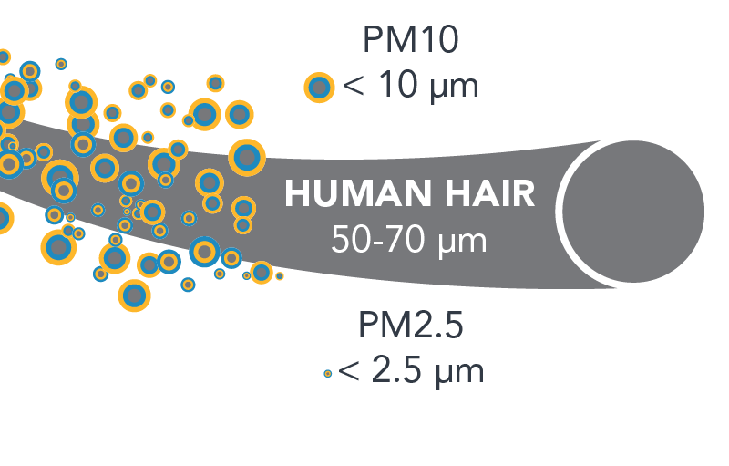
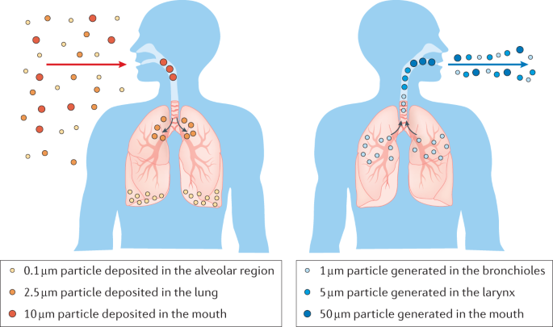
Particulate matter PM_{2.5}

Slide 4
objetive
This study aims to analyze maritime traffic's effect on air quality through multiple regression analysis using recurrent neural networks (RNN), allowing to forecast the daily concentration of PM_{2.5}.

Slide 5
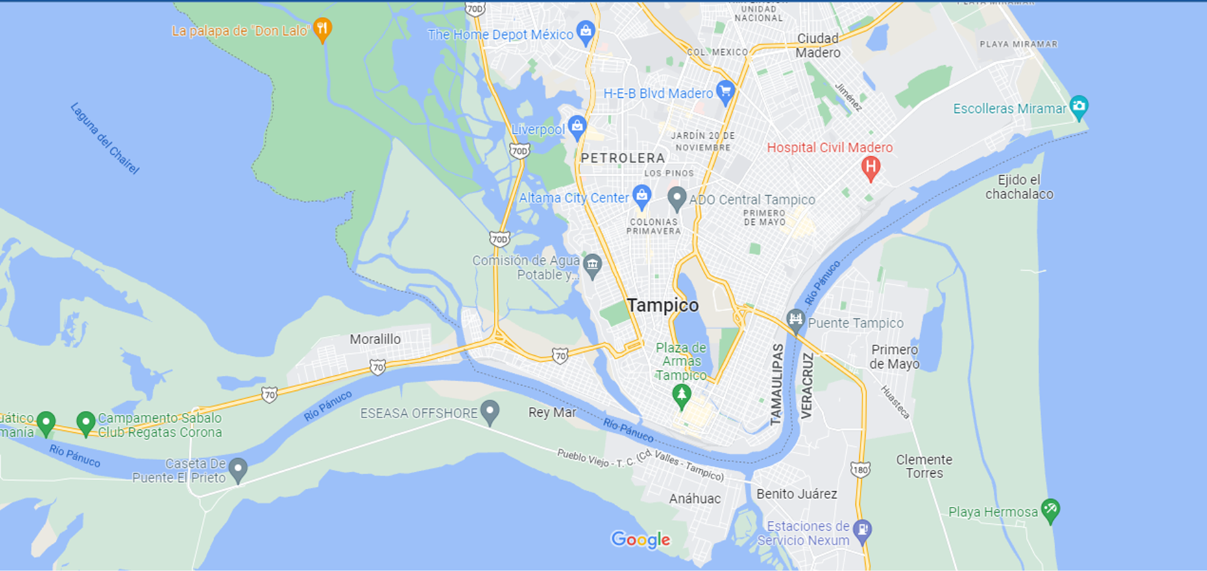
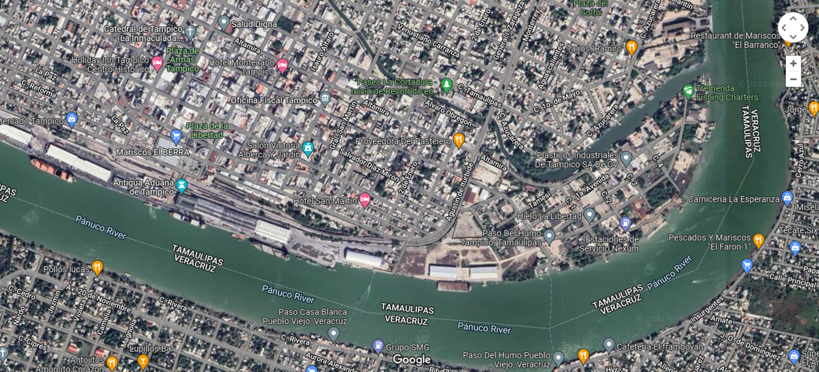
Study area

Slide 6
Descriptive Statistics Of Particulate Matter (PM₁, PM_{2.5} And PM₁₀) Monitored For A Period Of 9 Months in Tampico Tamaulipas In µg/m³
2021 | PM₁ (µg/m³) |  |  |  | PM_{2.5} (µg/m³) |  |  |  | PM₁₀ (µg/m³)
 | Median | IQR | Max | Min | Median | IQR | Max | Min | Median | IQR | Max | Min
May | 12.65 | 10.5 | 29.44 | 5.91 | 17.18 | 15.3 | 42.53 | 7.36 | 19.77 | 16.7 | 51.43 | 8.71
June | 9.4 | 4.95 | 26.98 | 1.91 | 12.01 | 6.83 | 39.66 | 2.5 | 15 | 8.21 | 48.39 | 3.47
July | 9.77 | 5.63 | 22.15 | 2.57 | 12.74 | 8.84 | 31.91 | 3.13 | 14.12 | 10.8 | 37.46 | 3.93
August | 10.58 | 4.03 | 26.83 | 3.52 | 13.59 | 6.15 | 39.7 | 4.27 | 15.25 | 6.71 | 48.06 | 5.1
September | 10.39 | 10.4 | 23 | 2.14 | 13.41 | 14.5 | 35.39 | 2.71 | 14.94 | 15.2 | 41.43 | 3.51
October | 10.79 | 8.41 | 31.16 | 3.4 | 13.39 | 13.1 | 46.44 | 4.63 | 14.95 | 15.1 | 56.94 | 6.08
November | 8.485 | 5.7 | 26.35 | 2.91 | 11.22 | 8.22 | 37.68 | 3.34 | 13.14 | 9.75 | 44.49 | 3.87
December | 17.06 | 8.65 | 34.6 | 4.57 | 24.56 | 14.1 | 51.97 | 5.93 | 29.35 | 18.1 | 63.36 | 7.7
January* | 12.77 | 8.55 | 24.92 | 3.23 | 17.58 | 13.3 | 35.62 | 3.93 | 21.45 | 16.1 | 42.29 | 4.7

Slide 7
Descriptive Statistics Of gases (CO and O₃) Monitored For A Period Of 9 Months Tampico Tamaulipas In µg/m³
 | CO (ppm) |  |  |  | O₃ (ppm)
 | Median | IQR | Max | Min | Median | IQR | Max | Min
May | 1.01 | 0.22 | 1.22 | 0.58 | 0.0200 | 0.0000 | 0.02 | 0.02
June | 1.25 | 0.27 | 1.66 | 0.48 | 0.0200 | 0.0000 | 0.02 | 0.01
July | 0.99 | 0.27 | 1.28 | 0.73 | 0.0200 | 0.0000 | 0.02 | 0.02
August | 1.32 | 0.2 | 1.87 | 0.99 | 0.0200 | 0.0000 | 0.02 | 0.02
September | 1.21 | 0.28 | 1.58 | 0.9 | 0.0200 | 0.0018 | 0.02 | 0.017
October | 1.21 | 0.19 | 1.41 | 1.05 | 0.0234 | 0.0034 | 0.03 | 0.0148
November | 1.45 | 0.16 | 1.68 | 1.13 | 0.0090 | 0.0021 | 0.02 | 0.0015
December | 1.45 | 0.1 | 1.61 | 1.21 | 0.0068 | 0.0035 | 0.0095 | 0.0001
January | 1.35 | 0.15 | 1.45 | 1.2 | 0.0100 | 0.0000 | 0.02 | 0.01

Slide 8
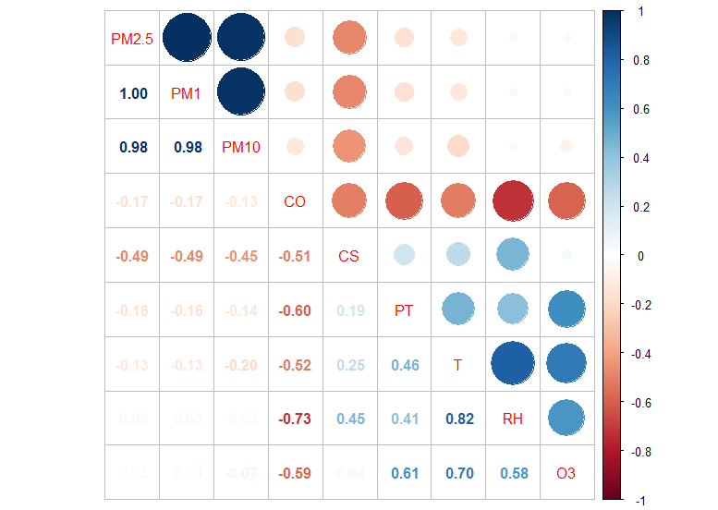
Correlation Matrix Or Air Pollutants, Meteorological Variables, And Daily Cargo Ship (CS) And Petrol Tankers (PT) Arrivals

Slide 9
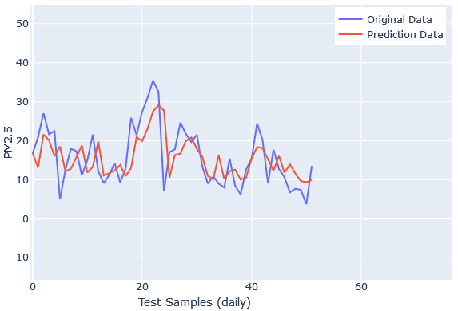
Prediction Accuracy Comparison Between Actual And Predicted Data (Blue Line: Original Values, Red Line: Predicted Values).

Slide 10
conclusions
Correlation coefficient analysis confirmed a very high relationship between the three types of particulate matter.
CO air pullutnat presents a high negative association with relative humidity.
Cargo ships show a moderate negative relationship with PM₁, PM_{2.5}, PM₁₀, and CO.
The petroleum tankers have a moderately negative relationship with CO (r=-0.60).
Linear regression analysis generated by the RNN prediction model obtains acceptable RMSE and MAE values.
High MAPE metric, the daily prediction of PM_{2.5} concentration should be considered with performance and accuracy moderate.

Slide 11
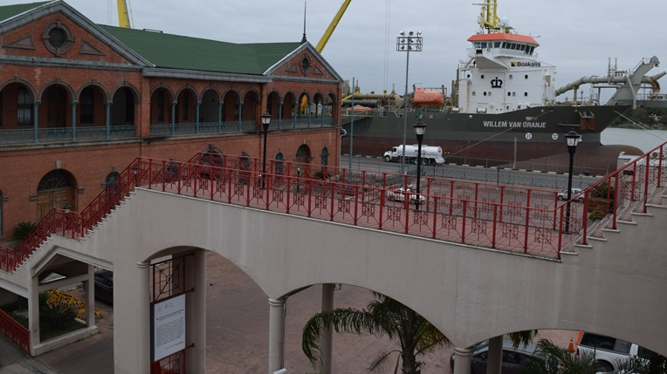
Questions

