Slide 1



A Critical View on the Partial Discharge Models for Various Electrical Machines’ Insulation Materials
D. Verginadis^{1*}, T. Iakovidis¹, A. Karlis¹, M. G. Danikas¹
Department of Electrical and Computer Engineering, Democritus University of Thrace, Xanthi, Greece
J. Antonino-Daviu²
Department of Electrical Engineering, Universitat Politècnica de València, Valencia, Spain
The 1st International Electronic Conference on Machines and Applications
Session: Machines Testing and Maintenance

Slide 2
Outline of the Presentation
Introduction
PDs on EMs
PD Models
  Capacitive Model
  Capacitive-Resistance Models
Simulations – Results
Discussion
Conclusions

Slide 3
Introduction (1/2)
Electrical Machines (EMs) and especially Synchronous Generators (SGs) play a vital role in energy production and in Industry.
Reliable, proper operation and maximum performance with the minimum maintenance are the qualities that should characterize an EM used in industry.
The component that plays the most significant role on the aforementioned characteristics is SG’s insulation system, which, most of the times, consists of a combination of Epoxy Resin (ER) and mica.

Slide 4
Introduction (2/2)
ER is characterized by:
  high mechanical strength and chemical resistance
  good physical and electrical properties
  resistance to moisture and radiation.
Mica has:
  low dielectric losses,
  good mechanical resistance, dielectric constant and thermal conductivity.
The combination of these two insulation materials creates very good insulation properties for SGs.

Slide 5
Partial Discharges on Electrical Machines
(1/2)
Partial Discharges (PDs) are electrical discharges, which partially bridge the insulation between conductors and they are both a symptom and a mechanism of insulation aging.
PDs are one of the most dangerous factors for contamination and degradation of the EMs’ insulation system.
PDs are both a symptom of insulation degradation and a way to investigate what is the condition of the EMs’ insulation system.
PD measurement (offline on online) on EMs (IEC 60034-27) uses coupling capacitors at the EM terminals and monitors the high frequency currents that flow through these capacitors.

Slide 6
Partial Discharges on Electrical Machines
(2/2)
Following figures were taken by a borescope inside a real SG’s stator and traces of PDs, serious damage and general insulation degradation are evident.
Visual Inspection 2009 Visual Inspection 2010

Slide 7
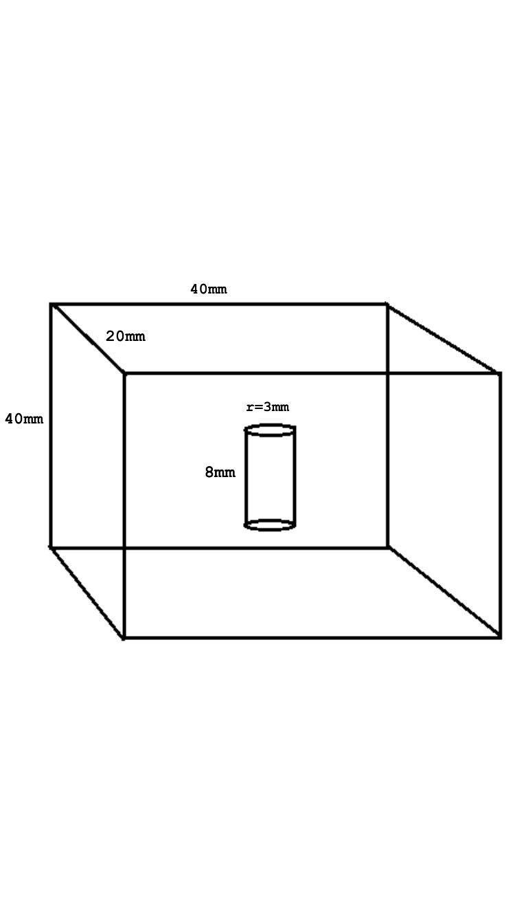
Simulation of PD Models
Simulations were made with:
  The test object of the figure
  Three different applied voltages (5 kV, 10 kV and 15 kV)
  Double radius and double height of the cylindrical void.
  Three different insulation materials:
    Epoxy Resin (Relative Permittivity = 3.6)
    Mica (Relative Permittivity = 5)
    Combination of these two insulation materials (Relative Permittivity is calculated by the following formula)

Slide 8

Combination of ER-Mica
where 𝑒𝑟1is the relative permittivity of mica, 𝑒𝑟2 is the relative permittivity of 28 ER, 𝑠1 is the width of mica and 𝑠2 is the width of ER.
ER and mica were supposed to cover the same volume of the test object.
The relative permittivity of the combination of these two insulation materials was calculated 𝑒𝑟3=4.12.

Slide 9
Capacitive Model (1/4)
AC High Voltage (HV) Source,
Resistor (𝑅1), which acts as a HV filter in order to reduce the noise of the source,
HV Measuring Capacitor (𝐶𝑚=1000 𝑝𝐹) and Coupling Capacitor (𝐶𝑘=8 1000 𝜇𝐹), which are used in order to capture the displacement current created during PD,
Measuring Impedance (MI) RLC (𝑅𝑚=50 𝛺,𝐶𝑚=0.45 𝜇𝐹 𝑎𝑛𝑑 𝐿𝑚=0.60 𝑚𝐻) in order to collect PD signals and
Three Capacitors (𝐶𝑎, 𝐶𝑏, 𝐶𝑐), whose values depend on the insulation material

Slide 10
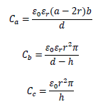
Capacitive Model (2/4)
where 𝜀0 is the dielectric constant in vacuum, 𝜀𝑟 is the relative permittivity (dielectric constant) of the insulating material, α is the length, b is the weight and d is the height of the test object, r is the radius, and h is the height of the void. It must be noted that 𝐶𝑐 is the capacitance of the void in the solid material, 𝐶𝑏 is the capacitance of the insulation material connected to the void and 𝐶𝑎 is the capacitance of the remaining insulation.

Slide 11
Capacitive Model (3/4)
PD Activity - ER (a) 5 kV, (b) 5 kV - double radius.
PD Activity - Mica (a) 10 kV, (b) 10 kV - double height.
PD Activity - Combination (a) 15 kV, (b) 15 kV - double radius.

Slide 12
Capacitive Model (4/4)
It is obvious in all figures that when the applied voltage increases, the number of PDs increases.
When the geometry of the void increases, the PD activity increases.
Mica seems to present more PDs and smaller maximum PD amplitude compared to the two other insulation materials.
ER has shown the fewest number of PDs.
The combination of the two materials seems to present the lowest number of PDs.

Slide 13
Capacitive-Resistance Model (1/4)
This PD model is an advanced capacitive model, because resistors were placed opposite the three capacitors.
The three resistors indicate the resistance of the insulation material and were added in order to have a more detailed representation of the insulation material, because geometric dimensions, relative permeability and specific volumetric resistance are taking into account.

Slide 14
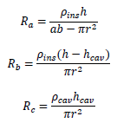
Capacitive-Resistance Model (2/4)
The three resistances are calculated by:
where 𝜌𝑖𝑛𝑠 is the electrical resistivity of solid insulation (10^(15) 𝛺𝑚) and 𝜌𝑐𝑎𝑣 is the electri-18 cal resistivity of the air cavity (10^(15) 𝛺𝑚).

Slide 15
Capacitive-Resistance Model (3/4)
PD Activity - ER (a) 5 kV, (b) 5 kV - double radius.
PD Activity - Mica (a) 10 kV, (b) 10 kV - double height.
PD Activity - Combination (a) 15 kV, (b) 15 kV - double radius.

Slide 16
Capacitive-Resistance Model (4/4)
The increase of the applied voltage leads to the increase of the PD activity.
The diagrams with double radius or/and double height, show that when the volume of the void increases, the number of PDs increases.
The combination of the two materials seems to achieve the best results
ER presents the fewest number of PDs.
Mica the smaller maximum PD amplitude.

Slide 17
Discussion (1/2)
The 2nd model presents more accurate diagrams thanks to the use of the resistances.
The simulation parameters were the same for the PD models; same applied voltages, same void geometries and same insulation materials. This was selected so that the results could be compared. The above results apply to all simulations of each model used in the present work.
The results presented are a small sample of all the simulations made.

Slide 18
Discussion (2/2)
The results show that PD activity increases when the applied voltage and the volume of the void increases.
The number of PDs in ER’s and mica’s simulations increase more when the radius becomes bigger rather than when the height increases.
The insulation material that seems to have better behavior is the combination ER-Mica, since it presents a reduction of the number of PDs in most of the simulations.

Slide 19
Conclusions
Different geometries of a cylindrical void and different applied voltages were used in order to investigate how ER, mica and the combination of these two materials were affected through two different PD models.
As for future work, simulations with different PD models, applied voltages and void geometries would be useful. These simulations can be combined with experiments or real PD measurements to adjust or improve the model and determine in a better way the condition of the insulation system.

Slide 20

Questions
For questions, please contact dvergina@ee.duth.gr and we will answer your questions as soon as possible.

Slide 21
Thank you very much for your time and your attention!

