Slide 1
The Influence of Silicon Carbide Abrasive on Machining of Ti-6Al-4V by AWJ
Lisa Dekster¹, Nikolaos E. Karkalos², Ryszard Machnik¹, Panagiotis Karmiris-Obratański^{1,2},Emmanouil L. Papazoglou² and Angelos P. Markopoulos²
¹ AGH University of Science and Technology, Faculty of Mechanical Engineering and Robotics, Department of Manufacturing Systems, al. Mickiewicza 30, 30-059 Cracow, Poland
² National Technical University of Athens, School of Mechanical Engineering, Laboratory of Manufacturing Technology, Heroon Polytechniou 9, 15780, Athens, Greece.
1st International Electronic Conference on Machines and Applications

Slide 2
Abrasive waterjet - Introduction
AWJ technology was developed to improve cutting abilities of the pure waterjet (PWJ)
This method allows cutting both brittle and ductile materials including hard-to-machine objects
No thermal impact on workpiece materials
High versatility, small machining force and high flexibility

Slide 3
Experimental procedure

Slide 4
Experimental procedure
Machine: H. G. RIDDER Automatisierungs-GmbH model HWE-P 1520
Workpiece material: Ti6Al4V
Abrasive material: SiC (mesh size 60)
Process parameters:
Jet pressure: 150 [MPa]
Traverse feed rate: 500-900 [mm/min]
Abrasive mass flow rate: 2-8 [g/s]
Stand-off distance: 1-5 [mm]
Diameter nozzle: 1[mm]

Slide 5
Experimental procedure - Measurements
Fig. 1. Measurements of depth and angle of one of the grooves
Fig. 1. Measurements of width of one of the grooves

Slide 6
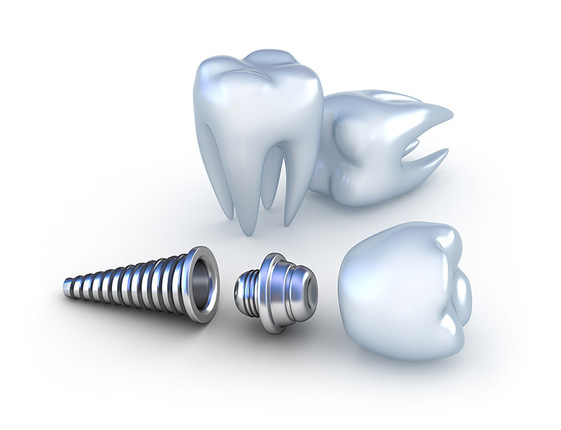
Workpiece material properties – Ti6Al4V
PROPERTIES
High strength
Low weight ratio
Outstanding corrosion resistance
APPLICATIONS
Biomedical implants
Aerospace components
Cryogenic applications
Offshore equipment
TYPICAL CHEMICAL SPECIFICATIONS
Al | 6%
V | 4%
C | 0.03%
Fe | 0.1%
O | 0.1%
N | 0.01%
H | <0.003%
Ti | Balance
BASIC MECHANICAL PROPERTIES
Modulus of Elasticity | 120 GPa
Yield Strength | 930 MPa
Ultimate tensile Strength | 970 MPa

Slide 7
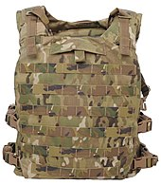
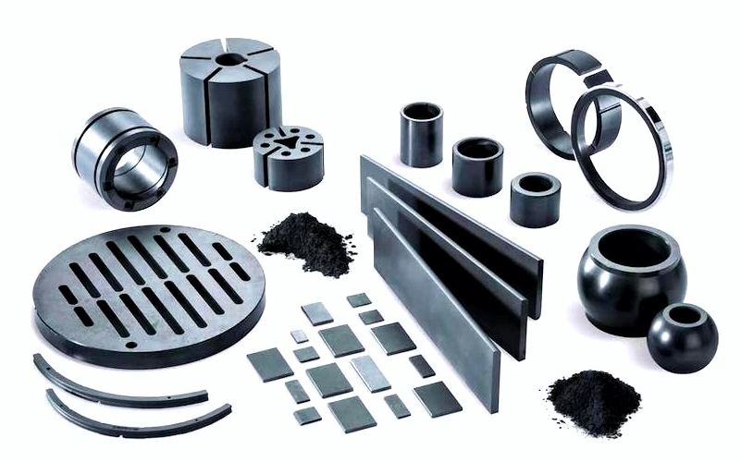
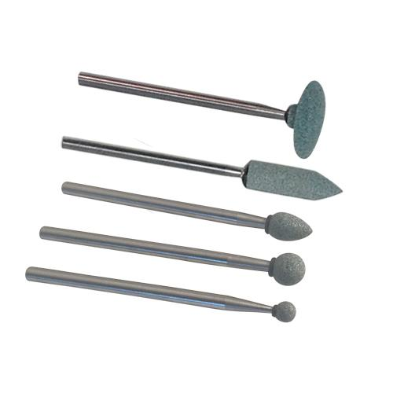
Abrasive material properties - SiC
PROPERTIES
Low density
High strength
High hardness, rigidity and wear resistance
High sublimation temperature
Highly inert chemically
APPLICATIONS
Abrasive and cutting tools
Structural material
Automobile parts
Electric systems
BASIC MECHANICAL PROPERTIES
Elastic Modulus | 410 GPa
Fracture toughness | 4.6 MPa m^{1/2}
Vickers hardness | 2800 Kg/mm²

Slide 8
Experimental results
Traverse feed rate [mm/min] | Abrasive mass flow rate [g/s] | Stand-off distance [mm] | Depth [µm] | Top kerf width [µm] | Kerf taper angle [deg.] | MRR [mm³/min]
500 | 2 | 1 | 877.480 | 1146.492 | 10.22 | 433.603
500 | 5 | 3 | 1726.720 | 1277.933 | 11.81 | 791.605
500 | 8 | 5 | 1994.743 | 1472.832 | 10.77 | 1090.523
700 | 2 | 3 | 558.177 | 1269.773 | 27.72 | 381.532
700 | 5 | 5 | 1278.603 | 1429.195 | 14.73 | 978.298
700 | 8 | 1 | 1639.627 | 1199.443 | 8.03 | 1111.164
900 | 2 | 5 | 478.093 | 1468.102 | 38.00 | 470.978
900 | 5 | 1 | 909.307 | 1199.140 | 10.62 | 841.814
900 | 8 | 3 | 1331.270 | 1363.540 | 15.96 | 1177.547

Slide 9
Experimental results
Relation between traverse feed rate and grooves depth and top kerf width
Relation between traverse feed rate and kerf taper angle

Slide 10
Experimental results
Relation between abrasive mass flow rate and grooves’ depth and top kerf width
Relation between abrasive mass flow rate and kerf taper angle

Slide 11
Experimental results
Relation between stand-off distance and grooves’ depth and top kerf width
Relation between stand-off distance and kerf taper angle

Slide 12
Conclusions
Silicon carbide as an abrasive can be used in the abrasive waterjet machining process, but its hardness should be taken into account when choosing a nozzle.
The most significant parameters to control the penetration depth are abrasive mass flow rate, which allows obtaining deeper geometries when it is increased (~70%) and traverse feed rate, which causes intensive deepening of grooves when it is decreased (~45%).
The accurate input parameter to control the top kerf width of the slots is stand-off distance, which caused grooves to widen by around 20% when increased to the maximum value.
Parameters which have a significant influence on the depth of the grooves also cause changes in the kerf taper angle. The deeper the grooves are, the sharper the angle becomes. Moreover, with an increase in the stand-off distance, the kerf taper angle increases by 53%.
Productivity of the machining process, expressed by MRR, is shown to be most affected by abrasive mass flow rate, whereas traverse flow rate and stand-off distance were found to be less significant within the selected parameter range.

