Slide 1
Study on the Regulation of Brain Structure and Cognition Function in Different Sports Patterns
Hao Tongtong，He Ying

Slide 2
01
Background
02
Objective
03
Methods
04
Results

Slide 3
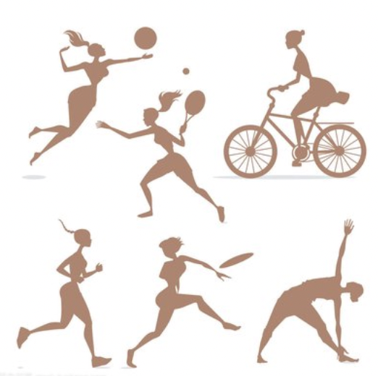
Background
After the age of 20, the brain's high-level functions, such as working memory and control inhibition ability, decline year by year. This decline is usually associated with the atrophy of the brain's structure, such as the lateral prefrontal cortex and hippocampus. The present study indicates that physical activity can improve brain cognition by influencing the level of neurotransmitters in the body and delaying the atrophy of certain functional regions.

Slide 4
Objective
In this paper, we discuss the relation of different sports and brain structure and function, analyze the classification of aerobic, anaerobic-anaerobically and coordinating sports, and discuss the benefits of sports intervention from the view of functional MRI, neuroendocrine and event related potential.
Aerobic fitness
Anaerobic fitness exercise
Coordinated fitness
Increase blood flow in brain functional areas and promote brain-derived nerves
Promote the production of brain-derived neurotrophic factor
Improve
Brain structure:
(1) The physical fitness level was positively correlated with the volume of hippocampus, prefrontal lobe and basal nucleus;
(2) Exercise can increase the volume of hippocampus, prefrontal lobe and basal nucleus or inhibit the volume atrophy
Executive function:
Fitness exercise can improve the inhibitory control, working memory and cognitive conversion of children, adults, healthy elderly and elderly with cognitive impairment.
Neuroelectrophysiology (EEG/ERP):
Fitness exercise has a positive effect on the activation of the prefrontal cortex, EEG and event related potential in children, adults and the elderly.

Slide 5
Innovation
(1) From the perspective of the mechanism, this paper systematically combs the regulatory effects and differences of different exercise modes on brain structure and cognitive function, so that researchers can comprehened and systematically understand the relationship between exercise and brain structure and cognition;
(2) This paper expounds the regulating effects of different exercise modes of the brain structure and cognitive function of the elderly, children, depression, Parkinson's disease and other special populations.

Slide 6
Methods
Through a large number of literature collection, the words "exercise, sport, cognitive function, brain plastic" and other words, were searched in the web of science, PubMed, CNKI Chinese databases, and the relevant inclusion criteria were established based on research requirements, and the final document was screened.

Slide 7
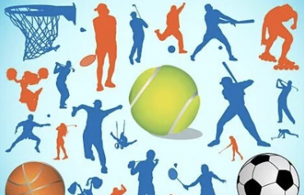
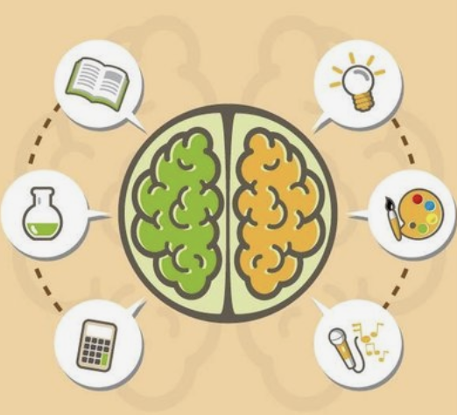
Results
① The volume of hippocampal gyrus, prefrontal lobe and basal ganglia of athletes with high physical fitness level or regular physical activity was larger; ② Physical activity has a positive relationship with cognitive function related to brain structure. ③ Sports activities can promote the executive function of healthy people at different ages, children and elderly people with cognitive impairment. The above changes may be related to the increase of blood volume in brain functional areas and insulin-like growth factor endocrine substances promoted by sports activities.Physical activity can enhance the performance of healthy people in different age groups, children and elderly with cognitive impairment.These changes might be associated with the increase of cerebral function area and the promotion of insulin-like growth factor secretion by exercise.

Slide 8
Thanks！

