Slide 2
LoRaWAN Network Coverage Analysis in the Transportation Sector: A Real-World Approach
Julius Schinschke and Andreas Schmietendorf
9th International Electronic Conference on Sensors and Applications (ECSA-9)

Slide 3
Introduction
LoRaWANs are an emerging technology for transmitting (IoT) data from sensors to applications
There are two main advantages:
The distance between transmitter and reciever
The low power consumption

Slide 4
Goal of the work
Since the networks in Germany are mainly driven by private individuals or companies using LoRaWAN, there is no complete coverage
Therefore, an analysis of the coverage is performed, which mainly concerns the needs of the transportation sector
A real-world approach is achieved by building a special measurement module that mimics a prototyping process
After measurements have been taken throughout Germany, the data collected are evaluated in this context

Slide 5
Measurement Methods
Takes place in two networks: The Things Network- / Industries (TTN/TTI) and The Peoples Network (TPN)
Measurement along German railroad lines
From inside the train
Along the German ICE-Network
Module should attempt to continuously send GNSS data over LoRaWAN to a backend application at short intervals
Interval is based on the EU regulation on the time on air to 1%
SF10, 13 bytes payload, and 125 kHz bandwidth resulted in airtime of approx. 411ms → 1 min interval is chosen

Slide 6
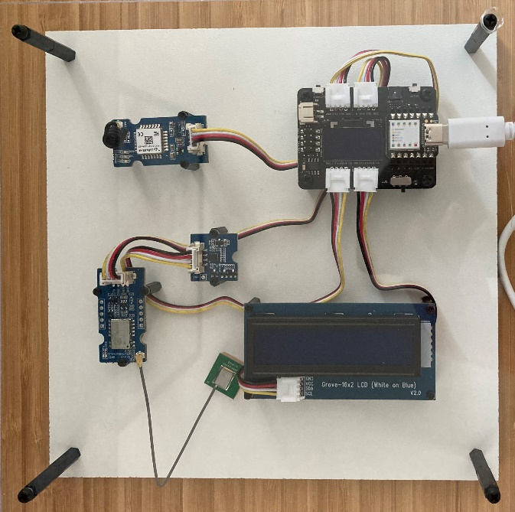
Measurement Modules
During the experiment, two measurement modules are built, as a need for improvement was identified
Module A (see Fig. 1)
Microcontroller incl. Expansion Board
LoRaWAN Module incl. antenna
Accelerometer
GNSS-Sensor incl. patch antenna
LC-Display
Module A problems:
GNSS reception and reallocation in trains
Especially in ICE trains, there was no reception in the car
2
1
3
4
5
Figure 1: Module A

Slide 7
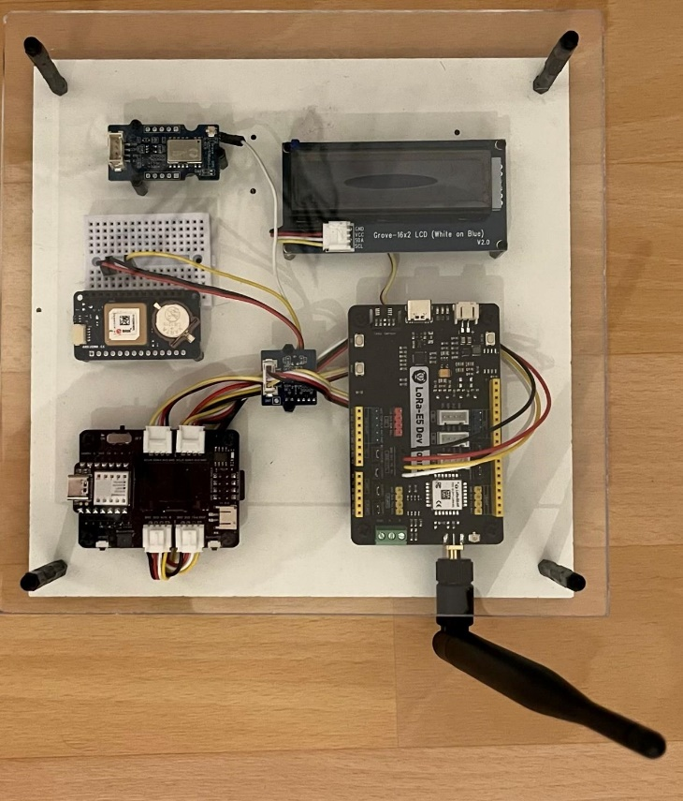
Measurement Modules
Revised Module B (see Fig. 2)
Microcontroller incl. Expansion Board
new LoRaWAN Module incl. antenna
Accelerometer
new GNSS-Sensor incl. patch antenna
LC-Display
Fallback GNSS-Sensor
6
5
4
3
1
2
Figure 2: Module A

Slide 8
Measurement Route
The route was redefined two times according to test measurements
The final route driven is shown in Table 1 (TTN/TTI)
Route is based on the German ICE network
Date | Start | Over | Destination
07/18/22 | Berlin | Magdeburg – Erfurt – Halle | Erfurt
07/19/22 | Erfurt | Nuremberg - Wuerzburg | Frankfurt/Main
07/20/22 | Frankfurt/Main | Mannheim – Colgone – Hagen | Cologne
07/21/22 | Cologne | Bonn – Muenster – Dortmund - Hamm | Muenster
07/22/22 | Muenster | Bremen – Hamburg – Luebeck | Hamburg
Table 1

Slide 9
Measurement Route
Table 2 shows the final route for TPN
2 parts are nearly the same with TTN/TTI (Frankfurt – Nuremberg, and Nuremberg – Halle)
Date | Start | Over | Destination
08/01/22 | Berlin | Wolfsburg – Kassel – Fulda | Frankfurt/Main
08/04/22 | Frankfurt/Main | Wuerzburg | Nuremberg
08/07/22 | Nuremberg | Erfurt – Halle | Berlin
Table 2

Slide 10
Results
After validation:
509 valid measurement points in TTN/TTI
154 valid measurement points in TPN
Each point is displayed on a map with a corresponding RSSI (see Fig. 3 a/b)

Slide 11
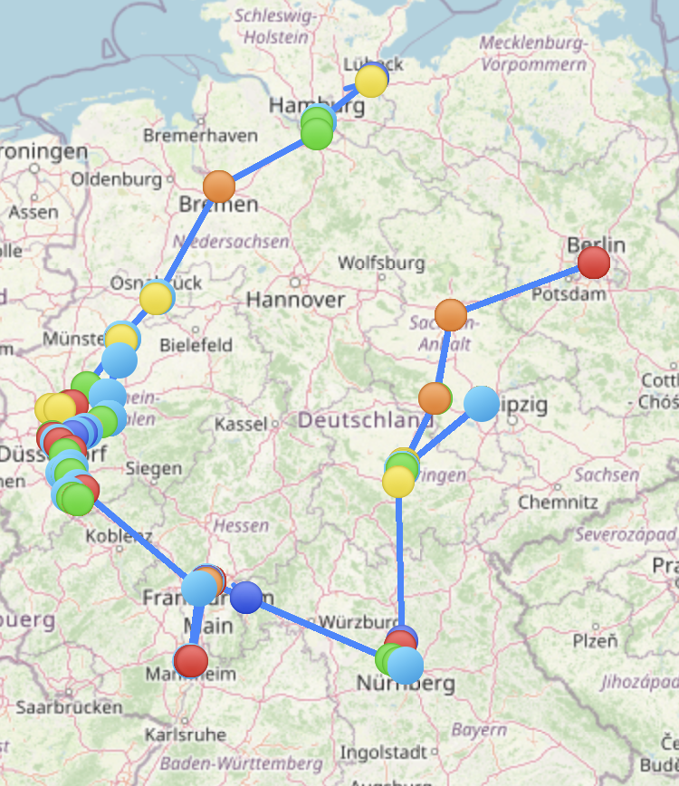
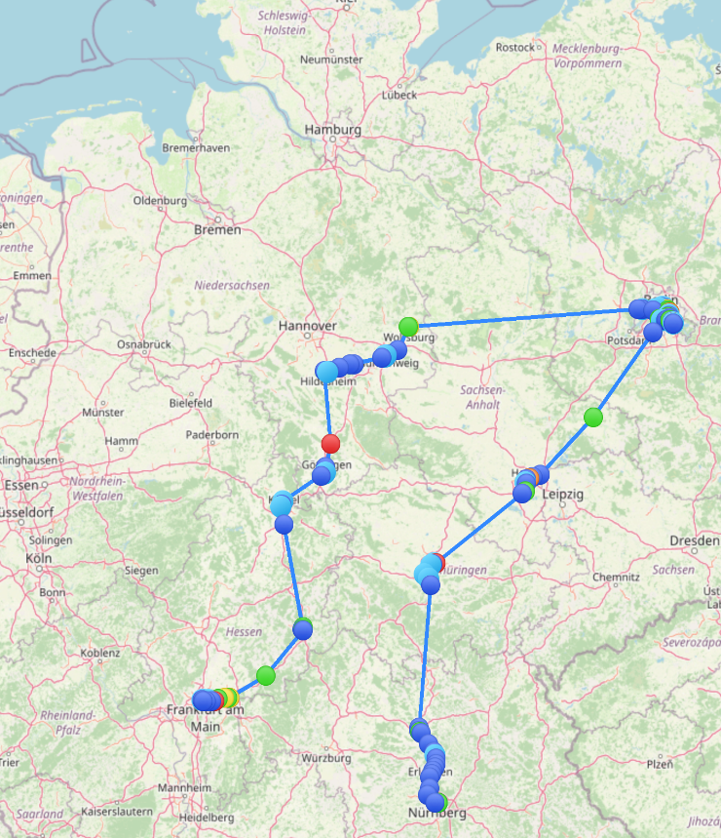
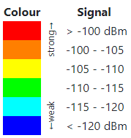
Results
Figure 3 (a): TTN/TTI Coverage
Figure 3 (b): TPN Coverage

Slide 12
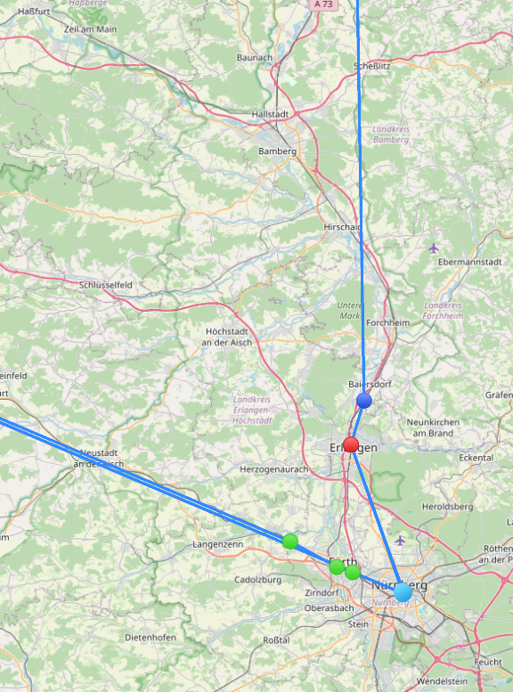
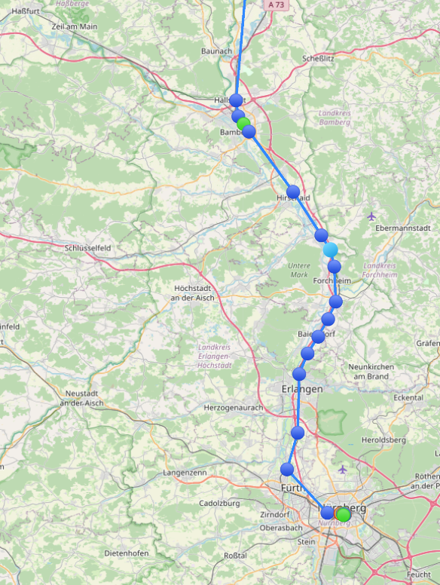
Results
Better coverage in TPN in some regions (Figure 4 a/b)
Figure 4 (a): TTN/TTI Coverage
Figure 4 (b): TPN Coverage

Slide 13
Results
The drop in measurement points by speed is also greater in TTN/TTI (Figure 5 a/b)
Figure 5 (a): TTN/TTI and TPN (in %) measuring points by min. speed
Figure 5 (b): TTN/TTI and TPN (in total) measuring points by min. speed

Slide 14
Discussion
In general, there is no wide-area coverage in both networks as Fig. 3 illustrates
The better coverage in TPN could be related to the larger number of gateways
That is supported by a higher number of measurement points with higher speeds (> 10 km/h) (see Fig. 5 b)
In TTN/TTI only a few points are measured with a bad signal, whereas in TPN a lot (see Fig. 3 a/b)

Slide 15
Discussion
LoRaWAN for live monitoring (eg. 5-minute updates) e.g. trucks or trains is not applicable
Geofencing would be a solution
Transmition would be limited to covered areas
Transmit attempts in uncovered areas would be avoided
Another option would be campus supply for uncovered regions
In combination with geofencing, it could provide a low-cost LoRaWAN connectivity solution

Slide 16
Limitations
Only the spreading factor (SF) 10 was used and sent with the highest possible power
Maybe in some situations with a bad signal, SF12 would perhaps bring better results
Problems with the measurement module occurred in both networks
In TTN/TTI some transmitted data was not received despite coverage after startup, a firmware reinstall fixed the problem
In TPN, there was a total failure between Frankfurt/Main and Nuremberg

Slide 17
Conclusion
LoRaWAN coverage appears mostly in urban areas
Live monitoring from long-distance transportation is not applicable
Geofencing and/or campus coverage could be a solution
For a specific use case, the measurements should be repeated with parameters adapted to the use case

Slide 18
Thank you.

