Slide 1

A Wireless Inductor- Capacitor Sensor For Glucose Detection
Hong Li, Haibo Xu, Shiru Lin, Yi Jia
10-08-2022

Slide 2
Outline
Introduction
Materials and Methods
Results and Discussions
Conclusions
References

Slide 3
Introduction
Second generation ---- non-physiological mediator (ferrocenes, ferricyanide, etc.)
Performance were interfered by the environment such as temperature, humidity of the electrode surface

Slide 4
Introduction
Four generations of glucose biosensors:
First generation ---- natural oxygen as mediator → hydrogen peroxide
The sensor performance depends on the amount of natural oxygen in the blood samples
Require a high operation potential

Slide 5
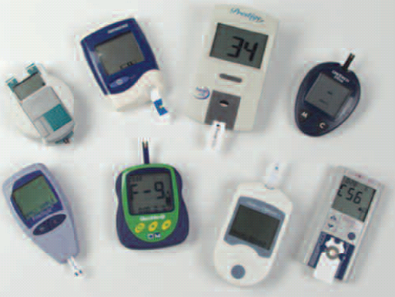
Introduction
Third generation ---- mediator eliminated
---- based on charge-trasnfer complexes
Limited by the environment and the dependency of enzyme’s activity
Notes:
Only a few enzymes have been proved to exhibit direct electron transfer at normal electrodes surfaces
5

Slide 6
Introduction
Forth generation ---- nonenzymatic glucose (NEG) sensors ---- electrodes made from metals, composites, carbon micro- or nano- materials etc.
Advantages of stability, simplicity, reproducibility, free from oxygen limitation
---- Promising for future applications
Notes:
the NEGs utilize elsectrodes made from
metals, composites, carbon micro- or nano- materials etc, embodied as nanotubes,
nanoparticles, porous films, or modified surfaces.
6

Slide 7
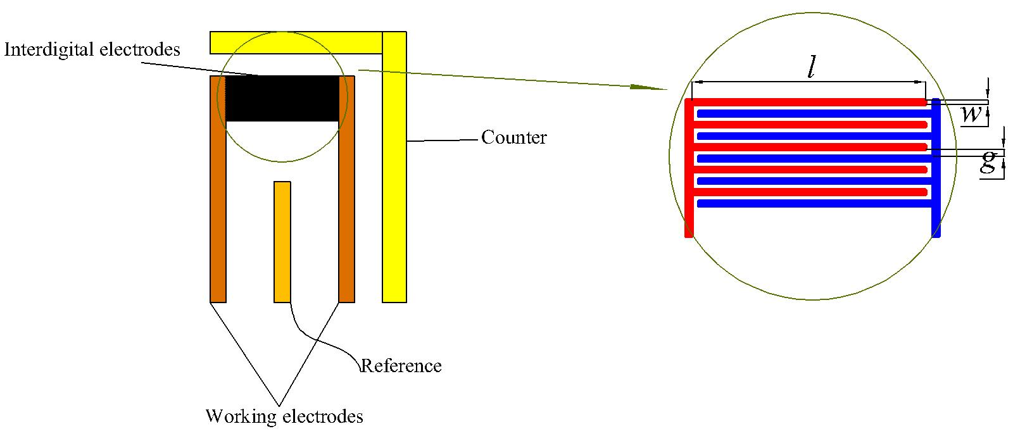
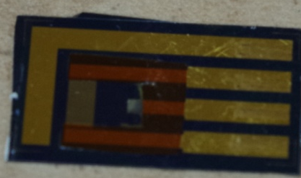
Materials and Methods
Capacitor
Inductor
LC sensor
Glucose Solution: 41.7g/dL Glucose tolerance beverage + Distilled water

Slide 8
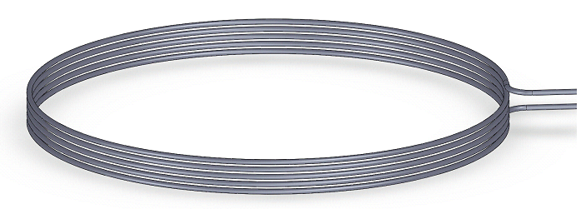
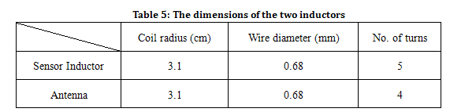
Materials and Methods
Inductor Configuration

Slide 9
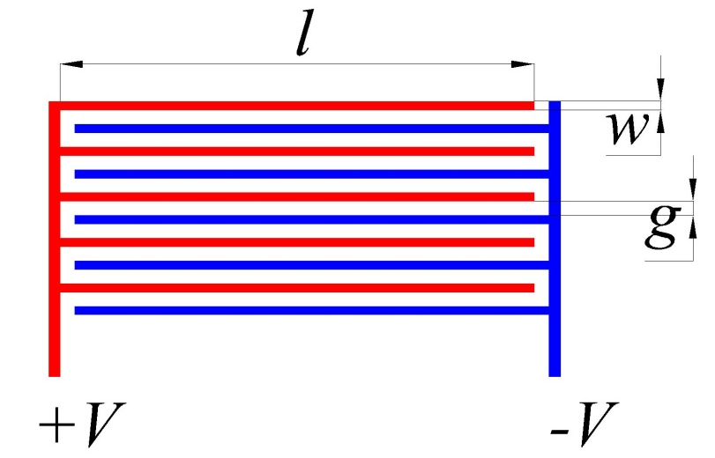
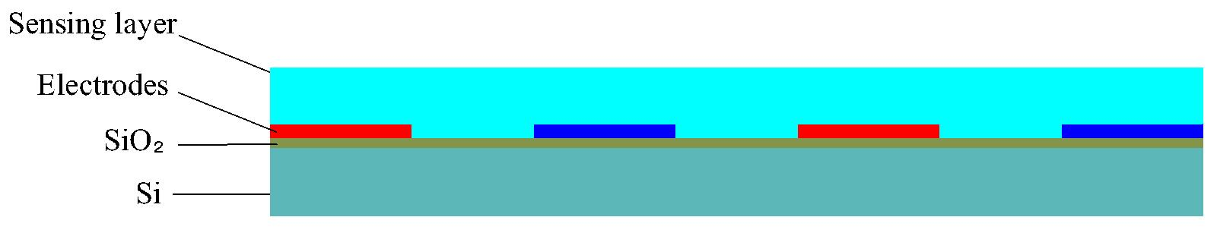
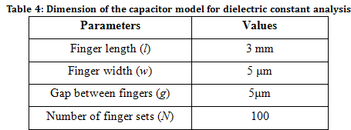
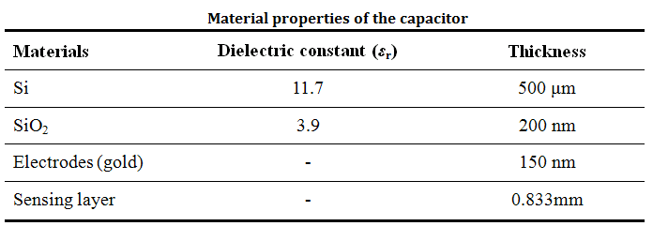
Materials and Methods
Capacitor Configuration

Slide 10
Results and Discussions
Sensor response
Frequency and Impedance response of the sensor to glucose concentration

Slide 11
Results and Discussions
Glucose beverage proportion: 0 – 44%
The resonance frequency: 1.9217 MHz to 1.8681 MHz
The exponential regression for resonance frequency:
Average regression error: 1.38%

Slide 12
Results and Discussions
Glucose beverage proportion: 0 – 44%
The impedance: 170.33 Ω to 110.68 Ω
Exponential regression for impedance:
Average regression error: 3.47%

Slide 13
Results and Discussions
Glucose beverage proportion: 0 - 4%
Sensitivity: 424.6 kHz and 721.6416 Ω
Linear Regression (r²=0.9853 and 0.9553 respectively)

Slide 14
Results and Discussions
Stability
N = 10
Standard deviation: 8.1466e-04 MHz and 0.367 Ω respectively

Slide 15
Conclusions
Summary : This paper presented a wireless passive sensor for glucose detection. The resonance frequency and impedance modulus both show good correlation and high stability to the glucose beverage solution with concentration from 0 to 44%
Future work: Selectivity of the sensor should be further studied

Slide 16
References
[1] Weibel, M.K.; Bright, H.J. The glucose oxidase mechanism. Interpretation of the pH dependence. J. Biol. Chem. 1971, 246, 2734-2744
[2] Eun-Hyung Yoo and Soo-Youn Lee, Glucose Biosensors: An Overview of Use in Clinical Practice. Sensors 2010, 10, 4558-4576
[3] Z. Zhu, L.G. Gancedo, A.J. Flewitt, H. Xie, F. Moussy, W.I. Milne, Sensors 12 (2012) 5996
[4] Kun Tian, Megan Prestgard, and Ashutosh Tiwari, A review of recent advances in nonenzymatic glucose sensors. Materials Schience and Engineering C 41 (2014) 100-118
[5] Kalpana Settu, Ching-Jung Chen, Jen-Tsai Liu, etc. Impedimetric method for measuring ultra-low E. coli concentrations in human urine, Biosensors and Bioelectronics 66 (2015) 244-250
[6]Tin Christopher Hang, Anthony Guiseppi-Elie, Frequency dependent and surface characterization of DNA immobilization and hybridization, Biosensors and Bioelectronics, 19 (2004) 1537- 1548
[7]Ming-Zhi Yang, Ching-Liang Dai and Cheng-Bei Hung, Fabrication of a glucose sensor with oscillator circuit using CMOS-MEMS technique. Microelectronic Engineering 97 (2012): 353–356
[8]Nam-Young Kim, Kishor Kumar Adhikari, Rajendra Dhakal et al., Rapid, Sensitive, and Reusable Detection of Glucose by a Robust Radiofrequency Integrated Passive Device Biosensor Chip. www.nature.com, Scientific Reports 5, No. 7807, 2015
[9] Zhixing Zhang, Panita Maturavongsadit, Junyi Shang et al., A dielectric affinity glucose microsensor using hydrogel-functionalized coplanar electrodes. Microfluid Nanofluidics. 21(5):93. doi: 10.1007/s10404-017-1926-3. Epub 2017

