Slide 1
Integrating Internet of Things (IoT) in Cultural Game Authoring Tool: An Innovative Approach in Maker Education
Pedagogical Innovations in Maker Movement
Mostafa Osama Mostafa Abdulrazic,
University of Nottingham Malaysia
The 9th International Electronic Conference on Sensors and Applications 2022

Slide 2
Overview
Cultural inclusion has become an important factor as countries have become diverse globally.
For interesting the young individuals about cultural heritage, innovative approach needs to be employed .
Hence, this research focuses on integrating Internet-of-Things (IoT) in a serious 3D game authoring tool.
However, initial research needs to be conducted to find appropriate way of integrating IoT in the game authoring tool and the effective ways of doing so.

Slide 3
Methodology
Participants initially played a short cultural game focusing on the history of Malacca where IoT was integrated as Radio-Frequency-Identification (RFID) cards for performing trading, or simple actions within the game. Game snippets are below.
Afterwards, the participants tried to design a short scene using the serious 3D game authoring tool.
Then they required to fill up a survey to demonstrate their interest in integrating IoT in the game authoring tool and how they would like it.

Slide 4
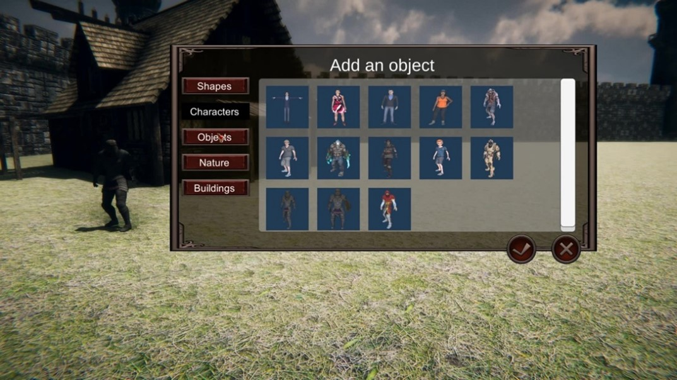
Methodology
The ease of interaction of the game authoring tool was evaluated. The participants used the prototype to make an example scene as shown.

Slide 5
Survey Questions
Q1: Do you think cultural game authoring tool will help people share cultural heritage in an immersive way?
Q2: Do you think integrating IoT in the form of RFID cards in this cultural game authoring tool would be engaging?
Q3: Did you enjoy making a short game scene with the game authoring tool?
Q4: Would you like to use RFID cards as a form of IoT integration in your cultural game?
Q5: Would you want to use the RFID cards for performing actions in the game?
Q6: While designing your own game scene, did you find the game authoring tool hard to use?

Slide 6
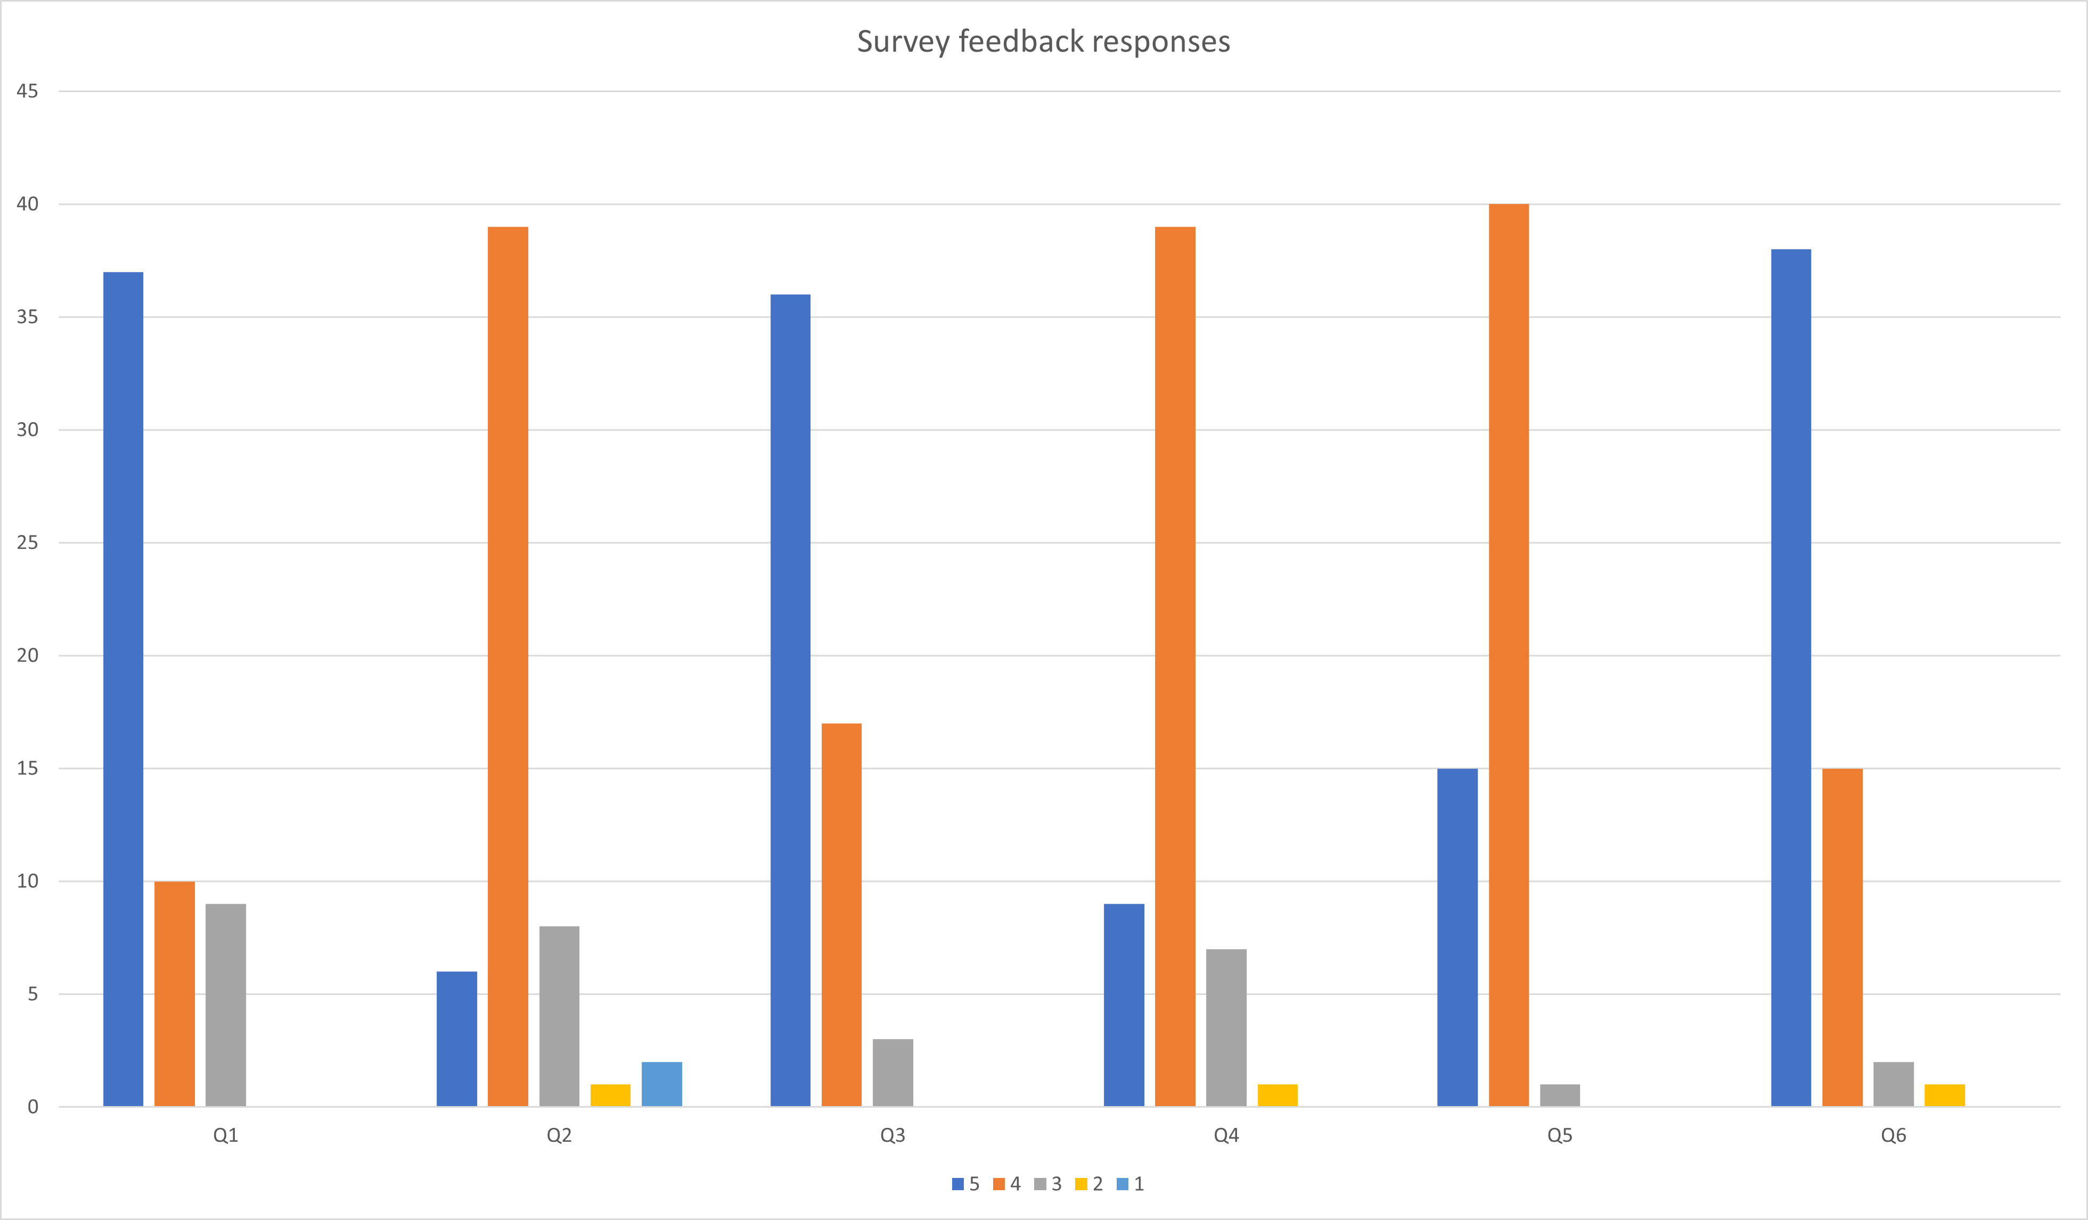
Survey
The participants were young individuals aged 11-15 years old.
Most of them found the game authoring tool easy-to –use and mentioned that this form of immersive cultural heritage storytelling or sharing is beneficial and interesting.
However, from the study, it can be concluded that integrating IoT in the serious 3D game authoring tool is not a necessity but it can be simply integrated for more participant involvement.

Slide 7
Thank you!

