Slide 1
ID- Sciform-063977
Enlarging the NSAIDs Family: Molecular Docking of Designed Pyrazole and Oxadiazole Derivatives as Novel
Anti-Inflammatory Agents
V. M. Patil*¹, H. N. More¹
¹Department of Pharmaceutical Chemistry,
Bharati Vidyapeeth College of Pharmacy, Kolhapur (affiliated to Shivaji University, Kolhapur), Maharashtra, India.
*E-mail: vipulpatil1230@gmail.com
The 2nd International Electronic Conference on Biomolecules: Biomacromolecules and the Modern World Challenges (IECBM);
Session:- Biomolecules: Proteins
1st to 15th November 2022

Slide 2
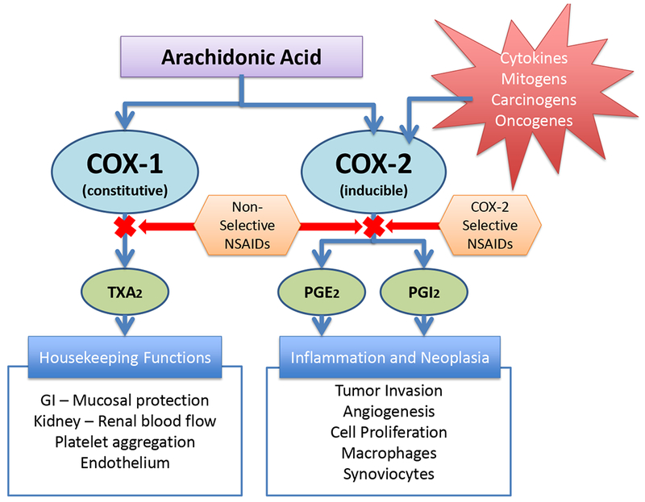
Background:
The development of the NSAID family represented in the treatment of inflammatory disorders, such as arthritis, and for the management of acute pains, concerning to the well-known traditional Non-Steroidal Anti-inflammatory Drugs (t-NSAIDs).

Slide 3
Cyclooxygenase (COX) and lipoxygenase (LOX) pathways takes primary role in inflammation and has responsible for many human diseases, like cancer, arthritis, psoriasis, and neurological disorders.
Prompted by the pursuit for new cyclooxygenase-2 (COX-2) inhibitors, we have identified novel classes of pyrazole and oxadiazole derivatives as potentially powerful anti-inflammatory molecules through the molecular docking approach.
Goal of this Research:
In the present study, various derivatives (ligands) of pyrazole and oxadiazole were prepared and virtually docked against the protein biomolecule 1CX2 which is a potential anti-inflammatory receptor.

Slide 4
Experimental Methods:
Protein and ligand preparation:
Selection of protein : 3D Crystal structure of cyclooxygenase-II with PDB: 1CX2 having 3.00 Å resolution; RCSB Protein data bank (https://www.rcsb.org/)
Processing of protein : PROCHECK tool to determine the quality of protein; binding pocket was predicted using CASTp3.0 server
Preparation of ligand : Designed using ChemSketch and imported into BIOVIA Discovery Studio (DS) 2020 to optimize. Around 253 pyrazole and oxadiazole derivatives were prepared.
Molecular docking analysis : AutoDock Vina package of PyRx 0.8 software.
Ligands were subjected to energy minimization and then converted to PDBQT format using the Open Babel plugin of PyRx. Docking interaction visualization and analysis of poseweres carried out using the BIOVIA DS 2020.

Slide 5
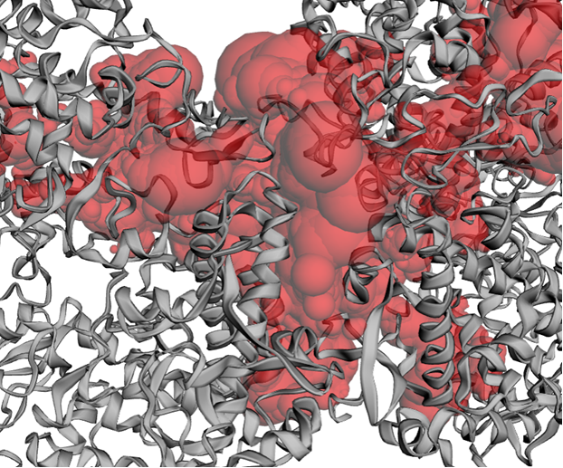
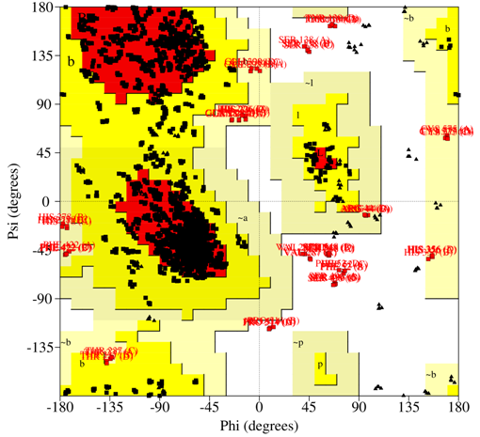
Results and discussion:
Protein and ligand preparation:
Selection & processing of protein : 3D Crystal structure of cyclooxygenase-II with PDB: 1CX2 was selected for the analysis and processed to find out the binding pocket in the protein structure.
Fig 1.Binding pocket (red) present in 1CX2. Fig 2. Ramachandran plot of the aromatase (1CX2)
showing 76.3% residues in the favored region.

Slide 6
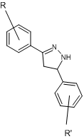
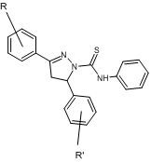
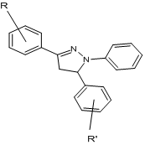
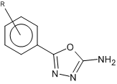
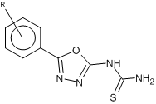
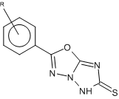
Preparation of ligand :
Around 223 pyrazole (D, E & F series) and 30 oxadiazole (VM1, VM2, VM3 series) derivatives were prepared virtually in 2D, converted to 3D and aligned to minimize the energy.
D series (76) E series (76) F series (71)
VM1 series (10) VM2 series (10) VM3 series (10)

Slide 7
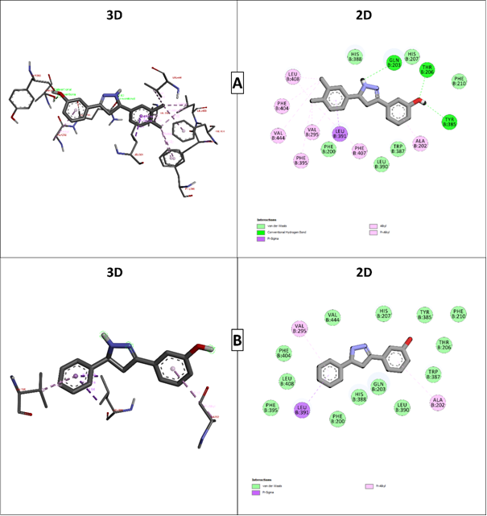
Molecular docking analysis : AutoDock Vina package of PyRx 0.8 software.
The binding affinity of synthesized compounds with targeted protein ranged from -6.7 to -10.7 kcal/mol. Among all ligands, D305 and D202 showed a higher binding affinity of -10.1 to -10.7 kcal/mol.
Fig 3. 2D and 3D interaction of comp. D305 with cyclooxygenase 2 (PDB: 1CX2)

Slide 8
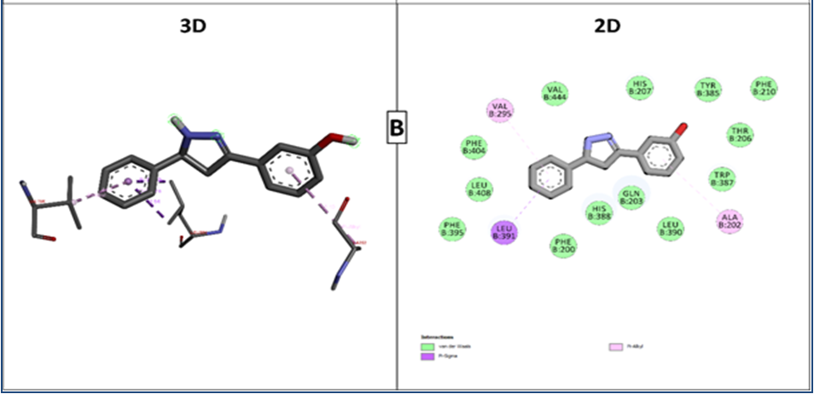
Fig 4. 2D and 3D interaction of comp. D202 with cyclooxygenase 2 (PDB: 1CX2)
Receptor protein and ligand binding interaction study:
The interaction of 6 and 7 with amino acid residues of 1CX2 such as GLN203, THR206, TYR38, LEU391, LEU408, PHE404, VAL444, VAL295, PHE395, PHE407, ALA202, HIS388, HIS207, PHE210, TRP387, LEU390, and PHE200 and the Conventional H bond, van der Waals, Π-Alkyl, and Π-Donor H bond are the bonds formed between interacting residues and ligands.

Slide 9
Conclusion:
The molecular docking simulation was done by PyRx, which is immensely useful for predicting and confirming the binding behavior of ligands as an anti-inflammatory agent against cyclooxygenase-II protein.
Designed compounds were virtually screened against cyclooxygenase-II (PDB: 1CX2). It was observed that all selected ligands have a good binding affinity with cyclooxygenase-II(PDB: 1CX2).
Out of 253 derivatives, D305 (6) and D202 (7) were the two with highest binding affinity against targeted protein. This illustrates that, the ligands showing anti-inflammatory activity have the good binding affinity to the target protein and it binds to the residual binding as native ligands.

Slide 10
Acknowledgement:
The authors are thankful to Shivaji University, Kolhapur, Solapur University, Solapur and Ashokrao Mane College of Pharmacy, Peth Vadgaon for providing sophisticated analytical instrumentation facility to conduct the characterization of synthesized compounds.
References:
Oniga S D, Pacureanu L, Stoica C I, Palage M D, Craciun A, Rusu L R, et al. COX inhibition profile and molecular docking studies of some 2-(Trimethoxyphenyl)-Thiazoles. Molecules 2017;22. https://doi.org/10.3390/molecules22091507.
Ju Z, Li M, Xu J, Howell DC, Li Z, Chen FE. Recent development on COX-2 inhibitors as promising anti-inflammatory agents: The past 10 years. Acta Pharmaceutica Sinica B 2022. https://doi.org/10.1016/j.apsb.2022.01.002.
Mizushima, Y.; Kobayashi, M. Interaction of antiinflammatory drugs with serum preoteins, especially with some biologically active proteins. J. Pharma. Pharmacol., 1968, 20, 169-173.
https://doi.org/10.1111/j.2042-7158.1968.tb09718.x
Azeem, A.K.; Dilip, C.; Prasanth, S.S.; Shahima, V. J. H. Anti-inflammatory activity of the glandular extracts of Thunnus alalunga. Asian Pac. J. Trop. Med., 2010, 3, 794-796.
https://doi.org/10.1016/S1995-7645(10)60190-3
Thank You

