Slide 1
Impact of different cross-linking agents on functional, rheological, and structural properties of talipot palm starch: A new source of stem starch
Muhammed navaf ¹, Kappat Valiyapeediyekkal Sunooj¹*
Department of food science and technology, Pondicherry University, Puducherry, 605014 India.
Correspondence: sunoojpufst786@gmail.com

Slide 2
Introduction
Starch is naturally abundant botanical biomaterial found in the plant kingdom
Talipot palm (Corypha umbraculifera L.) is a non-conventional source of starch with a starch yield of 76%.
Physical
Paper
Textile
Binding agent
Modification
Starch
Enzymatic
Chemical
Drug delivery
Thickening agent
Bio film

Slide 3
Objectives
To isolate the starch from the flour obtained from the trunk of Talipot palm.
To modify starch by using epichlorohydrin and phosphoric acid.
Characterization of modified starches

Slide 4
Plan of work

Slide 5
Isolation of starch
(alkali method) (Navaf et al., 2020).
PHASE- 1
Amylose content
Crosslinking
Epichlorohydrin (0.5% v/w ) (Siroha & Sandhu, 2018)
phosphoric acid (5%)(Ogunmolasuyi et al., 2017)
Swelling power
PHASE -2
Pasting properties
Textural properties
PHASE-3
Characterisation
Light transmittance
Rheological properties
Crystalline properties

Slide 6
Result & discussion

Slide 7
Amylose content and swelling power
Sample | Amylose (%)
CNS | 26.13±0.71ª
EPS | 19.15±0.34^{c}
PS | 21.84±0.51^{b}
The formation of ester linkages between starch chains in CLS's causes a decrease in the amylose content
The increased SP of EPS was due to the low degree of cross-linking, which may retain granule integrity and increase the amount of water entrapped in granules.
The decreased SP of PS is maybe due to the hydrolysis of glycosidic bonds during phosphoric acid treatment

Slide 8
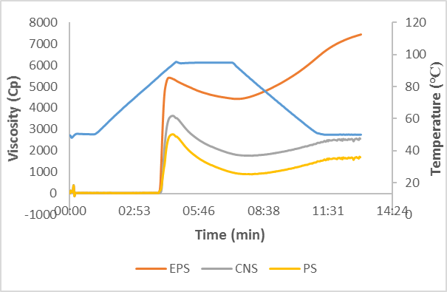
Pasting profile
 | CNS | EPS | PS
PV(cP) | 3646 | 5408 | 2773
TV(cP) | 1765 | 4417 | 892
BV(cP) | 1881 | 991 | 1881
SV(cP) | 797 | 3019 | 797
FV(cP) | 2562 | 7436 | 1689
The increased pasting profile of EPS is due to the lower degree of cross-linking.
The decreased peak viscosity of PS may be due to lower swelling power caused by the hydrolysis of glycosidic linkages.
EPS exhibited a higher setback viscosity, and thus have a strong gel.
cross-linking with the phosphate group restricted the re-orientation of amylose and amylopectin, leading to the decreased setback and final viscosities

Slide 9
Gel Textural properties
Sample | Hardness (N) | Springiness (mm) | Gumminess (Nmm) | Chewiness (Nmm) | Cohesiveness
CNS | 45.54±0.37^{b} | 0.91±0.02^{b} | 23.36±0.33^{b} | 21.22±0.22^{b} | 0.52±0.01ª
EPS | 149.69±1.34ª | 0.97±0.01ª | 66.75±0.63ª | 63.73±0.46ª | 0.43±0.00^{b}
PS | 13.62±0.10^{c} | 0.87±0.01^{b} | 5.59±0.48^{c} | 5.18±0.27^{c} | 0.43±0.01^{b}
The increased hardness of EPS may be due to the higher setback viscosity, resulting in higher re-orientation of starch molecules which form a strong gel.
The lower gelation capacity and setback viscosity of PS limits the rate at which leached starch molecules reoriented, ending in the development of the weak gel during cold storage

Slide 10
Light transmittance
The retrogradation rate, aggregate synthesis, and leaching of starch components, which causes turbidity to occur, are only a few of the variables that affect the light transmittance and paste clarity of starch gel during storage
The increased light transmittance of EPS is due to high swelling power.
The smaller, highly light-transparent molecules created by the hydrolysis of starch molecules may be the cause of improved light transmittance and paste clarity of PS

Slide 11
Rheological properties
The magnitude of G’ and G” was significantly (p ≤ 0.05) changed by cross-linking
The increased G’ and G” values of EPS is maybe due to the formation of rigid gel with high molecular integrity
The decreased G’ and G” values of PS starch are due to the restricted rate of retrogradation, which leads to the development of a weak gel.

Slide 12
Starch crystallinity
All the diffractograms exhibited similar pattern characteristics of type A crystalline patterns with diffraction peaks at an angle of 15.1°, 17.2°, 18.1°, and 23.2°.
The creation of a more ordered structure through cross-linking may be the cause of the enhanced RC value of EPS
the increased RC value of PS could ascribe to the hydrolysis of the amorphous region and the formation of phosphate dieter bond, giving increased integrity

Slide 13
conclusions
Treatment of talipot starch with epichlorohydrin and phosphoric acid significantly changed the functional, pasting, textural, rheological, and structural properties.
Treatment with epichlorohydrin improved the talipot starch's ability to swell and its pasting characteristics. However, it decreased in phosphoric acid-treated starch.
Paste clarity of talipot starch was significantly improved in both EPS and PS
Cross- linked talipot starches can be utilized for various food products like canned food, dairy products, etc.

Slide 14
Thank you….

