Slide 1
Modeling and simulation of magnetoliposomes formation by encapsulation of core-shell, magnetite-chitosan nanoparticles in liposomes enabled by a low-cost microfluidic system
Andres Mantilla-Orozco⁽¹⁾, Cristian Rodríguez⁽¹⁾ ,Isabella Quiroz⁽¹⁾, Daniel Forero ⁽¹⁾, María Camila Monsalve⁽¹⁾, Carlos E. Torres⁽¹⁾, Johann F. Osma PhD⁽²⁾, Carolina Muñoz-Camargo. PhD⁽¹⁾ , Luis H. Reyes⁽³⁾, Valentina Quezada⁽¹⁾, Juan C. Cruz. PhD ⁽¹⁾
Department of Biomedical Engineering.
Department of Chemical and Food Engineering
Department of Electrical and Electronics Engineering
Andres Mantilla-Orozco MSc student⁽¹⁾
Juan C. Cruz PhD⁽¹⁾
Carolina Muñoz-Camargo PhD⁽¹⁾

Slide 2
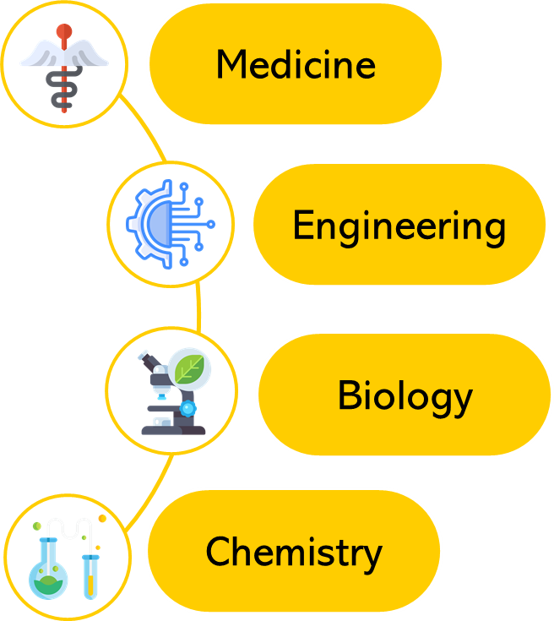
Nanostructured materials applications
Nanobiotechnology
Michael Goldberg, Robert Langer, and Xinqiao Jia. Nanostructured materials for applications in drug delivery and tissue engineering. Journal of Biomaterials Science, Polymer Edition, 18(3):241–268, 2007.
Oliver Kayser, A Lemke, and Norma Hernandez-Trejo. The impact of nanobiotechnology on the development of new drug delivery systems. Current pharmaceutical biotechnology, 6(1):3–5, 2005.
Daniel G Anderson, Jason A Burdick, and Robert Langer. Smart biomaterials. Science, 305(5692):1923–1924, 2004.

Slide 3
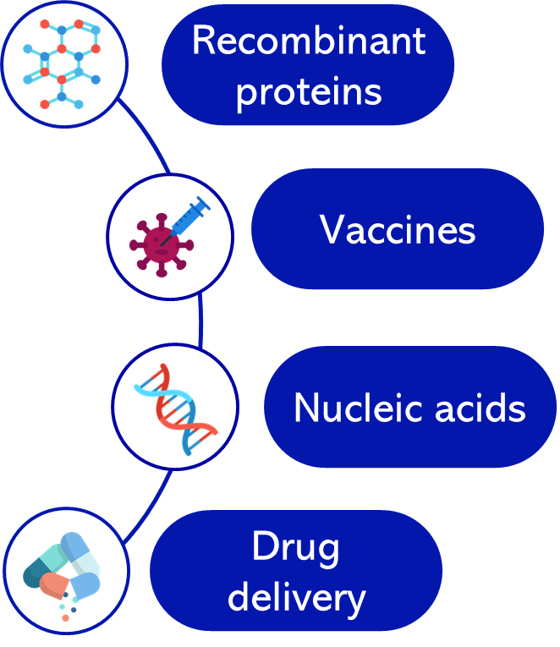
Nanostructured materials applications
Nanobiotechnology
Andrei Kolmakov and Martin Moskovits. Chemical sensing and catalysis by one-dimensional metal-oxide nanostructures. Annu. Rev. Mater. Res., 34:151–180, 2004.
Lubhandwa S Biswaro, Mauricio G da Costa Sousa, Taia Rezende, Simoni C Dias, and Octavio L Franco. Antimicrobial peptides and nanotechnology, recent advances and challenges. Frontiers in microbiology, 9:855, 2018.

Slide 4
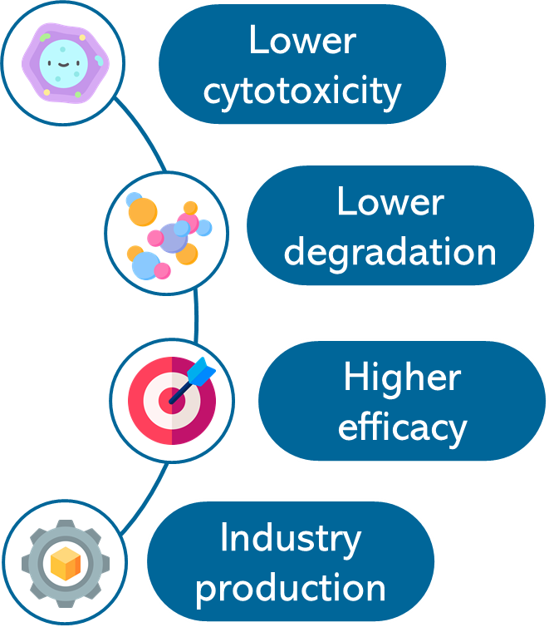
Nanostructured materials applications
Nanobiotechnology
Afsaneh Lavasanifar, John Samuel, and Glen S Kwon. Poly (ethylene oxide)-block-poly (l-amino acid) micelles for drug delivery. Advanced drug delivery reviews, 54(2):169–190, 2002.
Yunus E Kurtoglu, Manoj K Mishra, Sujatha Kannan, and Rangaramanujam M Kannan. Drug release characteristics of pamam dendrimer–drug conjugates with different linkers. International journal of pharmaceutics, 384(1-2):189–194, 2010.
Yan Chen and Lihong Liu. Modern methods for delivery of drugs across the blood–brain barrier. Advanced drug delivery reviews, 64(7):640–665, 2012.

Slide 5
Nanotransporters advantages like drug delivery systems
Protection of peptides, vaccines and desired drugs against extracellular degradation
Nanobiotechnology
Selectivity of the target therapy
Improvement of the pharmacokinetic profile
Huilin Shao, Changwook Min, David Issadore, Monty Liong, Tae-Jong Yoon, Ralph Weissleder, and Hakho Lee. Magnetic nanoparticles and micronmr for diagnostic applications. Theranostics, 2(1):55, 2012.
Jin Xie, Gang Liu, Henry S Eden, Hua Ai, and Xiaoyuan Chen. Surface-engineered magnetic nanoparticle platforms for cancer imaging and therapy. Accounts of chemical research, 44(10):883–892, 2011.
Navin Kumar Verma, Kieran Crosbie-Staunton, Amro Satti, Shane Gallagher, Katie B Ryan, Timothy Doody, Colm McAtamney, Ronan MacLoughlin, Paul Galvin, Conor S Burke, et al. Magnetic coreshell nanoparticles for drug delivery by nebulization. Journal of Nanobiotechnology, 11(1):1–12, 2013.

Slide 6
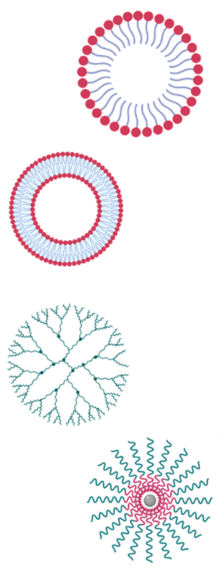
Nanotransporters advantages like drug delivery systems
Micelles
Protection of peptides, vaccines and desired drugs against extracellular degradation
Nanobiotechnology
Liposomes
Selectivity of the target therapy
Dendrimers
Improvement of the pharmacokinetic profile
Polymeric nanoparticles
Huilin Shao, Changwook Min, David Issadore, Monty Liong, Tae-Jong Yoon, Ralph Weissleder, and Hakho Lee. Magnetic nanoparticles and micronmr for diagnostic applications. Theranostics, 2(1):55, 2012.
Jin Xie, Gang Liu, Henry S Eden, Hua Ai, and Xiaoyuan Chen. Surface-engineered magnetic nanoparticle platforms for cancer imaging and therapy. Accounts of chemical research, 44(10):883–892, 2011.

Slide 7
Nano bioconjugates compounds advantages
Liposomes
v
v
Nanoparticles as
drug delivery vehicles
Iron oxide nanoparticles (Fe3O4)
Advances in synthesis allows potential applications in diagnostic/therapeutic techniques.
Biocompatibility
Biodegradability
Encapsulate hydrophilic/hydrophobic compounds
Similarity to cell’s membranes
Low cytotoxicity / High delivery rates
Liposomes/Nanopartices/AMP’s
Nanoparticles
Mingfeng Xie, Dijia Liu, and Yufeng Yang. Anti-cancer peptides: classification, mechanism of action, reconstruction and modification. Open Biology, 10(7):200004, 2020.
Su-Jin Kang, Do-Hee Kim, Tsogbadrakh Mishig-Ochir, and Bong- Jin Lee. Antimicrobial peptides: their physicochemical properties and therapeutic application. Archives of pharmacal research, 35(3):409– 413, 2012.
Fatma Gizem Avci, Berna Sariyar Akbulut, and Elif Ozkirimli. Membrane active peptides and

Slide 8
Nano bioconjugates synthesis technique
Manufacture devices to outperforming traditional analytical and sensing instruments employed in scientific research.
Development of several industries: medical, cosmetics, pharma and food. Low cost devices
Explored for the synthesis, manipulation, and separation of microscopic encapsulates.
Explore in silico and in vitro species dynamics to understand interaction between different phases in a system
Microfluidics
Mingfeng Xie, Dijia Liu, and Yufeng Yang. Anti-cancer peptides: classification, mechanism of action, reconstruction and modification. Open Biology, 10(7):200004, 2020.
Su-Jin Kang, Do-Hee Kim, Tsogbadrakh Mishig-Ochir, and Bong- Jin Lee. Antimicrobial peptides: their physicochemical properties and therapeutic application. Archives of pharmacal research, 35(3):409– 413, 2012.
Fatma Gizem Avci, Berna Sariyar Akbulut, and Elif Ozkirimli. Membrane active peptides and

Slide 9
Objectives
Implement multiphysics simulations to study in silico the encapsulation of core-shell, magnetite-chitosan nanoparticles in a microfluidic system by means of the COMSOL Multiphysics® software.
Notes:
To investigate the Multiphase models, type Euler-Euler to propose through its use, the encapsulation in liposomes of nanoparticles with magnetite core and polymer envelope.
Perform a sensitivity analysis to establish the most relevant operating parameters for the subsequent experimental phases.
Establish a suitable method for modeling the drag force in the Euler-Euler model

Slide 10
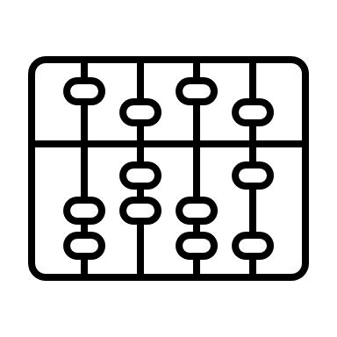
Euler-Euler (EE) Model
Liposome encapsulation of core-shell, magnetite-chitosan nanoparticles in a microfluidic system using a multiphase Euler-Euler computational model.
COMSOL Multiphysics Software
Euler-Euler (EE) model
Parameters
Material | Property | Value
H₂O | Density Dinamic Viscosity | $997 [kg/m^{3}$] $$8.9×{10}^{−4}[Pa∗s]$$
CS-MNP´s | Density Diffusivity | $1100[kg/m^{3}$] $$1.0×{10}^{−9}[m^{2}/s]$$
Liposomes | Density Diffusivity | $1000[kg/m^{3}$] $$1.51×{10}^{−5}[m^{2}/s]$$
Inc., C. (2020). COMSOL. Retrieved from http://www.comsol.com/products/multiphysics/

Slide 11
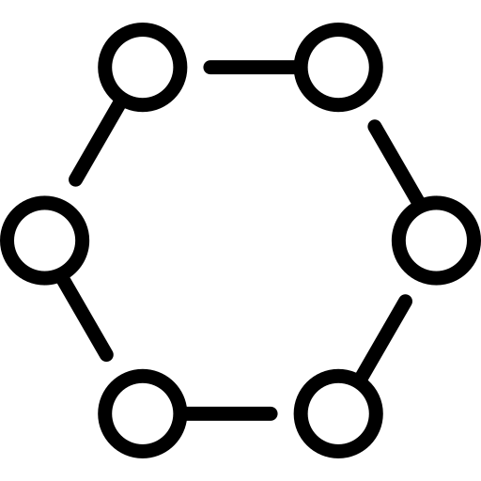
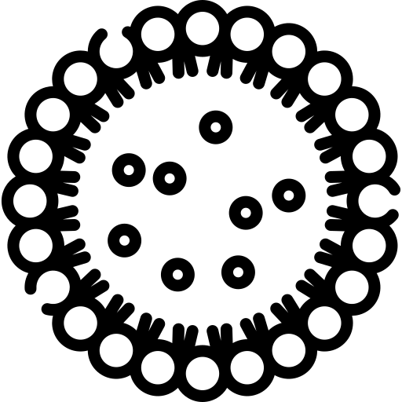
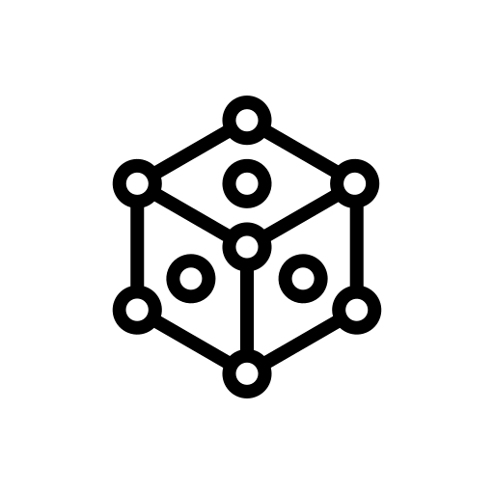
Euler-Euler (EE) Model
Mass Balance
Continuity relations for continuous and dispersed phases
Continuous phase (liposomes)
$$\frac{∂}{∂t}\left(ρ_{c}Ф_{c}\right)+∇∙\left(ρ_{c}Ф_{c}u_{c}\right)=m_{dc}$$
Dispersed phase (CS-MNPs)
$$\frac{∂}{∂t}\left(ρ_{d}Ф_{d}\right)+∇∙\left(ρ_{d}Ф_{d}u_{d}\right)=−m_{dc}$$
Where
$Ф=volume fraction \left(dimensionless\right)$
$ρ=density\left({Kg}/{m^{3}}\right)$
$u=velocity \left(m/s\right)$
$m_{dc}=mass transfer rate$
Inc., C. (2020). COMSOL. Retrieved from http://www.comsol.com/products/multiphysics/

Slide 12
Euler-Euler (EE) Model
Mass Balance
Relation between volume fractions. Continuous and dispersed phases considered incompressible
$$Ф_{c}=1−Ф_{d}$$
Continuous phase (liposomes)
$$\frac{∂Ф_{c}}{∂t}+∇∙\left(Ф_{c}u_{c}\right)=\frac{m_{dc}}{ρ_{c}}$$
Dispersed phase (CS-MNPs)
$$\frac{∂Ф_{d}}{∂t}+∇∙\left(Ф_{d}u_{d}\right)=\frac{−m_{dc}}{ρ_{d}}$$
Compute volume fraction
Inc., C. (2020). COMSOL. Retrieved from http://www.comsol.com/products/multiphysics/

Slide 13
Euler-Euler (EE) Model
Mass Balance
Continuity equation continuous phase mass balance and dispersed phase mass balance
$$∇∙\left(Ф_{c}u_{c}\right)+∇∙\left(Ф_{d}u_{d}\right)=\frac{m_{dc}}{ρ_{c}}−\frac{m_{dc}}{ρ_{d}}$$
$$Ф_{c}=1−Ф_{d}$$
$$∇∙\left[\left({1−Ф}_{d}\right)u_{c}+\left(Ф_{d}u_{d}\right)\right]=m_{dc}\left(\frac{1}{ρ_{c}}−\frac{1}{ρ_{d}}\right)$$
Compute mixture pressure
Inc., C. (2020). COMSOL. Retrieved from http://www.comsol.com/products/multiphysics/

Slide 14
Euler-Euler (EE) Model
Momentum Balance
For fluid-solids mixtures where $ρ_{d}≫ρ_{c}$, momentum balanced dispersed phase is modified in the manner of Enwald
Continuous phase (liposomes)
$$Ф_{d}∇∙τ_{d}$$
$$ρ_{c}Ф_{c}\left[\frac{∂}{∂t}\left(u_{c}\right)+u_{c}∇∙\left(u_{c}\right)\right]=−Ф_{c}∇p+∇p_{s}+Ф_{c}p_{c}g+F_{m,c}+{Ф_{c}F}_{c}−m_{dc}\left(u_{int}−u_{c}\right)$$
Dispersed phase (CS-MNPs)
$$Ф_{d}∇∙τ_{d}$$
$$ρ_{d}Ф_{d}\left[\frac{∂}{∂t}\left(u_{d}\right)+u_{d}∇∙\left(u_{d}\right)\right]=−Ф_{d}∇p+∇p_{s}+Ф_{d}p_{d}g+F_{m,d}+{Ф_{d}F}_{d}−m_{dc}\left(u_{int}−u_{d}\right)$$
$p_{s}=solid pressure\left(Pa\right)$
$τ=viscous stress tensor \left(Pa\right)$
Where
Momentum balance was assumed Newtonian fluid
Inc., C. (2020). COMSOL. Retrieved from http://www.comsol.com/products/multiphysics/

Slide 15
Euler-Euler (EE) Model
Viscous Stress Tensors
Continuous phase (liposomes)
$$τ_{c}=μ_{c}^{m}\left(∇u_{c}+{\left(u_{c}\right)}^{T}−\frac{2}{3}\left(∇∙u_{c}\right)I\right)$$
Dispersed phase (CS-MNPs)
$$τ_{d}=μ_{d}^{m}\left(∇u_{d}+{\left(u_{d}\right)}^{T}−\frac{2}{3}\left(∇∙u_{d}\right)I\right)$$
Where
$${μ_{c}^{m}, μ}_{d}^{m}=dinamyc viscosity (Pa)$$
Inc., C. (2020). COMSOL. Retrieved from http://www.comsol.com/products/multiphysics/

Slide 16
Euler-Euler (EE) Model
Momentum Balance
Using nonconservative forms
Dispersed phase (CS-MNPs)
$$ρ_{c}\left[\frac{∂}{∂t}\left(u_{d}\right)+u_{d}∇∙\left(u_{d}\right)\right]=−∇p+∇∙τ_{d}+ρ_{d}g+\frac{F_{m,d}}{d}+F_{d}−\frac{m_{dc}\left(u_{int}−u_{d}\right)}{d}$$
Where
$p=mixture pressure \left(Pa\right) equal for two phases$
$τ=viscous stress tensor \left(Pa\right)$
$\text{g}\text{ = }\text{vector} \text{of} \text{gravitational} \text{acceleration}\text{ (}\text{m}\text{/}s^{2})$
$F_{m}=interphase momentum transfer term\left(N/{m^{3}}\right)$
$F=volume force term\left(N/{m^{3}}\right)$
$u_{int}=interphase velocity (m/s)$
Inc., C. (2020). COMSOL. Retrieved from http://www.comsol.com/products/multiphysics/

Slide 17
Euler-Euler (EE) Model
Viscosity Models
Dispersed phase (CS-MNPs)
Krieger Type
$$μ_{mix}=μ_{c}{\left(1−\frac{Ф_{d}}{Ф_{d, max}}\right)}^{−2.5Ф_{d, max}}$$
Where
Maximum packing limit
$$Ф_{d,max}=0.62$$
Inc., C. (2020). COMSOL. Retrieved from http://www.comsol.com/products/multiphysics/
Inc., C. (2020). COMSOL. Retrieved from http://www.comsol.com/products/multiphysics/

Slide 18
Euler-Euler (EE) Model
Damping functions - Wall BC
Lam and Bremhorst EE Model (LB)
$$ε_{w}=v\left(\frac{∂^{2}k}{∂y^{2}}\right)$$
Wall Function
$$E=0$$
Viscous stress tensor related term
Yang et al. EE Model (YS)
$$E=vv_{t}\left(\frac{∂^{2}U^{2}}{∂y^{2}}\right)$$
$$ε_{w}=v\left(\frac{∂^{2}k}{∂y^{2}}\right)$$
Wall Function
Viscous stress tensor related term
Inc., C. (2020). COMSOL. Retrieved from http://www.comsol.com/products/multiphysics/
Inc., C. (2020). COMSOL. Retrieved from http://www.comsol.com/products/multiphysics/
Notes:
The calculation example is focus on low Reynolds number conditions, different turbulence models (SKE, AB, LB, LS, YS, AKN, CHC model) and two wall treatment for the near-wall shear flow forecasting and assessment

Slide 19
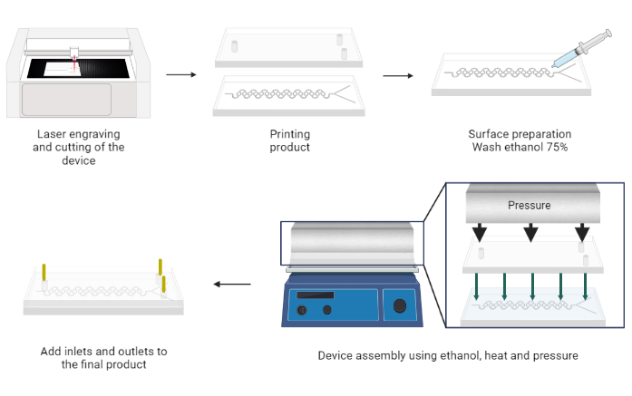
Manufacturing Process
Laser engraving
and cutting oh the device
Printing product
Surface preparation
Add inlets and outlets to the final product
Device assembly using pressure and heat
Figure 1. Manufacturing process
19
Inc., C. (2020). COMSOL. Retrieved from http://www.comsol.com/products/multiphysics/
Notes:
Three different geometries were selected, SARS, chambers and serpentine with circular features. Those geometries reach a higher interaction between dispersed and continuous phase than other tested previously in our microfluidic research group. Structure variations are focused in increase phase interaction and reach higher encapsulation efficiency which is measured by the dispersed phase volume fraction.

Slide 20
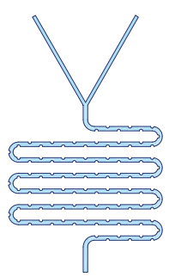
Geometries and Boundary conditions
SARS
Continuous phase inlet
(Liposomes)
Chambers
Dispersed phase inlet
(MNP’s)
Serpentine circular features
Outlet
Evaluation line
Figure 2. Geometries and boundary conditions, inlets, outlets and evaluation lines
20
Inc., C. (2020). COMSOL. Retrieved from http://www.comsol.com/products/multiphysics/
Notes:
Three different geometries were selected, SARS, chambers and serpentine with circular features. Those geometries reach a higher interaction between dispersed and continuous phase than other tested previously in our microfluidic research group. Structure variations are focused in increase phase interaction and reach higher encapsulation efficiency which is measured by the dispersed phase volume fraction.

Slide 21
Mesh selection
EXC: Extremely coarse
EC: Extra coarse
CR: Coarser
C:Coarse
N:Normal
F:Fine
FR: Finer
EF: Extra fine
EXF: Extremely fine
Figure 3. Mesh convergence analysis for SARS geometry. Complete mesh consist of 40175 domain elements
Inc., C. (2020). COMSOL. Retrieved from http://www.comsol.com/products/multiphysics/
21
Inc., C. (2020). COMSOL. Retrieved from http://www.comsol.com/products/multiphysics/
Notes:
Euler Euler approach was improve using damping functions in near wall zones. Firstable, we had the simple EE model, then LB functions were implemented, reaching dispersed volume fraction up to 0.35. Finally, the YS approach reach the highest volume fraction value, up to 0.4 inn chambers geometry

Slide 22
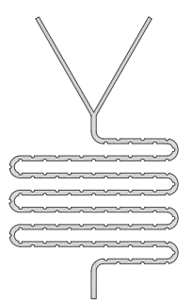
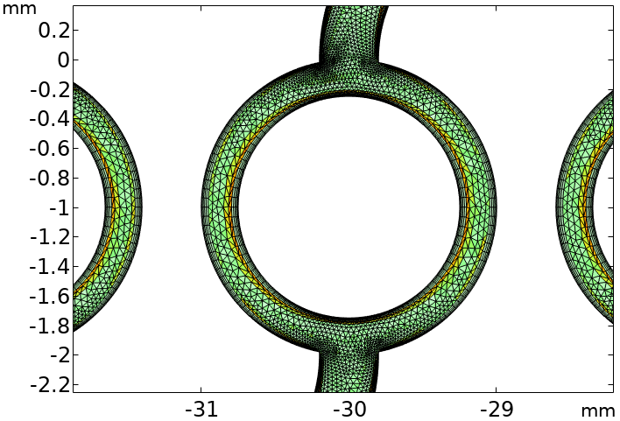
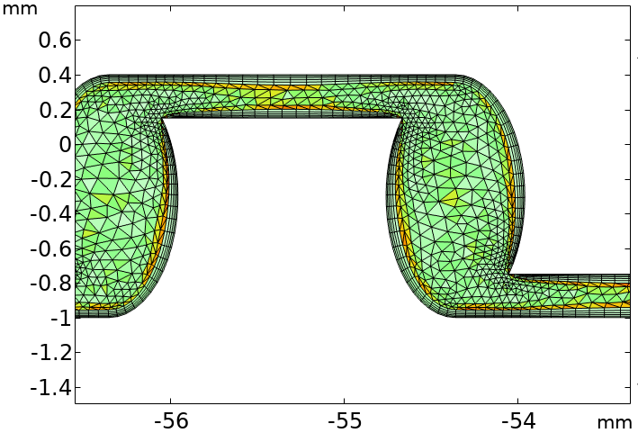
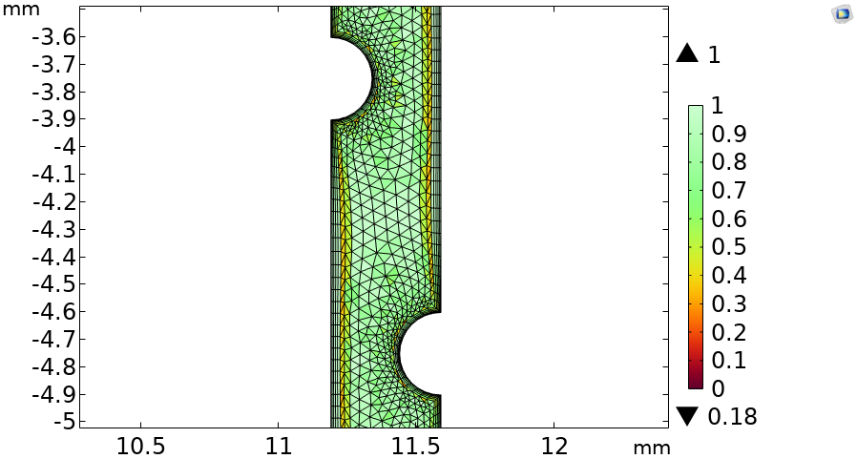
Mesh selection
Figure 4. Mesh quality. Left to right: SARS, Chambers and Serpentine circular features geometry
Inc., C. (2020). COMSOL. Retrieved from http://www.comsol.com/products/multiphysics/
22
Inc., C. (2020). COMSOL. Retrieved from http://www.comsol.com/products/multiphysics/
Notes:
Euler Euler approach was improve using damping functions in near wall zones. Firstable, we had the simple EE model, then LB functions were implemented, reaching dispersed volume fraction up to 0.35. Finally, the YS approach reach the highest volume fraction value, up to 0.4 inn chambers geometry

Slide 23
Dispersed phase Volume fraction
Figure 5. Dispersed phase volume fraction using variations in EE Model in chambers geometry
Inc., C. (2020). COMSOL. Retrieved from http://www.comsol.com/products/multiphysics/
23
Inc., C. (2020). COMSOL. Retrieved from http://www.comsol.com/products/multiphysics/
Notes:
Euler Euler approach was improve using damping functions in near wall zones. Firstable, we had the simple EE model, then LB functions were implemented, reaching dispersed volume fraction up to 0.35. Finally, the YS approach reach the highest volume fraction value, up to 0.4 inn chambers geometry

Slide 24
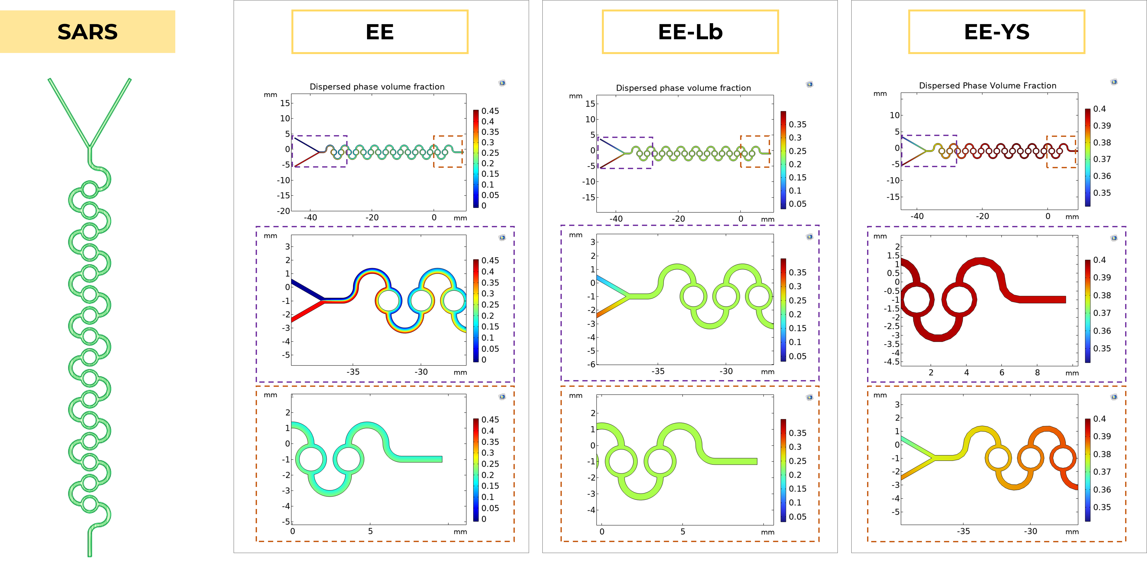
Dispersed phase Volume fraction
Figure 6. Dispersed phase volume fraction using variations in EE Model in SARS geometry
Inc., C. (2020). COMSOL. Retrieved from http://www.comsol.com/products/multiphysics/
24
Inc., C. (2020). COMSOL. Retrieved from http://www.comsol.com/products/multiphysics/
Notes:
Now, using SARS geometry, the simple euler euler approach reach volume fraction levels up to 0.45, meanwhile, LB and YS approaches reached dispersed volume fraction up to 0.35 and 0.4 respectively.

Slide 25
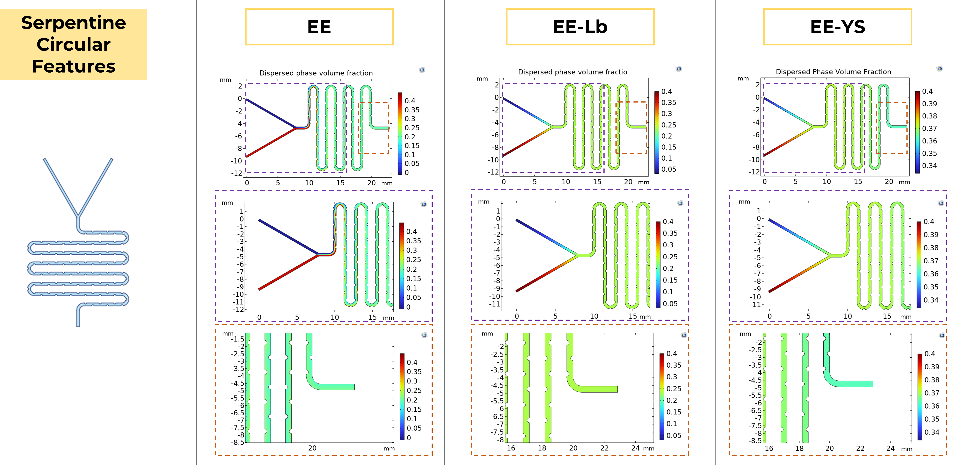
Dispersed phase Volume fraction
Figure 7. Dispersed phase volume fraction using variations in EE Model in serpentine CF geometry
25
Inc., C. (2020). COMSOL. Retrieved from http://www.comsol.com/products/multiphysics/
Notes:
Finally, for serpentine with circular features geometry, the three approaches reach the same maximum volume fraction level, up to 0.4. However, the LB and simple EE models got an homogeneous mix solution. In the other hand, YS shows us a two-phase mixture, and we can notice that because the two main colors at the end of the loops.

Slide 26
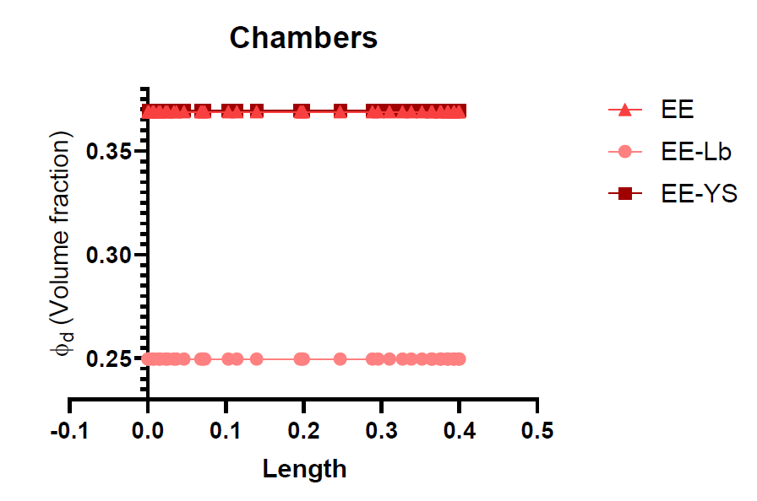
Encapsulation Efficiency (EE%)
$$EE\%=\left(\frac{φ_{d,min}}{{φ_{d}}/{FRR}}\right)×100$$
$$EE EE\%=38.69$$
$$EE Lb EE\%=58.48$$
$$EE Ys EE\%=98.69$$
Figure 8. Encapsulation efficiency Volume fraction variation by length in chambers geometry
26
Inc., C. (2020). COMSOL. Retrieved from http://www.comsol.com/products/multiphysics/
Notes:
Now, we calculate the encapsulation efficiency using phi parameters, maximum packing level and the maximum volume fraction reach in each case. For Chambers geometry, YS approach reach an encapsulation efficiency up to 98.69 percent. Encapsulation efficiency is measured using the interaction inside the microchannels device. Flow rate ratio is a parameter using to compare two phase inlets. In this case, FRR was 1:1

Slide 27
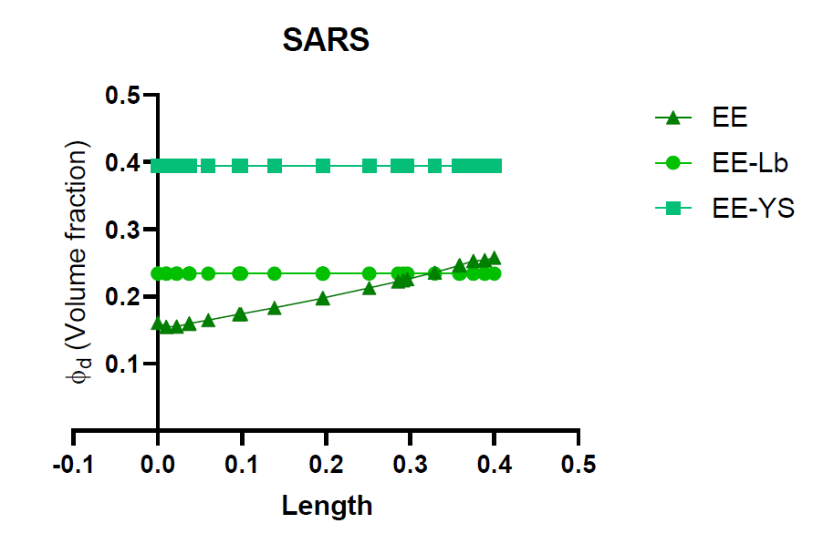
Encapsulation Efficiency (EE%)
$$EE\%=\left(\frac{φ_{d,min}}{{φ_{d}}/{FRR}}\right)×100$$
$$EE EE\%=47.58$$
$$EE Lb EE\%=58.71$$
$$EE Ys EE\%=90.79$$
Figure 9. Encapsulation efficiency Volume fraction variation by length in SARS geometry
27
Inc., C. (2020). COMSOL. Retrieved from http://www.comsol.com/products/multiphysics/
Notes:
The same for SARS geometry. In this case, YS approach reach the maximum encapsulation efficiency percentage too. It was up to 90.79 percent. In the other hand, encapsulation efficiency in simple EE and LB approach were similar, but less than 60 percent.

Slide 28
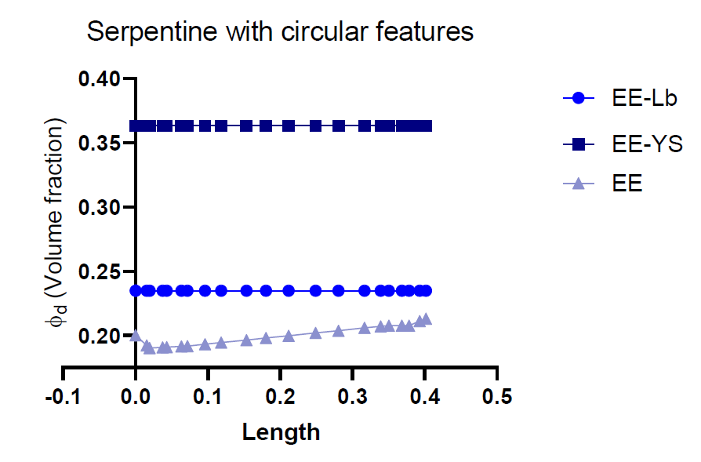
Encapsulation Efficiency (EE%)
$$EE\%=\left(\frac{φ_{d,min}}{{φ_{d}}/{FRR}}\right)×100$$
$$EE EE\%=92.18$$
$$EE Lb EE\%=62.38$$
$$EE Ys EE\%=92.33$$
Figure 10. Encapsulation efficiency Volume fraction variation by length in serpentine CF geometry
28
Inc., C. (2020). COMSOL. Retrieved from http://www.comsol.com/products/multiphysics/
Notes:
Now, for serpentine with circular features geometry, YS approach reach the highest encapsulation efficiency value. Reaching a 92.33%, but in this contrast with SARS and chamber geometries, simple EE reached a similar value to YS.

Slide 29
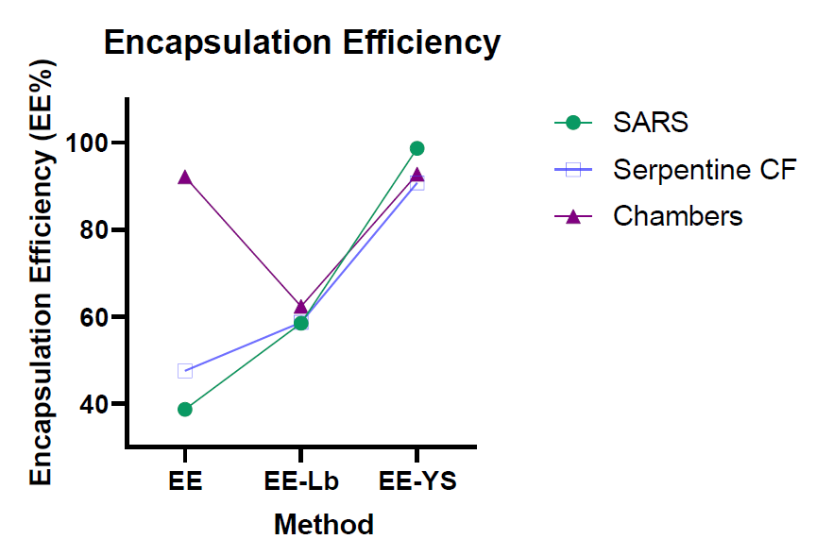
Encapsulation Efficiency (EE%)
$$EE\%=\left(\frac{φ_{d,min}}{{φ_{d}}/{FRR}}\right)×100$$
$$SARS > Chambers > Serpentine CF$$
Figure 11. Encapsulation efficiency Volume fraction variation by length. Comparative graph
29
Inc., C. (2020). COMSOL. Retrieved from http://www.comsol.com/products/multiphysics/
Notes:
Finally, we compare the three geometries using the mathematical models and it is shown in figure 7. The math model which reach the higher levels of encapsulation efficiency is the euler euler model usin YS approach. Ranking from great to low, sars with 98.69% is first, then chambers with values up to 92.33 and finally, serpentine whit 90.79%

Slide 30
Encapsulation Efficiency (EE%)
Table 2. Encapsulation efficiency contrast between geometries and math models
Model/Geometry | SARS | Serp CF | Chambers
EE | 38.69 | 47.58 | 92.18
EE-Lb | 58.48 | 58.71 | 62.38
EE-YS | 98.69 | 90.79 | 92.33
30
Inc., C. (2020). COMSOL. Retrieved from http://www.comsol.com/products/multiphysics/
Notes:
In table 1 we can contrast directly the values obtained for the different geometries using variations in models. The next step is start in vitro tests using sars geometries to compare in silico results and the lab results. In this way, SARS devices should to performance encapsulation levels up to 98%, increasing nanobioconjugates formation

Slide 31
Conclusions
By implementing near-wall damping functions in the Euler-Euler approximation, it is possible to model the mixing process more effectively as they address the turbulence phenomena at low Reynolds numbers by balancing the rate of of kinetic energy dissipation and thus ensure a better encapsulation process.
The LB and YS turbulence models had the best performance, obtaining EE% between 58.48-62.38% and 90.79-98.69% respectively.
The Euler-Euler model was sufficient for the analysis; however, stochastic processes related to the mixing process will be considered in future work.
According to the YS model with damping functions, the micromixer with the channel SARS geometry led to the highest EE%, i.e., 98.69%.
31
Inc., C. (2020). COMSOL. Retrieved from http://www.comsol.com/products/multiphysics/

Slide 32
Modeling and simulation of magnetoliposome formation by encapsulation of core-shell, magnetite-chitosan nanoparticles in liposomes enabled by a low-cost microfluidic system.
Thank you
for your attention
Andres D. Mantilla BSc.
Juan C. Cruz PhD
Carolina Muñoz-Camargo PhD

